Slide 1
Detecting Parkinson’s Disease using Gait analysis.
By:
Aditya Raj
2020179001
MCA (SS)
Project Guide DR. T Mala
(Associate Professor)

Slide 2
Introduction
Parkinson’s Disease (PD) is the second most hazardous neurological disorder.
Characteristics of PD are
Slow moving than expected, stooped-lean posture, small and shuffling steps
Doctors intervention through clinical trails leads to subjective measure, manual errors and time-consuming
The early diagnosis is critical to effective treatment.
An intelligent machine learning approach to diagnose Parkinson’s based on walking pattern (gait analysis) of person.

Slide 3
Problem Statement
To design and develop a system that can detect Parkinson’s disease using the walking pattern (Gait Analysis) of patient from the video and GAIT Sensor Data.
To identify the Posture of the individuals through key point detection.
To extract efficient features for classification of normal and PD patients.

Slide 4
Literature Survey
Title/Author/year | Problem Statement | Approach | Pros | Cons
Computer-Vision Based Diagnosis of Parkinson’s Disease via Gait. NAVLEEN KOUR , SUNANDA , AND SAKSHI ARORA 2019 | Vision based marker less modality provides more simple, affordable and easy way to capture gait data for efficient PD diagnosis | DL model like CNN or generative Adversarial networks | Highly compact Portable and more convenient for recording No requirements of heavy lab. Setup Cost effective | Difficult to interpret images from acquired Videos.
Human Pose Estimation, Rohit Josyula 2021 | Human Pose Estimation as the localization of human joints or predefined landmarks in images and videos | Face Landmark Detection With MediaPipe and OpenCV | Highly accurate Provides exact location of body landmarks | Accumulated error issue

Slide 5
Literature Survey
Title/Author/year | Problem Statement | Approach | Pros | Cons
Human Pose Estimation-Based Real-Time Gait Analysis Using Convolutional Neural Network, ALI ROHAN 1 (2020) | Human pose estimation combined with a CNN for classification between normal and abnormal gait of a human | Gait analysis mechanism using deep learning tools such as CNN | it eliminates the impact of other problematic constraints such as clothing, surface etc. | Classification of Images with different Positions
OpenPose: Realtime Multi-Person 2D Pose Estimation Using Part Affinity Fields, Zhe Cao, Tomas Simon , Shih-En Wei, and Yaser Sheikh 2021 | Realtime multi-person 2D pose estimation is a key component in enabling machines to have an understanding of people in images and videos. | Confidence Maps and Part Affinity Fields are processed by a greedy bipartite matching algorithm to obtain the poses for each person in the image. | High accuracy without compromise on execution Greedy parsing algorithm is effective | Slight tradeoff between speed and accuracy Failure cases still exist (i.e. foot and leg occluded, rare joint position, etc.)

Slide 6
Architecture Diagram of Detecting PD
6
Pose Estimation
Preprocessing
GAIT
Video
Feature Extraction
Openpose
Processing
JSON2CSV file creation
Key point filtering
Key landmark detection
8 Derived
Features
Classification
CNN
ALGORITHM
Gait Sensor Data
(For Calculation of FOG
& severity level)
IF
PD / Not PD
YES
Result
NO
HOME PAGE
Detection Of FOG
Detection of severity

Slide 7
Module
Pre-Processing
Pose Estimation
Feature Extraction
Classification
Detection Of FOG
Detection of severity
Final Output
User interface

Slide 8
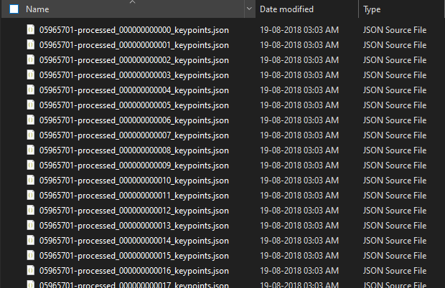
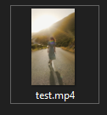
Module- 1. Pre-Processing
For each frame in a video, Openpose returned 2D image-plane coordinates of 25 key points together with prediction confidence of each point for each detected person.
Input: video
Output: keypoint saving (JSON)
Input
Output
OpenPose
library

Slide 9
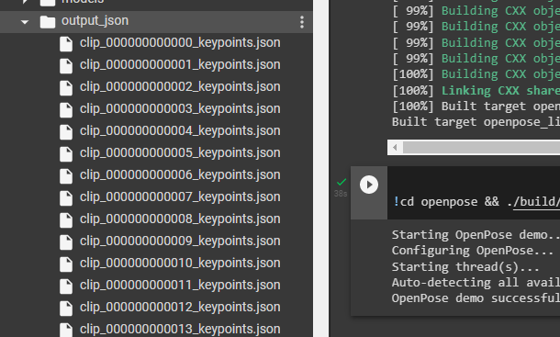
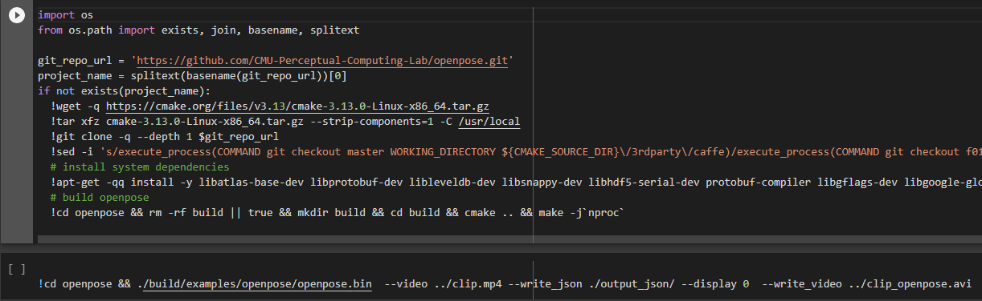
Module- 1. Pre-Processing
Output
Importing Openpose & Extracting video.
Custom Video
path
Extracting Frames into JSON

Slide 10
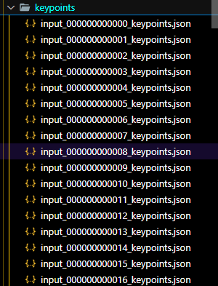
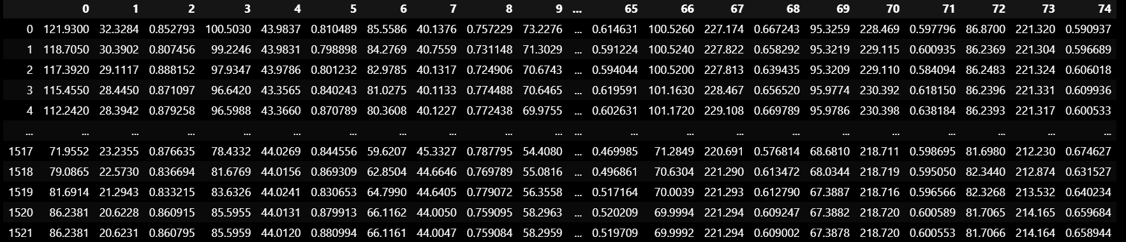
Module- 2. Pose Estimation
Pose estimation is a computer vision technique that predicts and tracks the location of a person.
Human pose estimation from video plays a critical role in various applications such as quantifying physical exercises, sign language recognition, and full-body gesture control.
2.1 KeyPoints JSON to CSV File Creation
Input
Output
JSON2CSV
Function()
10

Slide 11
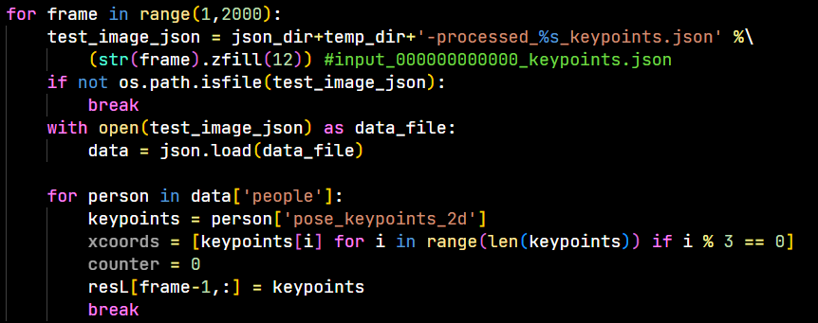
Modules- 2. Pose Estimation
2.1 KeyPoints JSON to CSV File Creation
11

Slide 12
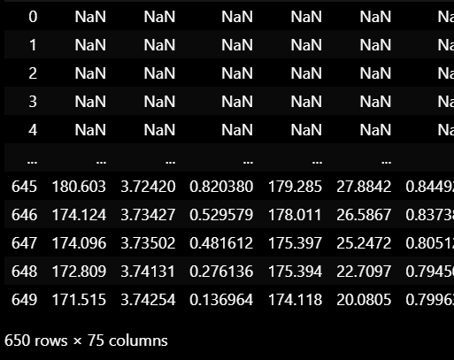
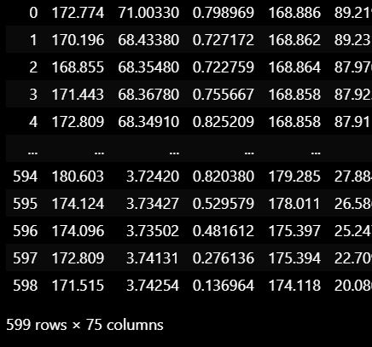
Module- 2. Pose Estimation
2.2 Keypoint Data Filtering
Remove and Filter the JSON with valid data for further processing.

Slide 13
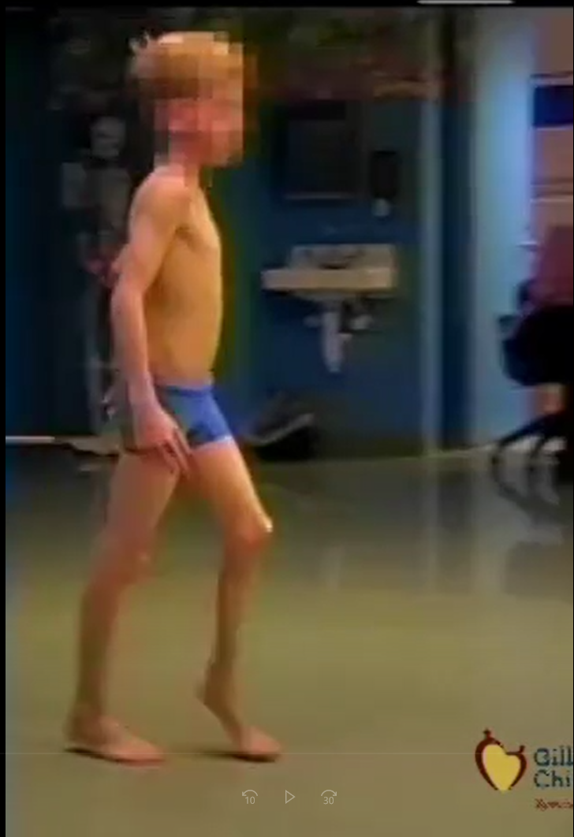
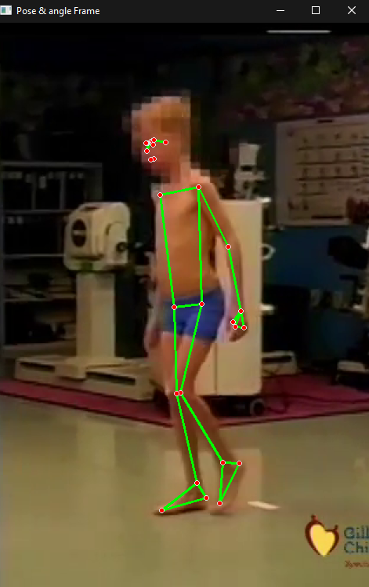
Module- 2. Pose Estimation
Pose estimation is a computer vision technique that predicts and tracks the location of a person.
2.3 Key landmark detection
Detects landmarks of a single body pose using Openpose
Input
Output
(Openpose
Landmark
Detection)
Input.mp4
processed.mp4

Slide 14
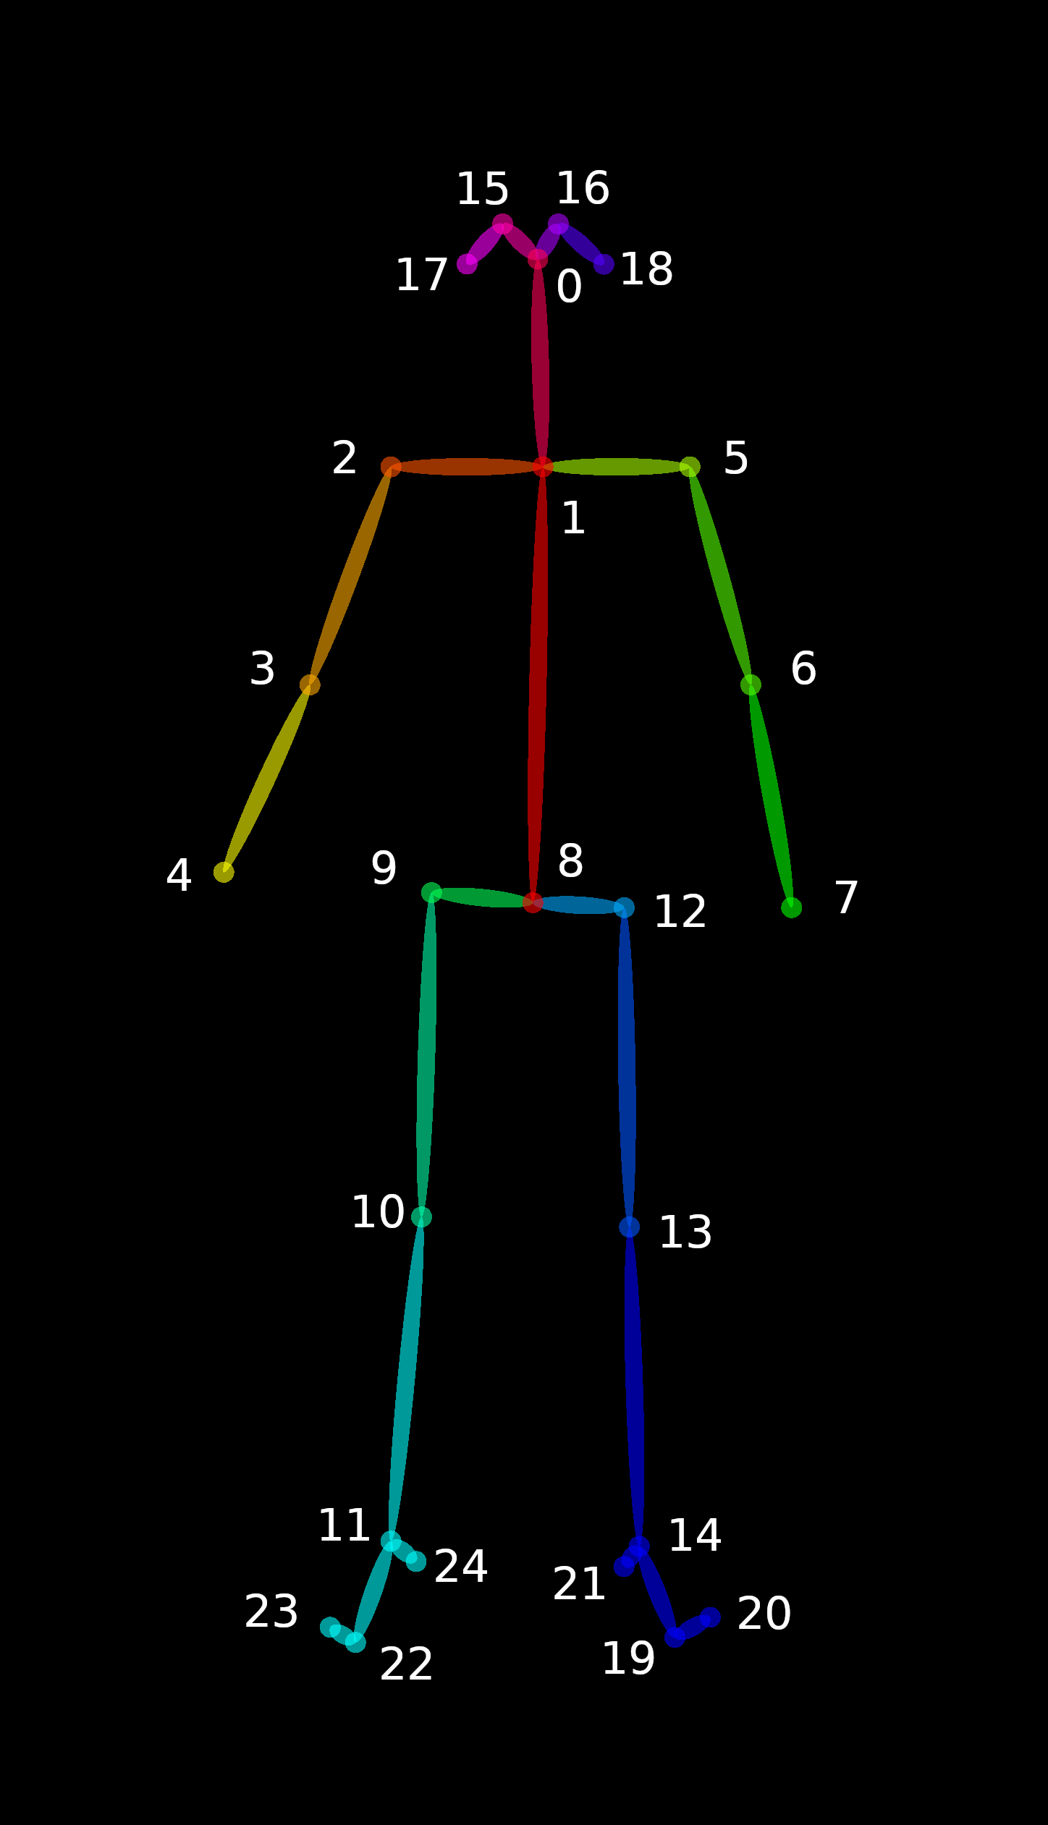
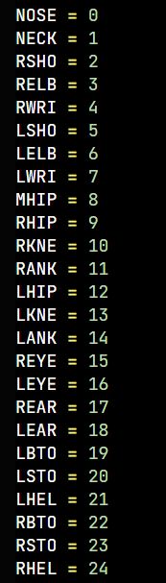
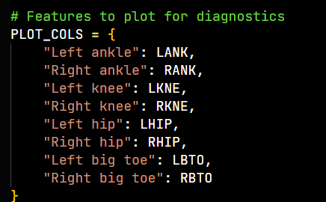
Modules- 2. Pose Estimation
2.3 Key landmark detection
Detects landmarks of a single body pose using Openpose

Slide 15
Modules- 3. Feature Extraction
With the help of a cross-platform wrapper of the OpenCV, Openpose library ,Machine learning algorithm like convolutional neural networks and python packages like Tensorflow, Keras, numpy, pandas etc… process, analyse and predict this features.
1. Gait Deviation Index(GDI) :
GDI aims at providing a comprehensive, easy to interpret, and clinically meaningful metric of overall gait function. It has been used as an outcome measure to study gait in several conditions: cerebral palsy (CP), post-stroke hemiparetic gait, and Parkinson’s disease among others.
The GDI provides a numerical value that expresses overall gait where 80 + indicates the absence of PD in gait pathology. Below 80 the freezing of gait occurs .
GDI Model Evaluation : split the dataset into training, validation, and test sets, such that the test and validation sets contained 10% of all patients.

Slide 16
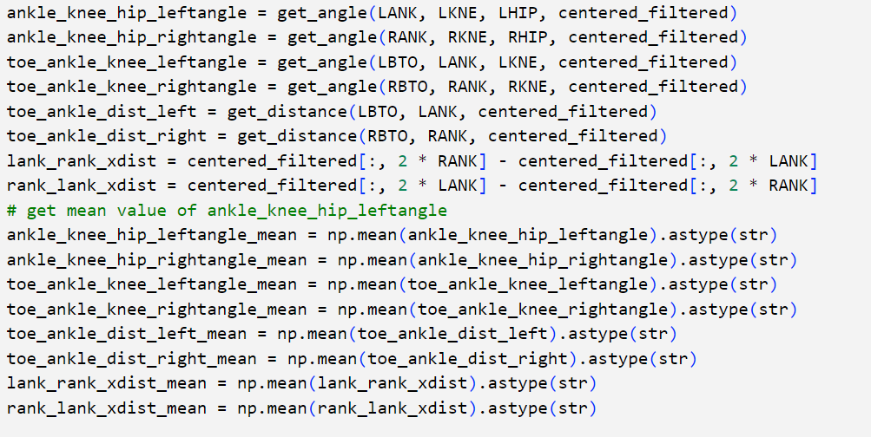
Modules- 3. Feature Extraction
['ankle_knee_hip_leftangle_mean','ankle_knee_hip_rightangle_mean','toe_ankle_knee_leftangle_mean','toe_ankle_knee_rightangle_mean','toe_ankle_dist_left_mean','toe_ankle_dist_right_mean','lank_rank_xdist_mean','rank_lank_xdist_mean' ]
8 Derived features are -
8 Derived
features
PD/Not PD
Model

Slide 17
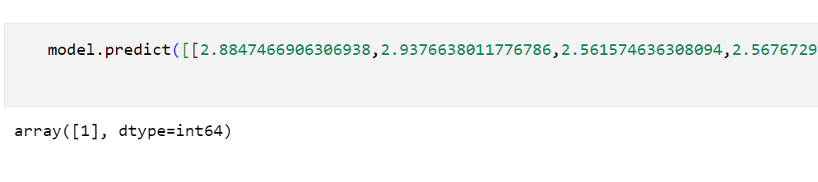
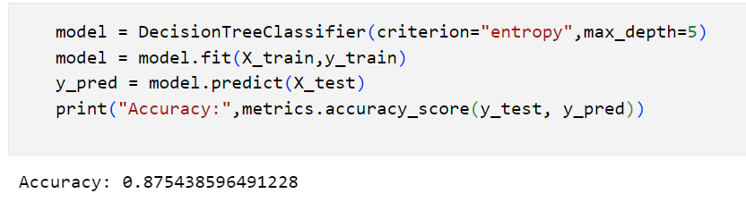
Modules- 3. Feature Extraction
0 - No Risk
1 - Risk Found

Slide 18
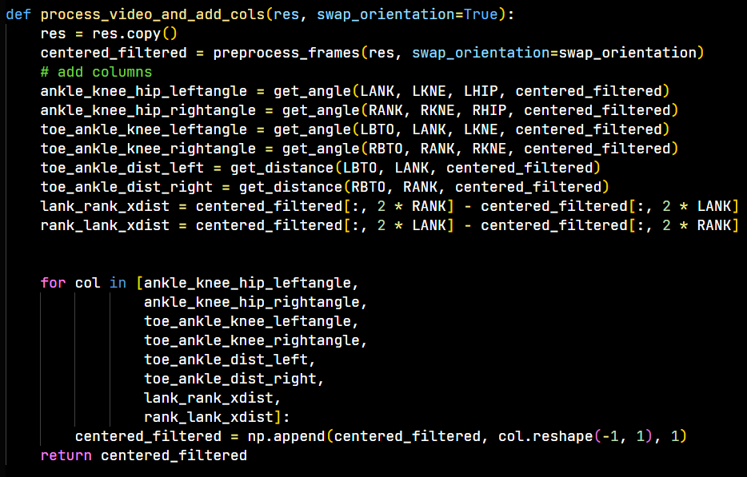
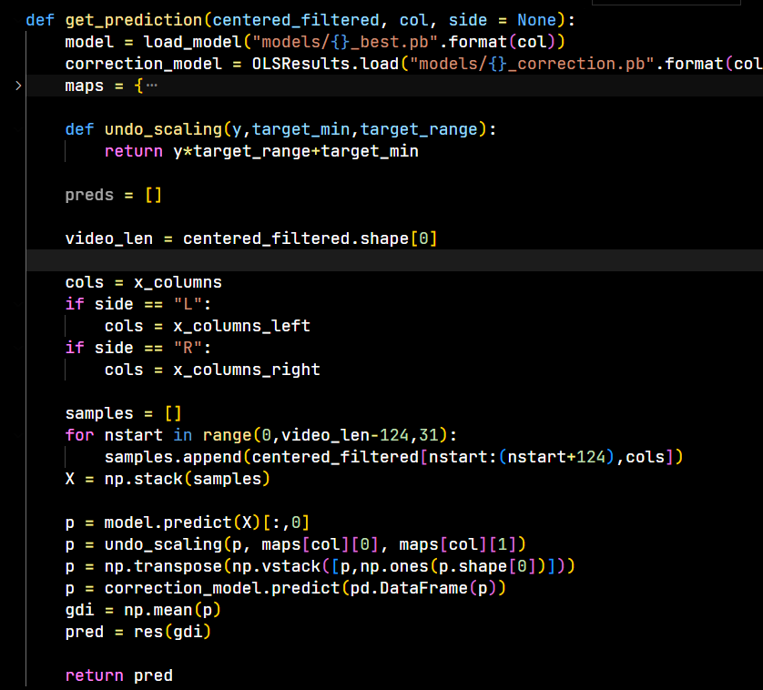
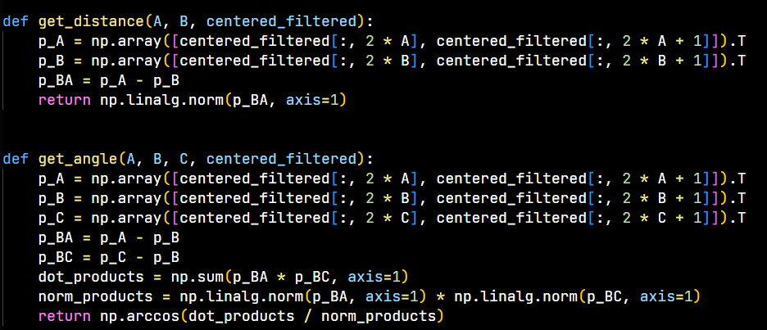
Modules- 3. Feature Extraction

Slide 19
Freezing of Gait Detection Model
Input From 3
Acceleration Sensors
(Trunk,
Thigh,
Shank)
(x,y,z)
0
CNN Algorithm
No Freeze
1
Freeze

Slide 20
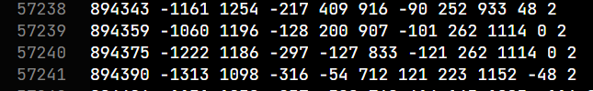
Daphnet Dataset (For FOG)
Daphnet Dataset
The dataset comprises of recordings of 3D acceleration at 64 Hz from 3 acceleration sensors.
The sensors are placed at the ankle (shank), on the thigh, and on the hip. The dataset was recorded in the lab with emphasis on generating many freeze events.
1: no freeze
2: freeze
Data column – 11(Each file comprises the data in a matrix format, with one line per sample, and one column per channel. )
Time of sample in millisecond
Ankle (shank) acceleration - horizontal forward acceleration [mg]
Ankle (shank) acceleration - vertical [mg]
Ankle (shank) acceleration - horizontal lateral [mg]
Upper leg (thigh) acceleration - horizontal forward acceleration [mg]
Upper leg (thigh) acceleration - vertical [mg]
Upper leg (thigh) acceleration - horizontal lateral [mg]
Trunk acceleration - horizontal forward acceleration [mg]
Trunk acceleration - vertical [mg]
Trunk acceleration - horizontal lateral [mg]
(0-not part of experiment/1-no freeze/2-freeze)

Slide 21
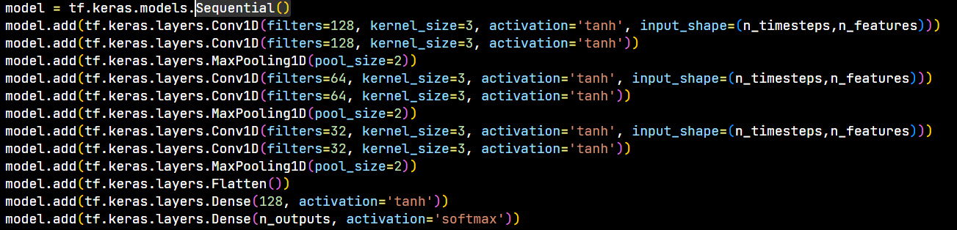
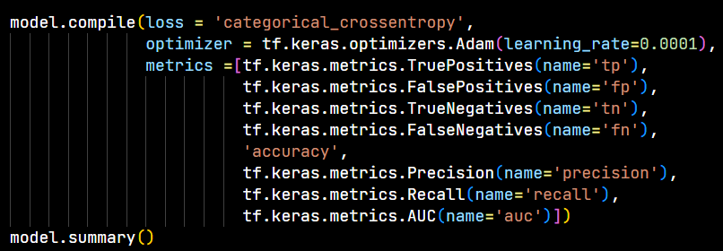
CNN Layers For FOG

Slide 22
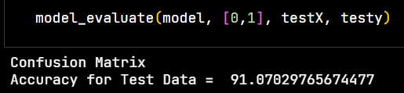
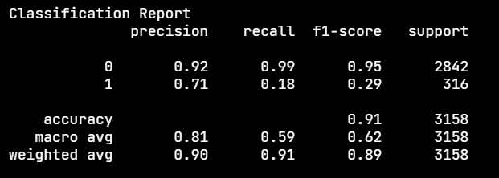
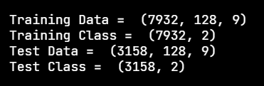
Model Evaluation
Accuracy = TP+TN/(TP+FP+FN+TN)
Precision = TP/(TP+FP)
Recall = TP/(TP+FN)
F1 Score = 2*(Recall * Precision) / (Recall + Precision)

Slide 23
Parkinson's Disease Severity Classification Model
Input From 16
Force Sensors
(under each
Foot 8*2 sensor)
CNN Algorithms
0
1
2
3
Score

Slide 24
Physionet Dataset
Physionet Dataset
The database includes the vertical ground reaction force records of subjects as they walked at their usual, self-selected pace for approximately 2 minutes on level ground.
The output of each of these 16 sensors has been digitized and recorded at 100 samples per second, and the records also include two signals that reflect the sum of the 8 sensor outputs for each foot.
Each line contains 19 columns:
Column 1: Time (in seconds)
Columns 2-9: Vertical ground reaction force (VGRF, in Newton) on each of 8 sensors located under the left foot
Columns 10-17: VGRF on each of the 8 sensors located under the right foot
Column 18: Total force under the left foot
Column 19: Total force under the right foot.

Slide 25
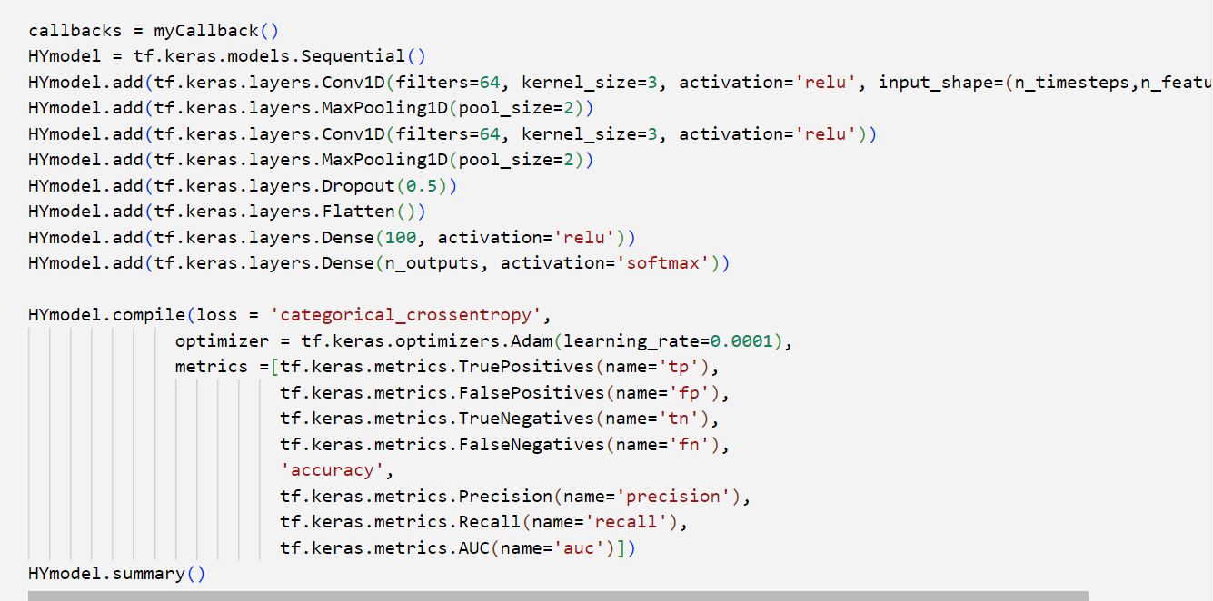
CNN Layers For PD Severity

Slide 26
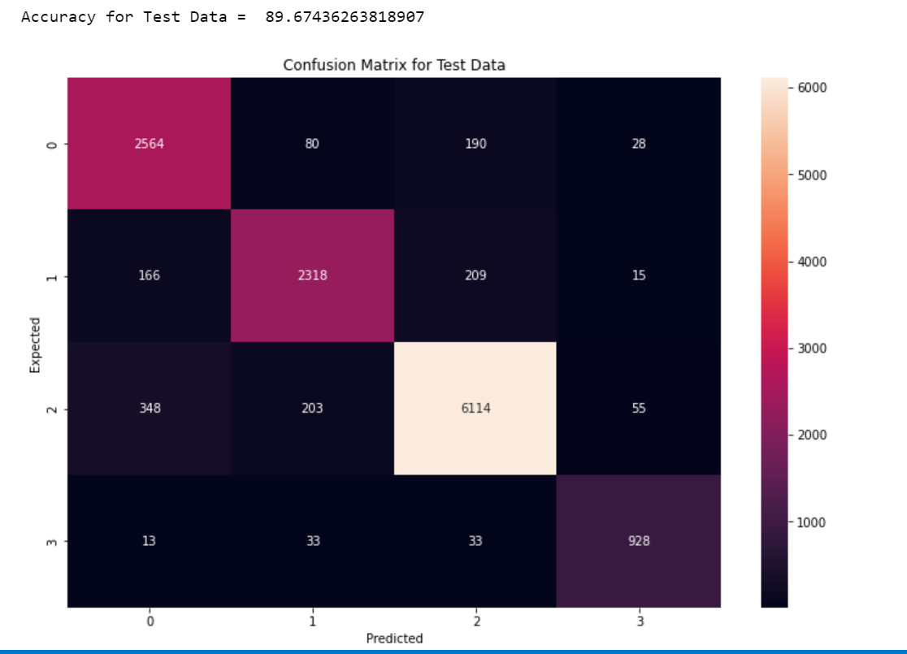
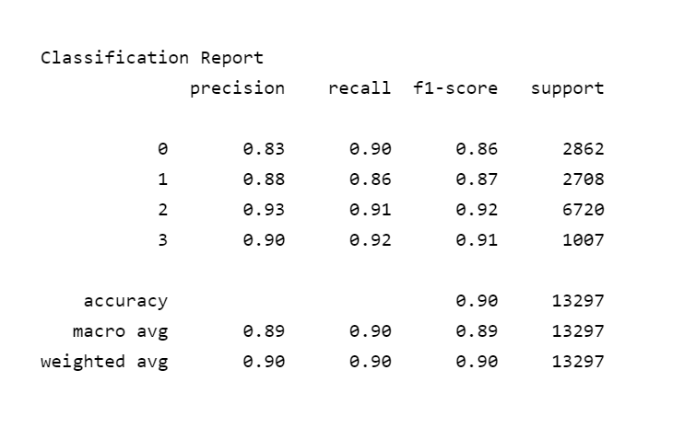
Model Evaluation
Accuracy = TP+TN/(TP+FP+FN+TN)
Precision = TP/(TP+FP)
Recall = TP/(TP+FN)
F1 Score = 2*(Recall * Precision) / (Recall + Precision)

Slide 27
Modules- 5. Classification
From the Feature Extraction values, machine learning model Analyze, detect and predict the person having Parkinson’s disease or not .
Parkinson’s disease (PD) is a progressive neurological disease. There are total 5 stages of PD.
In First Stage there is Slight difficulty walking and mild posture symptoms.
For first stage PD patient, it may give inaccurate prediction.
From second stage onwards, Symptoms at this stage become worse, Poor posture, Difficulty walking and from this stage machine will detect Person having PD symptoms or not.
Input
Output
Pre Processing
Pose Estimation
Feature Extraction
Classification
DEEP
LEARNING
ALGORITHM
FOG OR NOT
SEVERITY LEVEL
Yes
NO
home
GAIT video

Slide 28
References
Computer-Vision Based Diagnosis of Parkinson’s Disease via Gait: A Survey NAVLEEN KOUR , SUNANDA , AND SAKSHI ARORA School of Computer Science and Engineering, Shri Mata Vaishno Devi University, Katra 182320, India
J. Ortells, M. T. Herrero-Ezquerro, and R. A. Mollineda, ‘‘Vision-based gait impairment analysis for aided diagnosis,’’ Med. Biol. Eng. Comput., vol. 56, no. 9, pp. 1553–1564, Sep. 2018.
C. R. Pereira, D. R. Pereira, S. A. T. Weber, C. Hook, V. H. C. de Albuquerque, and J. P. Papa, ‘‘A survey on computerassisted Parkinson’s disease diagnosis,’’ Artif. Intell. Med., vol. 95, pp. 48–63, Apr. 2018.
D. H. Sutherland, ‘‘The evolution of clinical gait analysis: Part II Kinematics,’’ Gait Posture, vol. 16, no. 2, pp. 159–179, Oct. 2002.
Gait Analysis to Detect Parkinsons Disease. Accessed: Feb. 18, 2019. [Online]. Available: https://www.dr-hempelnetwork.com/digital-health-technolgy/gait-analysis-to-detectalzheimers-disease%E2%80%8B
von Schroeder, H. P., Coutts, R. D., Lyden, P. D., Billings, E. Jr & Nickel, V. L. Gait parameters following stroke: a practical assessment. J. Rehabil. Res. Dev. 32, 25–31 (1995).
Gage, J. R., Schwartz, M. H., Koop, S. E. & Novacheck, T. F. The identification and treatment of gait problems in cerebral palsy. (John Wiley & Sons, 2009).
Martin, C. L. et al. Gait and balance impairment in early multiple sclerosis in the absence of clinical disability. Mult. Scler. 12, 620–628 (2006). 6. D’Angelo, M. G. et al. Gait pattern in Duchenne muscular dystrophy. Gait Posture 29, 36–41 (2009).

