Slide 1
Telecom Churn Case Study SUBMISSION
Nageswara Reddy Kakarla
DDA1610191

Slide 2
Objective of Analysis and Conclusion
Business objective : To minimise customer churn
Objective of analysis : To predict customer who are likely to churn
Customer attributes available :
Use of results : Company can focus on retaining customers who are likely to churn
gender |  | TotalCharges
SeniorCitizen |  | Churn
Partner |  | MultipleLines
Dependents |  | InternetService
tenure |  | OnlineSecurity
PhoneService |  | OnlineBackup
Contract |  | DeviceProtection:
PaperlessBilling: |  | TechSupport
PaymentMethod |  | StreamingTV
MonthlyCharges |  | StreamingMovies

Slide 3
Methodology
Sample customer dataset of 7043 observations
Data already classified into customer who have churned
Division of data into train and test datasets
Application of popular predictive analysis algorithms on train and test datasets
K-KNN
Naïve-Bayes
Logistic Regression
SVM

Slide 4
Methodology
Check effectiveness of algorithms used based on following parameters
Accuracy
Specificity
Sensitivity
AUC(If applicable)
C – Statistic (If applicable)
KS – Statistic (If applicable)

Slide 5
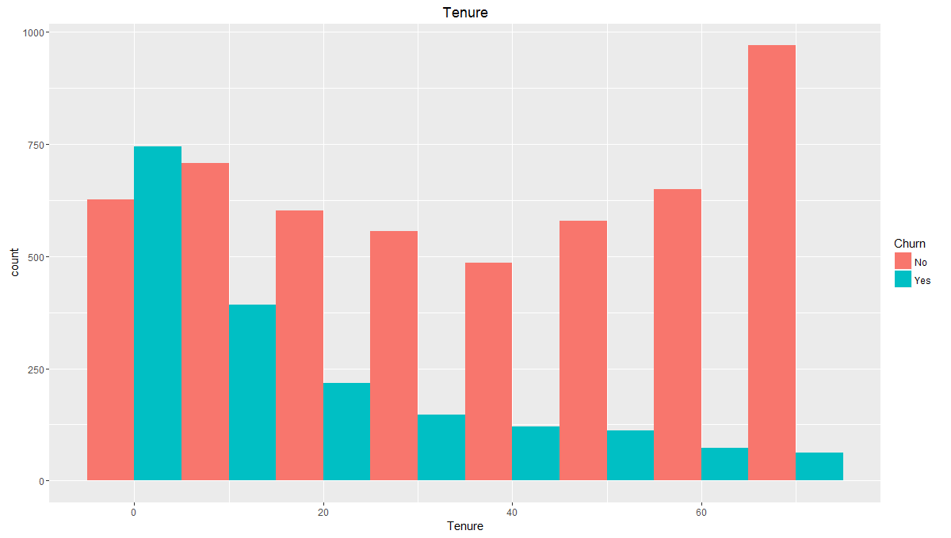
EDA – Churn more among recent customers Not enough effort to retain new customers? Service plans not attractive?
???

Slide 6
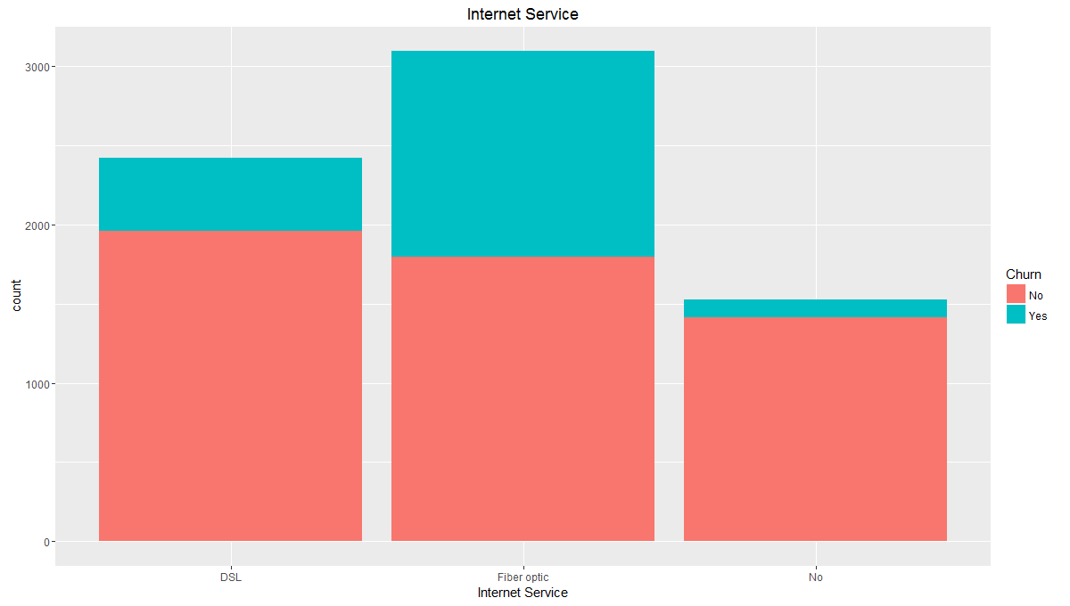
EDA – Churn more in users of fibre optic connection Expensive thus not worth the money? Quality of service not good?
???
Display graphs to interpret the causal relationships between the variables such as churn, tenure, total charges etc.

Slide 7
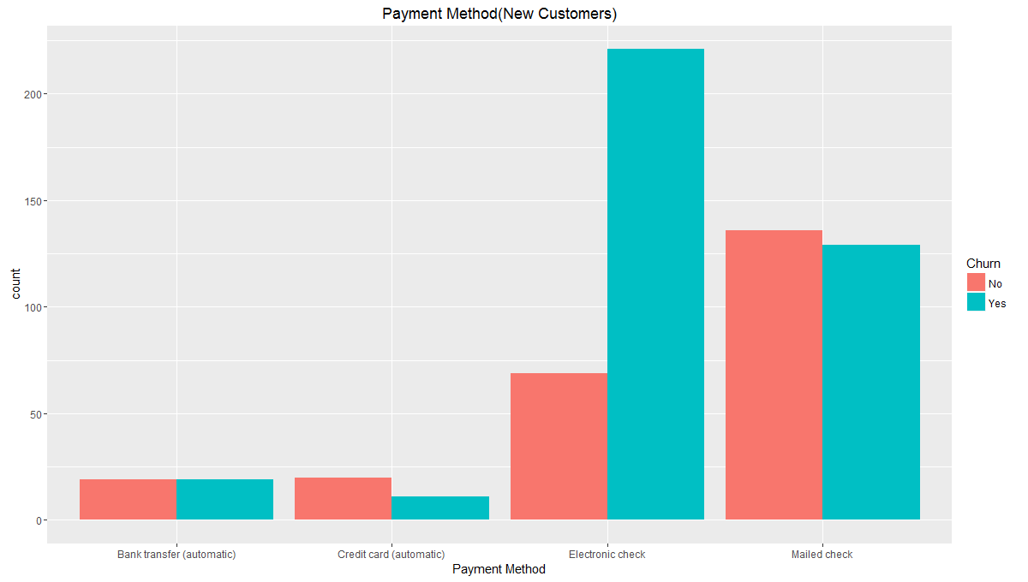
EDA – Among new customers mailed checks user churn more Check not reaching in time? Discontinuation of service even after payment?
???

Slide 8
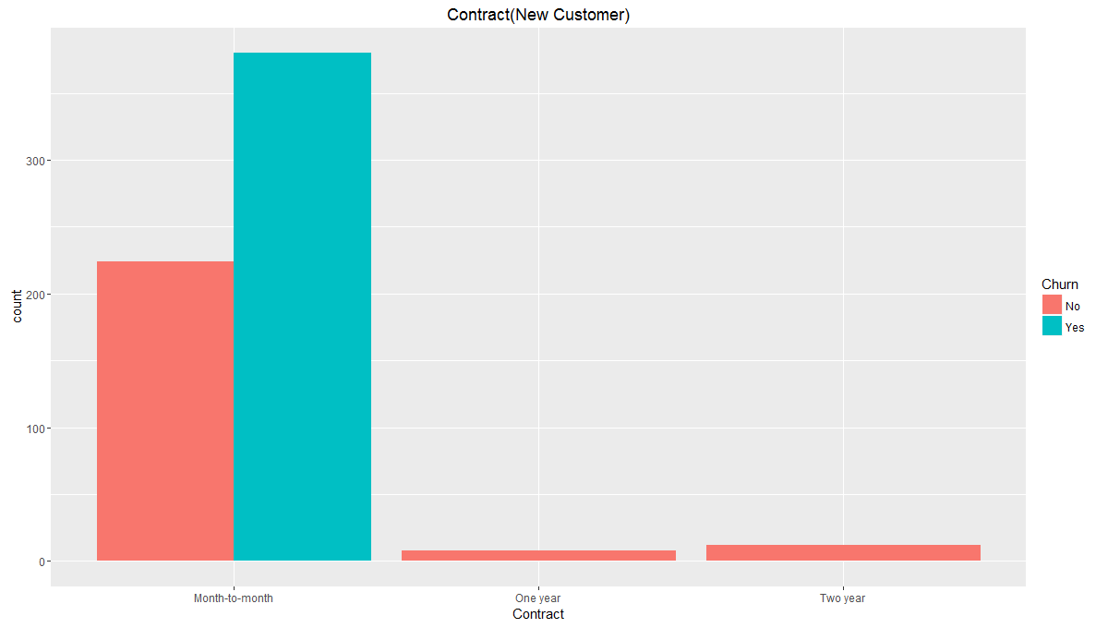
EDA- Most recent customers buy month-to-month and churn more Not enough effort to upsell? Longer plans are not economical for customers?
???

Slide 9
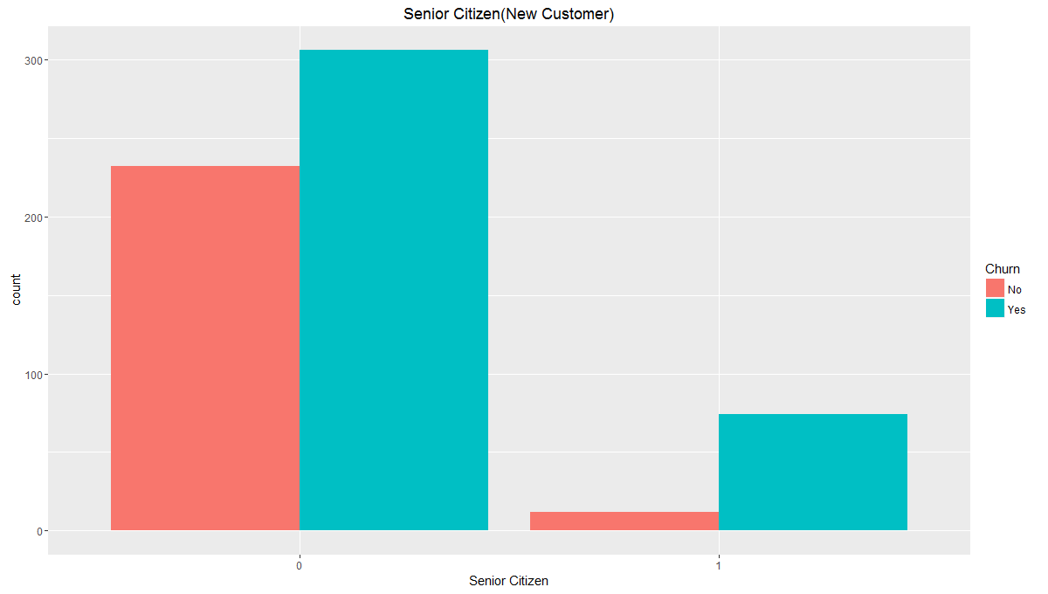
EDA- Most recent senior citizen churn Lack of technical support? Sophisticated new technology turning them away?
???

Slide 10
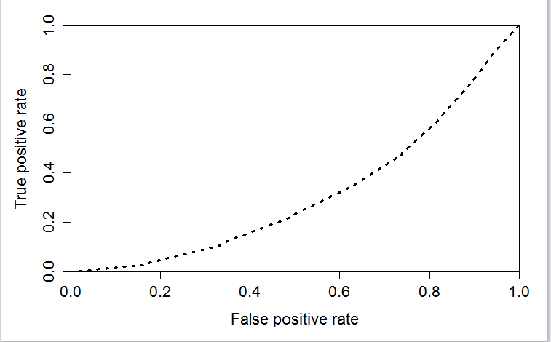
K-NN model insights and results
Following results were found when K-NN algorithm was applied on the given data set
Optimal value of K was found to be 17 and as seen from the table above, when K=17 :
Accuracy improved from 0.7172 to 0.77
Specificity improved from 0.8056 to 0.9055
K | 1 | 17
Accuracy | 0.717 | 0.77
Sensitivity | 0.481 | 0.409
Specificity | 0.806 | 0.906
AUC | 0.497 | 0.315
ROC Curve

Slide 11
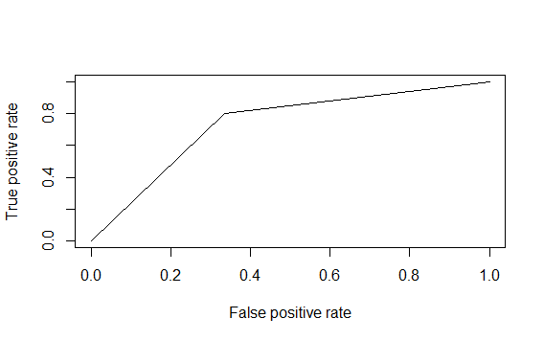
Naïve Bayes model insights and results
Parameter | Value
Accuracy | 0.7018
95% CI | (0.6818, 0.7213)
No Information Rate | 0.7354
P-Value [Acc > NIR] | 0.9998
Sensitivity | 0.8014
Specificity | 0.6660
Pos Pred Value | 0.4633
Neg Pred Value | 0.9031
Prevalence | 0.2646
Detection Rate | 0.2120
Detection Prevalence | 0.4576
Balanced Accuracy | 0.7337
'Positive' Class | Yes
AUC | 0.74
ROC Curve

Slide 12
Logistic Regression model insights and results
As per the data and application of Logistic Regression algorithm, following variables are most significant and create the most differentiation while predicting customer who are most likely to churn
Accuracy of model measured using C-Statistics, KS- Statistics and Decile
Variable | Coefficient |  | Variable | Coefficient
tenure | -0.036846 |  | PaymentMethodElectronic.check | 0.455848
SeniorCitizen | 0.354546 |  | MultipleLinesYes | 0.343756
ContractOne.year | -0.751674 |  | InternetServiceFiber.optic | 0.811923
ContractTwo.year | -1.606095 |  | InternetServiceNo | -0.595472
PaperlessBilling | 0.345957 |  | StreamingMoviesYes | 0.408441
 | Training Data | Test Data
AIC | 4158.2 | 1801.2
C-Statistics | 0.8424 | 0.8411
KS-Statistics | 0.52686 | 0.5265818
Decile | 2nd | 3rd

Slide 13
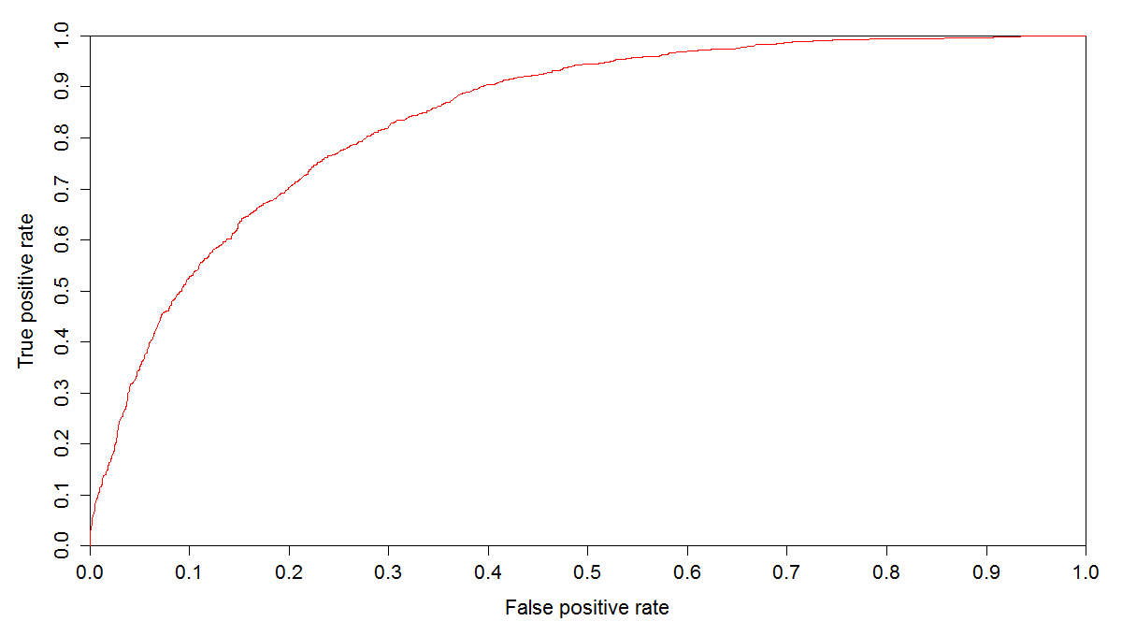
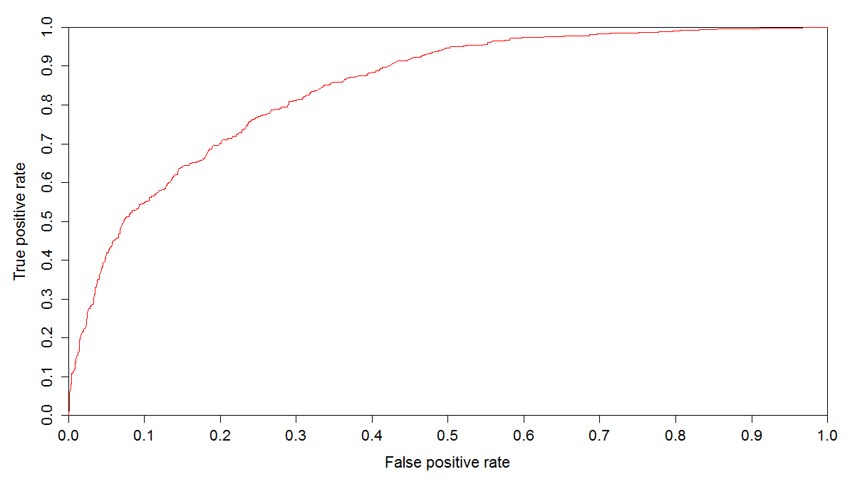
Logistic Regression model insights and results
As churned customers are positive class and we would like to predict customers who are going to churn accurately. Therefore, true positive(Sensitivity) rate should be high.
With more than 75% accuracy Sensitivity was found to be 75% at 0.3 probability threshold.
Also keeps Specificity high at nearly 75%
 | Training Data | Test Data
Accuracy | 0.762 | 0.754
Specificity | 0.763 | 0.749
Sensitivity | 0.761 | 0.77
Training Data
Test Data
ROC Curve
ROC Curve

Slide 14
SVM Model insights and results
SVM creates the hyperplane classifier and the cost function signifies the extent of misclassification allowed.
The cost function varies between 0.01 & .1 and tune function choose the best value from the range
Tune function choose .06 which gives
80 % Accuracy
Sensitivity is 54 % with positive class as yes.
Specificity is 90 % with positive class as yes.
This indicates model identifies which customer will not churn better i.e. 90 %
Reference
Prediction | NO | YES
NO | 1388 | 257
YES | 154 | 314

