Slide 1


Slide 2
Self-Esteem…What is it?
Self-Esteem…What’s it made of?
Difference bet.Self concept & Self Esteem
Types of Self-esteem
The secret to improving Self-esteem

Slide 3
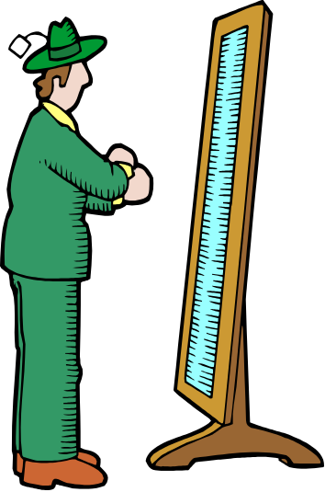
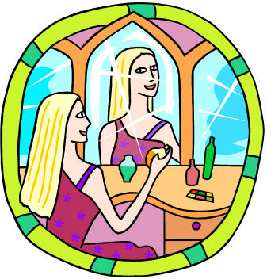
Self-Concept
Your VIEW of yourself
The ENTIRE picture...
It changes
S L O W L Y

Slide 4

Self-esteem refers to the way we see and think about ourselves.
Can change from moment to moment

Slide 5

Your self-esteem is made up of all the experiences and interpersonal relationships you’ve had in your life. Everyone you’ve ever met has added to or taken away from how you see yourself!

Slide 6

More capable of having open,Honest,and Appropriate Communications with others.
More Ambitious
Self-Confident
Seeks the Challenge of Worthwhile and Demanding Goals

Slide 7

People with high self-esteem possess the following characteristics:
-They like to meet new people.
-They don’t worry about how others will judge them.
-They have the courage to express themselves.
-Their lives are enriched with each new encounter.

Slide 8
-They are nicer to be around.
-Their ideas are met with interest because others want to hear what they have to say.
-They are magnets to positive opportunities!
People with high self-esteem have an “I think I can” attitude!

Slide 9

People with low self-esteem possess the following characteristics:
-They don’t believe in themselves.
-They see themselves failing before they begin.
-They have a hard time forgiving their mistakes and make themselves pay the price forever.
-They believe they can never be as good as they should be or as others.

Slide 10
-They are afraid to show their creativity because they will be ridiculed.
-They are dissatisfied with their lives.
-They spend most of their time alone.
-They complain and criticize.
-They worry about everything and do nothing.
- They are Uncertain of their own thoughts and Feelings
People with low self-esteem have an “I can’t do it” attitude.

Slide 11

Step 1
-Forgive yourself for past mistakes.
Step 2
-Focus on your positive attributes.
Step 3
-Follow the example of successful people.
Step 4
-Become a self talker.

Slide 12
Step 5
-Exhibit a good attitude.
Step 6
-Get plenty of rest.
Step 7
-Make your work skills your own
Step 8
-Practice your talents

Slide 13
Step 9
-Become physically fit.
Step 10
-Learn new things.
Step 11
-Improve your personal relationships.
Step 12
-Dress well!

Slide 14

Self-esteem comes from every experience of your life.
How you view yourself affects everything you do in life.
High self-esteem gives you a GOOD feeling about yourself.
Low self-esteem distorts your view of yourself.
Self-esteem can me improved!

Slide 15

You are a unique individual. No one else is like you in the whole world. This makes you special already!
Our time in this world is limited. Make it happen for you so you leave your mark in history!

