Slide 1
KHOJ
I got lost in a mela. My phone was useless.
How this idea started
The same story, again and again
I was in a huge crowd and got separated from my family.
Maha Kumbh 2025: tens of thousands of people were lost. Concerts, stadiums and railway platforms are the same: a crowd gets big, the network collapses, and a loudspeaker is the only tool left.
No signal. Calls and WhatsApp did not go through.
The only hope was a loudspeaker announcement.
So we built KHOJ
Find your family in a crowd with no internet and no SIM. Every phone running KHOJ becomes a relay, so the crowd itself becomes the network.
But every phone around me still had Bluetooth. Why can't phones just pass the message along?
1/6

Slide 2
WHAT KHOJ DOES
Main features
Live radar
Find
Family pass
Wristband QR
Each family member is a bubble at their real direction and distance.
An arrow that says how it knows. Shows nothing rather than a guess it cannot support.
Join a group with one QR code. Set how far someone may wander before everyone is alerted.
Any phone camera reads it with no app and no internet. Shows a Call button for the child's guardian.
Light up
Voice assistant
SOS and fall alert
Simple mode
Make a family member's torch, screen and sound go off so you can spot them in a crowd (they must allow it).
Speak in English, Hindi or Tamil. It runs on the phone and handles the whole app.
Hold or shake to alert the group. Fall detection sends an alert automatically.
A big-button screen for elders and first-time users.
Android today. Calling a wristband number needs ordinary phone signal; nothing else needs internet.
2/6

Slide 3
TECHNICAL
Offline ways phones talk to each other
Bluetooth LE mesh
Google Nearby Connections
Wi-Fi Direct and Wi-Fi Aware
BLE 5 extended advertising. Managed flooding with relay delay and duplicate suppression, store-carry-forward, ACK retries.
Cluster of phones. Starts on Bluetooth, upgrades to Wi-Fi LAN. Verified between our phones.
Higher-speed links when the phones support them. Wi-Fi LAN was the verified upgrade; Direct is not yet verified.
GATT link
Optional internet relay
Private by design
Direct Bluetooth connection as a fallback bearer.
If a phone happens to have internet it can bridge groups. Never required.
Packets are sealed with AES-256-GCM using a key only the family holds. Strangers can relay but not read. Identifiers rotate every 15 minutes.
Tested on 3 real phones. Range and crowd-scale behaviour still need more field testing.
3/6

Slide 4
MAIN INNOVATION
Packet regeneration with on-device AI
The problem
What exists today
In a dense crowd, Bluetooth packets are lost to collisions and bursts of interference. Today the mesh recovers by retrying.
Reed-Solomon recovery in direct sharing: 92.8% delivery vs 54.6% without it on bursty loss (simulation). A loss-predictor model already runs on the NPU path (currently paused).
The idea
A phone that misses a packet rebuilds it from the other packets it did receive (relays from neighbours, and parity).
What we are building
Regeneration inside the mesh itself. This is the design and prototype stage; there are no measured results for it yet.
A small model fills the gaps using what it already knows: last position, motion and time.
The model is trained on a laptop, then exported and run on the phone's Qualcomm NPU with the QNN delegate.
Honest limit
It improves delivery inside the existing range. It does not extend Bluetooth range.
4/6

Slide 5
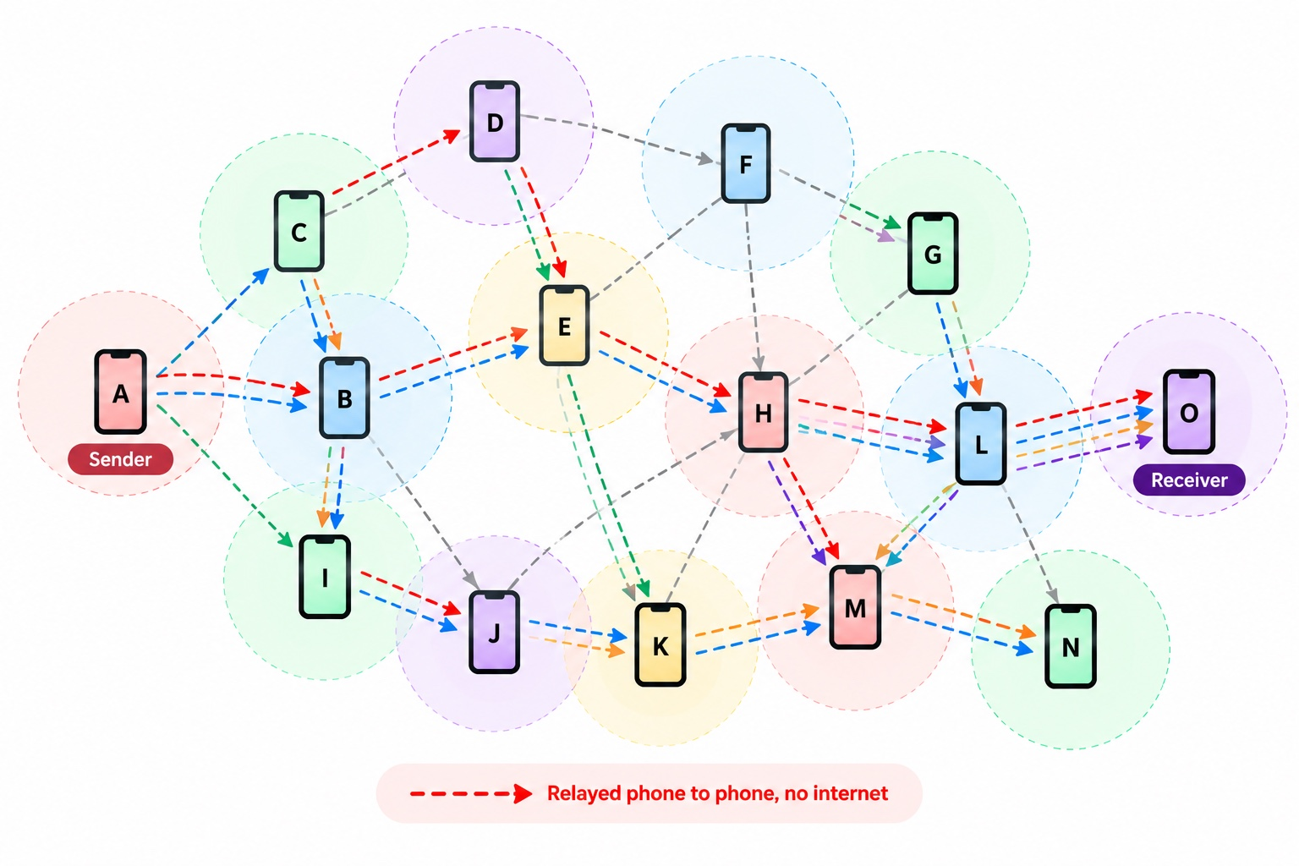
THE MESH
The crowd becomes the network
More phones means more routes, so the mesh gets stronger in a crowd.
SOS and Find messages get priority over everything else.
Phones that are out of range carry the message and pass it on later.
Find is honest about age: a live position is used as it is, a 10 to 20 second old one is predicted, and nothing is shown after 20 seconds.
Illustration: a message hops phone to phone from sender A to receiver O. No tower, no internet.
5/6

Slide 6
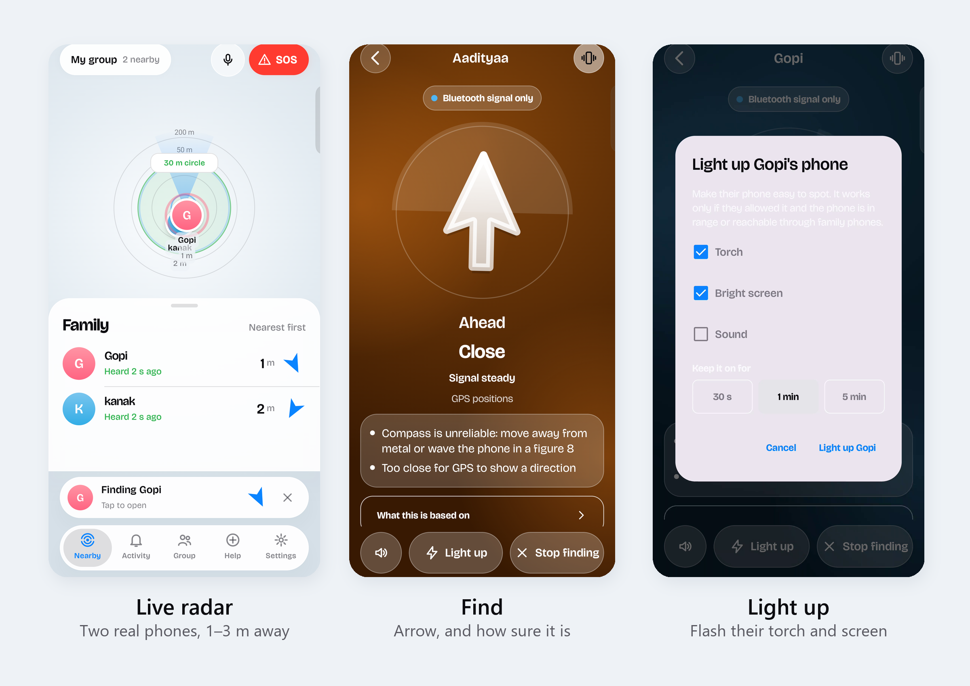
CONCLUSION
Losing signal should not mean losing your people
The problem
Our answer
Where we are
In big crowds the network fails exactly when families need it most, and a loudspeaker is all that is left.
KHOJ: phone-to-phone mesh, a radar and arrow to find family, a wristband any camera can read, and voice in Hindi and Tamil.
Working app on 3 real phones. Next: crowd-scale field tests and in-mesh packet regeneration on the NPU.
Join the beta
Early software. Android only for now. Not a replacement for calling 112.
6/6

