Slide 1

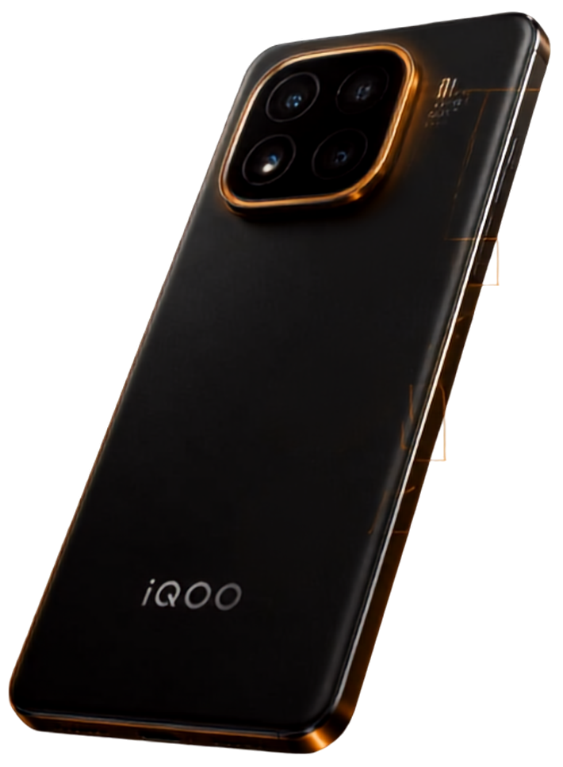
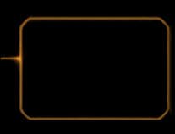

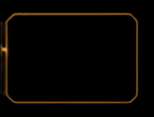

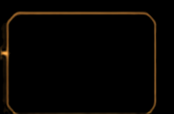



CAMERA
Visual Recognition
SenseGuard
IMU
Multimodal On-Device Medication Safety & Adherence
Motion Awareness
Camera • IMU • GNSS • On-device AI
iQOO Hackathon 2026 Pitch
Cognivista
2026-09-06

Slide 2

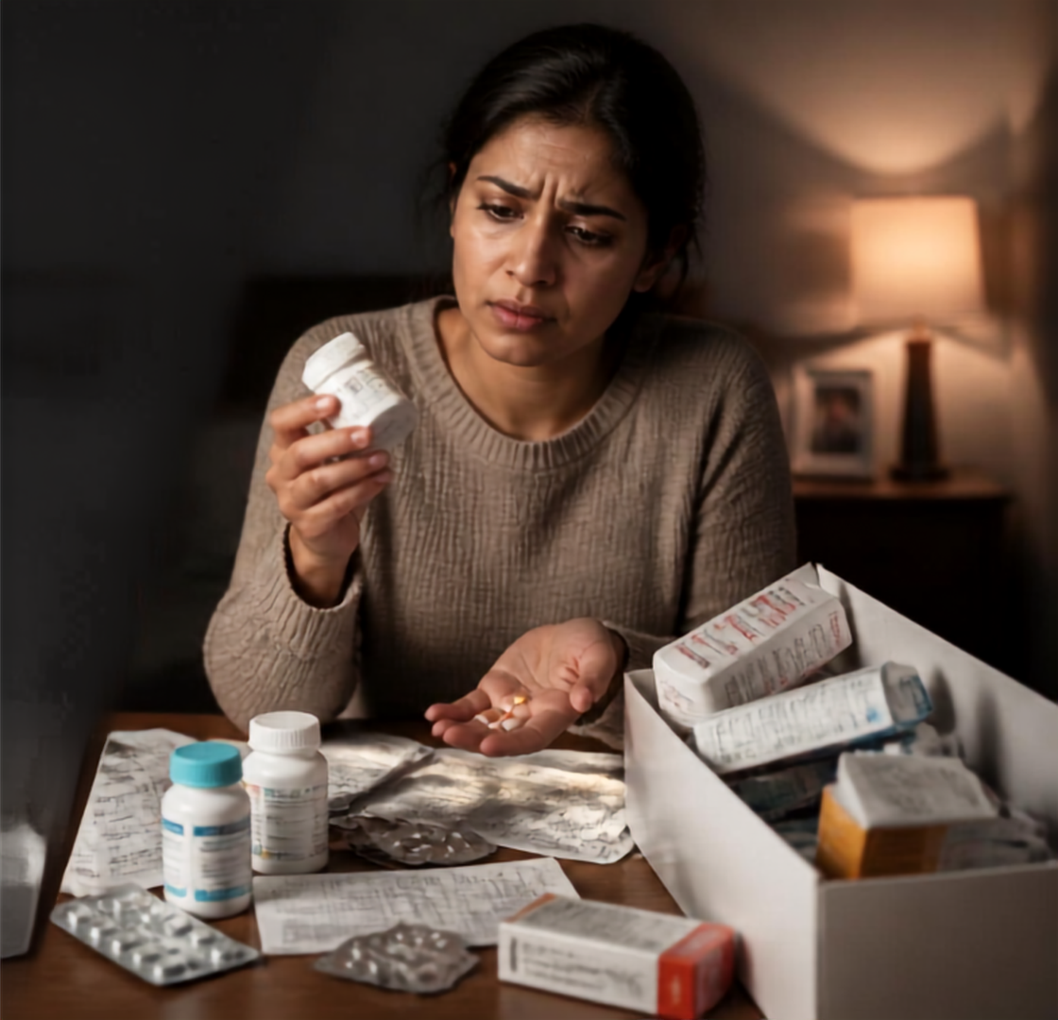

The Medication
Safety Challenge
“Information is fragmented across physical and behavioral contexts”
Medication details live in disconnected places
Patients face everyday uncertainty
Most apps miss the physical world
Context is multimodal, not one-dimensional
CORE CHALLENGE | Fragmented context across package identity, prescription schedule, clinician speech, time, and location — not merely reminders.

Slide 3

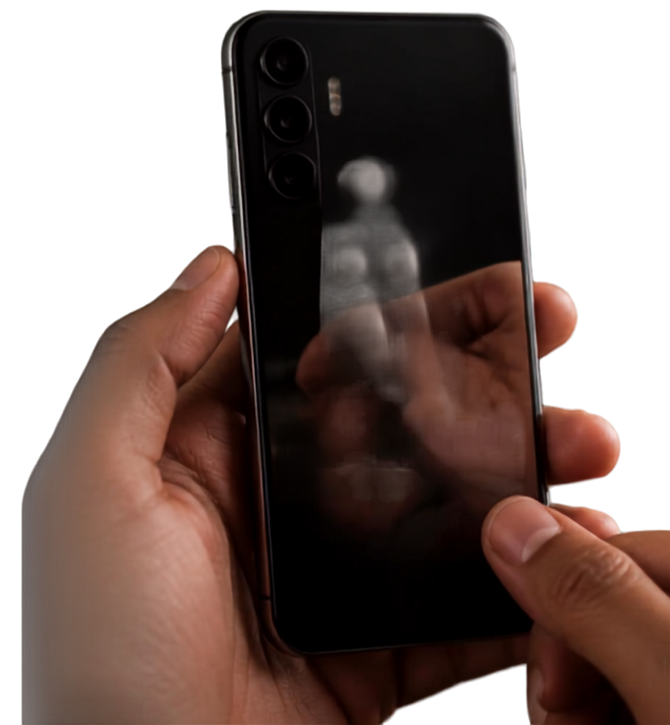


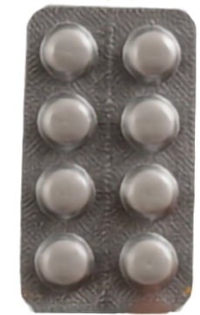









Core Insight —
One Medicine in Hand
We focus on the medicine you’re holding, not the clutter around it.
A simple, controlled interaction powers accurate identification.
PICK UP
SHOW
CAPTURE
IDENTIFY
VERIFY
LOG
Detected
medicine
phone
stabilizes
the medicine
& guide
securely
IMPLEMENTATION NOTE | Single-item capture reduces cluttered multi-object detection and enables controlled frame selection.

Slide 4

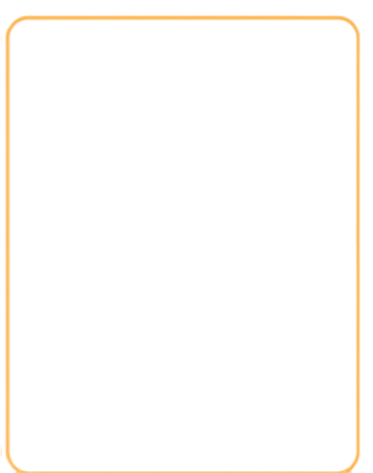









SenseGuard Product Vision
& Sensor Fusion
A closed-loop, multimodal intelligence stack for safer medication use.
SENSE
CONTEXTUALIZE
VERIFY
ACT
camera
microphone
GNSS
IMU
magnetometer
barometer
C/N,0
sensor fusion estimates
interaction state
location confidence
device stability
OCR and packaging vision
barcode / QR scanning
schedule and expiry
on-device AI fusion
visual feedback
voice cues
haptic alerts
medication event
logging
RAW SENSORS → SYNCHRONIZED STATE → DETERMINISTIC SAFETY RULES → ON-DEVICE AI EXPLANATION → SCREEN / VOICE / HAPTICS
continuous learning on-device
Exact sensor/API availability — especially GNSS C/N₀ — is validated on the loaner device.

Slide 5

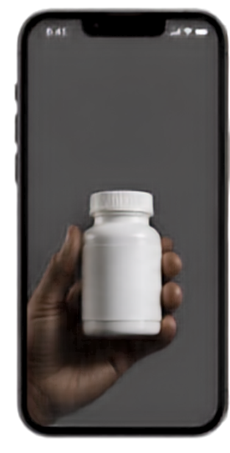
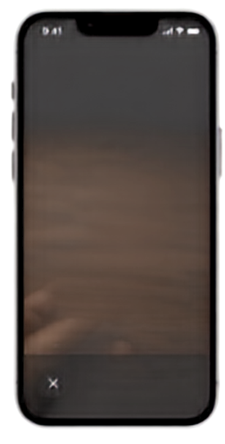
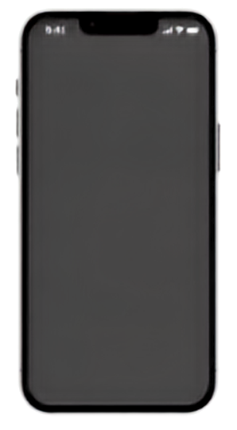
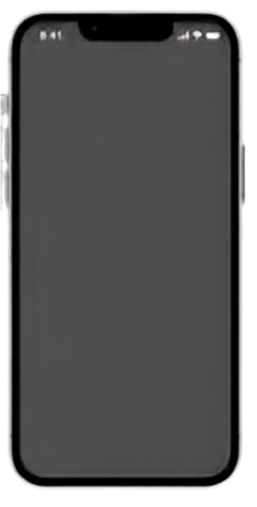

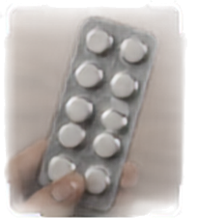










Main User Experience —
Scan to Action
From pickup detection to safe dose logging in five seamless steps.
Show me
your medicine
Hold steady
Identifying
Status
Dose logged
Keep the medicine
in frame
Due now
Inspection ready
Name
It’s time to take your medicine
Metformin 500mg
Dose
500 mg
Stay consistent, stay healthy.
Expiry
08/2026
Barcode
Based on
8901234567890
Sensor data
OCR + vision identify key medicine details
Your schedule
01
02
03
04
05
Pickup detected by IMU
Aim and hold steady
Extract key details
Decide action on-device
Guide and log
App becomes inspection-ready
IMU ensures stability for clear capture
On-device OCR + vision read name, dose, expiry and barcode
AI fuses sensors and schedule to determine medication status
Screen, voice and haptic guide the user and log the dose event
CAPTURE GATE | capture_ready = package detected + low IMU variance + sufficient frame quality

Slide 6



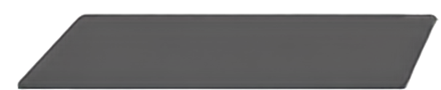

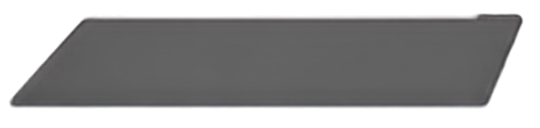


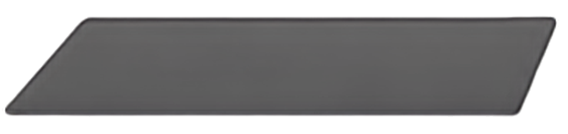


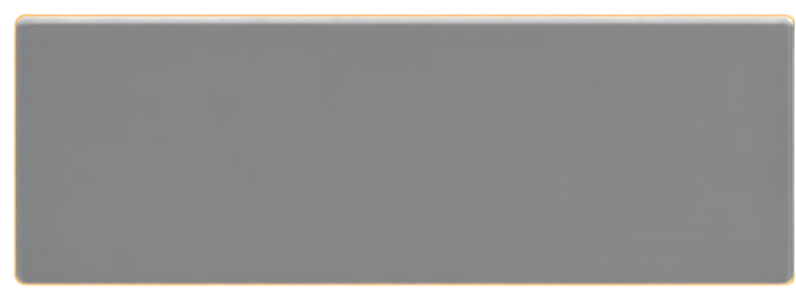
Verification & Evidence Fusion
MULTIPLE EVIDENCE SOURCES
QR IDENTITY
FUSED & EXPLAINABLE OUTPUT
PACKAGING SIGNATURE
SenseGuard combines multiple signals to verify medication safely
BARCODE / QR
CONFIDENCE
Delivers structured confidence levels, not just real or fake
EXPIRY CHECK
Reason: packaging mismatch detected
Every result is explained with clear reasons you can trust
PRESCRIPTION CONTEXT
Explainability: identity, packaging, identifier, expiry, prescription, and location-confidence signals fuse into structured PASS / WARNING / UNKNOWN states.
Screening support — not counterfeit certification.
ALL CHECKS PASS
PACKAGING WARNING
Identity match
PASS
Identity match
PASS
DO NOT RELY ON VISUAL CHECK ALONE
TAKE
NOW
Packaging signature
PASS
Packaging signature
WARNING
Barcode / QR
PASS
Barcode / QR
PASS
Expiry valid
PASS
Expiry valid
PASS
Review details and seek professional advice
Prescription context
PASS
Prescription context
PASS

Slide 7

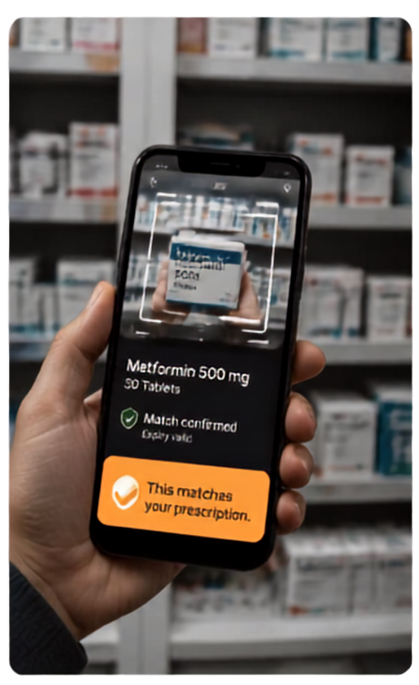
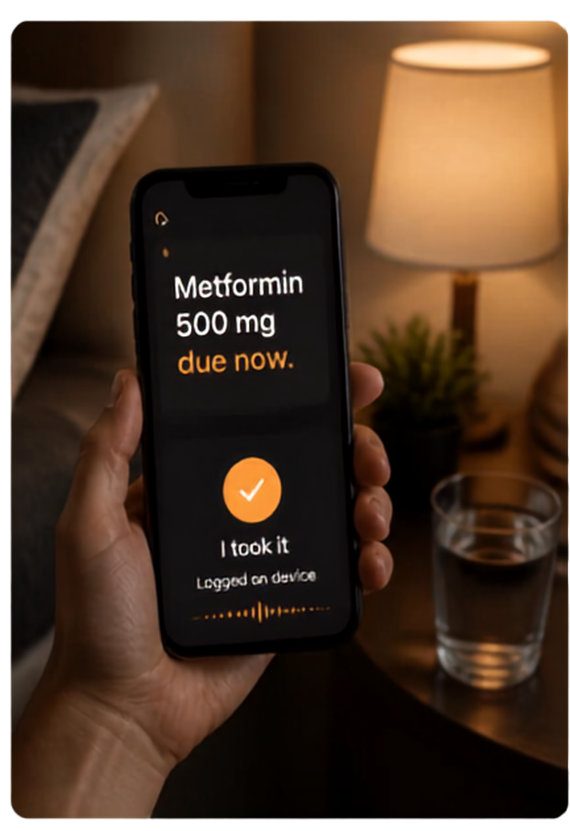
Demo Scenario Highlights
Pharmacy & Home
Pharmacy mode
Scan in pharmacy
Validate & verify
Metformin 500 mg 30 Tablets
This matches your prescription.
Match confirmed
Expire valo
This matches your prescription.
Home mode
Due reminder
Confirm intake
Logged on device
LOCAL-FIRST | Room/SQLite record + offline-first decision path
PHARMACY MODE
HOME MODE

Slide 8

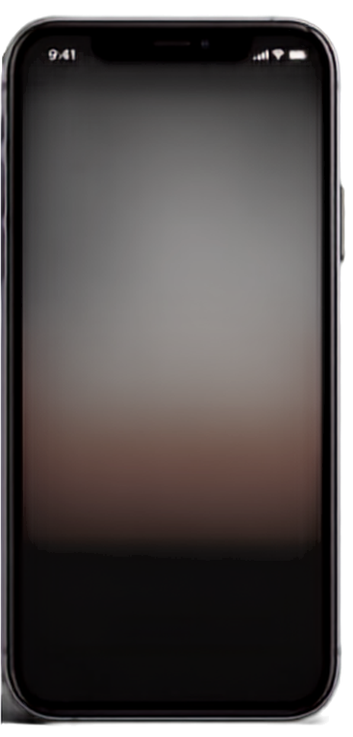
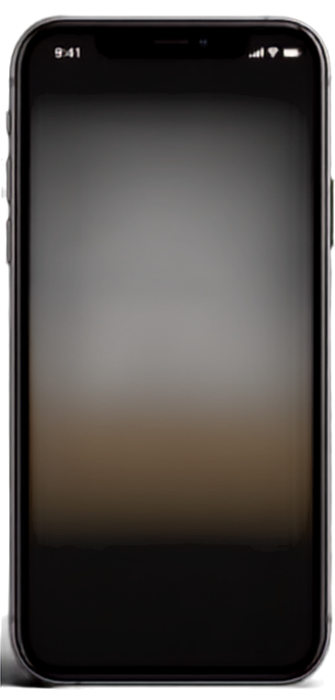

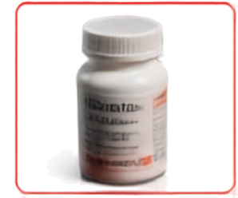

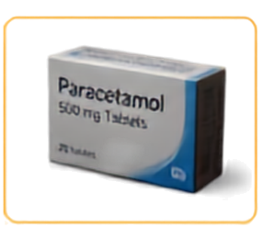







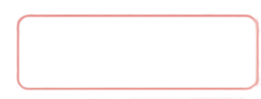





Demo Scenario Highlights —
Wrong & Suspicious Packaging
Wrong Medicine
Phone detects medicine not due now → red alert and haptic feedback:
“NOT DUE — scheduled for tonight”
NOT DUE
PACKAGING MISMATCH
Suspicious Packaging
Scheduled for tonight
Packaging signature mismatch triggers warning:
Consult pharmacist
“PACKAGING MISMATCH — consult pharmacist”
HAPTIC ALERT
HAPTIC ALERT
Community Safety
System logs suspicious events anonymously for community safety analytics
PRIVACY DEFAULT | Suspicious events use coarse location buckets; raw medicine images stay on-device by default.

Slide 9

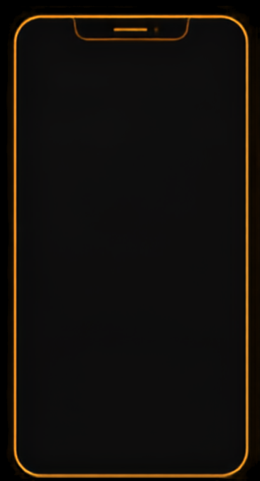








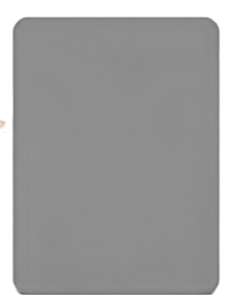












Clinician Communication &
Phone-First Architecture
From clinician instructions to safe, guided medication use
Structured Rules
PHONE CORE
linked to medication
Voice Capture
Multimodal Sensor Fusion
clinician instructions
Verification
safety and consistency
Office Kit
Guidance
Front Camera
clear, contextual medication support
Phone ↔ Laptop workflow bridge without replacing phone capabilities
visual context
On-Device AI / NPU
local reasoning and understanding
Logging
privacy-first, on-device records
Office Kit: screen mirroring • file transfer • shared clipboard • remote control — while the phone keeps the core loop.
STACK | CameraX + SensorManager + GNSS APIs → local structured state → OCR/vision + compact local model/NPU → Medication Decision Engine → Room/SQLite → TTS / haptics

Slide 10

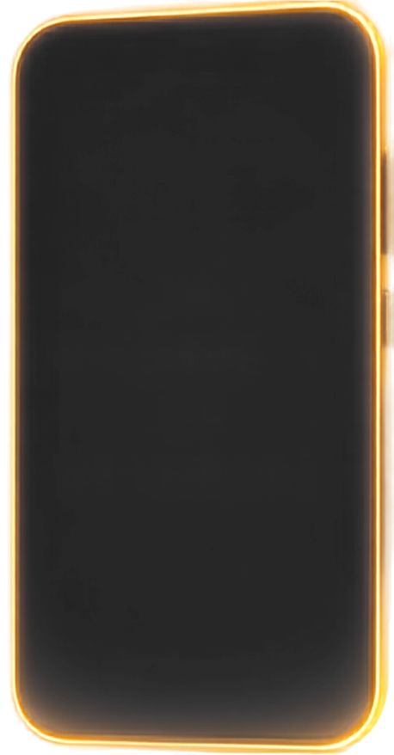
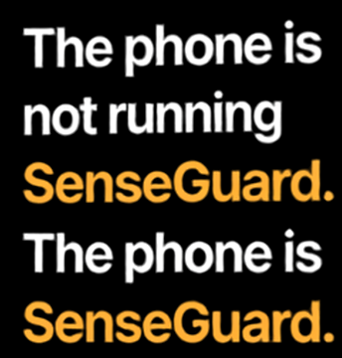

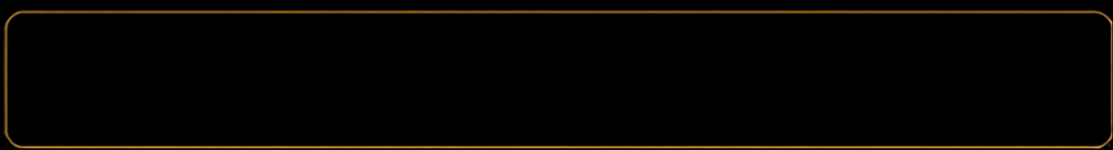

IMPACT & PRIORITIES
Building Safer
Every Day
IMPACT
BUILD PRIORITIES
Enhanced medication safety
Multimodal on-device sensing
Community intelligence
Accessibility for all
Core sensor use
AI reasoning
Stable capture
Verification
Schedule matching
Voice guidance
Logging
30-HOUR BUILD ORDER | hardware validation → camera/OCR → verification → sensor fusion → schedule/voice/logging → red-team testing
SAFETY BOUNDARY | Assistive screening, not prescribing or authenticity certification.
The phone is not running SenseGuard. The phone is SenseGuard.
ALIGNED TO IQOO HACKATHON 2026
Quality & Execution
Novelty & Innovation
Creative Phone Use
Technical Depth
Office Kit Readiness
Demo Day Impact

