Slide 1
Organization of Multiprocessor Systems
Flynn’s Classification
  Was proposed by researcher Michael J. Flynn in 1966.
  It is the most commonly accepted taxonomy of computer organization.
  In this classification, computers are classified by whether it processes a single instruction at a time or multiple instructions simultaneously, and whether it operates on one or multiple data sets.

Slide 2
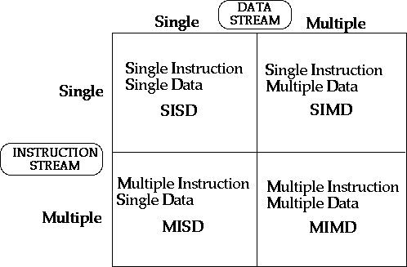
Taxonomy of Computer Architectures
Simple Diagrammatic Representation
4 categories of Flynn’s classification of multiprocessor systems by their instruction and data streams

Slide 3
Single Instruction, Single Data (SISD)
SISD machines executes a single instruction on individual data values using a single processor.
Based on traditional Von Neumann uniprocessor architecture, instructions are executed sequentially or serially, one step after the next.
Until most recently, most computers are of SISD type.

Slide 4
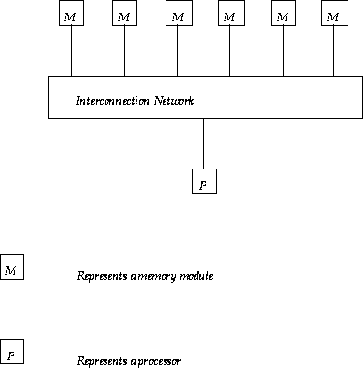
SISD
Simple Diagrammatic Representation

Slide 5
Single Instruction, Multiple Data (SIMD)
An SIMD machine executes a single instruction on multiple data values simultaneously using many processors.
Since there is only one instruction, each processor does not have to fetch and decode each instruction. Instead, a single control unit does the fetch and decoding for all processors.
SIMD architectures include array processors.

Slide 6
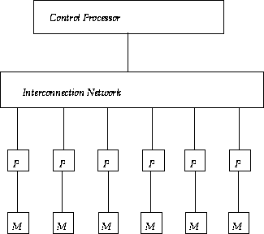
SIMD
Simple Diagrammatic Representation

Slide 7
Multiple Instruction, Multiple Data (MIMD)
MIMD machines are usually referred to as multiprocessors or multicomputers.
It may execute multiple instructions simultaneously, contrary to SIMD machines.
Each processor must include its own control unit that will assign to the processors parts of a task or a separate task.
It has two subclasses: Shared memory and distributed memory

Slide 8
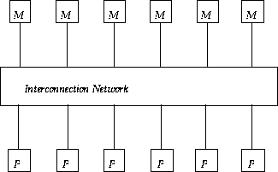
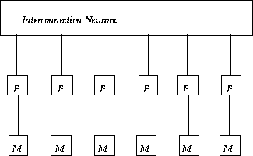
MIMD
Simple Diagrammatic Representation
(Shared Memory)
Simple Diagrammatic Representation(DistributedMemory)

Slide 9

Multiple Instruction, Single Data (MISD)
This category does not actually exist. This category was included in the taxonomy for the sake of completeness.

Slide 10
Analogy of Flynn’s Classifications
An analogy of Flynn’s classification is the check-in desk at an airport
  SISD: a single desk
  SIMD: many desks and a supervisor with a megaphone giving instructions that every desk obeys
  MIMD: many desks working at their own pace, synchronized through a central database

Slide 11
System Topologies
Topologies
  A system may also be classified by its topology.
  A topology is the pattern of connections between processors.
  The cost-performance tradeoff determines which topologies to use for a multiprocessor system.

Slide 12
Topology Classification
A topology is characterized by its diameter, total bandwidth, and bisection bandwidth
  Diameter – the maximum distance between two processors in the computer system.
  Total bandwidth – the capacity of a communications link multiplied by the number of such links in the system.
  Bisection bandwidth – represents the maximum data transfer that could occur at the bottleneck in the topology.

Slide 13

System Topologies
M
M
M
Shared Bus Topology
  Processors communicate with each other via a single bus that can only handle one data transmissions at a time.
  In most shared buses, processors directly communicate with their own local memory.
P
P
P
Shared Bus
Global
memory

Slide 14
System Topologies
P
Ring Topology
  Uses direct connections between processors instead of a shared bus.
  Allows communication links to be active simultaneously but data may have to travel through several processors to reach its destination.
P
P
P
P
P

Slide 15
System Topologies
P
Tree Topology
  Uses direct connections between processors; each having three connections.
  There is only one unique path between any pair of processors.
P
P
P
P
P
P

Slide 16
Systems Topologies
Mesh Topology
  In the mesh topology, every processor connects to the processors above and below it, and to its right and left.
P
P
P
P
P
P
P
P
P

Slide 17
System Topologies
Hypercube Topology
  Is a multiple mesh topology.
  Each processor connects to all other processors whose binary values differ by one bit. For example, processor 0(0000) connects to 1(0001) or 2(0010).
P
P
P
P
P
P
P
P
P
P
P
P
P
P
P
P

Slide 18
System Topologies
Completely Connected Topology
  Every processor has
  n-1 connections, one to each of the other processors.
  There is an increase in complexity as the system grows but this offers maximum communication capabilities.
P
P
P
P
P
P
P
P

Slide 19
MIMD System Architectures
Finally, the architecture of a MIMD system, contrast to its topology, refers to its connections to its system memory.
A systems may also be classified by their architectures. Two of these are:
  Uniform memory access (UMA)
  Nonuniform memory access (NUMA)

Slide 20
Uniform memory access (UMA)
The UMA is a type of symmetric multiprocessor, or SMP, that has two or more processors that perform symmetric functions. UMA gives all CPUs equal (uniform) access to all memory locations in shared memory. They interact with shared memory by some communications mechanism like a simple bus or a complex multistage interconnection network.

Slide 21
Uniform memory access (UMA) Architecture
Processor 1
Communications
mechanism
Processor 2
Shared
Memory
Processor n

Slide 22
Nonuniform memory access (NUMA)
NUMA architectures, unlike UMA architectures do not allow uniform access to all shared memory locations. This architecture still allows all processors to access all shared memory locations but in a nonuniform way, each processor can access its local shared memory more quickly than the other memory modules not next to it.

Slide 23
Nonuniform memory access (NUMA) Architecture
Processor 1
Processor 2
Processor n
Memory 1
Memory 2
Memory n
Communications mechanism

Slide 24
What is Pipelining?
A way of speeding up execution of instructions
Key idea:
overlap execution of multiple instructions

Slide 25
The Laundry Analogy
Ann, Brian, Cathy, Dave
each have one load of clothes
to wash, dry, and fold
Washer takes 30 minutes
Dryer takes 30 minutes
“Folder” takes 30 minutes
“Stasher” takes 30 minutes
to put clothes into drawers
A
B
C
D

Slide 26
If we do laundry sequentially...
6 PM
7
8
9
10
11
12
1
2 AM
30
30
30
30
30
30
30
30
30
30
30
30
30
30
30
30
T
a
s
k
O
r
d
e
r
Time
A
B
C
D
Time Required: 8 hours for 4 loads

Slide 27
To Pipeline, We Overlap Tasks
6 PM
7
8
9
10
11
12
1
2 AM
30
30
30
30
30
Time
30
30
T
a
s
k
O
r
d
e
r
A
B
C
D
Time Required: 3.5 Hours for 4 Loads

Slide 28
To Pipeline, We Overlap Tasks
6 PM
7
8
9
10
11
12
1
2 AM
30
30
30
30
30
Time
30
30
T
a
s
k
O
r
d
e
r
A
Pipelining doesn’t help latency of single task, it helps throughput of entire workload
Pipeline rate limited by slowest pipeline stage
Multiple tasks operating simultaneously
Potential speedup = Number pipe stages
Unbalanced lengths of pipe stages reduces speedup
Time to “fill” pipeline and time to “drain” it reduces speedup
B
C
D

Slide 29
Pipelining a Digital System
1 nanosecond = 10^-9 second
1 picosecond = 10^-12 second
Key idea: break big computation up into pieces
Separate each piece with a pipeline register
1ns
200ps
200ps
200ps
200ps
200ps
Pipeline
Register

Slide 30
Pipelining a Digital System
Why do this? Because it's faster for repeated computations
Non-pipelined:
1 operation finishes
every 1ns
1ns
Pipelined:
1 operation finishes
every 200ps
200ps
200ps
200ps
200ps
200ps

Slide 31
Comments about pipelining
Pipelining increases throughput, but not latency
  Answer available every 200ps, BUT
  A single computation still takes 1ns
Limitations:
  Computations must be divisible into stage size
  Pipeline registers add overhead

Slide 32
Pipelining a Processor
Recall the 5 steps in instruction execution:
  1. Instruction Fetch (IF)
  2. Instruction Decode and Register Read (ID)
  3. Execution operation or calculate address (EX)
  4. Memory access (MEM)
  Write result into register (WB)
Review: Single-Cycle Processor
  All 5 steps done in a single clock cycle
  Dedicated hardware required for each step

Slide 33
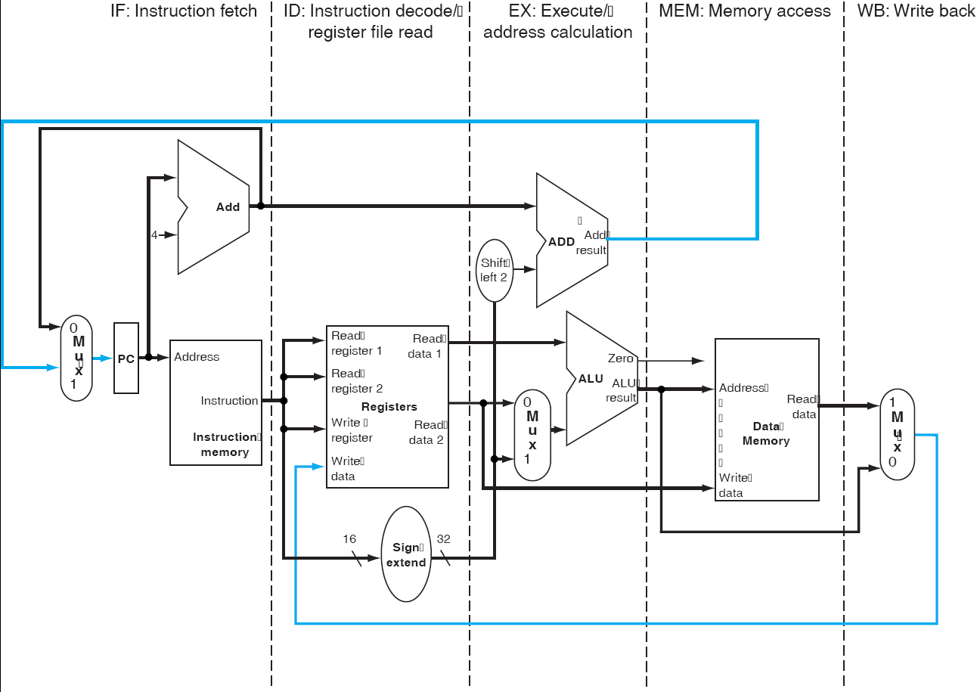
Review - Single-Cycle Processor
What do we need to add to actually split the datapath into stages?

Slide 34
The Basic Pipeline For MIPS
Cycle 1
Cycle 2
Cycle 3
Cycle 4
Cycle 5
Cycle 6
Cycle 7
I
n
s
t
r.
O
r
d
e
r
Ifetch
Reg
ALU
DMem
Reg
Ifetch
Reg
ALU
DMem
Reg
Ifetch
Reg
ALU
DMem
Reg
Ifetch
Reg
ALU
DMem
Reg
What do we need to add to actually split the datapath into stages?

Slide 35
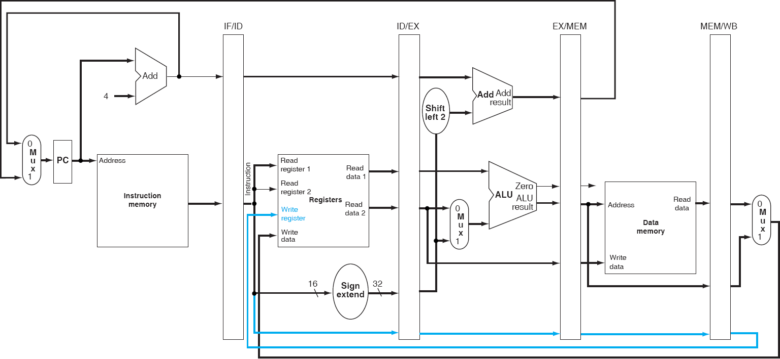
Basic Pipelined Processor

Slide 36
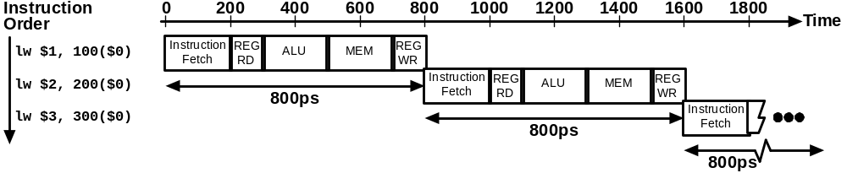
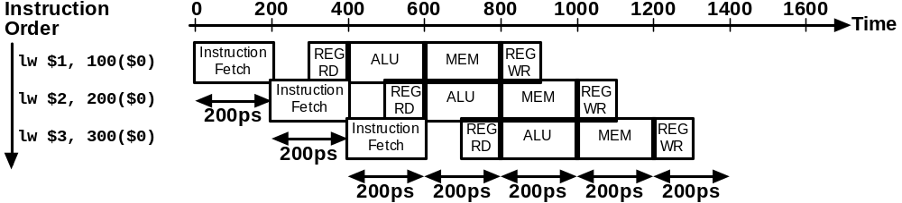
Single-Cycle vs. Pipelined Execution
Non-Pipelined
Pipelined

Slide 37
Speedup
Consider the unpipelined processor introduced previously. Assume that it has a 1 ns clock cycle and it uses 4 cycles for ALU operations and branches, and 5 cycles for memory operations, assume that the relative frequencies of these operations are 40%, 20%, and 40%, respectively. Suppose that due to clock skew and setup, pipelining the processor adds 0.2ns of overhead to the clock. Ignoring any latency impact, how much speedup in the instruction execution rate will we gain from a pipeline?
Average instruction execution time
= 1 ns * ((40% + 20%)*4 + 40%*5)
= 4.4ns
Speedup from pipeline
= Average instruction time unpiplined/Average instruction time pipelined
= 4.4ns/1.2ns = 3.7

Slide 38
Comments about Pipelining
The good news
  Multiple instructions are being processed at same time
  This works because stages are isolated by registers
  Best case speedup of N
The bad news
  Instructions interfere with each other - hazards
    Example: different instructions may need the same piece of hardware (e.g., memory) in same clock cycle
    Example: instruction may require a result produced by an earlier instruction that is not yet complete

Slide 39
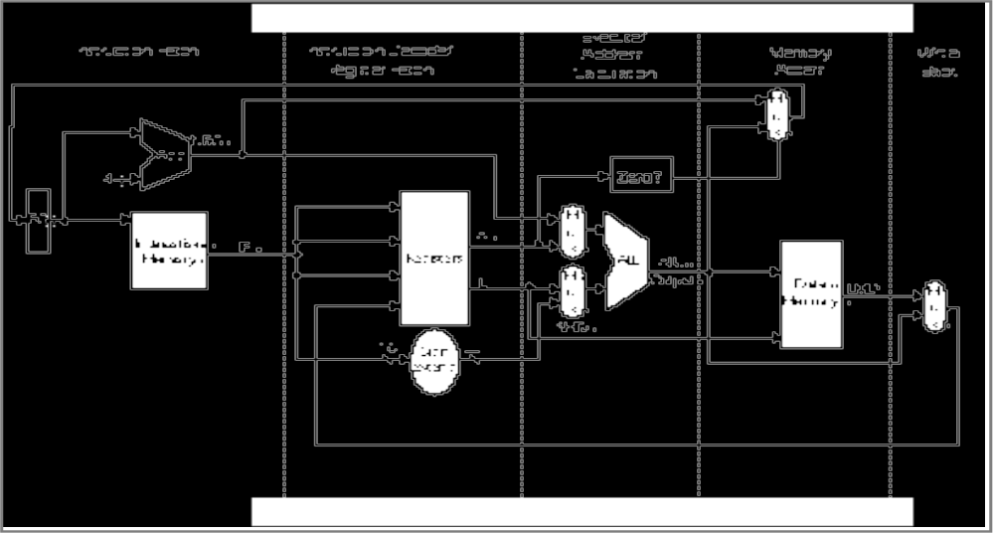
MIPS Functions
What Is Pipelining
Instruction
Fetch
Instr. Decode
Reg. Fetch
Execute
Addr. Calc
Memory
Access
Write
Back
Passed To Next Stage
IR <- Mem[PC]
NPC <- PC + 4
IR
L
M
D
Instruction Fetch (IF):
Send out the PC and fetch the instruction from memory into the instruction register (IR); increment the PC by 4 to address the next sequential instruction.
IR holds the instruction that will be used in the next stage.
NPC holds the value of the next PC.
Appendix A - Pipelining

Slide 40
MIPS Functions
What Is Pipelining
Instruction
Fetch
Instr. Decode
Reg. Fetch
Execute
Addr. Calc
Memory
Access
Write
Back
Passed To Next Stage
A <- Regs[IR6..IR10];
B <- Regs[IR10..IR15];
Imm <- ((IR16) ##IR16-31
IR
L
M
D
Instruction Decode/Register Fetch Cycle (ID):
Decode the instruction and access the register file to read the registers.
The outputs of the general purpose registers are read into two temporary registers (A & B) for use in later clock cycles.
We extend the sign of the lower 16 bits of the Instruction Register.
Appendix A - Pipelining

Slide 41
MIPS Functions
What Is Pipelining
Instruction
Fetch
Instr. Decode
Reg. Fetch
Execute
Addr. Calc
Memory
Access
Write
Back
Passed To Next Stage
A <- A func. B
cond = 0;
IR
L
M
D
Execute Address Calculation (EX):
We perform an operation (for an ALU) or an address calculation (if it’s a load or a Branch).
If an ALU, actually do the operation. If an address calculation, figure out how to obtain the address and stash away the location of that address for the next cycle.
Appendix A - Pipelining

Slide 42
MIPS Functions
What Is Pipelining
Instruction
Fetch
Instr. Decode
Reg. Fetch
Execute
Addr. Calc
Memory
Access
Write
Back
Passed To Next Stage
A = Mem[prev. B]
or
Mem[prev. B] = A
IR
L
M
D
MEMORY ACCESS (MEM):
If this is an ALU, do nothing.
If a load or store, then access memory.
Appendix A - Pipelining

Slide 43
MIPS Functions
What Is Pipelining
Instruction
Fetch
Instr. Decode
Reg. Fetch
Execute
Addr. Calc
Memory
Access
Write
Back
Passed To Next Stage
Regs <- A, B;
IR
L
M
D
WRITE BACK (WB):
Update the registers from either the ALU or from the data loaded.
Appendix A - Pipelining

Slide 44
Pipeline Hazards
Limits to pipelining: Hazards prevent next instruction from executing during its designated clock cycle
  Structural hazards: two different instructions use same h/w in same cycle
  Data hazards: Instruction depends on result of prior instruction still in the pipeline
  Control hazards: Pipelining of branches & other instructions that change the PC

Slide 45
Summary - Pipelining Overview
Pipelining increase throughput (but not latency)
Hazards limit performance
  Structural hazards
  Control hazards
  Data hazards

Slide 46
Pipeline Hurdles
Definition
conditions that lead to incorrect behavior if not fixed
Structural hazard
  two different instructions use same h/w in same cycle
Data hazard
  two different instructions use same storage
  must appear as if the instructions execute in correct order
Control hazard
  one instruction affects which instruction is next
Resolution
Pipeline interlock logic detects hazards and fixes them
simple solution: stall ­
increases CPI, decreases performance
better solution: partial stall ­
some instruction stall, others proceed better to stall early than late
Appendix A - Pipelining

Slide 47
Structural Hazards
When two or more different instructions want to use same hardware resource in same cycle
e.g., MEM uses the same memory port as IF as shown in this slide.
Time (clock cycles)
Cycle 1
Cycle 2
Cycle 3
Cycle 4
Cycle 5
Cycle 6
Cycle 7
I
n
s
t
r.
O
r
d
e
r
Load
Ifetch
Reg
ALU
DMem
Reg
Instr 1
Ifetch
Reg
ALU
DMem
Reg
Instr 2
Ifetch
Reg
ALU
DMem
Reg
Instr 3
Ifetch
Reg
ALU
DMem
Reg
Instr 4
Ifetch
Reg
ALU
DMem
Reg
Figure 3.6
Appendix A - Pipelining

Slide 48
Structural Hazards
Time (clock cycles)
Cycle 1
Cycle 2
Cycle 3
Cycle 4
Cycle 5
Cycle 6
Cycle 7
This is another way of looking at the effect of a stall.
I
n
s
t
r.
O
r
d
e
r
Load
Ifetch
Reg
ALU
DMem
Reg
Instr 1
Ifetch
Reg
ALU
DMem
Reg
Instr 2
Ifetch
Reg
ALU
DMem
Reg
Stall
Bubble
Bubble
Bubble
Bubble
Bubble
Instr 3
Ifetch
Reg
ALU
DMem
Reg
Figure 3.7
Appendix A - Pipelining

Slide 49
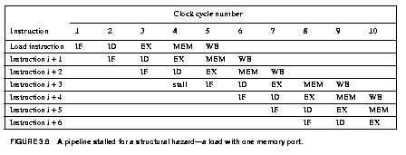
Structural Hazards
This is another way to represent the stall we saw on the last few pages.
Appendix A - Pipelining

Slide 50
Structural Hazards
Dealing with Structural Hazards
Stall
low cost, simple
Increases CPI
use for rare case since stalling has performance effect
Pipeline hardware resource
useful for multi-cycle resources
good performance
sometimes complex e.g., RAM
Replicate resource
good performance
increases cost (+ maybe interconnect delay)
useful for cheap or divisible resources
Appendix A - Pipelining

Slide 51
Structural Hazards
Structural hazards are reduced with these rules:
Each instruction uses a resource at most once
Always use the resource in the same pipeline stage
Use the resource for one cycle only
Many RISC ISA’a designed with this in mind
Sometimes very complex to do this. For example, memory of necessity is used in the IF and MEM stages.
Some common Structural Hazards:
Memory - we’ve already mentioned this one.
Floating point - Since many floating point instructions require many cycles, it’s easy for them to interfere with each other.
Starting up more of one type of instruction than there are resources. For instance, the PA-8600 can support two ALU + two load/store instructions per cycle - that’s how much hardware it has available.
Appendix A - Pipelining

Slide 52
Structural Hazards
This is the example on Page 144.
We want to compare the performance of two machines. Which machine is faster?
Machine A: Dual ported memory - so there are no memory stalls
Machine B: Single ported memory, but its pipelined implementation has a 1.05 times faster clock rate
Assume:
Ideal CPI = 1 for both
Loads are 40% of instructions executed
SpeedUp_{A} = Pipeline Depth/(1 + 0) x (clock_{unpipe}/clock_{pipe})
= Pipeline Depth
SpeedUp_{B} = Pipeline Depth/(1 + 0.4 x 1)
x (clock_{unpipe}/(clock_{unpipe} / 1.05)
= (Pipeline Depth/1.4) x 1.05
= 0.75 x Pipeline Depth
SpeedUp_{A} / SpeedUp_{B} = Pipeline Depth / (0.75 x Pipeline Depth) = 1.33
Machine A is 1.33 times faster
Appendix A - Pipelining

Slide 53
Data Hazards
A.1 What is Pipelining?
A.2 The Major Hurdle of Pipelining-Structural Hazards
-- Structural Hazards
  Data Hazards
  Control Hazards
A.3 How is Pipelining Implemented
A.4 What Makes Pipelining Hard to Implement?
A.5 Extending the MIPS Pipeline to Handle Multi-cycle Operations
These occur when at any time, there are instructions active that need to access the same data (memory or register) locations.
Where there’s real trouble is when we have:
instruction A
instruction B
and B manipulates (reads or writes) data before A does. This violates the order of the instructions, since the architecture implies that A completes entirely before B is executed.
Appendix A - Pipelining

Slide 54
Data Hazards
Execution Order is:
Instr_{I}
Instr_{J}
Read After Write (RAW)
Instr_{J} tries to read operand before Instr_{I} writes it
Caused by a “Dependence” (in compiler nomenclature). This hazard results from an actual need for communication.
I: add r1,r2,r3
J: sub r4,r1,r3
Appendix A - Pipelining

Slide 55
Data Hazards
Execution Order is:
Instr_{I}
Instr_{J}
Write After Read (WAR)
Instr_{J} tries to write operand before Instr_{I} reads i
  Gets wrong operand
  Called an “anti-dependence” by compiler writers.
  This results from reuse of the name “r1”.
Can’t happen in MIPS 5 stage pipeline because:
  All instructions take 5 stages, and
  Reads are always in stage 2, and
  Writes are always in stage 5
I: sub r4,r1,r3
J: add r1,r2,r3
K: mul r6,r1,r7
Appendix A - Pipelining

Slide 56
Data Hazards
Execution Order is:
Instr_{I}
Instr_{J}
Write After Write (WAW)
Instr_{J} tries to write operand before Instr_{I} writes it
  Leaves wrong result ( Instr_{I} not Instr_{J} )
Called an “output dependence” by compiler writers
This also results from the reuse of name “r1”.
Can’t happen in MIPS 5 stage pipeline because:
  All instructions take 5 stages, and
  Writes are always in stage 5
Will see WAR and WAW in later more complicated pipes
I: sub r1,r4,r3
J: add r1,r2,r3
K: mul r6,r1,r7
Appendix A - Pipelining

Slide 57
Data Hazards
Simple Solution to RAW
Hardware detects RAW and stalls
Assumes register written then read each cycle
  + low cost to implement, simple
  -- reduces IPC
Try to minimize stalls
Minimizing RAW stalls
Bypass/forward/short­circuit (We will use the word “forward”)
Use data before it is in the register
  + reduces/avoids stalls
  -- complex
Crucial for common RAW hazards
Appendix A - Pipelining

Slide 58
Data Hazards
Time (clock cycles)
IF
ID/RF
EX
MEM
WB
I
n
s
t
r.
O
r
d
e
r
add r1,r2,r3
Ifetch
Reg
ALU
DMem
Reg
sub r4,r1,r3
Ifetch
Reg
ALU
DMem
Reg
and r6,r1,r7
Ifetch
Reg
ALU
DMem
Reg
or r8,r1,r9
Ifetch
Reg
ALU
DMem
Reg
xor r10,r1,r11
Ifetch
Reg
ALU
DMem
Reg
The use of the result of the ADD instruction in the next three instructions causes a hazard, since the register is not written until after those instructions read it.
Figure 3.9
Appendix A - Pipelining

Slide 59
Data Hazards
Forwarding is the concept of making data available to the input of the ALU for subsequent instructions, even though the generating instruction hasn’t gotten to WB in order to write the memory or registers.
Forwarding To Avoid
Data Hazard
Time (clock cycles)
I
n
s
t
r.
O
r
d
e
r
add r1,r2,r3
Ifetch
Reg
ALU
DMem
Reg
sub r4,r1,r3
Ifetch
Reg
ALU
DMem
Reg
and r6,r1,r7
Ifetch
Reg
ALU
DMem
Reg
or r8,r1,r9
Ifetch
Reg
ALU
DMem
Reg
xor r10,r1,r11
Ifetch
Reg
ALU
DMem
Reg
Figure 3.10
Appendix A - Pipelining

Slide 60
Data Hazards
The data isn’t loaded until after the MEM stage.
Time (clock cycles)
I
n
s
t
r.
O
r
d
e
r
lw r1, 0(r2)
Ifetch
Reg
ALU
DMem
Reg
sub r4,r1,r6
Ifetch
Reg
ALU
DMem
Reg
and r6,r1,r7
Ifetch
Reg
ALU
DMem
Reg
or r8,r1,r9
Ifetch
Reg
ALU
DMem
Reg
There are some instances where hazards occur, even with forwarding.
Figure 3.12
Appendix A - Pipelining

Slide 61
Data Hazards
The stall is necessary as shown here.
Time (clock cycles)
I
n
s
t
r.
O
r
d
e
r
lw r1, 0(r2)
Ifetch
Reg
ALU
DMem
Reg
Bubble
sub r4,r1,r6
Ifetch
Reg
ALU
DMem
Reg
Bubble
and r6,r1,r7
Ifetch
Reg
ALU
DMem
Reg
Bubble
or r8,r1,r9
Ifetch
Reg
ALU
DMem
There are some instances where hazards occur, even with forwarding.
Figure 3.13
Appendix A - Pipelining

Slide 62
Data Hazards
This is another representation of the stall.
LW R1, 0(R2) | IF | ID | EX | MEM | WB
SUB R4, R1, R5 |  | IF | ID | EX | MEM | WB
AND R6, R1, R7 |  |  | IF | ID | EX | MEM | WB
OR R8, R1, R9 |  |  |  | IF | ID | EX | MEM | WB
LW R1, 0(R2) | IF | ID | EX | MEM | WB
SUB R4, R1, R5 |  | IF | ID | stall | EX | MEM | WB
AND R6, R1, R7 |  |  | IF | stall | ID | EX | MEM | WB
OR R8, R1, R9 |  |  |  | stall | IF | ID | EX | MEM | WB
Appendix A - Pipelining

Slide 63
Data Hazards
Pipeline Scheduling
Instruction scheduled by compiler - move instruction in order to reduce stall.
  lw Rb, b ­­ code sequence for a = b+c before scheduling
  lw Rc, c
  Add Ra, Rb, Rc ­­ stall
  sw a, Ra
  lw Re, e ­­ code sequence for d = e+f before scheduling
  lw Rf, f
  sub Rd, Re, Rf ­­ stall
  sw d, Rd
Arrangement of code after scheduling.
  lw Rb, b
  lw Rc, c
  lw Re, e
  Add Ra, Rb, Rc
  lw Rf, f
  sw a, Ra
  sub Rd, Re, Rf
  sw d, Rd
Appendix A - Pipelining

Slide 64
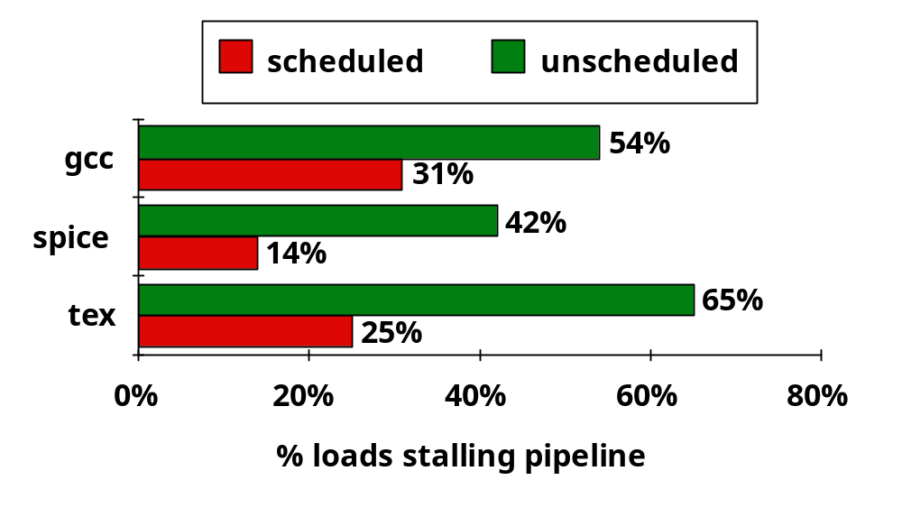
Data Hazards
Pipeline Scheduling
Appendix A - Pipelining

Slide 65
Control Hazards
A.1 What is Pipelining?
A.2 The Major Hurdle of Pipelining-Structural Hazards
-- Structural Hazards
  Data Hazards
  Control Hazards
A.3 How is Pipelining Implemented
A.4 What Makes Pipelining Hard to Implement?
A.5 Extending the MIPS Pipeline to Handle Multi-cycle Operations
A control hazard is when we need to find the destination of a branch, and can’t fetch any new instructions until we know that destination.
Appendix A - Pipelining

Slide 66
Control Hazard on Branches
Three Stage Stall
Control Hazards
10: beq r1,r3,36
Ifetch
Reg
ALU
DMem
Reg
14: and r2,r3,r5
Ifetch
Reg
ALU
DMem
Reg
18: or r6,r1,r7
Ifetch
Reg
ALU
DMem
Reg
22: add r8,r1,r9
Ifetch
Reg
ALU
DMem
Reg
36: xor r10,r1,r11
Ifetch
Reg
ALU
DMem
Reg
Appendix A - Pipelining

Slide 67
Branch Stall Impact
Control Hazards
If CPI = 1, 30% branch, Stall 3 cycles => new CPI = 1.9!
    (Whoa! How did we get that 1.9???)
Two part solution to this dramatic increase:
  Determine branch taken or not sooner, AND
  Compute taken branch address earlier
MIPS branch tests if register = 0 or ^ 0
MIPS Solution:
  Move Zero test to ID/RF stage
  Adder to calculate new PC in ID/RF stage
    must be fast
    can't afford to subtract
    compares with 0 are simple
    Greater-than, Less-than test sign­bit, but not-equal must OR all bits
    more general compares need ALU
  1 clock cycle penalty for branch versus 3
In the next chapter, we’ll look at ways to avoid the branch all together.
Appendix A - Pipelining

Slide 68
Five Branch Hazard Alternatives
Control Hazards
#1: Stall until branch direction is clear
#2: Predict Branch Not Taken
  Execute successor instructions in sequence
  “Squash” instructions in pipeline if branch actually taken
  Advantage of late pipeline state update
  47% MIPS branches not taken on average
  PC+4 already calculated, so use it to get next instruction
#3: Predict Branch Taken
  53% MIPS branches taken on average
  But haven’t calculated branch target address in MIPS
    MIPS still incurs 1 cycle branch penalty
    Other machines: branch target known before outcome
Appendix A - Pipelining

Slide 69
Control Hazards
Five Branch Hazard Alternatives
#4: Execute Both Paths
#5: Delayed Branch
  Define branch to take place AFTER a following instruction
  branch instruction
  sequential successor₁
  sequential successor₂
  ........
  sequential successor_{n}
  branch target if taken
  1 slot delay allows proper decision and branch target address in 5 stage pipeline
  MIPS uses this
Branch delay of length n
Appendix A - Pipelining

Slide 70
Delayed Branch
Control Hazards
Where to get instructions to fill branch delay slot?
  Before branch instruction
  From the target address: only valuable when branch taken
  From fall through: only valuable when branch not taken
  Cancelling branches allow more slots to be filled
Compiler effectiveness for single branch delay slot:
  Fills about 60% of branch delay slots
  About 80% of instructions executed in branch delay slots useful in computation
  About 50% (60% x 80%) of slots usefully filled
Delayed Branch downside: 7-8 stage pipelines, multiple instructions issued per clock (superscalar)
Appendix A - Pipelining

Slide 71
Evaluating Branch Alternatives
Control Hazards
Scheduling Branch CPI speedup v. Speedup v.
scheme penalty unpipelined stall
Stall pipeline 3 1.42 3.5 1.0
Predict taken 1 1.14 4.4 1.26
Predict not taken 1 1.09 4.5 1.29
Delayed branch 0.5 1.07 4.6 1.31
Conditional & Unconditional = 14%, 65% change PC
Appendix A - Pipelining

Slide 72
Pipelining Introduction Summary
Control Hazards
Just overlap tasks, and easy if tasks are independent
Speed Up Š Pipeline Depth; if ideal CPI is 1, then:
Hazards limit performance on computers:
  Structural: need more HW resources
  Data (RAW,WAR,WAW): need forwarding, compiler scheduling
  Control: delayed branch, prediction
Pipeline Depth
Clock Cycle Unpipelined
Speedup =
X
1 + Pipeline stall CPI
Clock Cycle Pipelined
Appendix A - Pipelining

Slide 73
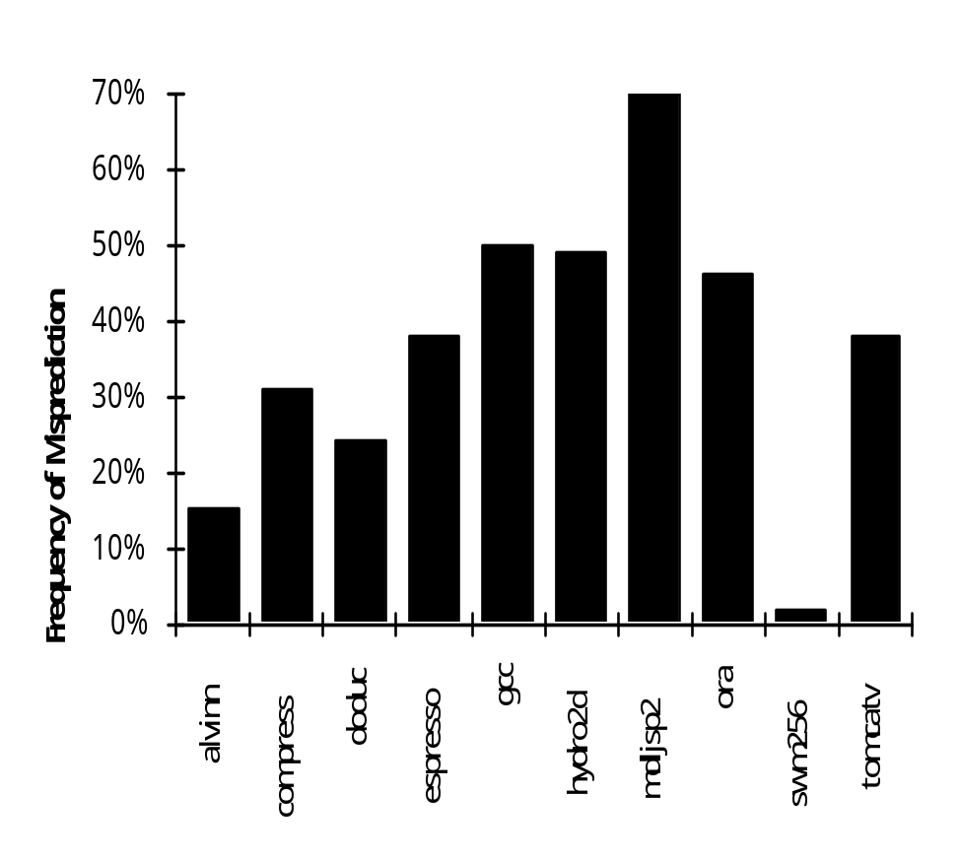
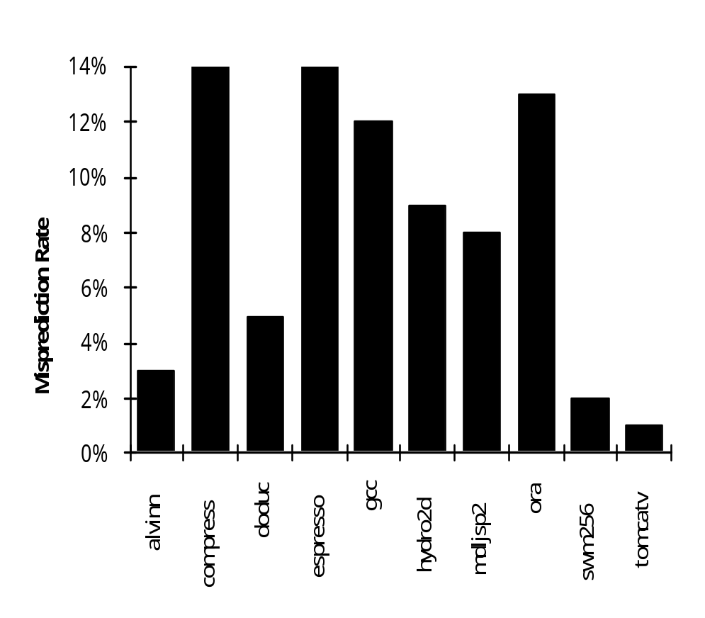
Compiler “Static” Prediction of
Taken/Untaken Branches
Control Hazards
The compiler can program what it thinks the branch direction will be. Here are the results when it does so.
Always taken
Taken backwards
Not Taken Forwards
Appendix A - Pipelining

Slide 74
Compiler “Static” Prediction of
Taken/Untaken Branches
Control Hazards
Improves strategy for placing instructions in delay slot
Two strategies
  Backward branch predict taken, forward branch not taken
  Profile-based prediction: record branch behavior, predict branch based on prior run
Appendix A - Pipelining

Slide 75
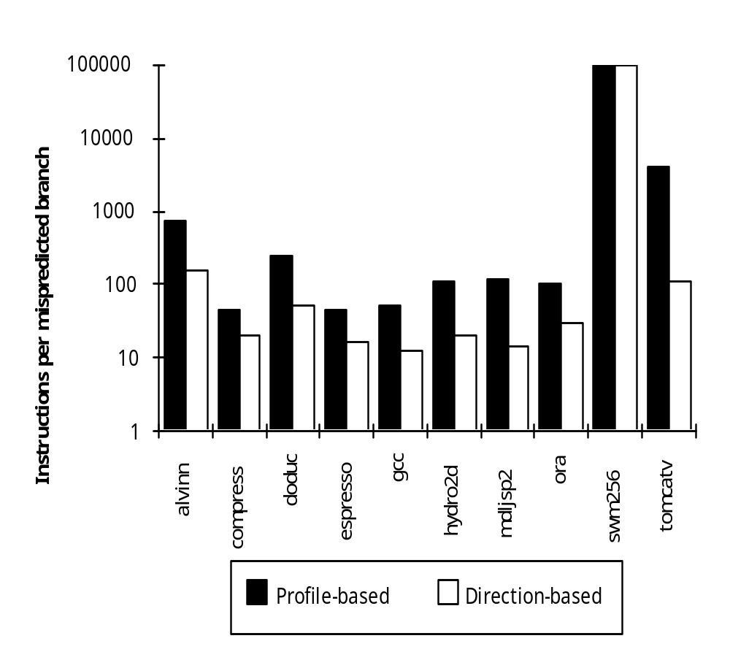
Evaluating Static Branch Prediction Strategies
Control Hazards
Misprediction ignores frequency of branch
“Instructions between mispredicted branches” is a better metric
Appendix A - Pipelining

Slide 76








An example execution sequence
Here’s a sample sequence of instructions to execute.
1000: lw $8, 4($29)
1004: sub $2, $4, $5
1008: and $9, $10, $11
1012: or $16, $17, $18
1016: add $13, $14, $0
We’ll make some assumptions, just so we can show actual data values.
  Each register contains its number plus 100. For instance, register $8 contains 108, register $29 contains 129, and so forth.
  Every data memory location contains 99.
Our pipeline diagrams will follow some conventions.
  An X indicates values that aren’t important, like the constant field of an R-type instruction.
  Question marks ??? indicate values we don’t know, usually resulting from instructions coming before and after the ones in our example.
addresses in decimal

Slide 77


Cycle 1 (filling)
IF: lw $8, 4($29)
ID: ???
EX: ???
MEM: ???
WB: ???
1
0
ID/EX
WB
EX/MEM
PCSrc
Control
M
WB
MEM/WB
4
IF/ID
EX
M
WB
Add
P
C
1004
Add
RegWrite (?)
Shift
left 2
1000
???
Read
register 1
Read
data 1
???
???
ALU
MemWrite (?)
Read
address
Instruction
[31-0]
???
Read
register 2
Read
data 2
???
???
Zero
???
0
1
Result
Address
???
Write
register
???
MemToReg
(?)
Instruction
memory
Data
memory
???
Write
data
Registers
ALUOp (???)
ALUSrc (?)
???
Write
data
Read
data
???
1
0
???
Sign
extend
???
RegDst (?)
MemRead (?)
???
???
???
0
1
???
???
???
???
???
???

Slide 78




Cycle 2
IF: sub $2, $4, $5
ID: lw $8, 4($29)
EX: ???
MEM: ???
WB: ???
1
0
ID/EX
WB
EX/MEM
PCSrc
Control
M
WB
MEM/WB
4
IF/ID
EX
M
WB
Add
P
C
1008
Add
RegWrite (?)
Shift
left 2
1004
29
Read
register 1
Read
data 1
129
???
ALU
MemWrite (?)
Read
address
Instruction
[31-0]
X
Read
register 2
Read
data 2
X
???
Zero
???
0
1
Result
Address
???
Write
register
???
Data
memory
MemToReg
(?)
Instruction
memory
???
Write
data
Registers
ALUOp (???)
???
ALUSrc (?)
???
Write
data
Read
data
1
0
4
Sign
extend
???
RegDst (?)
???
MemRead (?)
8
???
0
1
???
???
???
X
???
???

Slide 79












Cycle 3
IF: and $9, $10, $11
ID: sub $2, $4, $5
EX: lw $8, 4($29)
MEM: ???
WB: ???
1
0
ID/EX
WB
EX/MEM
PCSrc
Control
M
WB
MEM/WB
4
IF/ID
EX
M
WB
Add
P
C
1012
Add
RegWrite (?)
Shift
left 2
1008
4
Read
register 1
Read
data 1
104
129
ALU
MemWrite (?)
Read
address
Instruction
[31-0]
5
Read
register 2
Read
data 2
105
X
Zero
???
0
1
Result
Address
4
133
???
Write
register
Data
memory
MemToReg
(?)
Instruction
memory
???
Write
data
Registers
ALUOp (add)
ALUSrc (1)
???
Write
data
Read
data
???
1
0
X
Sign
extend
4
RegDst (0)
MemRead (?)
???
X
8
0
1
8
???
???
2
X
???

Slide 80


















Cycle 4
IF: or $16, $17, $18
ID: and $9, $10, $11
EX: sub $2, $4, $5
MEM: lw $8, 4($29)
WB: ???
1
0
ID/EX
WB
EX/MEM
PCSrc
Control
M
WB
MEM/WB
4
IF/ID
EX
M
WB
Add
P
C
1016
Add
RegWrite (?)
Shift
left 2
1012
10
Read
register 1
Read
data 1
110
104
ALU
MemWrite (0)
Read
address
Instruction
[31-0]
11
Read
register 2
Read
data 2
111
105
Zero
133
0
1
Result
Address
???
Write
register
–1
MemToReg
(?)
Instruction
memory
Data
memory
???
Write
data
Registers
ALUOp (sub)
ALUSrc (0)
X
Write
data
Read
data
99
???
1
0
X
Sign
extend
X
RegDst (1)
???
MemRead (1)
X
X
0
1
2
8
???
9
2
???

Slide 81













Cycle 5 (full)
IF: add $13, $14, $0
ID: or $16, $17, $18
EX: and $9, $10, $11
MEM: sub $2, $4, $5
WB:
lw $8, 4($29)
1
0
ID/EX
WB
EX/MEM
PCSrc
Control
M
WB
MEM/WB
4
IF/ID
EX
M
WB
Add
P
C
1020
Add
RegWrite (1)
Shift
left 2
1016
17
Read
register 1
Read
data 1
117
110
ALU
MemWrite (0)
Read
address
Instruction
[31-0]
18
Read
register 2
Read
data 2
118
111
Zero
-1
0
1
Result
Address
8
Write
register
110
Data
memory
MemToReg
(1)
Instruction
memory
99
Write
data
Registers
ALUOp (and)
ALUSrc (0)
105
Write
data
Read
data
X
99
1
0
X
Sign
extend
X
RegDst (1)
133
MemRead (0)
X
X
0
1
9
2
8
16
9
99

Slide 82

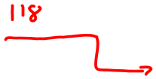


Cycle 6 (emptying)
IF: ???
ID: add $13, $14, $0
EX: or $16, $17, $18
MEM: and $9, $10, $11
WB: sub
$2, $4, $5
1
0
ID/EX
WB
EX/MEM
PCSrc
Control
M
WB
MEM/WB
4
IF/ID
EX
M
WB
Add
???
P
C
Add
RegWrite (1)
Shift
left 2
1020
14
Read
register 1
Read
data 1
114
117
ALU
MemWrite (0)
Read
address
Instruction
[31-0]
0
Read
register 2
Read
data 2
0
118
Zero
110
0
1
Result
Address
2
Write
register
119
Data
memory
MemToReg
(0)
Instruction
memory
-1
Write
data
Registers
ALUOp (or)
ALUSrc (0)
111
Write
data
Read
data
X
1
0
X
Sign
extend
X
RegDst (1)
MemRead (0)
X
X
0
1
16
9
13
16

Slide 83


Cycle 7
IF: ???
ID: ???
EX: add $13, $14, $0
MEM: or $16, $17, $18
WB: and
$9, $10, $11
1
0
ID/EX
WB
EX/MEM
PCSrc
Control
M
WB
MEM/WB
4
IF/ID
EX
M
WB
Add
P
C
???
Add
RegWrite (1)
Shift
left 2
???
???
Read
register 1
Read
data 1
???
114
ALU
MemWrite (0)
Read
address
Instruction
[31-0]
???
Read
register 2
Read
data 2
???
0
Zero
119
0
1
Result
Address
9
Write
register
114
Data
memory
MemToReg
(0)
Instruction
memory
110
Write
data
Registers
ALUOp (add)
ALUSrc (0)
118
Write
data
Read
data
X
X
1
0
???
Sign
extend
X
RegDst (1)
MemRead (0)
110
???
X
0
1
13
16
9
???
13
110

Slide 84

Cycle 8
IF: ???
ID: ???
EX: ???
MEM: add $13, $14, $0
WB: or $16,
$17, $18
1
0
ID/EX
WB
EX/MEM
PCSrc
Control
M
WB
MEM/WB
4
IF/ID
EX
M
WB
Add
P
C
???
Add
RegWrite (1)
Shift
left 2
???
???
Read
register 1
Read
data 1
???
???
ALU
MemWrite (0)
Read
address
Instruction
[31-0]
???
Read
register 2
Read
data 2
???
???
Zero
114
0
1
Result
Address
16
Write
register
???
Data
memory
MemToReg
(0)
Instruction
memory
119
Write
data
Registers
ALUOp (???)
ALUSrc (?)
0
Write
data
Read
data
X
X
1
0
???
Sign
extend
???
RegDst (?)
MemRead (0)
119
???
???
0
1
???
13
16
???
???
119

Slide 85
Cycle 9
IF: ???
ID: ???
EX: ???
MEM: ???
WB: add
$13, $14, $0
1
0
ID/EX
WB
EX/MEM
PCSrc
Control
M
WB
MEM/WB
4
IF/ID
EX
M
WB
Add
P
C
???
Add
RegWrite (1)
Shift
left 2
???
???
Read
register 1
Read
data 1
???
???
ALU
MemWrite (?)
Read
address
Instruction
[31-0]
???
Read
register 2
Read
data 2
???
???
Zero
???
0
1
Result
Address
13
Write
register
???
Data
memory
MemToReg
(0)
Instruction
memory
114
Write
data
Registers
ALUOp (???)
ALUSrc (?)
?
Write
data
Read
data
X
X
1
0
???
Sign
extend
???
RegDst (?)
114
MemRead (?)
???
???
0
1
???
???
13
???
???
114

Slide 86

That’s a lot of diagrams there
Compare the last nine slides with the pipeline diagram above.
  You can see how instruction executions are overlapped.
  Each functional unit is used by a different instruction in each cycle.
  The pipeline registers save control and data values generated in previous clock cycles for later use.
  When the pipeline is full in clock cycle 5, all of the hardware units are utilized. This is the ideal situation, and what makes pipelined processors so fast.
Try to understand this example or the similar one in the book at the end of Section 6.3.
 | Clock cycle
 | 1 | 2 | 3 | 4 | 5 | 6 | 7 | 8 | 9
lw $t0, 4($sp) | IF | ID | EX | MEM | WB
sub $v0, $a0, $a1 |  | IF | ID | EX | MEM | WB
and $t1, $t2, $t3 |  |  | IF | ID | EX | MEM | WB
or $s0, $s1, $s2 |  |  |  | IF | ID | EX | MEM | WB
add $t5, $t6, $0 |  |  |  |  | IF | ID | EX | MEM | WB

Slide 87





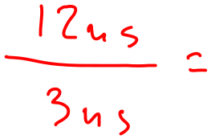

Performance Revisited
Assuming the following functional unit latencies:
What is the cycle time of a single-cycle implementation?
  What is its throughput?
What is the cycle time of a ideal pipelined implementation?
  What is its steady-state throughput?
How much faster is pipelining?
3ns
2ns
2ns
3ns
2ns
Inst
mem
Reg
Read
ALU
Data
Mem
Reg
Write

