Slide 1
MEMORY ORGANIZATION

Slide 2
Topics for discussion
Memory organization
Memory hierarchy
Types of memory
Memory management hardware

Slide 3
MEMORY ORGANIZATION
Memory hierarchy
Main memory
Auxiliary memory
Associative memory
Cache memory
  Storage technologies and trends
  Locality of reference
  Caching in the memory hierarchy
Virtual memory
Memory management hardware.

Slide 4
RANDOM-ACCESS MEMORY (RAM)
Key features
  RAM is packaged as a chip.
  Basic storage unit is a cell (one bit per cell).
  Multiple RAM chips form a memory.
Static RAM (SRAM)
  Each cell stores bit with a six-transistor circuit.
  Retains value indefinitely, as long as it is kept powered.
    Relatively insensitive to disturbances such as electrical noise.
  Faster and more expensive than DRAM.

Slide 5
Cont…
Dynamic RAM (DRAM)
  Each cell stores bit with a capacitor and transistor.
  Value must be refreshed every 10-100 ms.
  Sensitive to disturbances.
  Slower and cheaper than SRAM.

Slide 6
SRAM VS DRAM SUMMARY
Tran. Access
per bit time Persist? Sensitive? Cost Applications
SRAM 6 1X Yes No 100x cache memories
DRAM 1 10X No Yes 1X Main memories,
frame buffers

Slide 7
CONVENTIONAL DRAM ORGANIZATION
d x w DRAM:
  dw total bits organized as d supercells of size w bits
16 x 8 DRAM chip
cols
memory
controller
0
1
2
3
2 bits
/
0
addr
1
rows
2
supercell
(2,1)
(to CPU)
3
8 bits
/
data
internal row buffer

Slide 8
READING DRAM SUPERCELL (2,1)
Step 1(a): Row access strobe (RAS) selects row 2.
Step 1(b): Row 2 copied from DRAM array to row buffer.
16 x 8 DRAM chip
cols
memory
controller
RAS = 2
0
1
2
3
2
/
0
addr
1
rows
2
8
/
3
data
internal row buffer

Slide 9
READING DRAM SUPERCELL (2,1)
Step 2(a): Column access strobe (CAS) selects column 1.
Step 2(b): Supercell (2,1) copied from buffer to data lines, and eventually back to the CPU.
16 x 8 DRAM chip
cols
memory
controller
CAS = 1
0
1
2
3
2
/
0
To CPU
addr
1
rows
2
supercell
(2,1)
3
8
/
data
supercell
(2,1)
internal row buffer
internal buffer

Slide 10
MEMORY MODULES
addr (row = i, col = j)
: supercell (i,j)
DRAM 0
64 MB
memory module
consisting of
eight 8Mx8 DRAMs
DRAM 7
bits
56-63
bits
48-55
bits
40-47
bits
32-39
bits
24-31
bits
16-23
bits
8-15
bits
0-7
63
63
56
56
55
55
48
48
47
47
40
40
39
39
32
32
31
31
24
24
23
23
16
16
15
15
8
8
7
7
0
0
Memory
controller
64-bit doubleword at main memory address A
64-bit doubleword at main memory address A
64-bit doubleword

Slide 11
ENHANCED DRAMS
All enhanced DRAMs are built around the conventional DRAM core.
  Fast page mode DRAM (FPM DRAM)
    Access contents of row with [RAS, CAS, CAS, CAS, CAS] instead of [(RAS,CAS), (RAS,CAS), (RAS,CAS), (RAS,CAS)].
  Extended data out DRAM (EDO DRAM)
    Enhanced FPM DRAM with more closely spaced CAS signals.
  Synchronous DRAM (SDRAM)
    Driven with rising clock edge instead of asynchronous control signals.

Slide 12
Cont…
  Double data-rate synchronous DRAM (DDR SDRAM)
    Enhancement of SDRAM that uses both clock edges as control signals.
  Video RAM (VRAM)
    Like FPM DRAM, but output is produced by shifting row buffer
    Dual ported (allows concurrent reads and writes)

Slide 13
NONVOLATILE MEMORIES
DRAM and SRAM are volatile memories
  Lose information if powered off.
Nonvolatile memories retain value even if powered off.
  Generic name is read-only memory (ROM).
  Misleading because some ROMs can be read and modified.
Types of ROMs
  Programmable ROM (PROM)
  Eraseable programmable ROM (EPROM)
  Electrically eraseable PROM (EEPROM)
  Flash memory

Slide 14
Cont…
Firmware
  Program stored in a ROM
    Boot time code, BIOS (basic input/output system)
    graphics cards, disk controllers.

Slide 15
TYPICAL BUS STRUCTURE CONNECTING
CPU AND MEMORY
A bus is a collection of parallel wires that carry address, data, and control signals.
Buses are typically shared by multiple devices.
CPU chip
register file
ALU
system bus
memory bus
main
memory
bus interface
I/O
bridge

Slide 16
MEMORY READ TRANSACTION (1)
CPU places address A on the memory bus.
register file
Load operation: movl A, %eax
ALU
%eax
main memory
I/O bridge
A
0
bus interface
x
A

Slide 17
MEMORY READ TRANSACTION (2)
Main memory reads A from the memory bus, retreives word x, and places it on the bus.
register file
Load operation: movl A, %eax
ALU
%eax
main memory
I/O bridge
x
0
bus interface
x
A

Slide 18
MEMORY READ TRANSACTION (3)
CPU read word x from the bus and copies it into register %eax.
register file
Load operation: movl A, %eax
ALU
%eax
x
main memory
I/O bridge
0
bus interface
x
A

Slide 19
MEMORY WRITE TRANSACTION (1)
CPU places address A on bus. Main memory reads it and waits for the corresponding data word to arrive.
register file
Store operation: movl %eax, A
ALU
%eax
y
main memory
I/O bridge
0
A
bus interface
A

Slide 20
MEMORY WRITE TRANSACTION (2)
CPU places data word y on the bus.
register file
Store operation: movl %eax, A
ALU
%eax
y
main memory
I/O bridge
y
0
bus interface
A

Slide 21
MEMORY WRITE TRANSACTION (3)
Main memory read data word y from the bus and stores it at address A.
register file
Store operation: movl %eax, A
ALU
%eax
y
main memory
I/O bridge
0
bus interface
y
A

Slide 22
DISK GEOMETRY
Disks consist of platters, each with two surfaces.
Each surface consists of concentric rings called tracks.
Each track consists of sectors separated by gaps.
tracks
surface
track k
gaps
spindle
sectors

Slide 23
DISK GEOMETRY
(MULTIPLE-PLATTER VIEW)
Aligned tracks form a cylinder.
cylinder k
surface 0
platter 0
surface 1
surface 2
platter 1
surface 3
surface 4
platter 2
surface 5
spindle

Slide 24
DISK CAPACITY
Capacity: maximum number of bits that can be stored.
  Vendors express capacity in units of gigabytes (GB), where 1 GB = 10^9.
Capacity is determined by these technology factors:
  Recording density (bits/in): number of bits that can be squeezed into a 1 inch segment of a track.
  Track density (tracks/in): number of tracks that can be squeezed into a 1 inch radial segment.
  Areal density (bits/in2): product of recording and track density.

Slide 25
Cont…
Modern disks partition tracks into disjoint subsets called recording zones
  Each track in a zone has the same number of sectors, determined by the circumference of innermost track.
  Each zone has a different number of sectors/track

Slide 26
COMPUTING DISK CAPACITY
Capacity = (# bytes/sector) x (avg. # sectors/track) x (# tracks/surface) x (# surfaces/platter) x (# platters/disk)
Example:
  512 bytes/sector
  300 sectors/track (on average)
  20,000 tracks/surface
  2 surfaces/platter
  5 platters/disk
Capacity = 512 x 300 x 20000 x 2 x 5
= 30,720,000,000 = 30.72 GB

Slide 27
DISK OPERATION
(SINGLE-PLATTER VIEW)
The disk surface
spins at a fixed
rotational rate
The read/write head
is attached to the end
of the arm and flies over
the disk surface on
a thin cushion of air.
spindle
spindle
spindle
spindle
spindle
By moving radially, the arm can position the read/write head over any track.

Slide 28
DISK OPERATION
(MULTI-PLATTER VIEW)
read/write heads
move in unison
from cylinder to cylinder
arm
spindle

Slide 29
DISK ACCESS TIME
Average time to access some target sector approximated by :
  T_{access} = T_{avg} _{seek} + T _{avg rotation} + T_{avg transfer}
Seek time (T_{avg seek})
  Time to position heads over cylinder containing target sector.
  Typical T _{avg seek} = 9 ms
Rotational latency (T_{avg rotation})
  Time waiting for first bit of target sector to pass under r/w head.
  T_{avg rotation} = 1/2 x 1/RPMs x 60 sec/1 min

Slide 30
DISK ACCESS TIME
Transfer time (T_{avg transfer})
  Time to read the bits in the target sector.
  T _{avg transfer} = 1/RPM x 1/(avg # sectors/track) x 60 secs/1 min.

Slide 31
DISK ACCESS TIME EXAMPLE
Given:
  Rotational rate = 7,200 RPM
  Average seek time = 9 ms.
  Avg # sectors/track = 400.
Derived:
  T _{avg rotation} = 1/2 x (60 secs/7200 RPM) x 1000 ms/sec = 4 ms.
  T _{avg transfer} = 60/7200 RPM x 1/400 secs/track x 1000 ms/sec = 0.02 ms
  T _{access} = 9 ms + 4 ms + 0.02 ms

Slide 32
DISK ACCESS TIME EXAMPLE
Important points:
  Access time dominated by seek time and rotational latency.
  First bit in a sector is the most expensive, the rest are free.
  SRAM access time is about 4 ns/double word, DRAM about 60 ns
    Disk is about 40,000 times slower than SRAM,
    2,500 times slower then DRAM.

Slide 33
LOGICAL DISK BLOCKS
Modern disks present a simpler abstract view of the complex sector geometry:
  The set of available sectors is modeled as a sequence of b-sized logical blocks (0, 1, 2, ...)
Mapping between logical blocks and actual (physical) sectors
  Maintained by hardware/firmware device called disk controller.
  Converts requests for logical blocks into (surface,track,sector) triples.
Allows controller to set aside spare cylinders for each zone.
  Accounts for the difference in “formatted capacity” and “maximum capacity”.

Slide 34
I/O BUS
CPU chip
register file
ALU
system bus
memory bus
main
memory
bus interface
I/O
bridge
I/O bus
Expansion slots for
other devices such
as network adapters.
USB
controller
graphics
adapter
disk
controller
mouse
keyboard
monitor
disk

Slide 35
READING A DISK SECTOR (1)
CPU chip
CPU initiates a disk read by writing a command, logical block number, and destination memory address to a port (address) associated with disk controller.
register file
ALU
main
memory
bus interface
I/O bus
USB
controller
graphics
adapter
disk
controller
mouse
keyboard
monitor
disk

Slide 36
READING A DISK SECTOR (2)
CPU chip
Disk controller reads the sector and performs a direct memory access (DMA) transfer into main memory.
register file
ALU
main
memory
bus interface
I/O bus
USB
controller
graphics
adapter
disk
controller
mouse
keyboard
monitor
disk

Slide 37
READING A DISK SECTOR (3)
CPU chip
When the DMA transfer completes, the disk controller notifies the CPU with an interrupt (i.e., asserts a special “interrupt” pin on the CPU)
register file
ALU
main
memory
bus interface
I/O bus
USB
controller
graphics
adapter
disk
controller
mouse
keyboard
monitor
disk

Slide 38
LOCALITY EXAMPLE
Claim: Being able to look at code and get a qualitative sense of its locality is a key skill for a professional programmer.
Question: Does this function have good locality?
int sumarrayrows(int a[M][N])
{
int i, j, sum = 0;
for (i = 0; i < M; i++)
for (j = 0; j < N; j++)
sum += a[i][j];
return sum
}

Slide 39
LOCALITY EXAMPLE
Question: Does this function have good locality?
int sumarraycols(int a[M][N])
{
int i, j, sum = 0;
for (j = 0; j < N; j++)
for (i = 0; i < M; i++)
sum += a[i][j];
return sum
}

Slide 40
LOCALITY EXAMPLE
Question: Can you permute the loops so that the function scans the 3-d array a[] with a stride-1 reference pattern (and thus has good spatial locality)?
int sumarray3d(int a[M][N][N])
{
int i, j, k, sum = 0;
for (i = 0; i < M; i++)
for (j = 0; j < N; j++)
for (k = 0; k < N; k++)
sum += a[k][i][j];
return sum
}

Slide 41
MEMORY HIERARCHIES
Some fundamental and enduring properties of hardware and software:
  Fast storage technologies cost more per byte and have less capacity.
  The gap between CPU and main memory speed is widening.
  Well-written programs tend to exhibit good locality.
These fundamental properties complement each other beautifully.
They suggest an approach for organizing memory and storage systems known as a memory hierarchy.

Slide 42
AUXILIARY MEMORY
Physical Mechanism
Magnetic
Electronic
Electromechanical
Characteristic of any device
Access mode
Access Time
Transfer Rate
Capacity
Cost

Slide 43
AN EXAMPLE MEMORY HIERARCHY
Smaller,
faster,
and
costlier
(per byte)
storage
devices
L0:
registers
CPU registers hold words retrieved from L1 cache.
L1:
on-chip L1
cache (SRAM)
L1 cache holds cache lines retrieved from the L2 cache memory.
L2:
off-chip L2
cache (SRAM)
L2 cache holds cache lines retrieved from main memory.
L3:
main memory
(DRAM)
Larger,
slower,
and
cheaper
(per byte)
storage
devices
Main memory holds disk
blocks retrieved from local
disks.
L4:
local secondary storage
(local disks)
Local disks hold files retrieved from disks on remote network servers.
L5:
remote secondary storage
(distributed file systems, Web servers)

Slide 44
ACCESS METHODS
• Sequential
– Start at the beginning and read through in order
– Access time depends on location of data and previous location – e.g. tape
• Direct
– Individual blocks have unique address
– Access is by jumping to vicinity plus sequential search
– Access time depends on location and previous location – e.g. disk

Slide 45
Cont..
Random
– Individual addresses identify locations exactly
– Access time is independent of location or previous access – e.g. RAM
• Associative
– Data is located by a comparison with contents of a portion of the store
– Access time is independent of location or previous access – e.g. cache

Slide 46
PERFORMANCE
• Access time
– Time between presenting the address and getting the valid data
• Memory Cycle time
– Time may be required for the memory to “recover” before next access
– Cycle time is access + recovery
• Transfer Rate
– Rate at which data can be moved

Slide 47
MAIN MEMORY
SRAM vs. DRAM
• Both volatile
– Power needed to preserve data
• Dynamic cell
– Simpler to build, smaller
– More dense
– Less expensive
– Needs refresh
– Larger memory units (DIMMs)
• Static
– Faster – Cache

Slide 48
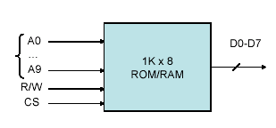
Cont…
1K x 8:
1K = 2n,
n: number of address lines
8: number of data lines
R/W: Read/Write Enable
CS: Chip Select.

Slide 49
PROBLEMS
a) For a memory capacity of 2048 bytes, using 128x8 chips, we need 2048/128=16 chips.
b) We need 11 address lines to access 2048 = 2¹¹, the common lines are 7 (since each chip has 7 address lines; 128= 2⁷)
c) We need a decoder to select which chip is to accessed. Draw a diagram to show the connections.

Slide 50
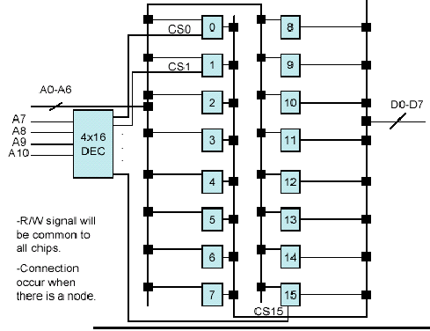
Cont…

Slide 51
Cont…
The address range for chip 0 will be:
0000 0000000 to 0000 1111111 , thus
000 to 07F (Hexadecimal)
The address range for chip 1 will be:
0001 0000000 to 0001 1111111 , thus
080 to 0FF (Hexadecimal)
And so on until we hit 7FF. (check this!)

Slide 52
MAGNETIC DISK AND DRUMS
Magnetic Disk and Drums are similar in operation
High Rotating surfaces with magnetic recording medium
Rotating surface
  Disk- a round flat plate
  Drum – cylinder
Rotating surface rotates at uniform speed and is not stopped or started during access operations
Bits are recorded as magnetic spots on the surface as it passes a stationary mechanism-WRITE HEAD
Stored bits are detected by a change in a magnetic field produced by a recorded spot on a surface as it passes thru the READ HEAD
  HEAD –(conducting coil)

Slide 53
MAGNETIC DISK
Bits are stored in magnetized surface in spots along the concentric circle called tracks
Track divided into sections –sectors
  Single read/write head for each disk surface-the track address bits are used by a mechanical assembly to move the head into the specified track position be for reading and writing.
  Separate read/write head for each track in each surface .The address bits can then select a particular track electronically through a decoder circuit.
More expensive found in large computer

Slide 54
Cont…
Permanent timing tracks are used in disks to synchronize the bits and recognize the sectors
A disk system is addressed by address bits that specify the disk no. The disk surface, sector no., and the track within the sector
After the read/write heads are positioned in the specified track. The system has to wait until the rotating disk reaches the specified sector under the read/write head.
Information transfer is very fast once the beginning of a sector has been reached
Disk with multiple heads and simultaneous transfer of bits from several tracks at the same time

Slide 55
Cont…
A track in a given sector near the circumference is longer than a track near the center of the disk.
If bits are recorded with equal density, some tracks will contain more recorded bits than other
To make all records in a sector of equal length, some disks uses variable recording density with higher density on tracks near the center than on tracks near the circumference. This equalizes the number of bits on all tracks of a given sector
Disks
  Hard disk
  Floppy Disk

Slide 56
MAGNETIC TAPES
A magnetic tape transport system consist of the electrical, mechanical ,electronic component to provide the parts and control mechanism for a magnetic tape
Tape is a strip of plastic coated with a magnetic recording medium
Bits are recorded as magnetic spots on the tape along several tracks
Read/Write heads are mounted on in each track so that data can be recorded and read as a sequence of characters
Magnetic tape can’t be stopped or started fast enough between individuals characters because of this info is recorded in blocks where the tape can be stopped.

Slide 57
Cont…
The tape start moving while in a gap and attains constant
speed by the time it reaches the next record
Each record on a tape has an identification bit pattern at the beginning and end.
By reading the bit pattern at the end of the record the control recognizes the beginning of a gap.
A tape is addressed by specifying the record number and the number of characters in a record.
Records may be fixed or variable length

Slide 58
ASSOCIATIVE MEMORY
It is a memory unit accessed by content (Content Addressable Memory CAM).
Word read/written no address specified memory find the empty unused location to store the data similarly memory located all word which match the specified content and marks them for reading
Uniquely suited for parallel searches by data association.
More expensive than RAM because each cell must have storage and logic circuits for matching with an external argument.
Each word in memory is compared with the argument register (A). If a word matches, then the corresponding bit in the match register will be set.
(K) is the key register responsible for masking the data to select a field in the argument word.

Slide 59
Cont…
Fig.1:Block diagram of Associative memory
Argument register (A)
A₁
A_{j}
A_{n}
Key register (R)
K₁
K_{j}
K_{n}
Match register
Input
Word 1
C₁₁
C_{1j}
C_{1n}
M_{1n}
Associative memory
Array and logic
M words
N bits per word
M
Word i
C_{i1}
C_{ij}
C_{in}
M_{in}
Read
Word m
C_{m1}
C_{mj}
C_{mn}
M_{mn}
Write
Bit1
Bitj
Bitn
Output
A 101 111100
K 111 000000
Word 1 100111100
Word 2 101 000001
Fig.2:An Associative array of one word

Slide 60
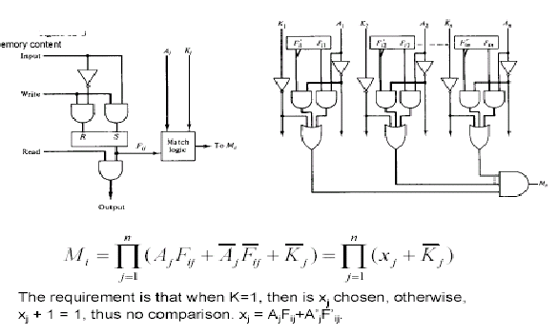
Cont…
Match logic for one word of associative memory
One cell for associative memory

Slide 61
Cont…
• A read operation takes place for those locations where M_{i}=1.
• Usually one location, but if more than one, then locations will be read in sequence.
• A write can be done in a RAM like addressing, thus device will operate in a RAM writing CAM reading.
• A TAG register is available with a number of bits that is the same as the number of word, to keep track of which locations are empty (0) or full (1), after a read/write operation.

Slide 62
LOCALITY
Principle of Locality:
  Programs tend to reuse data and instructions near those they have used recently, or that were recently referenced themselves.
  Temporal locality: Recently referenced items are likely to be referenced in the near future.
  Spatial locality: Items with nearby addresses tend to be referenced close together in time.
Locality Example:
  Data
    Reference array elements in succession (stride-1 reference pattern):
    Reference sum each iteration:
  Instructions
    Reference instructions in sequence:
    Cycle through loop repeatedly:
sum = 0;
for (i = 0; i < n; i++)
sum += a[i];
return sum;
Spatial locality
Temporal locality
Spatial locality
Temporal locality

Slide 63
LOCALITY EXAMPLE
Locality Example:
  Data
    Reference array elements in succession (stride-1 reference pattern):
    Reference sum each iteration:
  Instructions
    Reference instructions in sequence:
    Cycle through loop repeatedly:
sum = 0;
for (i = 0; i < n; i++)
sum += a[i];
return sum;
Spatial locality
Temporal locality
Spatial locality
Temporal locality

Slide 64
CACHE MEMORY
References at any given time tend to be confined within a few localized area in memory - Locality of Reference
To lesser memory reference –Cache

Slide 65
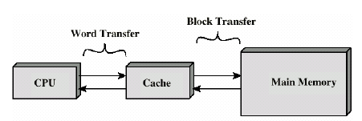
CACHE ($)
• Small amount of fast memory
• Sits between normal main memory and CPU
• May be located on CPU chip or module

Slide 66
CACHE READ OPERATION
Start
Hit ratio=#hits/#memory calls
Require address (RA) from CPU
Is block containing RA in cache?
No
Access main memory for block containing RA
Yes
Fetch RA word and deliver in CPU
Allocate cache for main memory for block
Add main memory block to cache line
Deliver RA word to CPU
Done

Slide 67
Cont…
• Transformation of data from Memory to $ is referred to as Mapping.
• 3 types of mapping:
– Associative Mapping (fastest, most flexible)
– Direct mapping (HW efficient)
– Set-associative mapping
CPU
Main Memory
32 K * 12
Mem: 15-bit address
Same address is sent to $
Cache
Memory
52*11
Example of Cache Memory

Slide 68
CACHES
Cache: A smaller, faster storage device that acts as a staging area for a subset of the data in a larger, slower device.
Fundamental idea of a memory hierarchy:
    For each k, the faster, smaller device at level k serves as a cache for the larger, slower device at level k+1.
Why do memory hierarchies work?
    Programs tend to access the data at level k more often than they access the data at level k+1.
    Thus, the storage at level k+1 can be slower, and thus larger and cheaper per bit.
    Net effect: A large pool of memory that costs as much as the cheap storage near the bottom, but that serves data to programs at the rate of the fast storage near the top.

Slide 69
CACHING IN A MEMORY HIERARCHY
Smaller, faster, more expensive
device at level k caches a
subset of the blocks from level k+1
8
Level k:
4
9
14
3
10
Data is copied between
levels in block-sized transfer units
10
4
0
1
2
3
4
Larger, slower, cheaper storage
device at level k+1 is partitioned
into blocks.
Level k+1:
4
5
6
7
8
9
10
10
11
12
13
14
15

Slide 70
GENERAL CACHING CONCEPTS
Program needs object d, which is stored in some block b.
Cache hit
  Program finds b in the cache at level k. E.g., block 14.
Request
12
14
Request
14
12
0
1
2
3
Level
k:
4*
9
14
12
14
3
4*
12
Request
12
4*
0
1
2
3
Level
k+1:
4
5
6
7
4*
8
9
10
11
12
13
14
15
12

Slide 71
Cont…
Cache miss
  b is not at level k, so level k cache must fetch it from level k+1. E.g., block 12.
  If level k cache is full, then some current block must be replaced (evicted). Which one is the “victim”?
    Placement policy: where can the new block go? E.g., b mod 4
    Replacement policy: which block should be evicted? E.g., LRU

Slide 72
Cont…
Types of cache misses:
  Cold (compulsary) miss
    Cold misses occur because the cache is empty.
  Conflict miss
    Most caches limit blocks at level k+1 to a small subset (sometimes a singleton) of the block positions at level k.
    E.g. Block i at level k+1 must be placed in block (i mod 4) at level k+1.
    Conflict misses occur when the level k cache is large enough, but multiple data objects all map to the same level k block.
    E.g. Referencing blocks 0, 8, 0, 8, 0, 8, ... would miss every time.
  Capacity miss
    Occurs when the set of active cache blocks (working set) is larger than the cache.

Slide 73
EXAMPLES OF CACHING IN THE HIERARCHY
Cache Type
What Cached
Where Cached
Latency (cycles)
Managed By
Registers
4-byte word
CPU registers
0
Compiler
TLB
Address translations
On-Chip TLB
0
Hardware
L1 cache
32-byte block
On-Chip L1
1
Hardware
L2 cache
32-byte block
Off-Chip L2
10
Hardware
Virtual Memory
4-KB page
Main memory
100
Hardware+OS
Buffer cache
Parts of files
Main memory
100
OS
Network buffer cache
Parts of files
Local disk
10,000,000
AFS/NFS client
Browser cache
Web pages
Local disk
10,000,000
Web browser
Web cache
Web pages
Remote server disks
1,000,000,000
Web proxy server

Slide 74
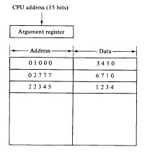
ASSOCIATIVE MAPPING:
• The 15-bit address as well as its corresponding data word are stored in $.
• If a match in address is found (address from CPU is placed in (A) register), data word is sent to CPU.
Associative Mapping of Cache (all no. in octal)

Slide 75
Cont…
If no match, then data word is accessed from Memory, and the address data pair are transferred to $.
If $ is full, a replacement algorithm is used to free some space.

Slide 76
DIRECT MAPPING
• A RAM is used for Cache ($).
• The 15-bit address is divided into
Index=k, and TAG=n-k.
n=15 (address for Memory), k=9 (address for $).
• Each word in $ consists of the data word along with its associated TAG.
• When CPU issues a read, the index part is used to locate the address in $, and then the remaining portion is compared to TAG, if there is a match, then that is a HIT.
IF there is no match, then this is a MISS.
• If MISS, then read from Memory and store word + TAG in $ again.

Slide 77
ADDRESSING RELATIONSHIP BETWEEN CACHE AND MAIN
Tag (6bits) | Index (9 bits)
00 000
77 777
32K*12
Main Memory
Address=15 bits
Data =12 bits
000
777
512*12
Cache Memory
Address=9 bits
Data =12 bits
Octal
address
Octal address

Slide 78
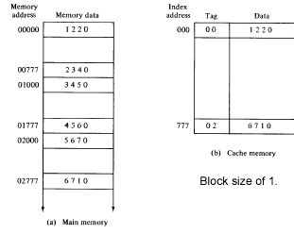
DIRECT MAPPING CACHE ORGANISATION

Slide 79
Cont…
• Disadvantage
what if two or more words whose addresses have the same index but different TAG? Increase MISS ratio!
• Usually, this will happen when words are far away in the address range
Far from $ size, i.e. after 512 location in this example.
64x8 = 512
64 blocks
8 words/block
Block (6 bits) Word (3 bits)
Index=007 Block 0, word 8
Index=103 Block 8, word 4
$

Slide 80
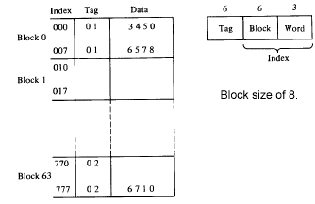
DIRECT MAPPING
64x8 = 512
64 blocks
8 words/block

Slide 81

Cont…

Slide 82
SET ASSOCIATIVE
Improvement over direct mapping

Slide 83
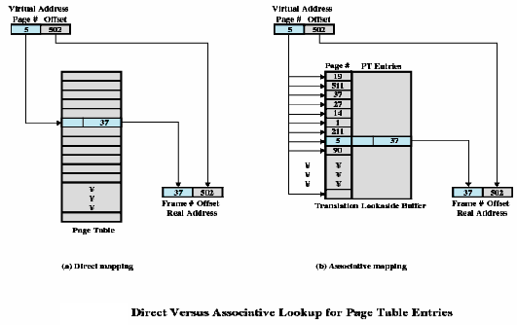
Cont…

Slide 84
WRITING TO $
Two methods:
Write through
  update main memory with every memory write operation with cache being updated in parallel if it contain the word at the specified address
Write back
  only cache location is updated during write operation. This location is then marked by a flag so that later when the word is removed from the it is copied into main memory

Slide 85
VIRTUAL MEMORY
Virtual memory (VM) is used to give programmers the illusion that they have a very large memory at their command.
A computer has a limited memory size.
VM provides a mechanism for translating program oriented addresses into correct memory addresses.
Address mapping can be performed using an extra memory chip, using main memory itself (portion of it) or using associative memory using page tables.

Slide 86
PROBLEMS
a) Memory is 64Kx16, and $ is 1K words, with block size of 4.
b) Each $ location will have the 16-bits of data, added to them the number of TAG bits, as well as the valid bit, thus 23-bits.
Index = 10 bits TAG = 6 bits
Block = 8 bits, word = 2 bits

Slide 87
HARDWARE AND CONTROL STRUCTURES
Memory references are dynamically translated into physical addresses at run time
  A process may be swapped in and out of main memory such that it occupies different regions
A process may be broken up into pieces that do not need to located contiguously in main memory
All pieces of a process do not need to be loaded in main memory during execution

Slide 88
EXECUTION OF A PROGRAM
Operating system brings into main memory a few pieces of the program
Resident set - portion of process that is in main memory
An interrupt is generated when an address is needed that is not in main memory
Operating system places the process in a blocking state

Slide 89
EXECUTION OF A PROGRAM
Piece of process that contains the logical address is brought into main memory
  Operating system issues a disk I/O Read request
  Another process is dispatched to run while the disk I/O takes place
  An interrupt is issued when disk I/O complete which causes the operating system to place the affected process in the Ready state

Slide 90
ADVANTAGES OF BREAKING
A PROCESS
More processes may be maintained in main memory
  Only load in some of the pieces of each process
  With so many processes in main memory, it is very likely a process will be in the Ready state at any particular time
A process may be larger than all of main memory

Slide 91
TYPES OF MEMORY
Real memory
  Main memory
Virtual memory
  Memory on disk
  Allows for effective multiprogramming and relieves the user of tight constraints of main memory

Slide 92
MEMORY TABLE FOR MAPPING A VIRTUAL ADDRESS
Virtual address
Virtual
address register
(20 bits)
Memory
mapping
table
Main
memory address
(15 bits)
Main
memory
Main memory
Buffer register
Memory table
buffer register

Slide 93
ADDRESS AND MEMORY SPACE SPLIT INTO GROUPS OF 1K WORDS
Page 0
Page 1
Page 2
Page 3
Page 4
Page 5
Page 6
Page 7
Block 0
Block 1
Block 2
Block 3
Memory space
N=4 K=2¹²
Address space
N=8 K=2¹³

Slide 94
MEMORY TABLE IN A PAGED SYSTEM
Page No.
Line No.
101 | 0101010011
Presence
bit
000 |  | 0
001 | 11 | 1
010 | 00 | 1
011 |  | 0
100 |  | 0
101 | 01 | 1
110 | 10 | 1
111 |  | 0
Block 0
Block 1
Block 2
Block 3
Table
address
01 | 0101010011
Main memory
Address register
MBR
01 | 1
Main
Page table

Slide 95
ASSOCIATIVE MEMORY PAGE TABLE
Page No.
Virtual register.
101 | Line Number
Argument register.
111 00
Key register
000 | 11
001 | 00
010 | 01
011 | 10
Associative memory
Page No. Block No

Slide 96
THRASHING
Swapping out a piece of a process just before that piece is needed
The processor spends most of its time swapping pieces rather than executing user instructions

Slide 97
PRINCIPLE OF LOCALITY
Program and data references within a process tend to cluster
Only a few pieces of a process will be needed over a short period of time
Possible to make intelligent guesses about which pieces will be needed in the future
This suggests that virtual memory may work efficiently

Slide 98
SUPPORT NEEDED FOR VIRTUAL MEMORY
Hardware must support paging and segmentation
Operating system must be able to management the movement of pages and/or segments between secondary memory and main memory

Slide 99
PAGING
Each process has its own page table
Each page table entry contains the frame number of the corresponding page in main memory
A bit is needed to indicate whether the page is in main memory or not

Slide 100
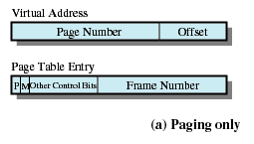
PAGING

Slide 101
MODIFY BIT IN PAGE TABLE
Modify bit is needed to indicate if the page has been altered since it was last loaded into main memory
If no change has been made, the page does not have to be written to the disk when it needs to be swapped out

Slide 102
PAGE TABLES
The entire page table may take up too much main memory
Page tables are also stored in virtual memory
When a process is running, part of its page table is in main memory

Slide 103
TRANSLATION LOOKASIDE BUFFER
Each virtual memory reference can cause two physical memory accesses
  One to fetch the page table
  One to fetch the data
To overcome this problem a high-speed cache is set up for page table entries
  Called a Translation Lookaside Buffer (TLB)

Slide 104
TRANSLATION LOOKASIDE BUFFER
Contains page table entries that have been most recently used
Given a virtual address, processor examines the TLB
If page table entry is present (TLB hit), the frame number is retrieved and the real address is formed
If page table entry is not found in the TLB (TLB miss), the page number is used to index the process page table
First checks if page is already in main memory
  If not in main memory a page fault is issued
The TLB is updated to include the new page entry

Slide 105
PAGE SIZE
Smaller page size, less amount of internal fragmentation
Smaller page size, more pages required per process
More pages per process means larger page tables
Larger page tables means large portion of page tables in virtual memory
Secondary memory is designed to efficiently transfer large blocks of data so a large page size is better

Slide 106
PAGE SIZE
Small page size, large number of pages will be found in main memory
As time goes on during execution, the pages in memory will all contain portions of the process near recent references. Page faults low.
Increased page size causes pages to contain locations further from any recent reference. Page faults rise.

Slide 107
SEGMENTATION
May be unequal, dynamic size
Simplifies handling of growing data structures
Allows programs to be altered and recompiled independently
Lends itself to sharing data among processes
Lends itself to protection

Slide 108
SEGMENT TABLES
Corresponding segment in main memory
Each entry contains the length of the segment
A bit is needed to determine if segment is already in main memory
Another bit is needed to determine if the segment has been modified since it was loaded in main memory

Slide 109
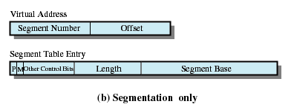
SEGMENT TABLE ENTRIES

Slide 110
COMBINED
PAGING AND SEGMENTATION
Paging is transparent to the programmer
Segmentation is visible to the programmer
Each segment is broken into fixed-size pages

Slide 111
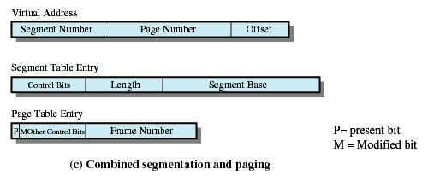
COMBINED
SEGMENTATION AND PAGING

Slide 112
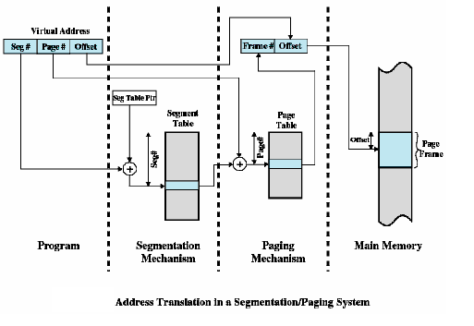
Cont…

Slide 113
FETCH POLICY
Fetch Policy
  Determines when a page should be brought into memory
  Demand paging only brings pages into main memory when a reference is made to a location on the page
    Many page faults when process first started
  Prepaging brings in more pages than needed
    More efficient to bring in pages that reside contiguously on the disk

Slide 114
PLACEMENT POLICY
Determines where in real memory a process piece is to reside
Important in a segmentation system
Paging or combined paging with segmentation hardware performs address translation

Slide 115
REPLACEMENT POLICY
Placement Policy
  Which page is replaced?
  Page removed should be the page least likely to be referenced in the near future
  Most policies predict the future behavior on the basis of past behavior

Slide 116
Cont…
Frame Locking
  If frame is locked, it may not be replaced
  Kernel of the operating system
  Control structures
  I/O buffers
  Associate a lock bit with each frame

Slide 117
BASIC REPLACEMENT ALGORITHMS
Optimal policy
  Selects for replacement that page for which the time to the next reference is the longest
  Impossible to have perfect knowledge of future events

Slide 118
BASIC REPLACEMENT ALGORITHMS
Least Recently Used (LRU)
  Replaces the page that has not been referenced for the longest time
  By the principle of locality, this should be the page least likely to be referenced in the near future
  Each page could be tagged with the time of last reference. This would require a great deal of overhead.

Slide 119
Cont…
First-in, first-out (FIFO)
  Treats page frames allocated to a process as a circular buffer
  Pages are removed in round-robin style
  Simplest replacement policy to implement
  Page that has been in memory the longest is replaced
  These pages may be needed again very soon

Slide 120
Cont…
Clock Policy
  Additional bit called a use bit
  When a page is first loaded in memory, the use bit is set to 1
  When the page is referenced, the use bit is set to 1
  When it is time to replace a page, the first frame encountered with the use bit set to 0 is replaced.
  During the search for replacement, each use bit set to 1 is changed to 0

Slide 121
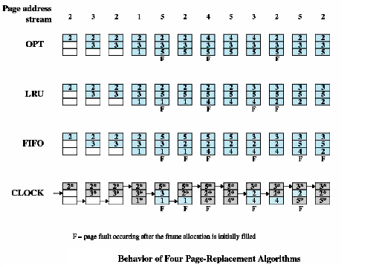
Cont…

Slide 122
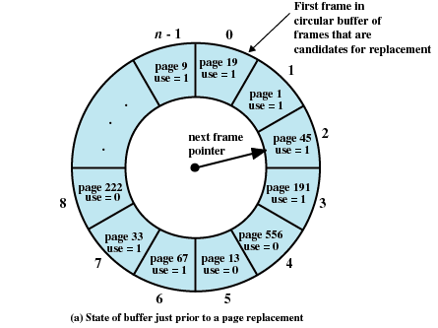
Cont…

Slide 123
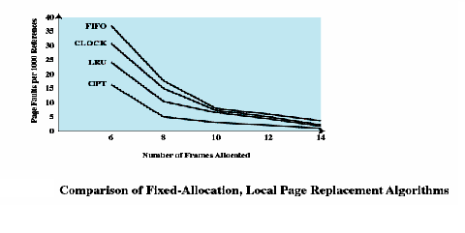
COMPARISON OF PLACEMENT ALGORITHMS

Slide 124
BASIC
REPLACEMENT ALGORITHMS
Page Buffering
  Replaced page is added to one of two lists
    Free page list if page has not been modified
    Modified page list

Slide 125
RESIDENT SET SIZE
Fixed-allocation
  Gives a process a fixed number of pages within which to execute
  When a page fault occurs, one of the pages of that process must be replaced
Variable-allocation
  Number of pages allocated to a process varies over the lifetime of the process

Slide 126
FIXED ALLOCATION, LOCAL SCOPE
Decide ahead of time the amount of allocation to give a process
If allocation is too small, there will be a high page fault rate
If allocation is too large there will be too few programs in main memory

Slide 127
VARIABLE ALLOCATION GLOBAL SCOPE
Easiest to implement
Adopted by many operating systems
Operating system keeps list of free frames
Free frame is added to resident set of process when a page fault occurs
If no free frame, replaces one from another process

Slide 128
Cont…
When new process added, allocate number of page frames based on application type, program request, or other criteria
When page fault occurs, select page from among the resident set of the process that suffers the fault
Reevaluate allocation from time to time

Slide 129
CLEANING POLICY
Demand cleaning
  A page is written out only when it has been selected for replacement
Precleaning
  Pages are written out in batches

Slide 130
CLEANING POLICY
Best approach uses page buffering
  Replaced pages are placed in two lists
    Modified and unmodified
  Pages in the modified list are periodically written out in batches
  Pages in the unmodified list are either reclaimed if referenced again or lost when its frame is assigned to another page

Slide 131
LOAD CONTROL
Determines the number of processes that will be resident in main memory
Too few processes, many occasions when all processes will be blocked and much time will be spent in swapping
Too many processes will lead to thrashing

Slide 132
PROCESS SUSPENSION
Lowest priority process
Faulting process
  This process does not have its working set in main memory so it will be blocked anyway
Last process activated
  This process is least likely to have its working set resident

Slide 133
Cont…
Process with smallest resident set
  This process requires the least future effort to reload
Largest process
  Obtains the most free frames
Process with the largest remaining execution window

Slide 134
LINUX MEMORY MANAGEMENT
Page directory
Page middle directory
Page table

Slide 135
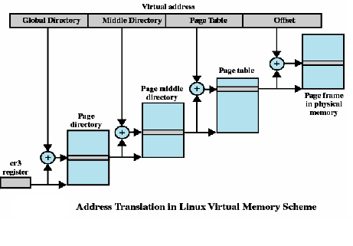
Cont…

Slide 136
CONCLUSIONS
Memory hierarchy
Types of memory
Mapping schemes
Paging
Segmentation
Replacement Algorithm

