Slide 1
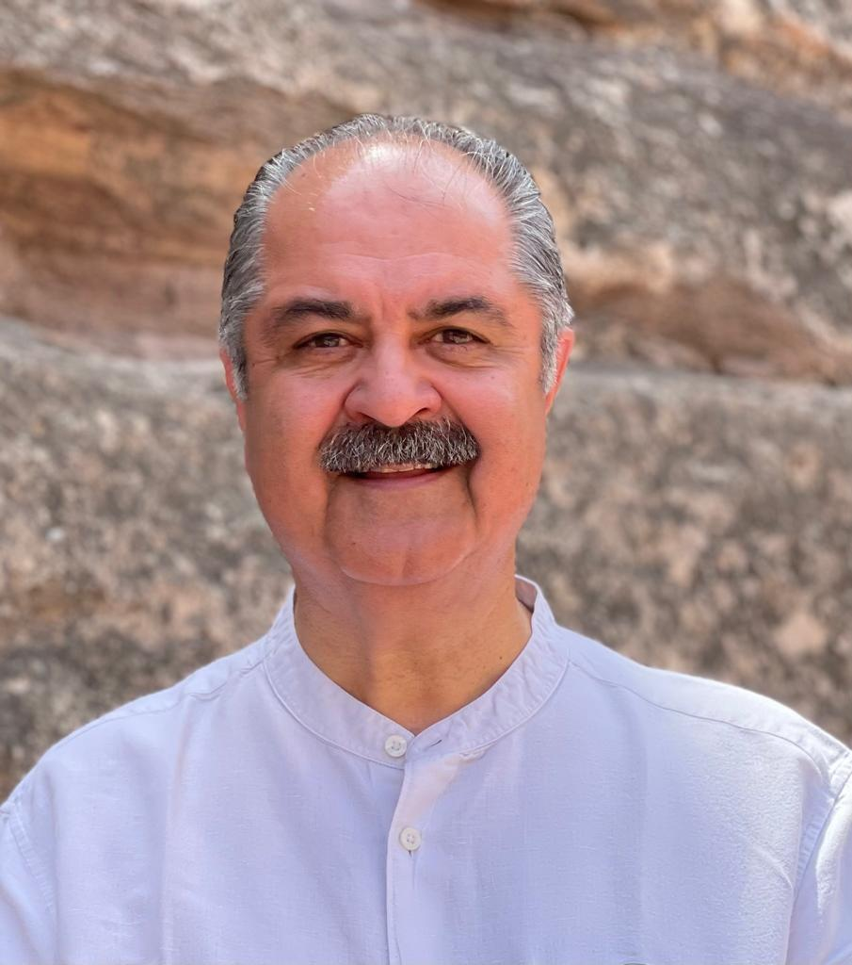


Prof. Ashok Khurana, M.B.B.S., M.D. (Radiodiagnosis), India
MBBS from the All India Institute of Medical Sciences, New Delhi
MD in Radiodiagnosis from All India Institute of Medical Sciences, New Delhi
Trained at the HERLEV HOSPITAL in Denmark in Ultrasound
Chairman and Consultant in Reproductive Ultrasound at The Ultrasound Lab, New Delhi. Practicing ultrasound in New Delhi since 1980
Professor, School of Health Sciences, Dubrovnik International University, Croatia
Professor, Indian Medical Association, 2017-2020
Past President of the Society of Fetal Medicine (2018-2020)
Former ISUOG (International Society of Ultrasound in Obstetrics and Gynecology) Ambassador in India
Former Dean, Indian College of Medical Ultrasound (ICMU)
Mentor Emeritus, Society of Fetal Medicine
Director, ScholarMD Fetal Medicine Program
Program Director, Apex Institute of Fetal and Reproductive Sciences
Editor in Chief: Journal of Fetal Medicine

