Slide 1
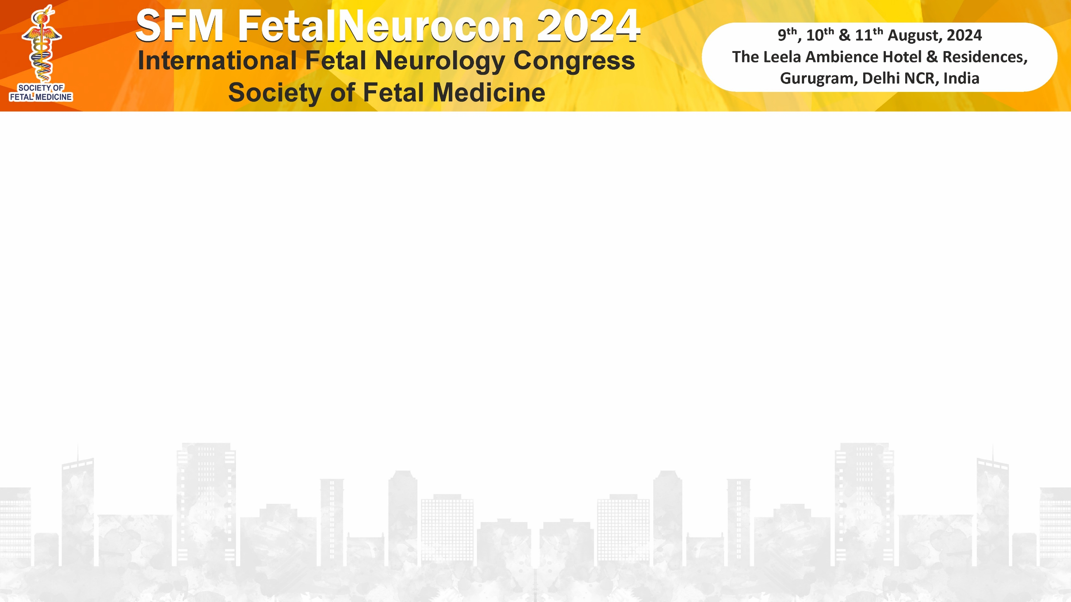
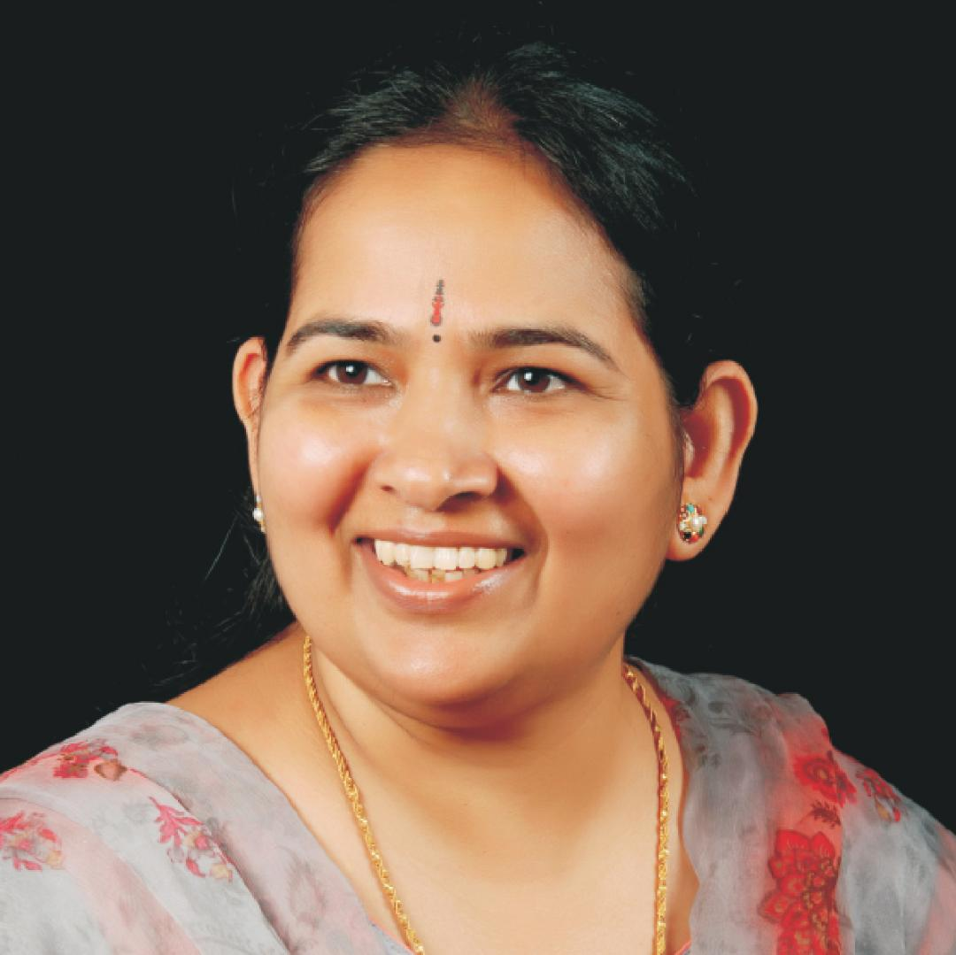
Name: Dr Vandana Bansal
MD, DGO, DNB, MNAMS, FICOG, FRCOG (UK),
FNB (High Risk Pregnancy and Perinatology)
First Post-doctoral Fellow of National Board (FNB) in India qualified in
High Risk Pregnancy & Perinatology
Designation: Addl. Professor (Ob Gyn) & Head of Ultrasound deptt. Director and Feto-Maternal Medicine Consultant
President Society of Fetal Medicine, Mumbai Chapter
Institute: Nowrosjee Wadia Maternity Hospital & Seth GS Medical College, Mumbai
Surya Mother and Child Hospital , Mumbai

