Slide 1

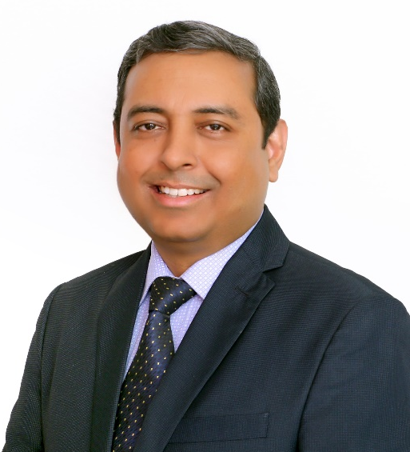
Name: Dr Alok Varshney
Designation: Sr. Consultant Radiologist
Institute: Central Diagnostics, Dwarka, New Delhi

