Slide 1
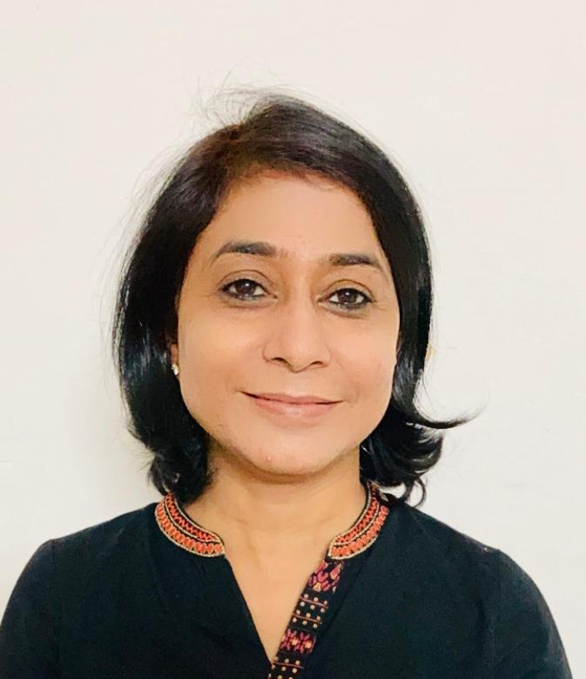

Prof(Col ) Reema Bhatt
MS, DNB, FICOG, MNAMS(Obsts &Gyne)
Prof and Head Fetal Medicine and Perinatology
Amrita Hospital ,Faridabad
Served as Senior Advisor in the Prestigious Army Hospital Research and Referral for 9 years and total 23 years in Armed Force
National Secretary of Society of Fetal Medicine
Co chairperson of Subcommittee of Fetal Medicine AOGD 2019-2021
National Advisory Board of Journal of Fetal Medicine
Special interest in Invasive fetal therapy
Numerous publications in National and International Journals
Awards
President’s Appreciation for meritorious service in Armed Forces
Chief of Army Staff Commendation
Army Commanders Commendation
Mr. S Bhattacharya & Dr Ganguli’s Gold Medal – 42nd Annual Conference of Association of Obstetricians and Gynaecologists of Delhi
Dr Neera Aggarwals Medal Best Paper , Silver Medal in 35th Annual Conference of Association of Obstetricians and Gynaecologists of Delhi

