Slide 1
Android Development with Kotlin

Slide 2
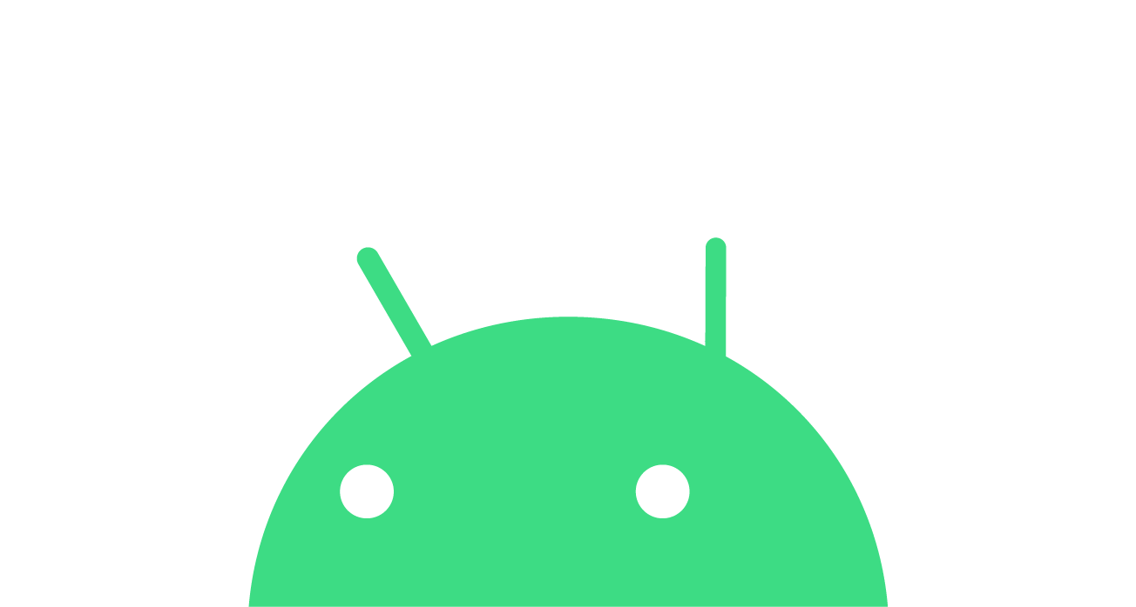
Prerequisites
Basic computer literacy
Basic math skills
Computer & headphones
Internet connection
(Optional) Android device & USB cable
Notes:
Here are some the prerequisites that will be helpful. Having basic computer literacy and basic math skills is recommended. You’ll also need a computer and access to the internet to take the online course. [Mention WiFi instructions if necessary.]
After this short presentation, we’ll all be working independently on the course. Use headphones to play the videos, so it doesn’t disrupt others around you.
It’s also helpful if you have an Android device so you can test your app. A USB cable will be needed for connecting your phone to the computer. If you don’t have an Android device, don’t worry, you can still use your computer to emulate an Android device.

Slide 3
Why do you want to learn Android?
Notes:
Before we dive into the content, I want to get to know you better and what brought you here. Please take out a piece of paper. Take a moment to think about your answers to these questions and write them down.
[Give 2-3 minutes to work and when most people have put down their pencils, proceed.]

Slide 4
Android
Open-source mobile platform
12 major platform releases so far
2.5 billion monthly active Android devices
2+ billion monthly active Google Play users
Notes:
These statistics are as of August 2020.

Slide 5
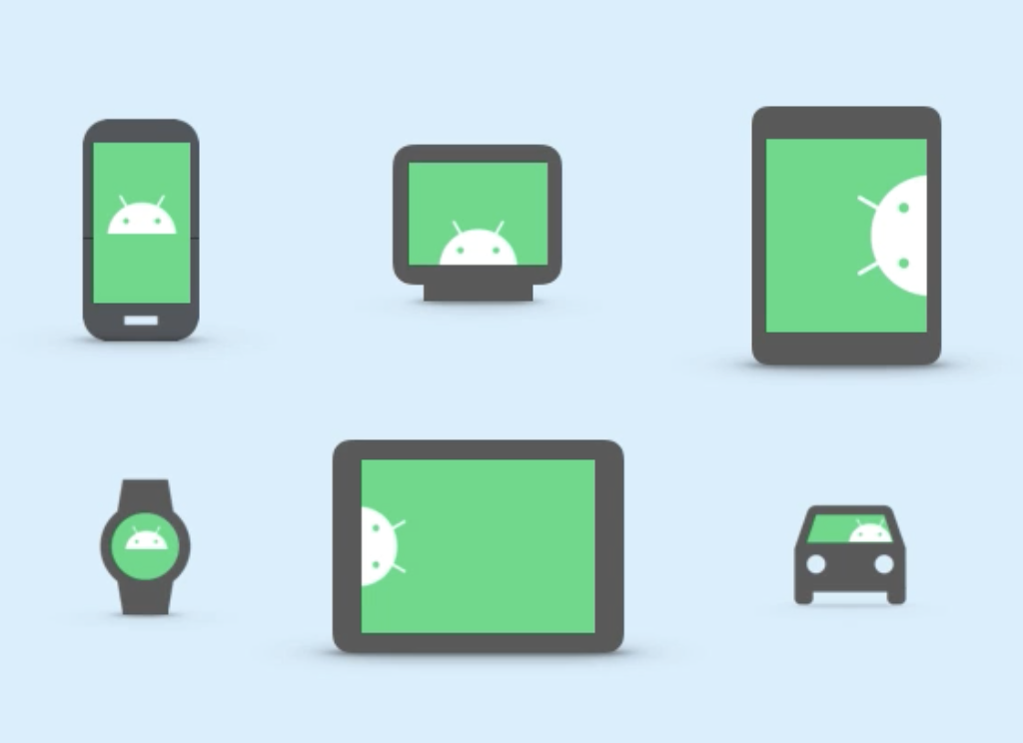
Available across different form factors
Notes:
There are Android phones, tablets, TVs, watches, and even cars.

Slide 6
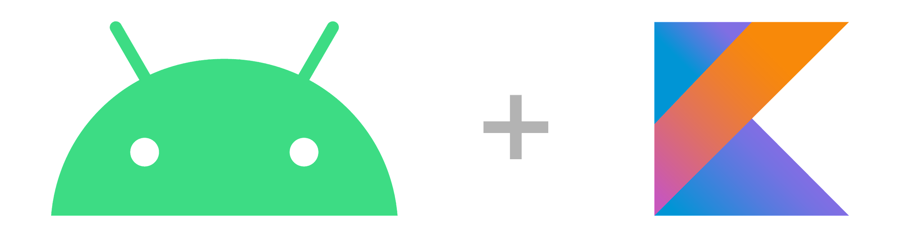
Build Android apps in Kotlin
Notes:
In 2017, Kotlin was officially announced as another supported language on Android.
Two years later, in 2019, Google announced their commitment to making Android development increasingly Kotlin-first. That means new platform features and libraries will first be made available in Kotlin. As a result, new developers are encouraged to build their Android apps in Kotlin.
Together, JetBrains and Google created the Kotlin Foundation to protect, promote, and advance the development of the Kotlin language.
Resources:
Android Announces Support for Kotlin blogpost
Google I/O 2019 blogpost
Kotlin Foundation

Slide 7
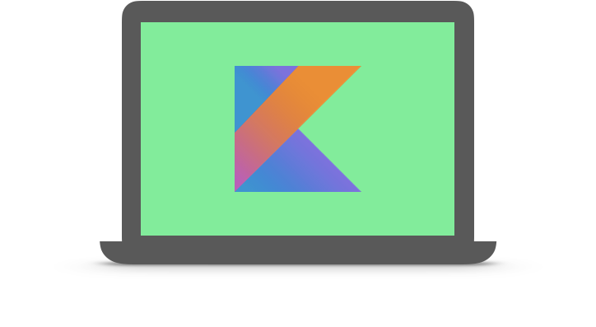
Kotlin
A modern programming language that helps developers be more productive.
Notes:
Kotlin is an open-source statically typed language, which supports both functional programming and object-oriented programming styles. Kotlin was designed to be pragmatic for developers, with a focus on interoperability, safety, clarity, and tooling support.
Kotlin is a modern programming language that has rapidly gained momentum in the industry. According to JetBrains, as of December 2019, there are over 4 million developers globally using Kotlin. Kotlin is currently ranked as the #4 most-loved programming language among developers, according to the 2020 Stack Overflow Developer Survey.
Furthermore, over 60% of professional Android developers use Kotlin, and over 70% of the top 1000 Android apps contain Kotlin code.
Resources:
Kotlin 1.0 released
Kotlin Evolution
Developer Stories

Slide 8
Benefits of Kotlin
Expressive and concise
Safer code
Interoperable
Structured Concurrency
Notes:
Here are some key benefits on why to use Kotlin for Android.
Expressive and concise: With Kotlin, you can express your ideas with less lines of code. There is less boilerplate code. This means development time can be quicker and maintenance is easier. Kotlin also has type inference, so you can omit data types if the Kotlin compiler can infer it, which makes the code more concise.
Safer code: Kotlin also has language features to help you avoid common programming errors. For example, the type system in Kotlin helps you avoid NullPointerExceptions in your code, which can lead to less crashes in an app.
Interoperable: Kotlin is 100% interoperable with the Java programming language. That means you can use existing Java classes and libraries with your Kotlin code. You can add Kotlin to an existing Java project, and there’s even a tool to help you convert Java code into Kotlin code.
Structured Concurrency: With Kotlin coroutines, asynchronous code is as straightforward to work with as blocking code. This simplifies background task management (e.g., for network calls or accessing the database). Using coroutines is the recommended solution for asynchronous programming on Android.
Resources:
Android's Kotlin-first approach
Null Safety
Interoperability
Kotlin coroutines on Android

Slide 9
Idiomatic Kotlin
Kotlin is at its best when used idiomatically
Avoid just translating Java into Kotlin
As you learn more Kotlin, you'll find easier, more concise ways to do things
For a list of common Kotlin idioms, refer to the Kotlin Language Guide on Idioms
Notes:
Resource:
Idioms

Slide 10
About this course

Slide 11
Learning Objectives
Build your first Android apps
Set up Android Studio on your computer
Learn the basics of the Kotlin programming language
Discover resources to continue learning
Notes:
Let’s talk about what you will learn as part of Android Basics. First and foremost, the goal is for you to build your first Android apps. To do this, you’ll install Android Studio on your computer, which is an application to build Android apps. Along the way, you will be exposed to programming concepts and the Kotlin language.
At the end, we’ll also talk about resources on how you can continue learning and building apps beyond this event.

Slide 12
Start here:
g.co/android/basics
Notes:
Open the course page with the link we provided you.

Slide 13
Concept Overview
Notes:
Now that you’re familiar with the learning platform and how the course looks, let’s dive into some important concepts that you’ll be learning about.

Slide 14
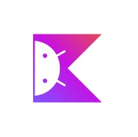
Kotlin Programming Language
Use Kotlin to start writing Android apps
Kotlin helps developers be more productive
Pathway 1
Pathway 2
Pathway 3
Notes:
In this course, you’ll be learning how to code in Kotlin. Kotlin is a programming language that you’ll use to build Android apps. Kotlin is a modern and popular programming language, known for helping developers be more productive. Kotlin allows you to be more concise when writing your code, and you can write safer code that’s less prone to errors.
As a result of many great language features, Kotlin has quickly gained momentum in industry. It is reportedly one of the fastest growing programming languages, according to GitHub.
Pathway 1 of the course is focused on helping you understand the basics of Kotlin.
[Read about Android’s Kotlin-first approach]

Slide 15

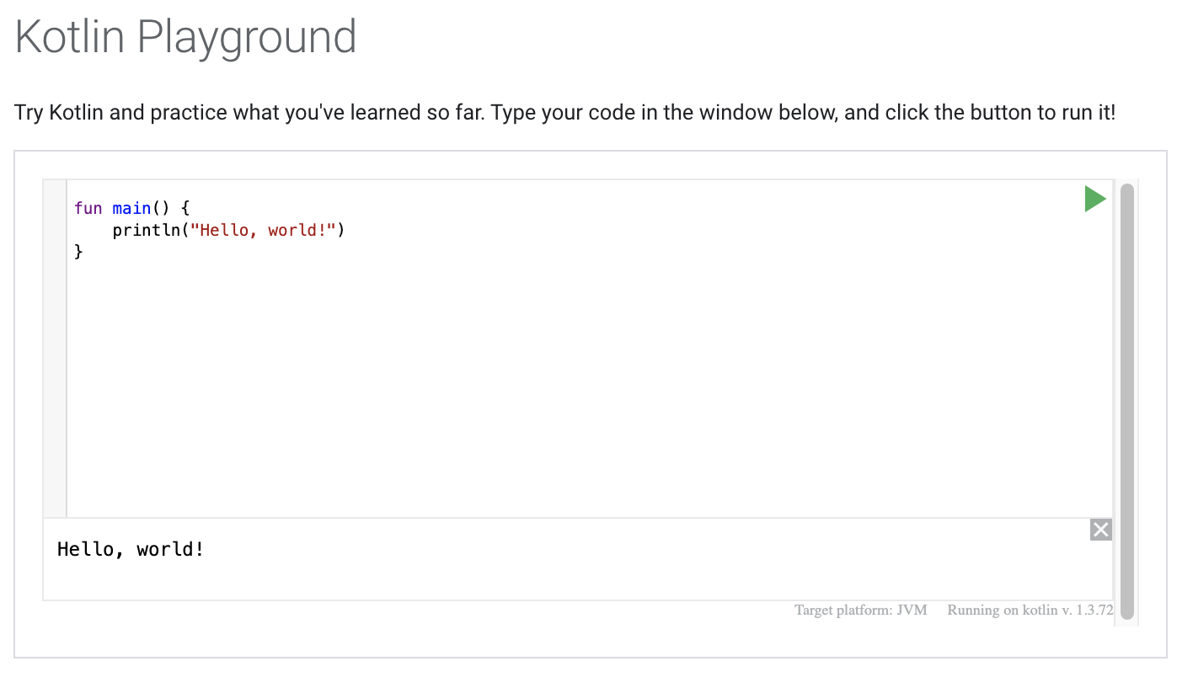
Kotlin Playground
Write and run Kotlin
code in the browser
Pathway 1
Pathway 2
Pathway 3
Notes:
To make it easier for you to learn, you’ll be writing your code in the Kotlin Playground which you can access via the web browser. The site looks something like this. You can write your code in this window and hit the green arrow to run it. The result of your code (known as the output) will show up at the bottom of the window (where it says “Hello, world!”).

Slide 16
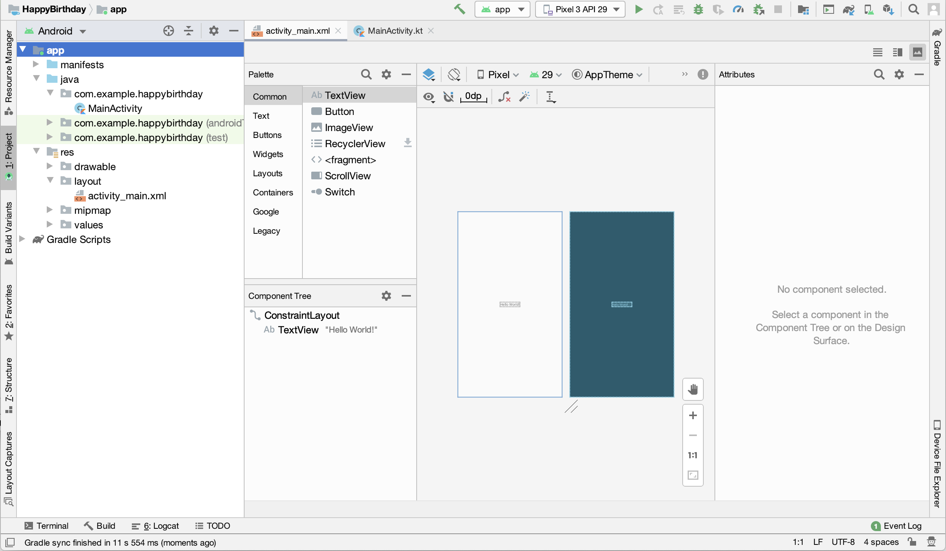
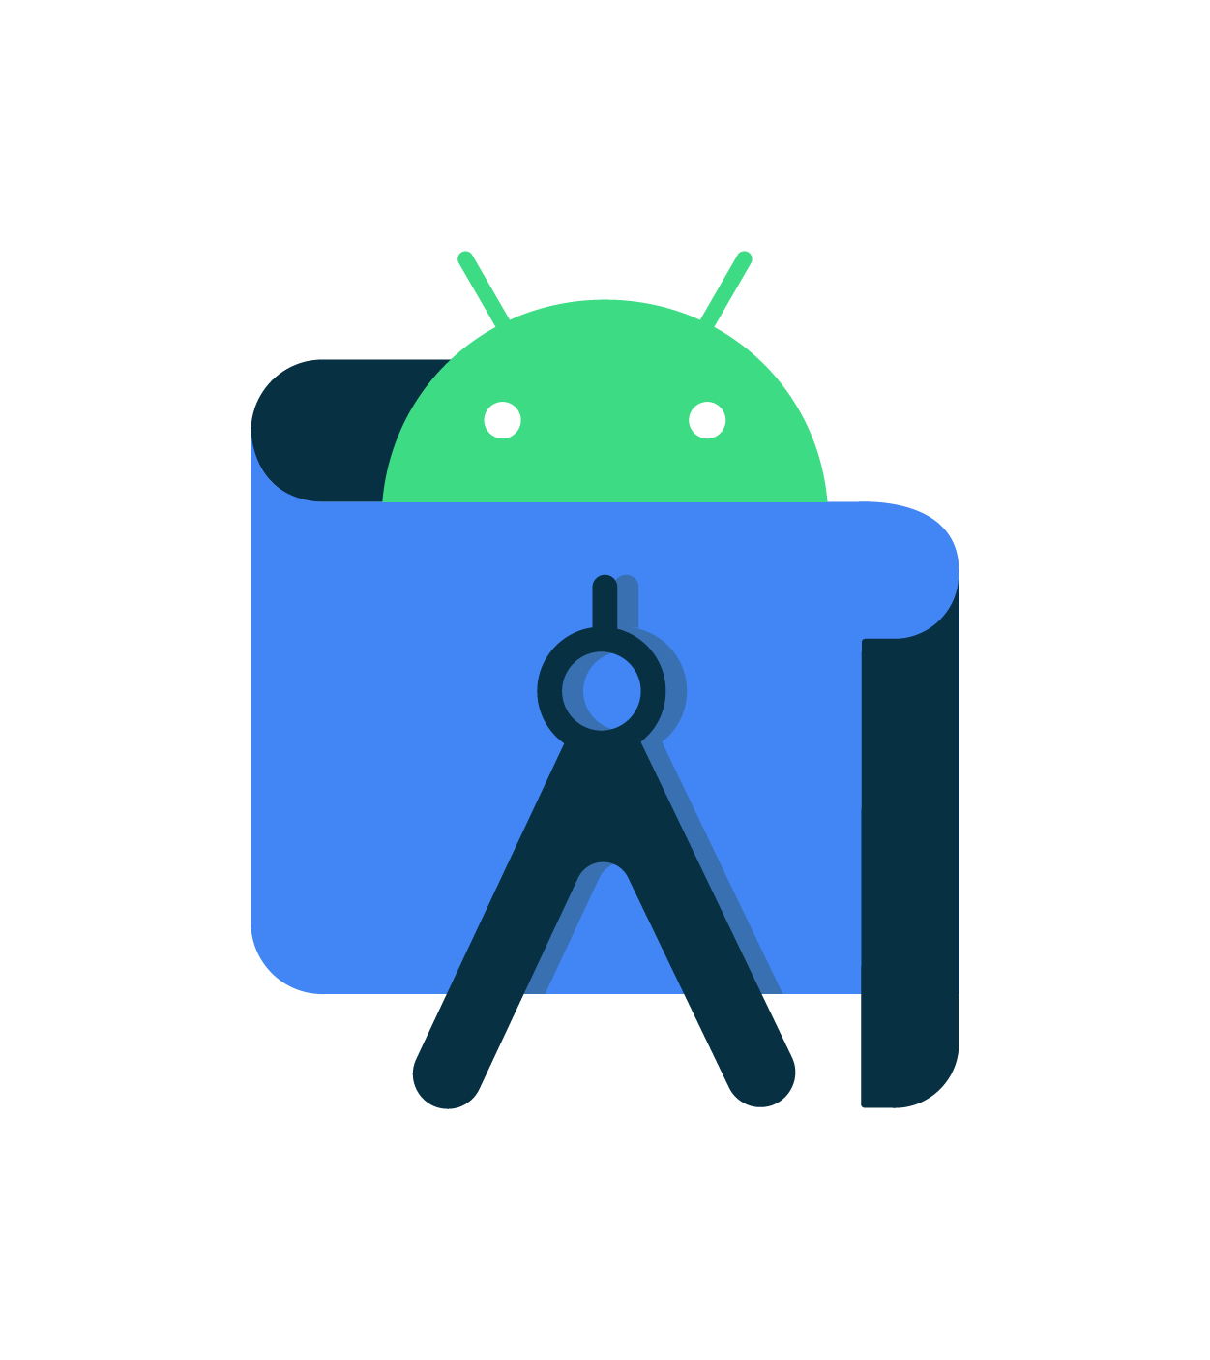
Android Studio
Official tool to build Android apps
Pathway 1
Pathway 2
Pathway 3
Notes:
Pathway 2 is where you create your first app! You will need to download and install Android Studio on your computer. This is the official tool that professional developers use for Android development. This is where you’ll be writing your Kotlin code and building your apps.

Slide 17
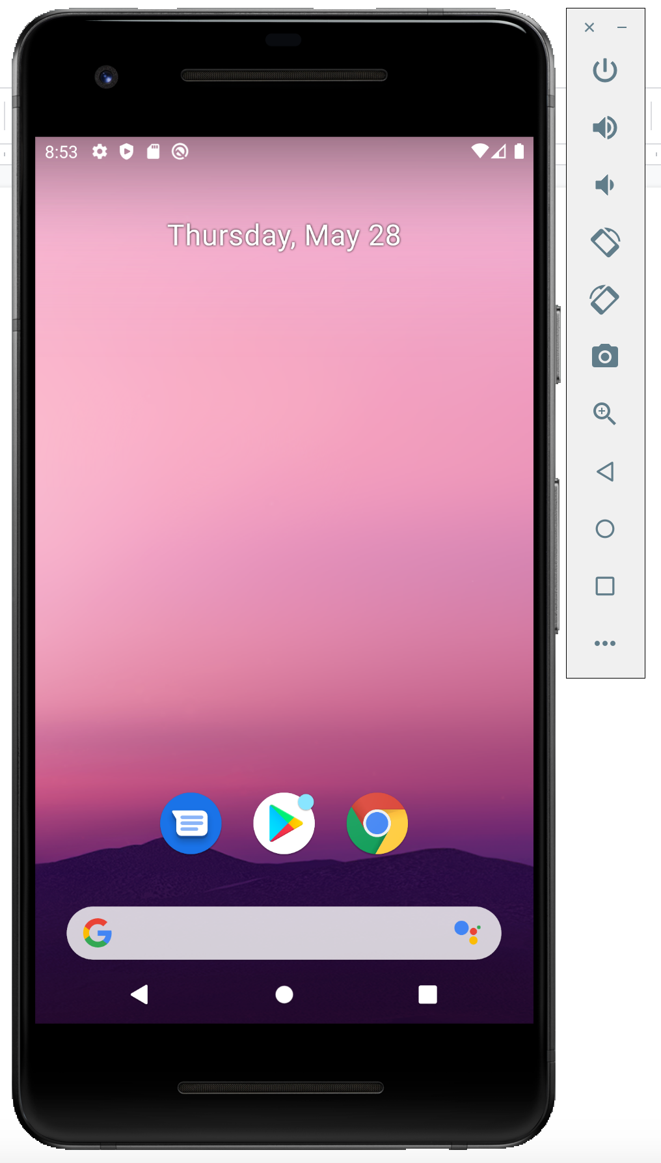
Android Emulator
Emulate an Android device on your computer.
Run your app on the emulator
Pathway 1
Pathway 2
Pathway 3
Notes:
In Android Studio, you can also use the Android Emulator, which can emulate various Android devices on your computer. The emulator allows you to run your app and it provides almost all capabilities that a real Android device would have. If you do have a physical device and want to use it, there are also instructions in Pathway 2 to get you setup.
[Students can either use the emulator or a physical device to test their app, it’s up to personal preference.]

Slide 18
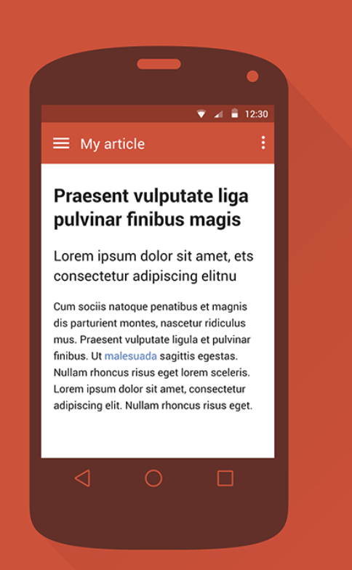
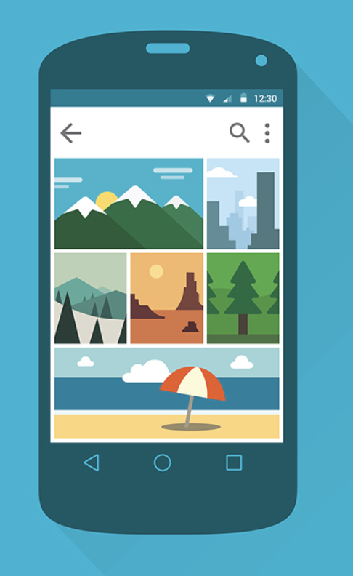
User Interface
The part of your app where
the user interacts with it
Pathway 1
Pathway 2
Pathway 3
Notes:
Lastly, in Pathway 3, you’ll learn the basic concepts of customizing the user interface of a simple app. The user interface (also known as UI) of your app includes what the app looks like and how the user interacts with it.

Slide 19
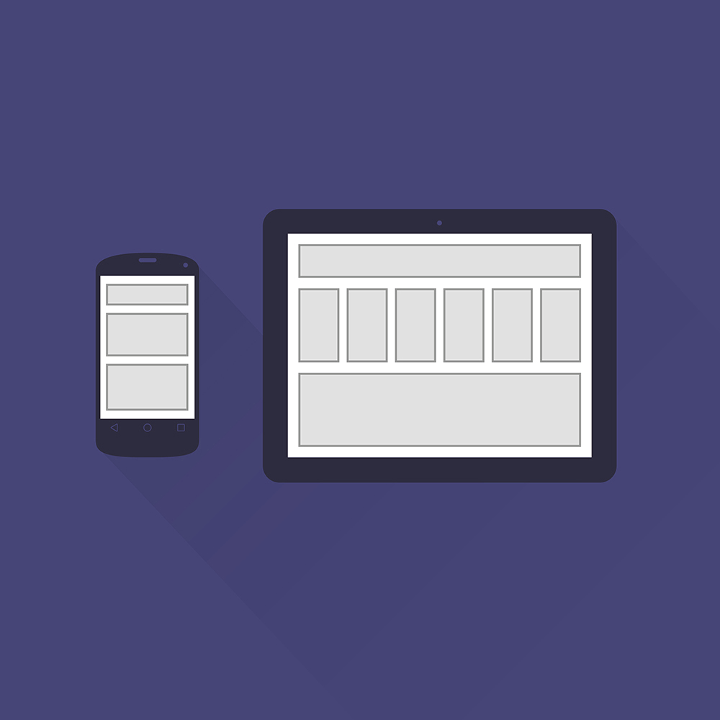
Layouts
Layouts
Views
Button
Aa
Pathway 1
Pathway 2
Pathway 3
Notes:
The layout of an app is the design or arrangement of what the user sees on the screen. In Android, a layout is made up of Views.

Slide 20


TextView
ImageView
Button
Views
Hello Android!
Pathway 1
Pathway 2
Pathway 3
Notes:
Here are some examples of types of Views that are provided by Android: TextView for displaying text, ImageView for displaying images, and Button to perform some action when tapped.

