Slide 1

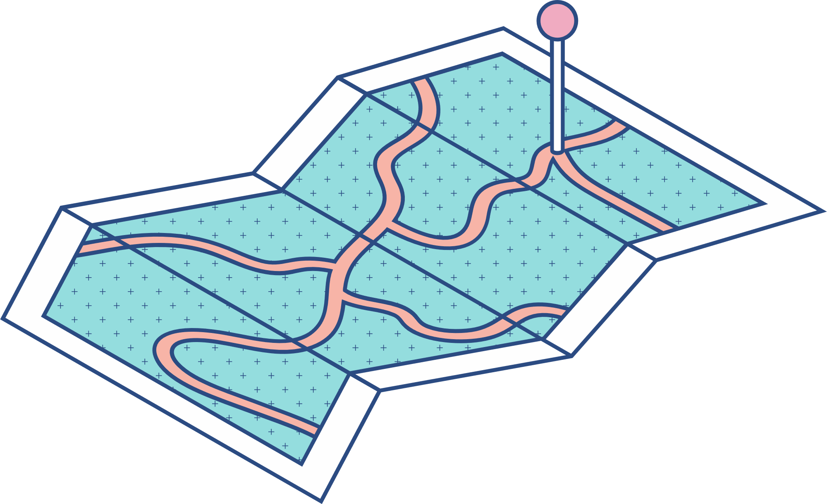


Navigating Airports Using Graph Algorithms
Course Title : - Data Structures & Algorithms
Course Code : - CSL2020
Instructor : - Suchetana Chakraborty
Mentor : - Jainan Nareshkumar Tandel (M23CSA010) &
Dhruv(B20EE016)
Team Members: -
Aaditya Kamble (B22MT024)
Jadeja Vishwjeetsinh (B22MT023)
Sahil (B22MT038)
Ghanshyam (B22PH009)

Slide 2
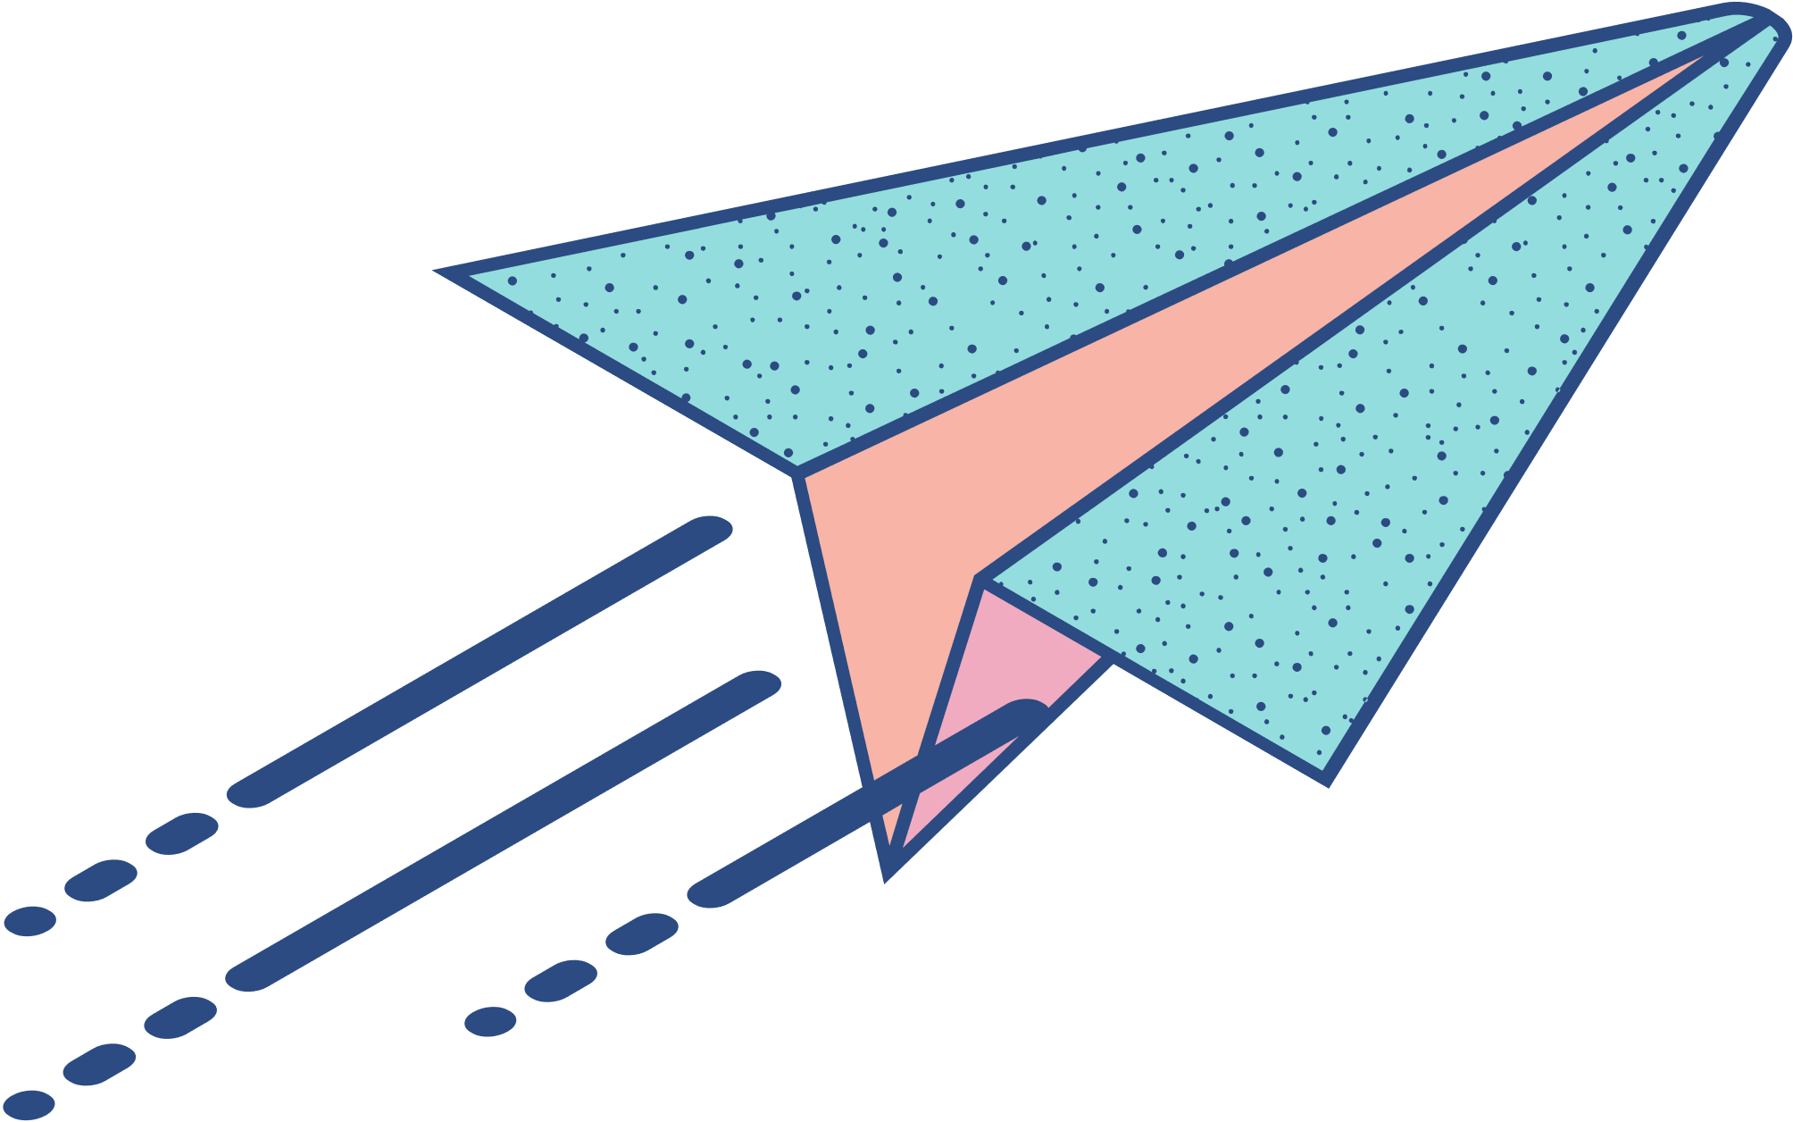
Problem Statement
Introducing the Problem:
Finding the shortest distance between airports in a network of routes. Utilizing datasets containing airport and route information. Implementing Dijkstra's, Floyd Warshall's, and Bellman-Ford's algorithms. And aalso comparing their outputs.
Efficient route planning is crucial for fast travel and passenger satisfaction in aviation.
Comparing the outputs of Dijkstra's, Bellman-Ford, and Floyd-Warshall's algorithms using accurate data allows for a comprehensive evaluation of their performance and suitability for different scenarios, leading to informed decision-making in route selection.

Slide 3

Current Status
Some Research papers have been published in this Regard.
According to GeeksforGeeks, Bellman-Ford is the faster Algorithm when the graph is unweighted.
As per medium.com
“The Bellman-Ford algorithm is more versatile ........ Dijkstra’s Algorithm is more efficient ....... weights.”
Overall, It is seen as not easy to answer, so which is the better algorithm? It is a common perception that Dijksrtra is more efficient and Bellman is better for handling negative cycles, and both of these are better than the Floyd Algorithm.

Slide 4
Limitations of Algorithms
Dijkstra's
Limited to graphs with non-negative edge weights.
Inefficient for graphs with negative edge weights or cycles.
Requires a priority queue for efficient implementation, which can be memory-intensive and challenging to implement in certain scenarios.
Bellman-Ford
It may need help finding the shortest path in negative-weight cycles.
Floyd Warshall
Memory-intensive nature due to the need to store the distance matrix.

Slide 5
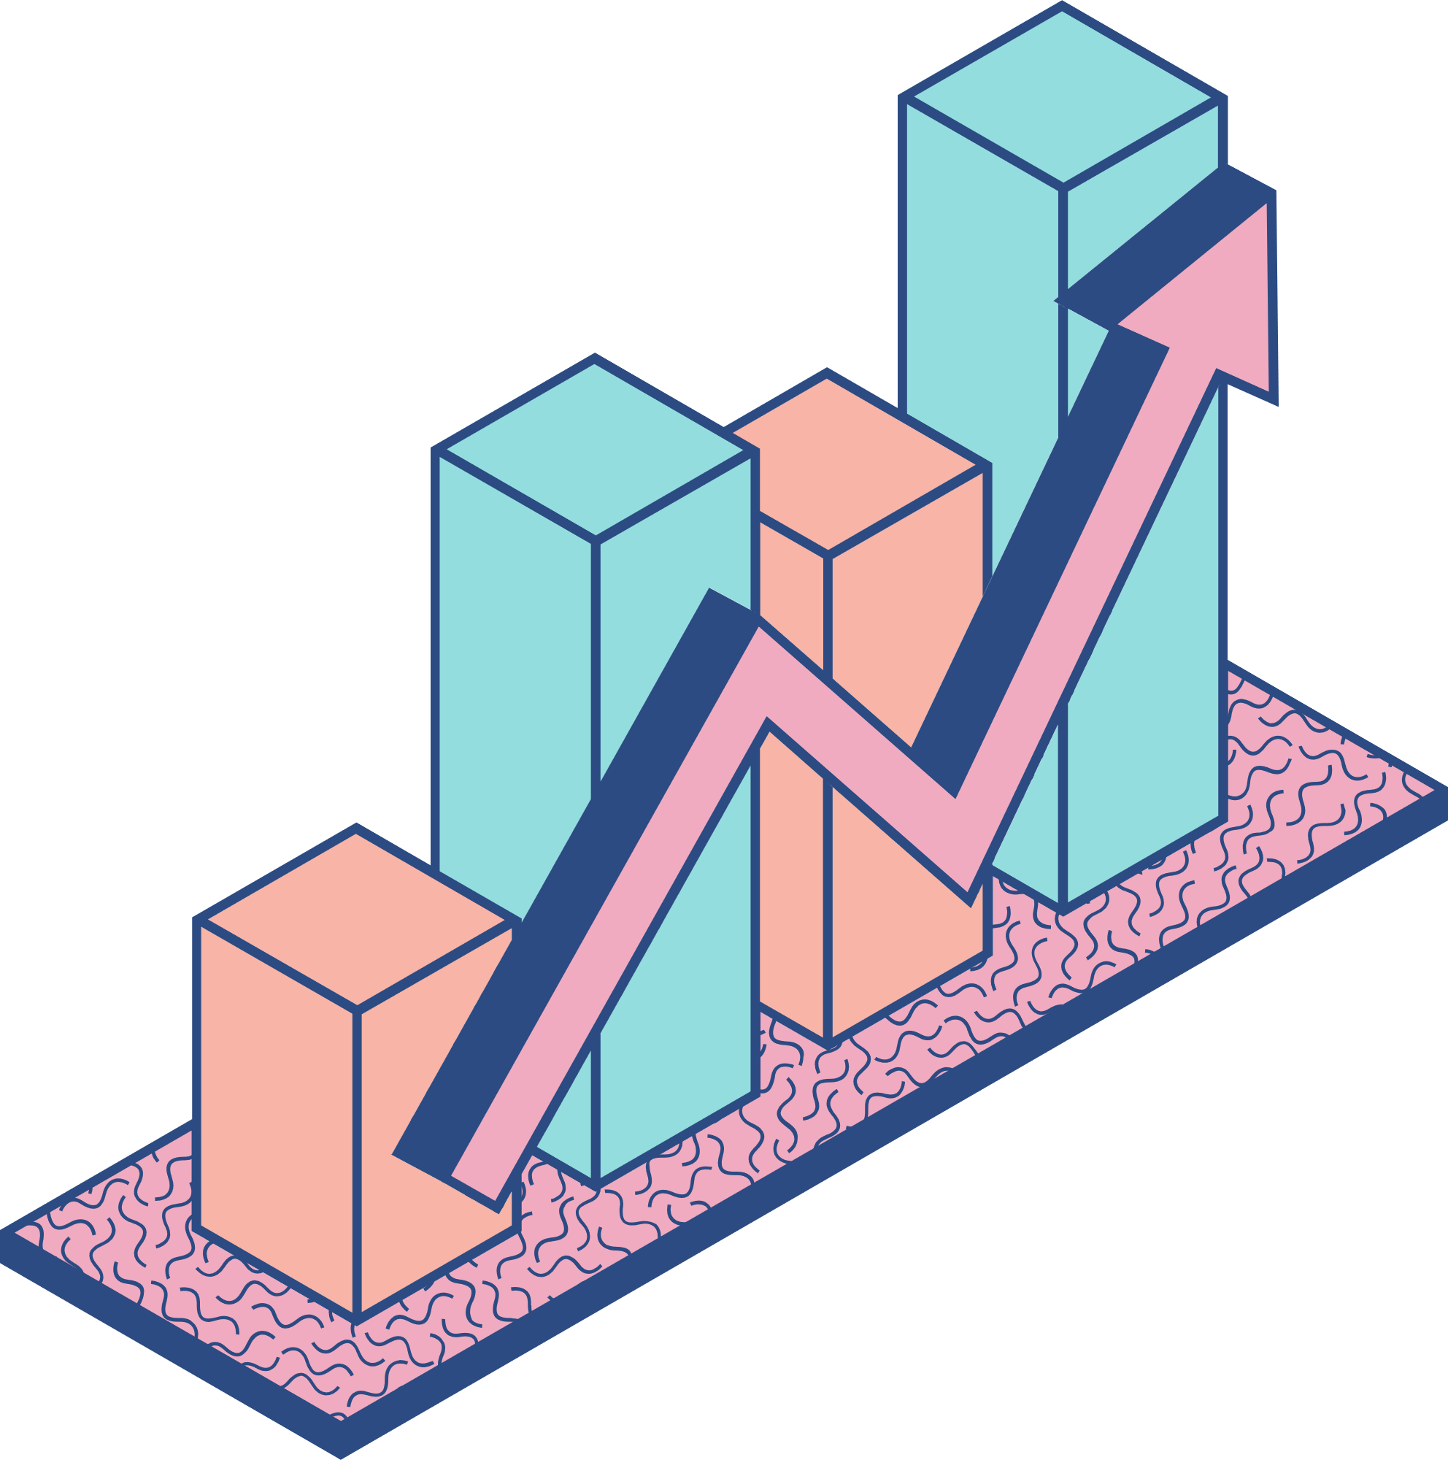
Idea
Improvements & Implementation:
Github Repo Link: ideathon-code-submission-b22mt024
Data structures: Used a graph data structure to represent the network of airports and routes and adjacency lists and matrices to store the connections between airports. Algorithms: Selected well-suited and common algorithms to handle the problem. Used both types of algorithms, to find the shortest path between a single source and all other airports, used Dijkstra and to find the shortest path between all pairs of vertices, used Floyd-Warshall.

Slide 6
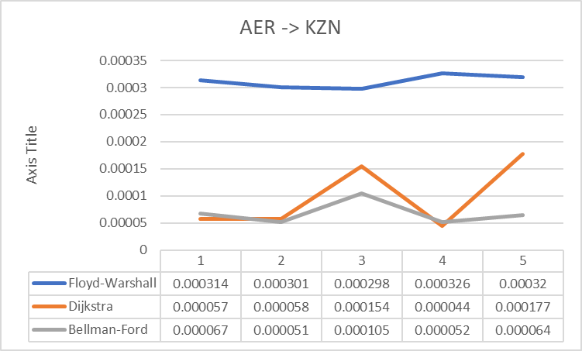
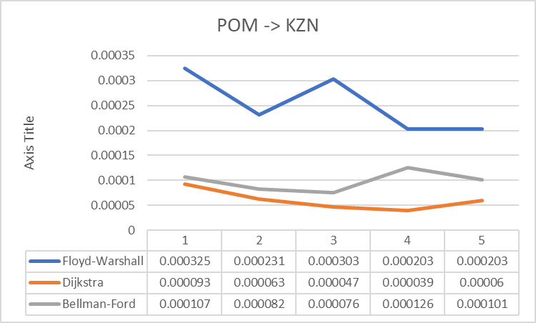
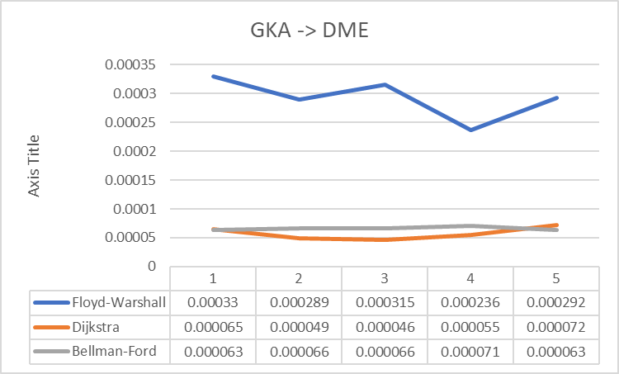
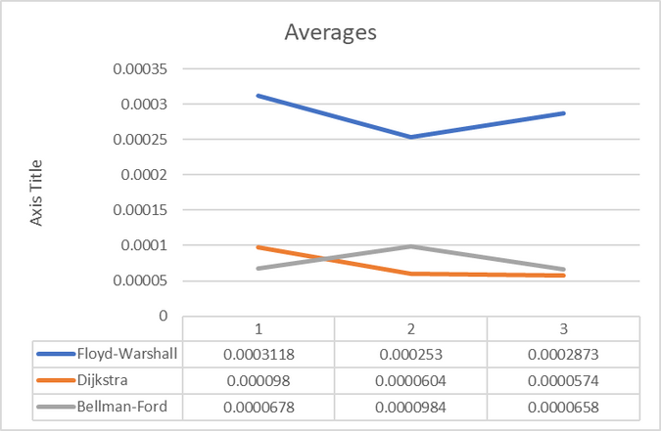
Results & Analysis
Time complexity:

Slide 7
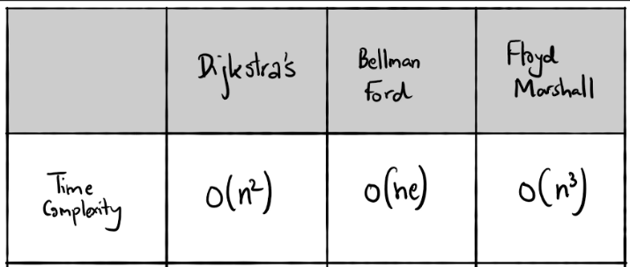
In terms of time complexity, Dijkstra's algorithm and Bellman-ford seems to be comparatively same and the efficient compared to Floyd-Warshall.
Floyd-Warshall consistently performs slower than Dijkstra and Bellman-Ford algorithms in the given scenarios.
n -> number of vertices
e -> number of connections.

Slide 8
Conclusion
Finally, to conclude our implementation of all three algorithms, Dijkstra, Bellman-Ford, and Floyd-Warshall, It is seen that both the Dijkstra and Bellman are very closely matched and outperform each other at several occasions, so it would be unfair to say that any one algorithm is faster than other. Still, the Floyd algorithm is the slowest among the three. This might have been because it uses three nested loops to iterate over all pairs of vertices. We have used any graph with negative cycles, which is when the bellman algorithm is asit to shine, so in comparison of Time complexities, Dijkstra has a better consists at outperforming other algorithm any graph with negative cycles, which is when the bellman algorithm is asit to shine, so in comparison of Time complexities, Dijkstra has a better consists at outperforming other algorithms, and look at the point that no one cycles were considered It could be stated that Dijkstra is a super algorithm if negative cycles are not considered.

Slide 9
Conclusion
Scope of future extension:
This initiative supports future expansion research in numerous areas. First, improving algorithms and data structures for massive datasets may boost efficiency. Parallelization and heuristics may save computation time and optimise resource use. The route planning system may be more resilient when finding and addressing negative-weight cycles in the Bellman-Ford algorithm. Finally, real data sources, including flight schedules, weather, and airport congestion, may improve route planning accuracy and responsiveness, improving the traveller experience.
Summary:
By applying graph algorithms, the research optimised aircraft route planning. The research implemented and compared Dijkstra's, Bellman-Ford's, and Floyd-Warshall's algorithms to assess their performance and application. Using accurate data and thorough research, route selection improved client travel experiences. The project's findings provide the groundwork for aircraft route planning enhancements.

Slide 10
Contribution & Acknowledgement
Each of our Team members made equal contributions to the codes
and we took lot of references from other sources also.
Vishwjeetsinh Jadeja (B22MT023)
Aaditya Kamble(B22MT024)
Sahil (B22MT038)
Ghanshyam (B22PH009)
Took a lead of Floyd-Warshall algorithm.
Lead the Team
Took a lead of Dijkstra algorithm.
Handle all the trouble shooting issues and errors.
Took a lead of Bellman-Ford algorithm.
Did major research required.
Study the time complexities of all algorithms.
Made datasets, did data processing and manage all datas of airport and routes files.
Visulize the graphs along with minor improvements here and there
Suggested the idea of the project.
Dijkstra's Algorithm
Floyd Warshall Algorithm
Bellman-Ford Algorithm
iqcode
programesecure
stackoverflow
dev
geeks for geeks
stackflow
github
stacksoverflow
geeksforgeeks
Programiz
codereview.stackexchange
stackoverflow
code.pieces.app

