Slide 1
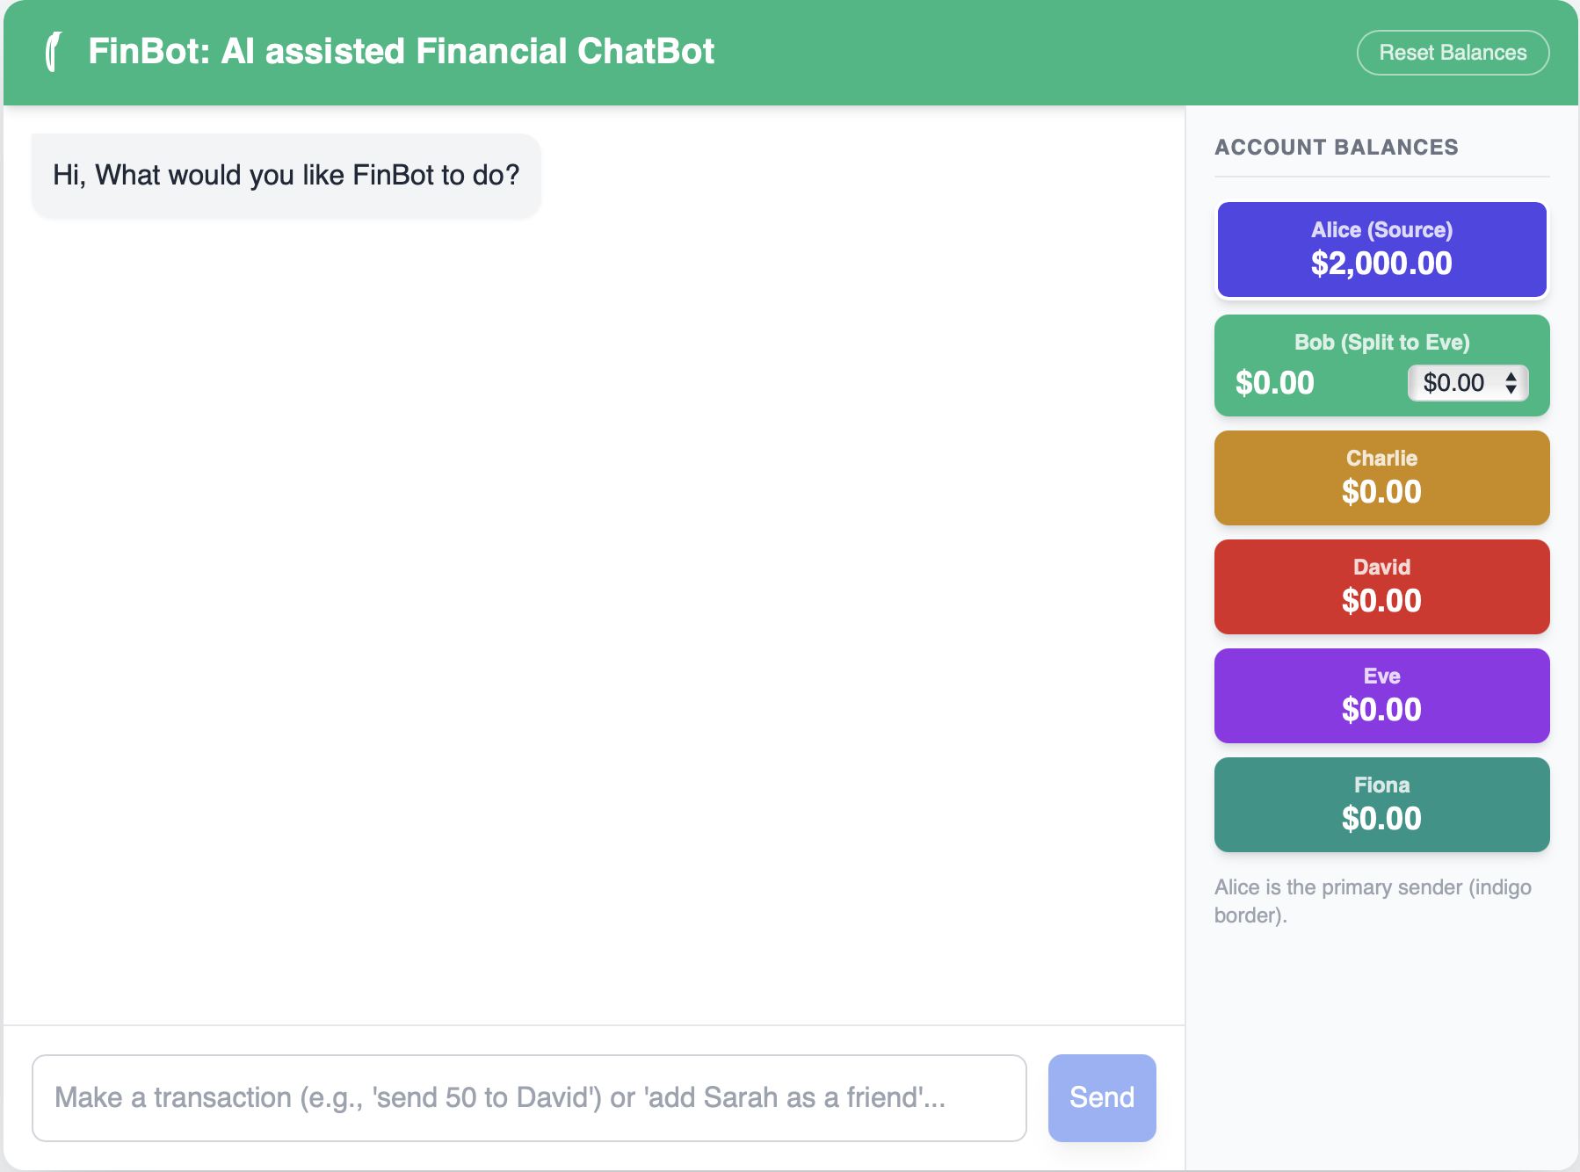
FinBot
AI Assisted Financial Chatbot and a multi-recipient payment System

Slide 2
FinBot - Features
Which stock should I buy?
Can differentiate between financial and non-financial prompts.
Fraud detection using KYC/KYB.
Safe transfer to friends and authentic businesses.
Money deposit, withdraw, balance lookup and history lookup.
Every transaction requires authentication through password.
Daily transection limit.
Supports multi-recipient payment system.
And all other benefits of an AI chatbot!
Send $5 to Bob.
Can you tell my balance?
How’s the weather today?
Create a monthly budget.

Slide 3




Send $10 to Bob …
No
Financial?
Response from Gemini
Using RegEx
Get amount and recipient using Gemini
No
Trusted?
Individual
KYC/KYB
Corporation
Trusted?
No
Yes
Yes
Other Safeguards
All transactions require authorization via password.
Amount more than predetermined threshold is not allowed.

Slide 4

Multi Recipient Payment System
What is it?
Automatically transfer money from one source to multiple recipient via single transaction using predetermined filters such as sender, amount, split ratio/amount etc.
Why is it?
Promotes collaboration between multiple corporations. i.e., DOMINOS and ST. JUDE.
ST. JUDE gets money with each transaction between customer and DOMINOS at the time of the transaction.
DOMINOS doesn’t have to calculate and send money manually to ST. JUDE.
Customer gets the satisfaction of actually donating to ST. JUDE (transparency).
You have made the donation!
Not, Donation is made in your name!

