Slide 1
INSIGHTVISTA 2026
OLYMPIC ATHLETE
EVENT ANALYTICS
From raw records to business-ready insights
GROUP • Analytics Squad
Member 1 | PEN: 240840116043
Member 2 | PEN: 240840116049
Member 3 | PEN: 240840116127
Member 4 | PEN: 250843116017
Member 5 | PEN: 240840116095
Dataset: Olympic athlete events • Coverage: 1896–2016

Slide 2
01 | Raw Data Observation
Understanding the dataset before analysis
ROWS
COLUMNS
SPORTS
TEAMS
YEARS
269,731
13
66
1,184
1896–2016
• 13 fields capture athlete identity, demographics, team/NOC, year, season, host city, sport, event and medal outcome.
• The dataset spans 1896–2016 and contains both Summer and Winter Olympic records.
• Most records are from Summer Olympics (221,167); Winter records: 48,564.
• Medal values include Gold, Silver, Bronze and No Medal; each row represents an athlete-event participation record.
INSIGHTVISTA 2026 • 02/08

Slide 3
02 | Steps Performed on the Raw Data
A reproducible data preparation workflow
1
Load
Imported the CSV and inspected dimensions, column names and data types.
2
Profile
Checked missing values, duplicate rows and category distributions.
3
Validate
Reviewed numeric fields (Age, Height, Weight, Year) and category fields.
4
Standardize
Used consistent column labels and interpreted “No Medal” as a valid outcome, not missing data.
5
Prepare
Grouped records by sport, year, team and medal outcome for visualization.
INSIGHTVISTA 2026 • 03/08

Slide 4
03 | Final Clean Dataset
Quality checks and analytical-ready structure
ROWS RETAINED
MISSING CELLS
DUPLICATE ROWS
MEDAL RECORDS
269,731
0
0
39,772
• The supplied file is already a clean dataset: all 269,731 rows have values in all 13 columns.
• No exact duplicate rows were detected, so no records needed to be removed for duplication.
• Numeric fields are ready for summary statistics; categorical fields are ready for grouping and comparison.
• “No Medal” was preserved as a meaningful category. Medal-winning records are counted separately when needed.
• Important interpretation: medal counts here are athlete-event records, not necessarily unique physical medals.
Output: a validated, analysis-ready table for dashboarding and recommendations.
INSIGHTVISTA 2026 • 04/08

Slide 5
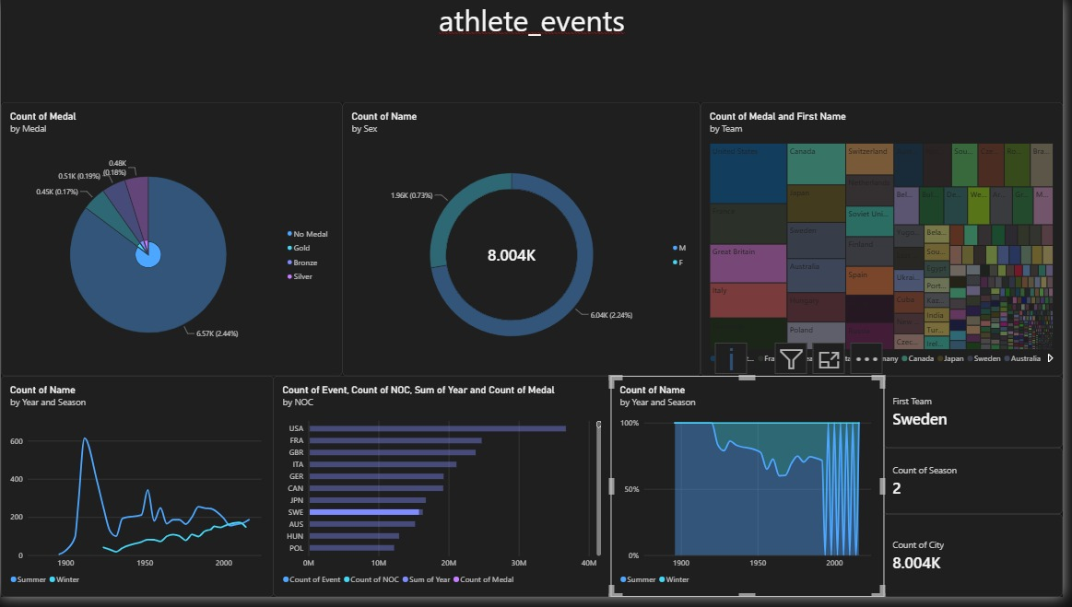
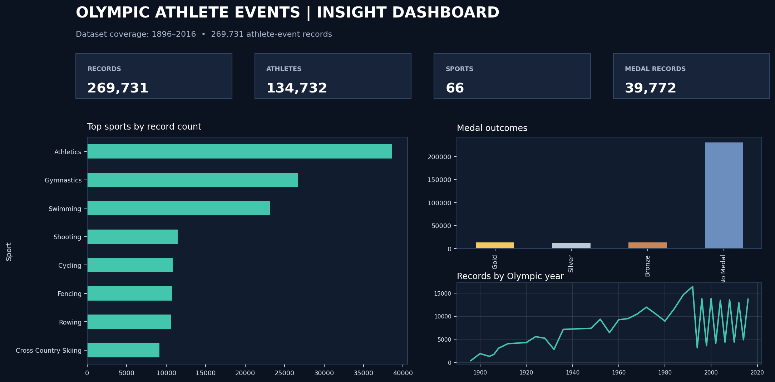
04 | Visualization Dashboard
Actual Power BI dashboard provided by Analytics Squad
INSIGHTVISTA 2026 • 05/08

Slide 6
05 | Dashboard Observations
What the charts tell us at a glance
UNIQUE ATHLETES
FEMALE RECORDS
MEDAL RECORDS
SPORTS
134,732
27.6%
14.7%
66
• Athletics has the largest record count (38,624), followed by Gymnastics and Swimming.
• Most rows are “No Medal” (229,959); medal-winning rows total 39,772.
• The number of records varies across Olympic years; 1992 has the largest record count in this file.
• Female athlete-event records account for about 27.6% of all rows, indicating a gender representation gap across the full historical period.
INSIGHTVISTA 2026 • 06/08

Slide 7
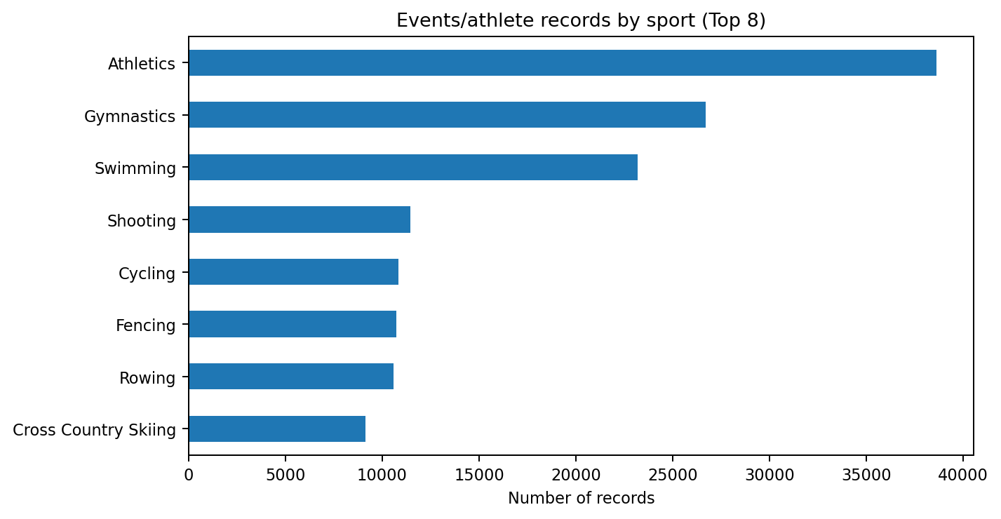
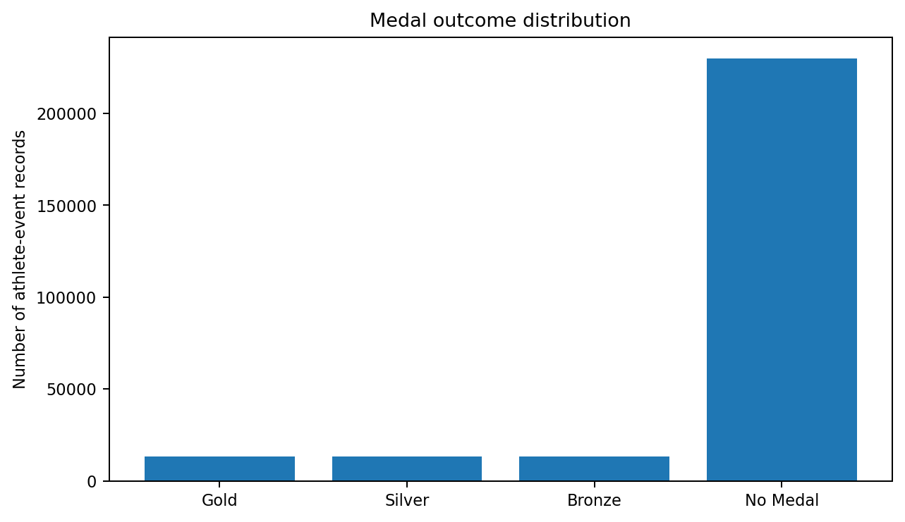
06 | Deeper Insights
Patterns worth investigating further
• The United States has the highest count of medal-winning athlete-event records in this dataset (5,219), followed by the Soviet Union and Germany.
• Gold (13,369), Silver (13,108) and Bronze (13,295) counts are broadly similar.
• These are historical participation records. Host city, sport popularity, gender participation and medal outcomes should be explored by year/season to avoid misleading overall comparisons.
INSIGHTVISTA 2026 • 07/08

Slide 8
07 | Business Recommendations
How stakeholders can use the insights
01 Sponsorship strategy
Prioritize high-participation sports such as Athletics, Gymnastics and Swimming; validate audience reach before allocating budgets.
02 Athlete development
Compare medal outcomes by sport, country and Olympic year to identify areas for coaching investment.
03 Inclusion & access
Track female participation over time and by sport to identify gaps and measure progress.
04 Host-city planning
Use historical record volume by year/season to estimate staffing, venue and event-operation needs.
05 Better decisions
Add audience, viewership, costs, ticket sales and sponsorship revenue to connect sporting outcomes to actual business impact.
Business takeaway: use this dataset to spot patterns; combine it with financial and audience data before making investment decisions.
INSIGHTVISTA 2026 • 08/08

