Slide 1
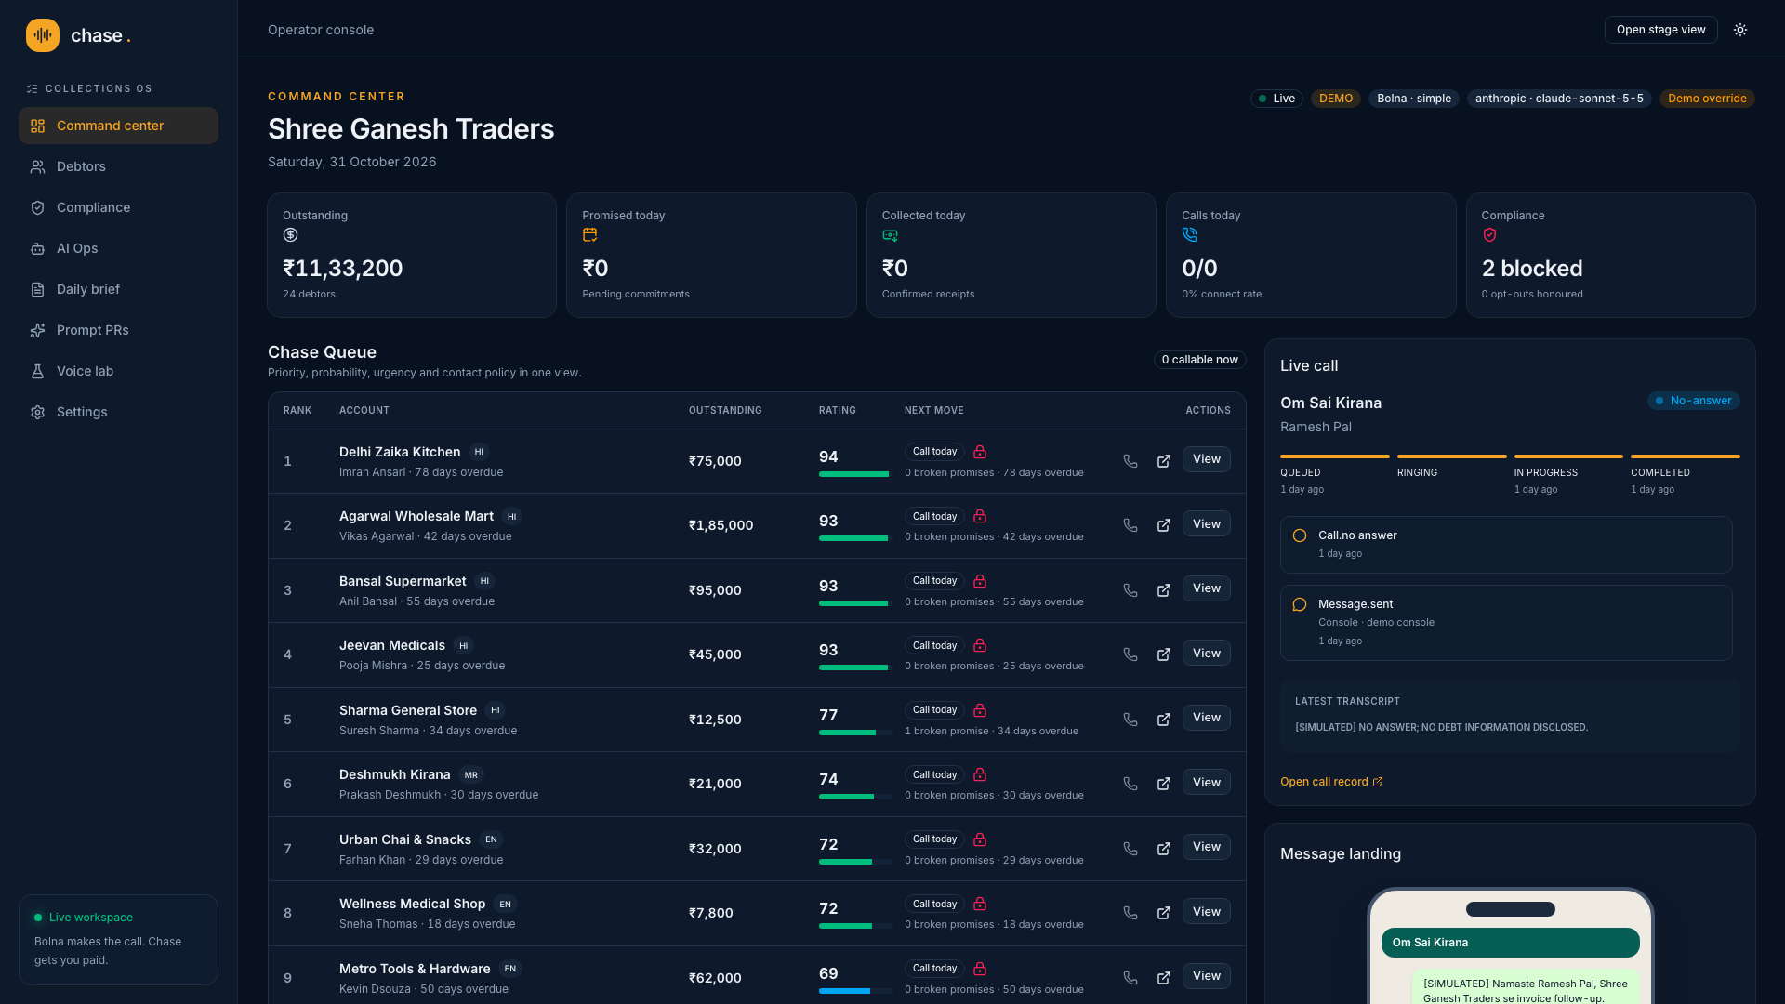
THE PROBLEM
Indian SMB credit still runs on the owner’s follow-up
The ledger knows who owes money. The owner still decides who to chase, makes the call, sends the link and remembers every promise.
24 fictional debtors · ₹11,33,200 outstanding in the reset demo
Voice AI can make the call. The operating work around it is still missing.
CHASE
Notes:
Demo figures are from the committed fictional portfolio after pnpm demo:reset. They are not customer traction.

Slide 2
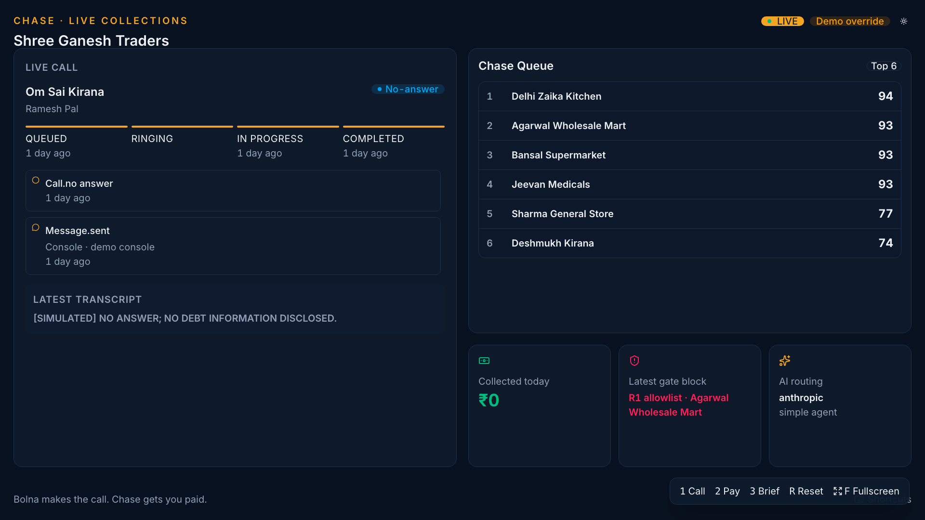
LIVE DEMO
One call. Payment action, restraint and a queue that learns.
Bolna speaks Hinglish. Chase controls the account, tools and conduct.
Notes:
Demo flow: identity before dues, broken-promise recall, ₹2,000 payment link, 9 pm callback block, rating move, owner brief.

Slide 3
HOW IT WORKS
Chase is the control layer around every Bolna execution
01
Rank
A deterministic Chase Rating prioritises cash, urgency and effort.
02
Gate
R1–R11 decides whether contact is allowed before any dispatch.
03
Act
Seven authenticated tools turn conversation into durable work.
04
Learn
Claude updates the dossier, rating, owner brief and prompt evidence.
Next.js · Neon · Claude · Bolna · WhatsApp/console · hosted UPI/Razorpay test
Notes:
Architecture is one Next.js application in Vercel bom1 with Postgres as the source of truth and SWR polling.

Slide 4
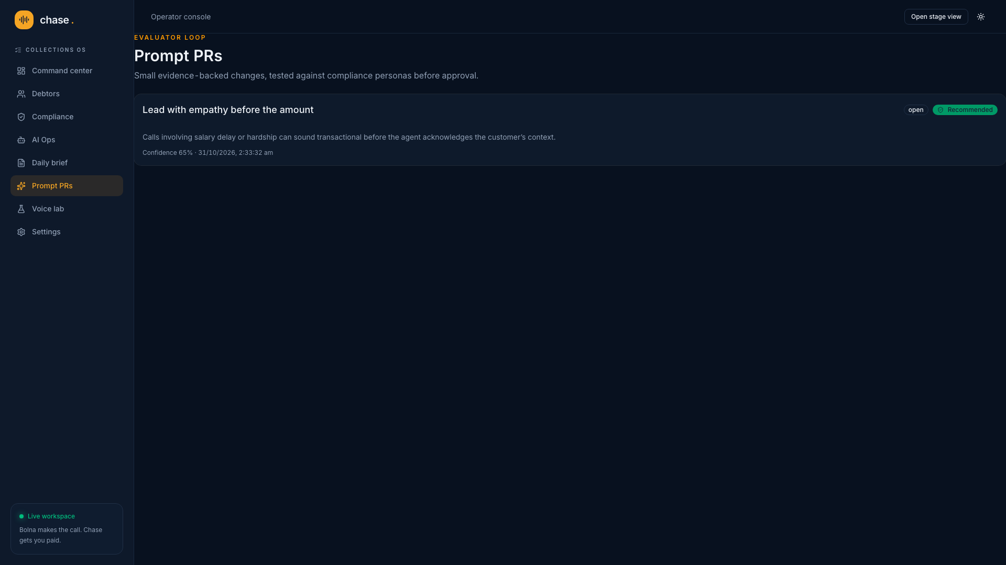
WHY NOW
Voice quality is ready. The improvement loop was the missing piece.
Bolna handles multilingual calling and execution.
Claude turns outcomes into typed evidence, then proposes a small prompt diff.
Eight personas test the base and candidate. Any compliance regression blocks recommendation.
Human approval stays in the loop.
Notes:
The Prompt PR shown is a seeded, evidence-linked demo proposal. Protected compliance sections cannot be edited.

Slide 5
BUSINESS MODEL
Charge for active accounts. Win when the customer collects.
PLATFORM
OUTCOME
Monthly fee per active account
A share of recovered dues
Covers ranking, conduct controls, agent tools, operator console and management brief.
Aligns pricing with cash received while keeping simulated and test-mode money outside billing.
Start with distributors and wholesalers that already export receivables from Tally or spreadsheets.
Notes:
No price point or production revenue is claimed. The requested model is a monthly fee per active account plus a share of recovered dues.

Slide 6
THE ASK
Pilot Chase with a distributor whose owner still runs collections by phone
We want paid design partners and channel introductions into Indian distribution.
Bolna makes the call.
Chase gets you paid.
chase-liard.vercel.app
Notes:
Close after the owner brief call. The public read-only passcode must be provided separately once configured.

