Slide 1
Recommender System DATA mining: CS535-01
Aaditya Sakharam Patil
B00713570

Slide 2
What is recommender system
Recommender system is a technology that seeks to predict the "rating" or "preference" a user would give to an item.
Approaches:
Collaborative filtering
User based
Item Based
Content-based filtering
Hybrid recommender systems

Slide 3
MY project
Language:
Java with Apache Mahout
External Libraries:
commons-math3-3.6.1
mahout-core-0.8
mahout-integration-0.12.2
mahout-math-0.12.2
guava-19.0
slf4j-api-1.7.21
slf4j-nop-1.7.21
Algorithms:
Matrix Factorization
ALSWR Factorizer
SVD Recommender

Slide 4
Why APACHE MAHOUT and Matrix factorization?
Mahout offers a ready-to-use framework for doing data mining tasks on large volumes of data.
Mahout’s flexible collaborative filtering framework features a broad range of algorithm implementations and provides all necessary building blocks for real-world recommender systems
Mahout also offers tools to evaluate the prediction quality of a recommender on a random split of the data.
Matrix factorization techniques are usually more effective because they allow us to discover the latent features underlying the interactions between users and items.
Matrix Factorization is simply a mathematical tool for playing around with matrices, and is therefore applicable in many domains where one would like to find out something hidden under the data.

Slide 5
Algorithm: LATENT FACTOR MODELS
It is based on projecting the user-item interactions onto a lower-dimensional feature space.
In Mahout, the SVDRecommender computes recommendations from such a projection.
The necessary decomposition of the interaction data is computed by a Factorizer.
Mahout has implemented matrix factorization based on:
SGD(Stochastic Gradient Descent)
ALSWR(Alternating-Least-Squares with Weighted-λ-Regularization).

Slide 6
ALSWR (Alternating-Least-Squares with Weighted-λ-Regularization):
ALSWR is an iterative algorithm to solve the low rank factorization of user feature matrix U and item feature matrix M.
At the beginning of the algorithm, M is initialized with the average item ratings as its first row and random numbers for the rest row.
In every iteration, we fix M and solve U by minimization of the cost function L(R, U, M), then we fix U and solve M by the minimization of the cost function similarly. The iteration stops until a certain stopping criteria is met.
L(R, U, M) = sum(pow((R[u,i] - U[u,]* (M[i,]^t)), 2)) + lambda * (sum(n(u) * ||U[u,]||^2) + sum(n(i) * ||M[i,]||^2))

Slide 7
ALSWR (Alternating-Least-Squares with Weighted-λ-Regularization):
To solve the matrix U when M is given, each user’s feature vector is calculated by resolving a regularized linear least square error function using the items the user has rated and their feature vectors:
Similarly, when M is updated, we resolve a regularized linear least square error function using feature vectors of the users that have rated the item and their feature vectors:
1/2 * d(L(R,U,M)) / d(U[u,f]) = 0
1/2 * d(L(R,U,M)) / d(M[i,f]) = 0

Slide 8
SVD Recommender
SVD gives User matrix ‘U’ and Item Matrix ‘M’ by factorizing the Matrix R into three matrices.
Here is the matrix factorization: R=MΣU^{T}
It takes the matrix R as an input, and gives M, Σ and U, such that:
R is equal to the product MΣU^{T}.
The columns of M can build back all of the columns of R.
The columns of U can build back all of the rows of R.
The columns of M are orthogonal, as well as the columns of U.
Σ is a diagonal matrix.

Slide 9
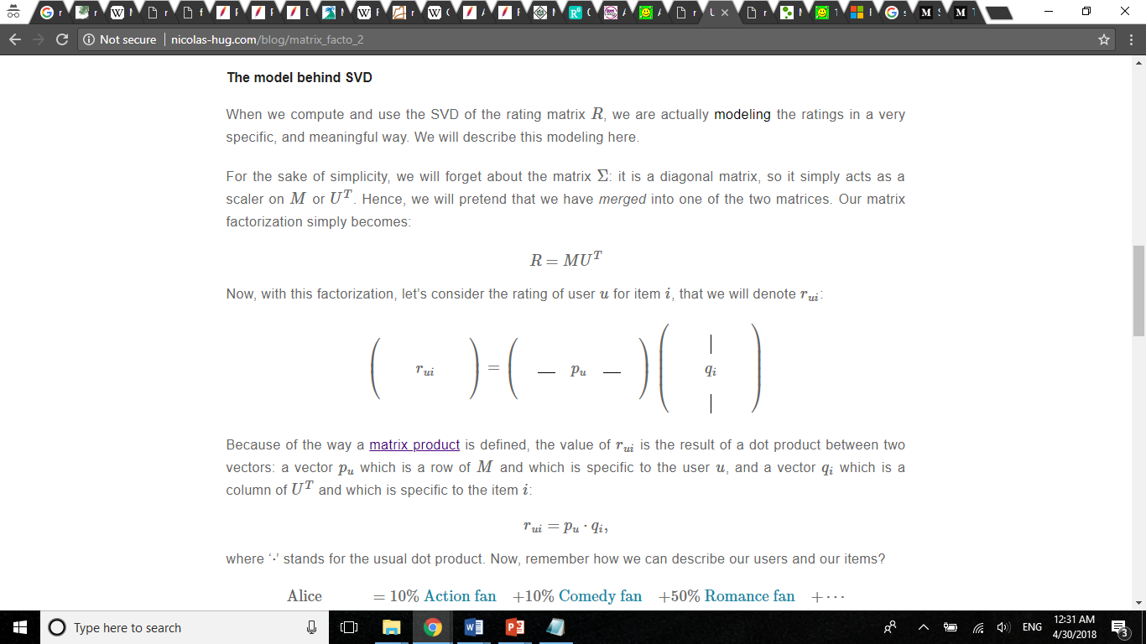
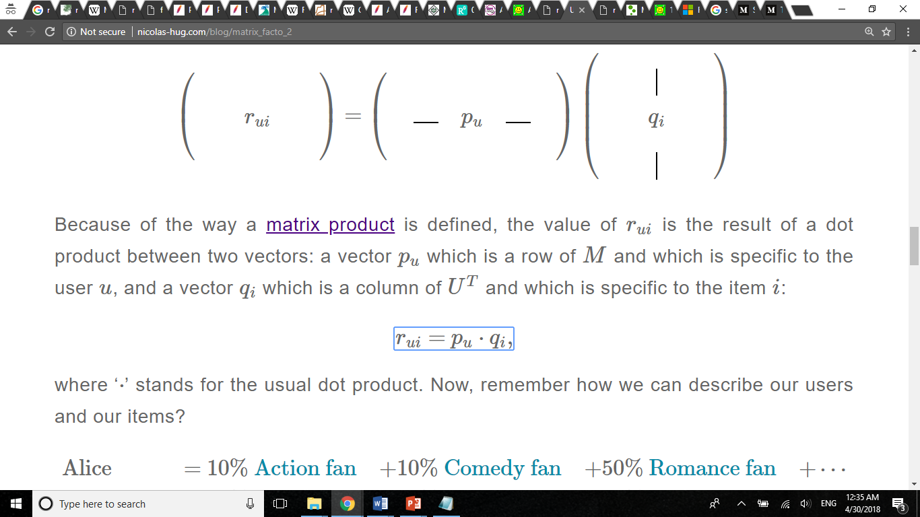
SVD Recommender
Matrix Σ is a diagonal matrix, so it simply acts as a scaler on M or U^{T}
Our matrix factorization simply becomes: R=MU^{T}
Consider the rating of user u for item i, that we will denote rui:
The value of r_{ui} is the result of a dot product between two vectors: a vector p_{u} which is a row of M and which is specific to the user u, and a vector q_{i} which is a column of U^{T} and which is specific to the item i:

Slide 10
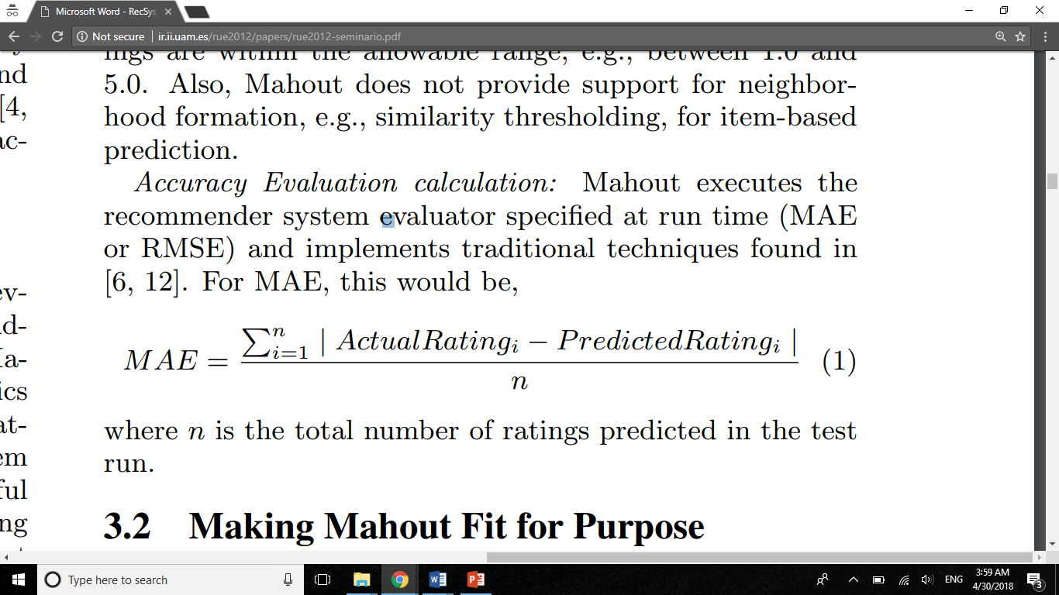
Evaluations:
Matrix:
Mean Absolute Error(MAE)
MAE is calculated by AverageAbsoluteDifferenceRecommenderEvaluator in mahout.
Training Data: 80% of all data
Testing data: 20% of the data
MAE obtained: 0.7578592939407708

Slide 11
Evaluations of Different Algorithms:
Evaluations are done with 80% training data and 20% testing data
ALGORITHM | MAE
ALSWRFactorizer factorizer = new ALSWRFactorizer(model, 20, 0.085, 15); SVDRecommender svd = new SVDRecommender(dataModel, factorizer); | 0.7578592939407708
ALSWRFactorizer factorizer = new ALSWRFactorizer(model, 50, 0.085, 15); SVDRecommender svd = new SVDRecommender(dataModel, factorizer); | 0.7629410184355793
SVDPlusPlusFactorizer factorizer = new SVDPlusPlusFactorizer(model, 50, 15); SVDRecommender svd = new SVDRecommender(dataModel, factorizer); | 0.8125401578420356
UserSimilarity similarity = new PearsonCorrelationSimilarity(model); NearestNUserNeighborhood neighbour = new NearestNUserNeighborhood(400, similarity, model); return new GenericUserBasedRecommender (model, neighbour, similarity); | 0.8234045864839203
UserSimilarity similarity = new PearsonCorrelationSimilarity(model); NearestNUserNeighborhood neighbour = new NearestNUserNeighborhood(50, similarity, model); return new GenericUserBasedRecommender (model, neighbour, similarity); | 0.8638892720349901

Slide 12
Evaluations of Different Algorithms:
Evaluations are done with 80% training data and 20% testing data
ALGORITHM | MAE
UserSimilarity similarity = new TanimotoCoefficientSimilarity(model); NearestNUserNeighborhood neighbour = new NearestNUserNeighborhood(400, similarity, model); return new GenericUserBasedRecommender (model, neighbour, similarity); | 0.8159369138076692
ItemSimilarity itemSimilarity = new TanimotoCoefficientSimilarity(model); return new GenericItemBasedRecommender(model, itemSimilarity); | 0.8079314214447291
ItemSimilarity itemSimilarity = new PearsonCorrelationSimilarity(model); return new GenericItemBasedRecommender(model, itemSimilarity); | 0.8531408778399598

Slide 13
real-world application:
Three-dimensional irregular seismic data reconstruction via low-rank matrix completion:
Based on properties of the seismic wavefields and on signal processing concepts, such as sparse signal representation in a transform domain, an algorithm has been developed for the reconstruction of seismic traces randomly missing from a uniform grid of a 3D seismic volume.
Low-rank components capture geometrically meaningful structures in seismic data that encompass conventional local features such as events and dips.
The rank of the seismic data (computed by singular value decomposition) increases with noise or missing traces.
low-rank matrix completion (MC) with a designed texture-patch transformation to 3D seismic data reconstruction is used.

Slide 14
real-world application:
2. Correlation Matrix Completion in insurance and risk management.
An insurance company with many lines of business is required to satisfy certain capital requirements but may have incomplete knowledge of the underlying correlation matrix.
Calculations of the capital that financial firms are required to hold can allow for some diversification between types of risks.
Diversification can be derived from the dependency relations between capital for individual risks, specified in the form of a correlation matrix.
It is often the case that not all of the entries in the correlation matrix Σ are known.
For example, the insurer may be exposed to different risks than those considered in the standard formula, or may not be using the standard formula at all.
In such cases, Correlation Matrix Completion is used predict risks.

Slide 15
References:
Explicit Solutions to Correlation Matrix Completion Problems, with an Application to Risk Management and Insurance
Georgescu, Dan I. and Higham, Nicholas J. and Peters, Gareth W.
Three-dimensional irregular seismic data reconstruction via low-rank matrix completion
Article in Geophysics · August 2013
https://mahout.apache.org
http://nicolas-hug.com/blog/matrix_facto_2
https://en.wikipedia.org

Slide 16
THANK YOU..!

