Slide 1
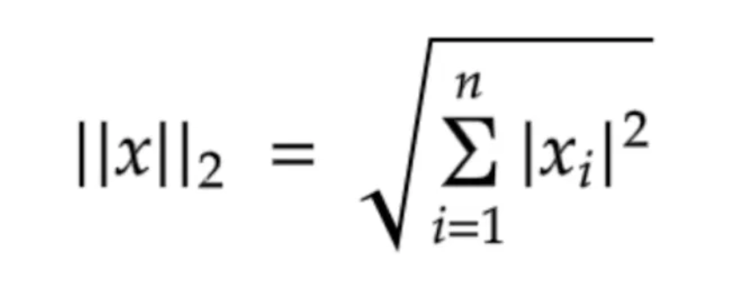


9
9
3
4
7
0
4
7
3
7
1
2
0
0.47
0.47
0.15
0.20
0.36
0
0.21
0.36
0.15
0.36
0.052
0.10
0
Embedding[i]=phone_number[i]
$${\left\|x\right\|}_{2}$$
Phone number
Embeddings

Slide 2
Differential Privacy
Invisible" Individual Contribution: DP ensures that the presence or absence of any single individual's data in a dataset does not significantly affect the outcome of an analysis.
1. Centralized Differential Privacy (CDP)- A trusted data curator holds the raw, sensitive data. The curator adds noise to the query results or aggregated statistics before releasing them to the public.
2. Local Differential Privacy (LDP)Mechanism: Noise is added by each individual to their own data before it is sent to the data collector. The collector then aggregates these noisy responses.
Noise Adding Mechanism
Laplaican noise
Exponential noise
Gaussian noise
Randomised response
In our case, we will add noise by generating fake query as being implemented in https://machinelearning.apple.com/research/wally-search

Slide 3
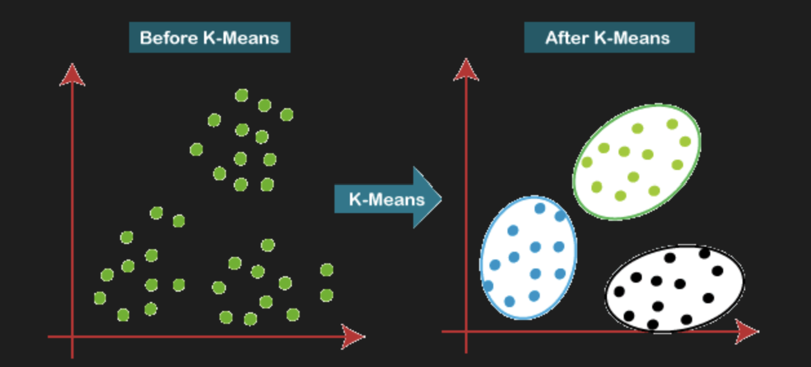
K-Means Clustering
K-means clustering is an unsupervised machine learning approach that uses similarities to divide a dataset into K different clusters.
The algorithm aims to minimize the within-cluster variance, ensuring that data points within the same cluster are as similar as possible while data points in different clusters are as dissimilar as possible.

Slide 4
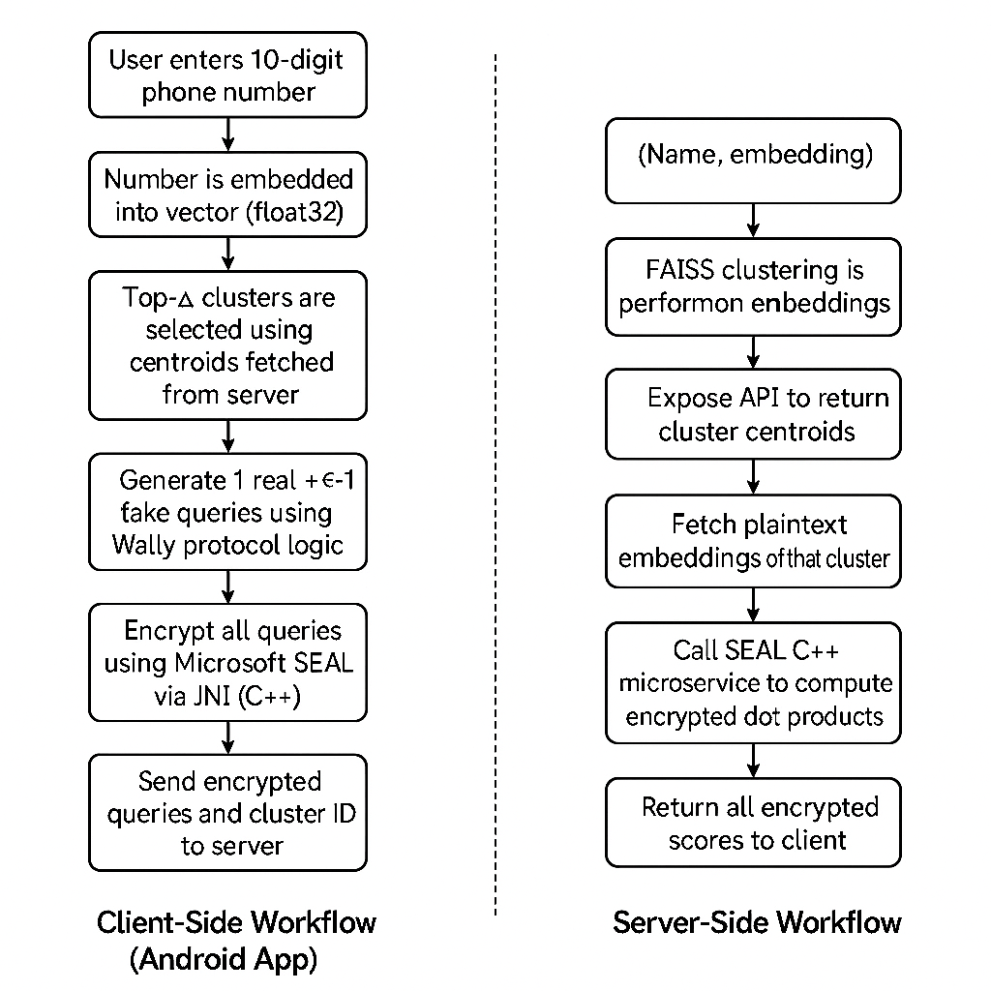
Workflow

