Slide 1


Slide 2
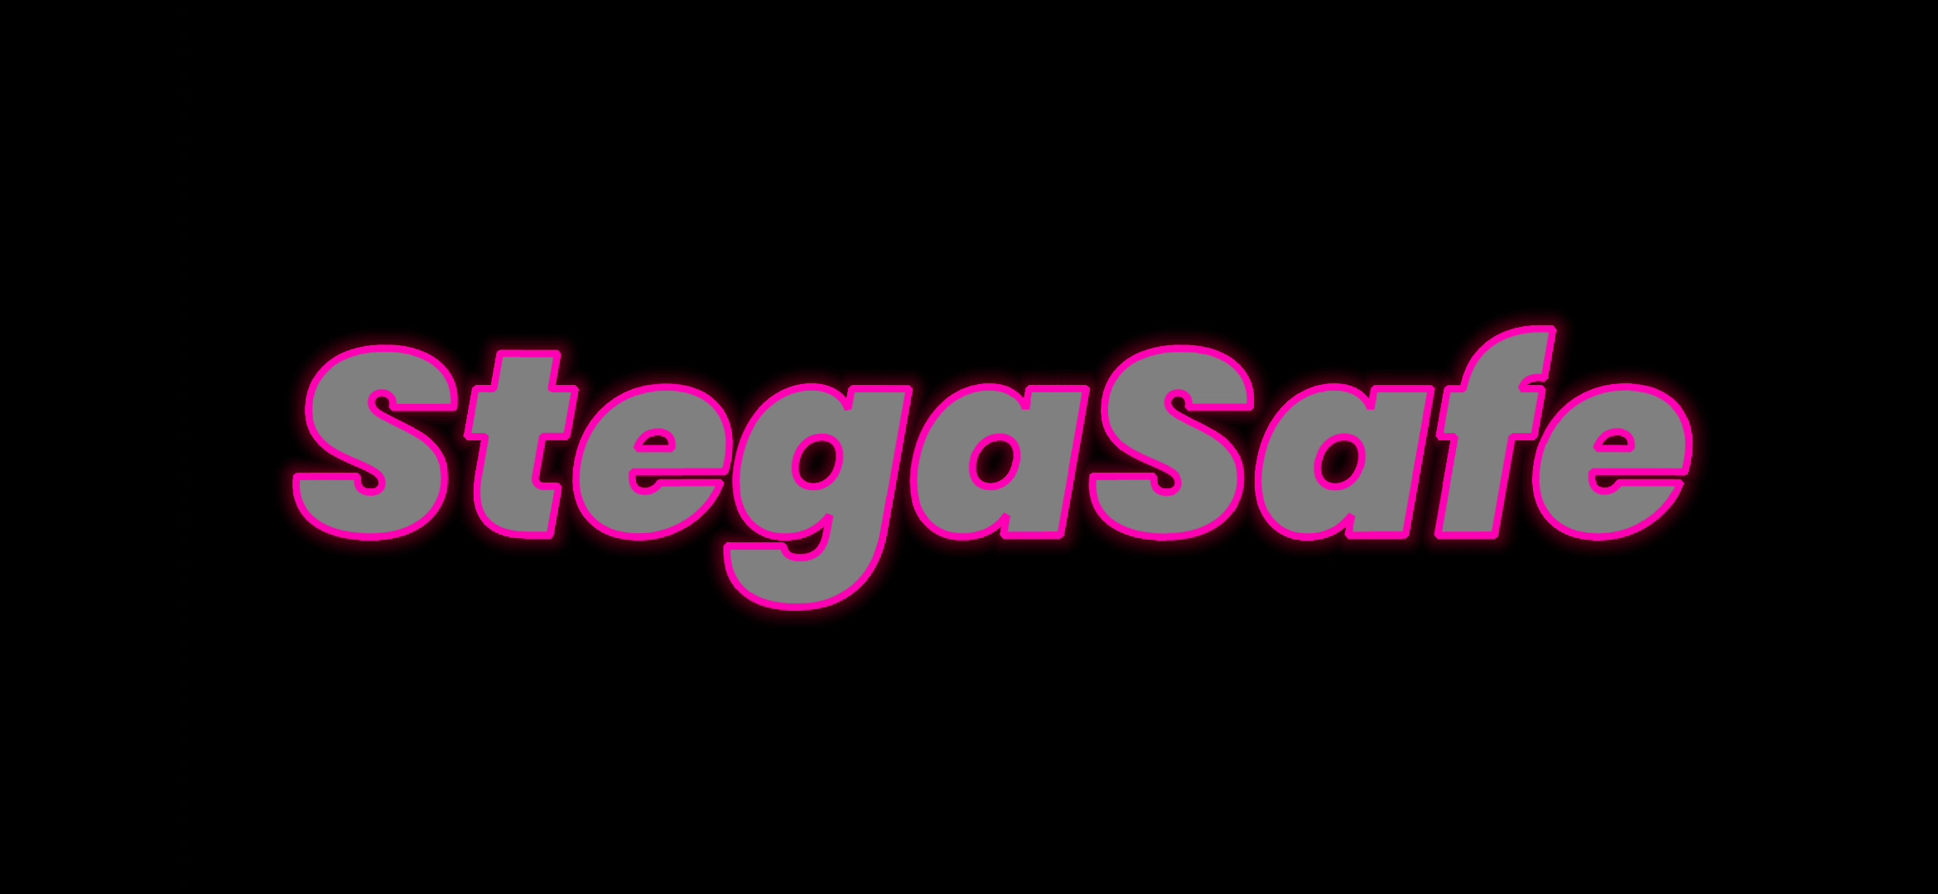

Slide 4
StegaSafe: Image-Based Message Encryption
Submitted to:
Department of Computer Science and Engineering

Slide 5
Supervised by: Prof. Shraddha Sharma
Team Members
1. Aaditya Panwar(0827CS211001)
2. Anusha Nagar (0827CS211029)
3.Anushka Patel (0827CS211030)

Slide 6
Project Presentation Outline
Introduction
Problem Statement
Survey of Existing Systems
Project Objectives
Requirement Analysis
Solution Proposed
Features
System architecture
User Interface
Testing Plan
The Outcome Discussion
Conclusions

Slide 7

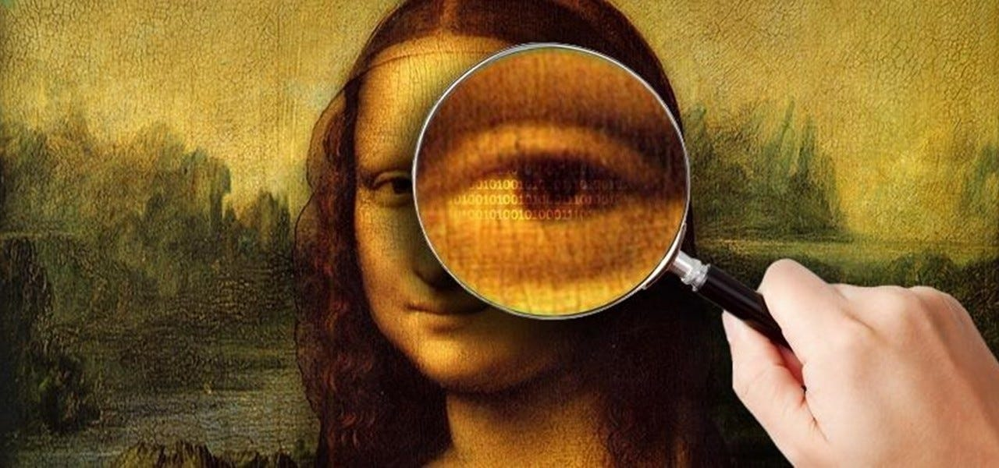
Introduction
Steganography Defined: Steganography is the art of hiding information within digital media, such as images, audio, or video, to ensure secure and covert communication.

Slide 8


Introduction
Importance: In an era of increasing cybersecurity threats, StegaSafe offers a discreet method for protecting sensitive information without attracting attention.

Slide 9
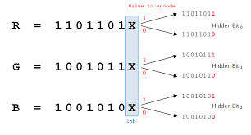
Introduction
Project Overview: StegaSafe is a Python-based application designed to embed and extract secret messages within image files using Least Significant Bit (LSB) steganography.

Slide 10
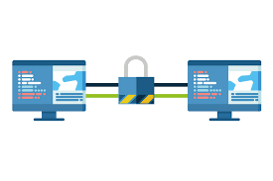
The Problem Statement
Need for Secure Communication: With rising cyber threats, there's a critical need for methods that ensure the confidentiality of sensitive information during digital communication.

Slide 11
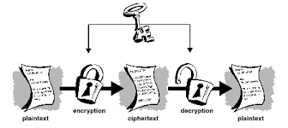
The Problem Statement
Limitations of Traditional Encryption: While encryption secures data, it can attract attention and indicate the presence of hidden information, potentially leading to targeted attacks.

Slide 12
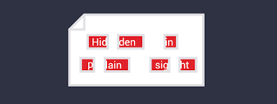
The Problem Statement
Steganography as a Solution: By embedding messages within innocuous files like images, steganography provides a covert means of communication, reducing the risk of detection and unauthorized access.

Slide 13
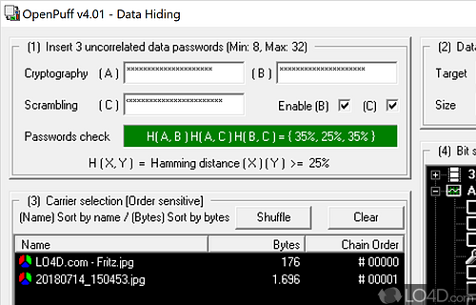
Survey of Existing Systems
OpenPuff
Advantages: Supports multiple media formats, robust security features.
Disadvantages: Complex user interface, steep learning curve.
Gaps: Not user-friendly for non-technical users.

Slide 14
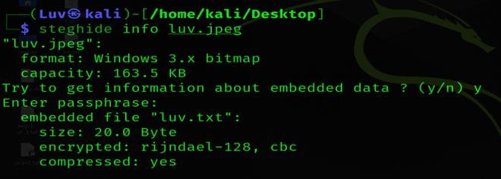
Survey of Existing Systems
StegHide
Advantages: Strong password-based encryption.
Disadvantages: Command-line interface only, lacks GUI.
Gaps: Limited usability for beginners.

Slide 15
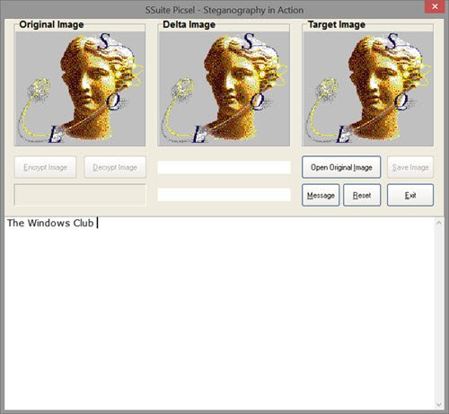
Survey of Existing Systems
SSuite Picsel
Advantages: Lightweight, simple to use.
Disadvantages: No encryption, limited security.
Gaps: Vulnerable to detection, unsuitable for sensitive data.

Slide 16
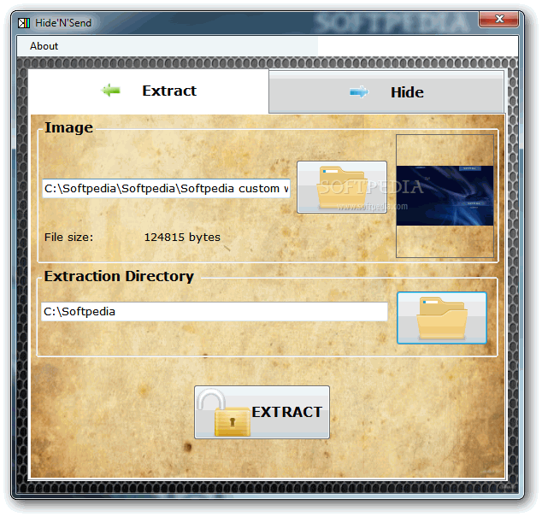
Survey of Existing Systems
Hide'N'Send
Advantages: Intuitive interface, minimal image distortion.
Disadvantages: Limited to PNG and BMP formats.
Gaps: Lacks support for popular formats like JPG.

Slide 17
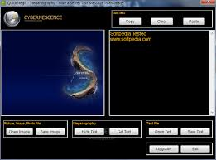
Survey of Existing Systems
QuickStego
Advantages: Extremely easy to use.
Disadvantages: Only supports BMP, no encryption.
Gaps: Not secure for sensitive information.

Slide 18
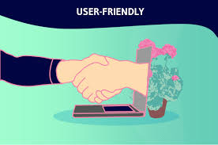
Objectives
Primary Objective:
Develop a user-friendly application that enables secure hiding and retrieval of messages within image files using LSB steganography.

Slide 19
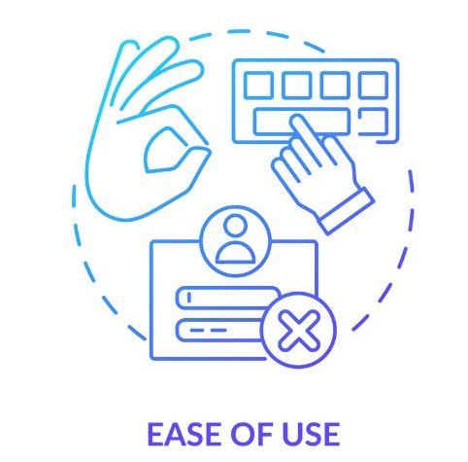




Objectives
Specific Goals:
Ease of Use: Design an intuitive GUI accessible to both technical and non-technical users.
Security: Ensure that hidden messages remain undetectable without decoding.
Functionality: Support common image formats (PNG, JPG) for wider usability.
Performance: Maintain image quality with minimal distortion during encoding.
Accessibility: Allow users to easily load, encode, decode, and save images within the application.

Slide 20

Requirement Analysis
Functional Requirements:
Message Encoding: Ability to embed text messages into images.
Message Decoding: Retrieve hidden messages from encoded images.
Image Handling: Load and save images in supported formats (PNG, JPG).
User Interface: Provide tools for selecting images, inputting messages, and executing operations.

Slide 21
Requirement Analysis
Non-Functional Requirements:
Performance: Fast encoding and decoding with minimal processing time.
Usability: Intuitive and accessible interface design.
Reliability: Accurate message retrieval without data loss.
Compatibility: Support for various image resolutions and sizes.

Slide 22

Requirement Analysis
Technical Requirements:
Hardware: Standard laptop or PC with sufficient processing power.
Software: Python, Kivy framework, PIL (Python Imaging Library), stegano library.
Data: Collection of test images in PNG and JPG formats for development and testing.

Slide 23
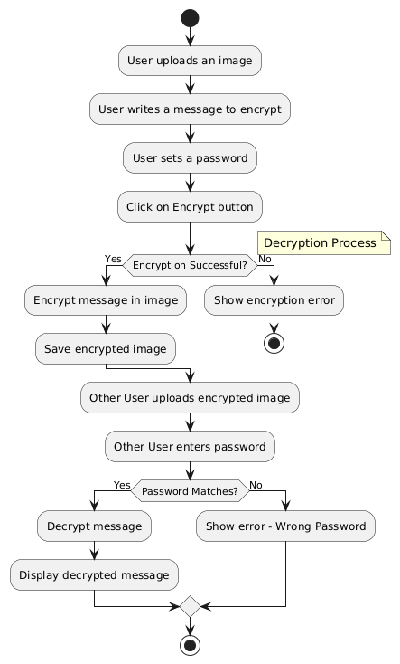
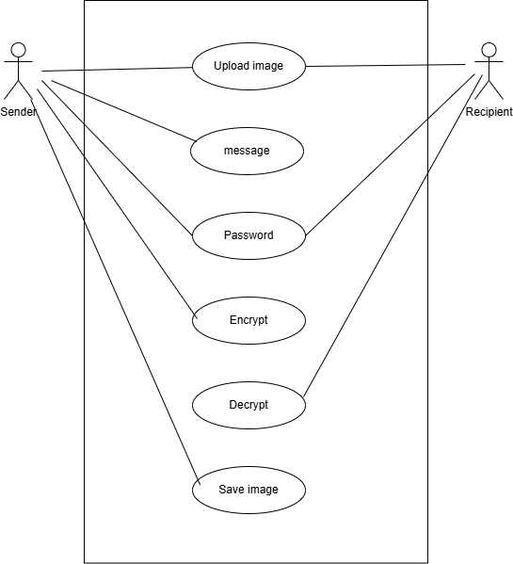
UML Diagrams

Slide 24
Solution Proposed
StegaSafe Application:
Core Technology: Utilizes Least Significant Bit (LSB) steganography to embed and extract messages within image pixels.
User-Friendly Interface: Built with Kivy to provide an accessible and intuitive GUI for all users.
Supported Formats: Compatible with widely-used image formats like PNG and JPG.
Security Measures: Ensures that hidden messages remain undetectable without the decoding process.

Slide 25
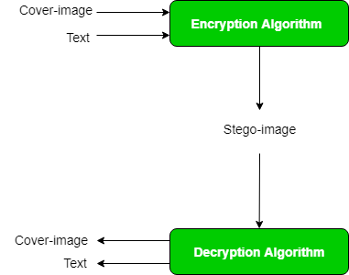
Solution Proposed
Workflow:
Load Image: User selects an image file from their device.
Input Message: User enters the text message to be hidden.
Encode Message: Application embeds the message into the image.
Save Encoded Image: User saves the modified image with the hidden message.
Decode Message: User can later load the encoded image to retrieve the hidden message.

Slide 26
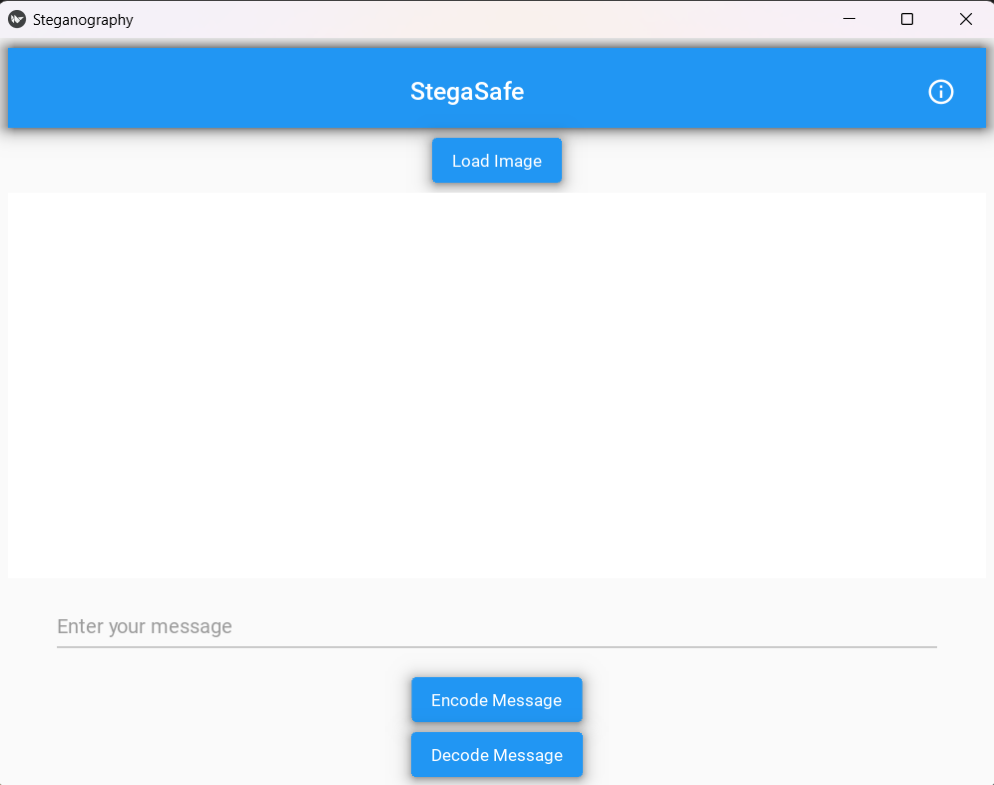
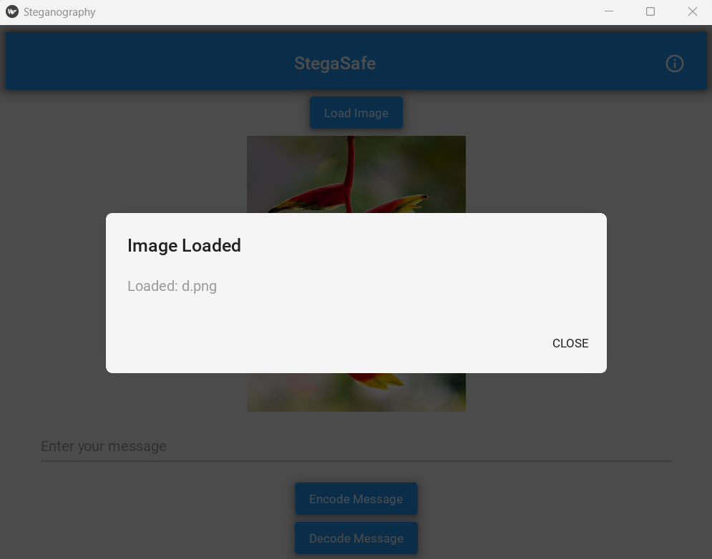
Screenshots

Slide 27
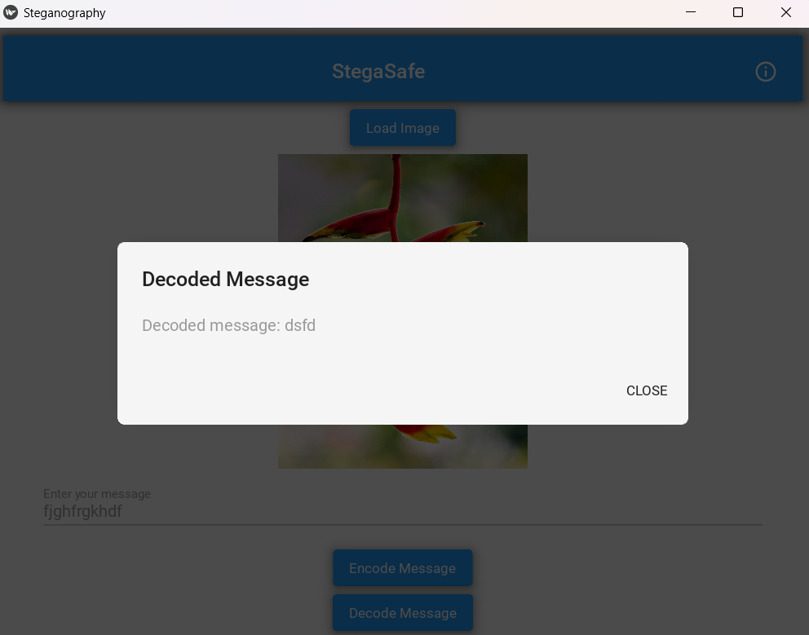
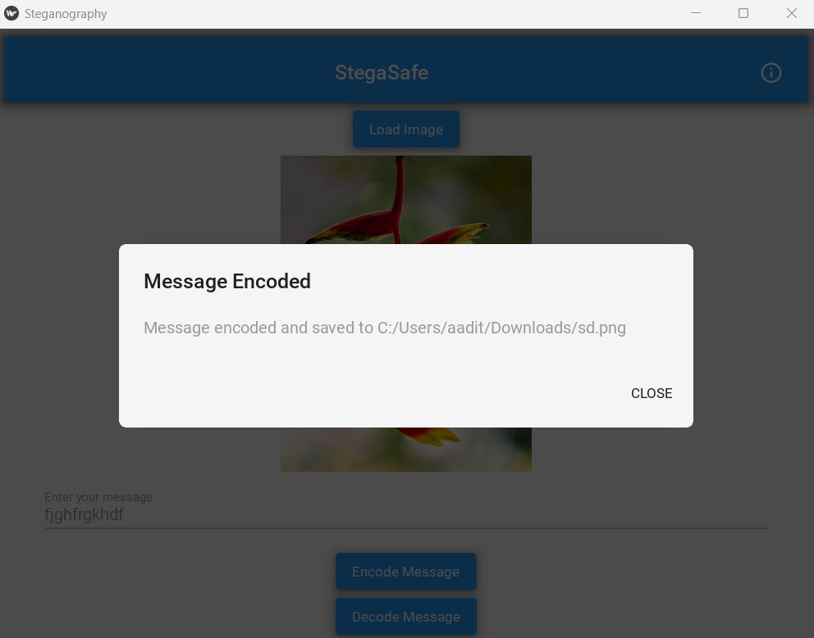
Screenshots

Slide 28
Features
Functional Features:
LSB Steganography: Embed and extract messages using the Least Significant Bit method.
Image Saving: Save encoded images without noticeable changes.
Format Support: Handle PNG and JPG image formats.

Slide 29
Features
Security Features:
Data Concealment: Hidden messages are not detectable without decoding.
Privacy Assurance: Prevent unauthorized access to hidden information.

Slide 30
Features
Performance Features:
Efficient Processing: Quick encoding and decoding with minimal impact on image quality.
Visual Integrity: Maintain the original appearance of images post-encoding.

Slide 31

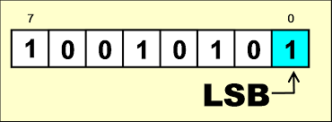
System Architecture
Main Components:
User Interface (UI):Developed with Kivy.Handles user interactions like image selection, message input, and initiating encoding/decoding.
Steganography Core:Implements the LSB algorithm.Manages the embedding and extraction of messages within image pixels.
File Handling System:Manages loading and saving of image files.Ensures compatibility with supported formats and handles file I/O operations.

Slide 32
System Architecture
Interaction Flow:
User Action: User interacts with the UI to load an image and input a message.
Processing: The UI sends the data to the steganography core, which processes the encoding or decoding.
File Management: The file handling system manages the image files, saving encoded images or retrieving decoded messages.

Slide 33

User Interface
Design Principles:
Simplicity: Clean and straightforward layout for ease of use.
Intuitiveness: Logical arrangement of buttons and input fields.
Accessibility: Clear labels and instructions for all functionalities.

Slide 34
User Interface
Key Elements:
Image Preview Area: Displays the selected image before and after encoding.
Text Input Field: Allows users to enter the message to be hidden.
Load Image Button: Opens a dialog to select an image file.
Encode Button: Initiates the encoding process to embed the message.
Decode Button: Starts the decoding process to retrieve the hidden message.
Result Display Label: Shows success messages or error notifications.

Slide 35
User Interface
User Workflow:
Click "Load Image" to select an image.
Enter the message in the text input field.
Click "Encode" to embed the message.
Save the encoded image.
To retrieve, load the encoded image and click "Decode."

Slide 36

Testing Plans
Testing Strategies:
Unit Testing:Test individual components like encoding and decoding functions to ensure they work correctly.
Integration Testing:Verify the interaction between UI, steganography core, and file handling system.
User Acceptance Testing (UAT):Conduct testing with actual users to assess usability and functionality in real-world scenarios.

Slide 37
The Outcome
Successful Development:
Delivered a fully functional steganography application, StegaSafe, capable of embedding and extracting messages within PNG and JPG images.

Slide 38
The Outcome
Meeting Objectives:
User-Friendly Interface: Achieved an intuitive GUI that simplifies the steganography process for all users.
Data Security: Ensured that hidden messages remain undetectable without proper decoding, enhancing data privacy.
Performance: Maintained high image quality with minimal distortion during encoding and efficient processing times.

Slide 39
Discussion
Challenges Faced:
Maintaining Image Quality: Ensuring that embedding messages did not noticeably alter the original image.
Message Accuracy: Guaranteeing that decoded messages matched the original inputs without data loss.
User Interface Design: Balancing functionality with simplicity to cater to a wide range of users.

Slide 40
Discussion
Limitations:
File Format Support: Currently limited to PNG and JPG images; does not support audio or video files.
Security Vulnerabilities: LSB steganography alone does not provide encryption, making it susceptible to certain detection and extraction attacks.
Scalability: Handling extremely large images or very long messages may affect performance.

Slide 41
Discussion
Future Enhancements:
Encryption Integration: Adding encryption layers to enhance security and protect hidden messages from unauthorized access.
Expanded Format Support: Incorporating additional media types like audio, video, and PDF files for broader applicability.
Advanced Steganography Techniques: Exploring more sophisticated methods to increase the robustness and undetectability of hidden messages.
Cross-Platform Compatibility: Ensuring the application runs seamlessly on various operating systems, including mobile platforms.

Slide 42
Discussion
Lessons Learned:
Importance of User-Centric Design: Prioritizing ease of use significantly improves user adoption and satisfaction.
Balancing Security and Usability:Achieving high security without compromising the application's accessibility requires careful design considerations.
Thorough Testing: Comprehensive testing is crucial to identify and resolve issues related to performance, accuracy, and user experience.

Slide 43
Conclusion
Project Success:
StegaSafe successfully delivers a practical and effective solution for secure, hidden communication through image-based steganography.
Key Achievements:
Developed a user-friendly application with an intuitive interface.
Implemented reliable LSB steganography for embedding and extracting messages.
Ensured data privacy and minimal image distortion, maintaining visual integrity.
Final Thoughts:
StegaSafe represents a significant step forward in the realm of digital privacy and data security, offering a balance between ease of use and robust protection.
As cyber threats continue to evolve, tools like StegaSafe will play a crucial role in safeguarding confidential information.

Slide 44
Acknowledgment
I would like to express my sincere gratitude to everyone who contributed to the successful completion of this project:
Prof. Shraddha Sharma: For their valuable guidance, insights, and continuous support throughout the development of this project.
AITR CSE Departmemt: For providing the necessary resources and a conducive learning environment.
Peers and Colleagues: For their constructive feedback and encouragement during the project phases.
Family and Friends: For their unwavering support and motivation.
Your contributions have been invaluable in helping me bring StegaSafe to life, and I truly appreciate your involvement.

Slide 45
References
OpenPuff Steganography Tool: https://embeddedsw.net/OpenPuff_Steganography_Home.html
StegHide Documentation: https://steganosaur.us/stegohide/
SSuite Picsel: https://www.ssuitesoft.com
Hide'N'Send GitHub Repository: https://github.com/hide-n-send
QuickStego: https://quickstego.com
Kivy Documentation: https://kivy.org/doc/stable/
Stegano Library: https://github.com/cedricbonhomme/Stegano

Slide 46
Q&A

Slide 47
THANKS

