Slide 1
Smart Food Waste Management Using Data Mining
Demand Prediction and Food-Item Association Analysis
Data Mining & Data Warehousing Project
Algorithms: Linear Regression + Apriori
Tools: Python + Power BI
Notes:
Imagine you are managing a college cafeteria.
>
Tomorrow, hundreds of students are coming.
>
**How much food would you prepare?** [PAUSE] [EYE CONTACT]
>
100 plates?
>
150?
>
200?
>
If we prepare **too much**... [PAUSE]
>
food gets wasted.
>
But if we prepare **too little**... [PAUSE]
>
students may not get enough.
>
So the real question is:
>
**"How do we decide the right amount?"** [LONG PAUSE]
>
And that's where our project begins.
>
**Smart Food Waste Management Using Data Mining.**
🧠 Remember:
Cafeteria → How much? → Too much → Too little → Right amount → Project
---

Slide 2
Introduction
Cafeterias prepare food every day based on expected student demand. Demand changes with the number of students, food item, meal type, day and other conditions.
This project applies Data Mining to:
1
Understand food preparation and wastage patterns
Over-preparation
leads to food wastage
Under-preparation
leads to unmet demand
2
Predict food demand
3
Discover associations between food items
4
Visualize the results using Power BI
Goal: prepare the right amount of food.
Notes:
Every day, a cafeteria prepares food based on expected student demand.
>
But demand doesn't stay the same.
>
It can change with the number of students, food item, meal type, day and other conditions.
>
So we basically have two problems.
>
**Too much preparation leads to food waste.**
>
**Too little preparation leads to unmet demand.**
>
[PAUSE]
>
So we thought:
>
**Instead of looking at the waste only after it happens, can we use past data to make a better decision before preparing the food?**
>
[PAUSE]
>
That is the main idea behind our project.
[INTONATION]
Don't say everything at the same speed.
Say:
**"Too much preparation..."** ↘
**"...leads to food waste."**
Then:
**"Too little preparation..."** ↘
**"...leads to unmet demand."**
That contrast will sound very good.

Slide 3
Dataset Used: Smart Food Waste Dataset
21,900
45
Jan 2025 – Dec 2025
25
3
5
7
records
features
date range
food items
food categories
meal types
days of week
Sample records (9 of 45 columns shown)
Date | Food_Item | Food_Category | Meal_Type | Quantity_ Prepared | Quantity_ Sold | Quantity_ Wasted | Number_of_ Students | Actual_ Demand
2025-01-01 | Buttermilk | Beverage | Beverages | 41.07 | 39.09 | 1.98 | 171.55 | 39.09
2025-01-01 | Lemon Juice | Beverage | Beverages | 40.15 | 37.21 | 2.94 | 171.55 | 37.21
2025-01-01 | Tea | Beverage | Beverages | 77.84 | 57.53 | 20.31 | 171.55 | 57.53
2025-01-01 | Aloo Paratha | Main Course | Breakfast | 40.98 | 39.88 | 1.10 | 171.55 | 39.88
Quantities are in units per food item per day. Columns not shown include weather, temperature, event/holiday flags, cost, price and derived fields.
Notes:
This is his first section.
Tell him not to rush.
"To solve this problem, we needed data."
>
"Our Smart Food Waste dataset contains **21,900 records and 45 features**."
>
"The data covers January 2025 to December 2026."
>
"It contains information like food item, food category, meal type, quantity prepared, quantity sold, quantity wasted, number of students and actual demand."
>
"We used this data to understand food demand and wastage patterns."
🧠 Partner's memory:
Data → 21,900 → 45 → 2025–2026 → Prepared → Sold → Wasted → Demand
That's it.

Slide 4
Problem Statement
Cafeterias need to estimate food demand accurately to reduce over-preparation and avoid unnecessary food wastage while still meeting student demand.
1
How much food demand can be predicted?
Problem
Food waste and unmet demand
2
Where is food wastage occurring?
Data
Cafeteria food records
3
Which food items are associated with each other?
Solution
Prediction + association analysis
4
How can the results support better food planning?
Notes:
🧑 PARTNER
Let him continue for 30–40 seconds:
"After studying the dataset, we identified four main questions."
>
"First, how much food demand can be predicted?"
>
"Second, where is food wastage happening?"
>
"Third, which food items are associated with each other?"
>
"And fourth, how can these results support better food planning?"
Then:
**"So we needed data mining techniques to answer these questions."**
🧑 YOU

Slide 5
Project Objectives
1
Analyze cafeteria food preparation, sales and wastage.
2
Predict food demand using Linear Regression.
3
Discover food-item associations using Apriori.
4
Identify useful patterns from the generated results.
5
Visualize analytical findings using Power BI.
Project methodology
Cafeteria food data
Linear Regression
(demand prediction)
Apriori
(item associations)
Power BI
(visualization)
Insights for food planning
Notes:
"Our objectives were directly connected to those questions."
>
First, we wanted to analyze food preparation, sales and wastage.
>
Second, we wanted to predict food demand.
>
Third, we wanted to discover relationships between food items.
>
And finally, we wanted to visualize the results and identify useful patterns.
>
[POINT]
>
So our complete approach was:
>
**Data → Analysis → Prediction and Association → Visualization.**

Slide 6
Data Mining Algorithms Used
Linear Regression
Apriori Association Rule Mining
Purpose
Demand Prediction
Purpose
Food-item Association Analysis
Question answered
“How much food demand can we expect?”
Question answered
“Which food items are frequently associated?”
Output
Actual Demand vs Predicted Demand
Output
Association Rules with Support, Confidence and Lift
These two algorithms address two different but complementary analytical objectives.
Notes:
🧑 YOU
"We selected these two algorithms because they solve two different problems."
>
**Linear Regression** answers one question:
>
**"How much food demand can we expect?"**
>
[PAUSE]
>
And **Apriori** answers another:
>
**"Which food items are frequently associated?"**
>
[PAUSE]
>
So in very simple words:
>
**Linear Regression tells us HOW MUCH.**
>
**Apriori tells us WHAT GOES TOGETHER.**

Slide 7
How Linear Regression Works
Food Dataset
Linear Regression learns the relationship between input variables and food demand and uses that relationship to estimate demand.
Select / Input Features
Train Linear Regression Model
MAE
Average size of the prediction error
Learn relationship: inputs → demand
Predict Demand
RMSE
Like MAE, but penalizes large errors more
Compare Actual vs Predicted
R²
Share of demand variation explained by the model
Evaluate: MAE, RMSE and R²
Notes:
**Can a model learn from what happened before and estimate what might happen next?** [PAUSE]
>
That's what Linear Regression helps us do.
>
It learns the relationship between the input variables and food demand.
>
Then it gives us a predicted demand.
>
Finally, we compare the prediction with the actual demand.
>
And because demand is a numerical value, we evaluate the model using **MAE, RMSE and R²**.
[GESTURE]
When saying:
**Input → Model → Demand**
Use your hand to move from left to right.
---

Slide 8
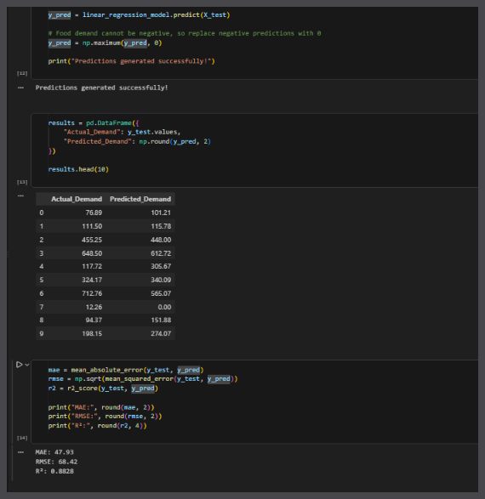
Linear Regression — Python Implementation
47.93
68.42
0.8828
MAE
RMSE
R²
Average Actual Demand
239.25
Average Predicted Demand
248.36
Regression is evaluated with MAE, RMSE and R².
Actual project code and output: prediction generation + MAE/RMSE/R² evaluation
Notes:
"Now let's see how we actually implemented this in Python."
>
First, we divided our data into training and testing data.
>
We had **17,520 training records and 4,380 testing records**.
>
[POINT]
>
Then we connected the preprocessing step and Linear Regression model using a pipeline.
>
After training the model, we generated predictions on the test data.
>
We also made sure that the predicted food demand cannot be negative.
>
Finally, we evaluated the predictions.
Now move toward the result cards.
[PAUSE]
"And this is where we can see how the model performed."
>
**MAE was 47.93.**
>
**RMSE was 68.42.**
>
And our **R² was 0.8828.**
>
[PAUSE]
>
"So the model explains approximately **88% of the variation in demand**."
Then partner.

Slide 9
Apriori Association Rule Mining
Food Transaction Data
Apriori identifies items that frequently occur together in transactions and generates association rules.
Create Transactions
Support
How frequently the combination occurs.
Find Frequent Itemsets
Confidence
How often the consequent appears when the antecedent appears.
Generate Association Rules
Evaluate Rules
Lift
How much stronger the association is compared with random occurrence.
Support + Confidence + Lift
Association does NOT imply causation.
Identify Strong Associations
Notes:
"Imagine we have thousands of cafeteria transactions."
>
Some food items may appear together again and again.
>
Instead of manually checking thousands of records, we can let the algorithm find these patterns.
>
That's what Apriori does.
>
It finds frequent item combinations and then generates association rules.
>
We mainly look at three measures:
>
[And one important point:
>
**Association does not mean causation.**

Slide 10
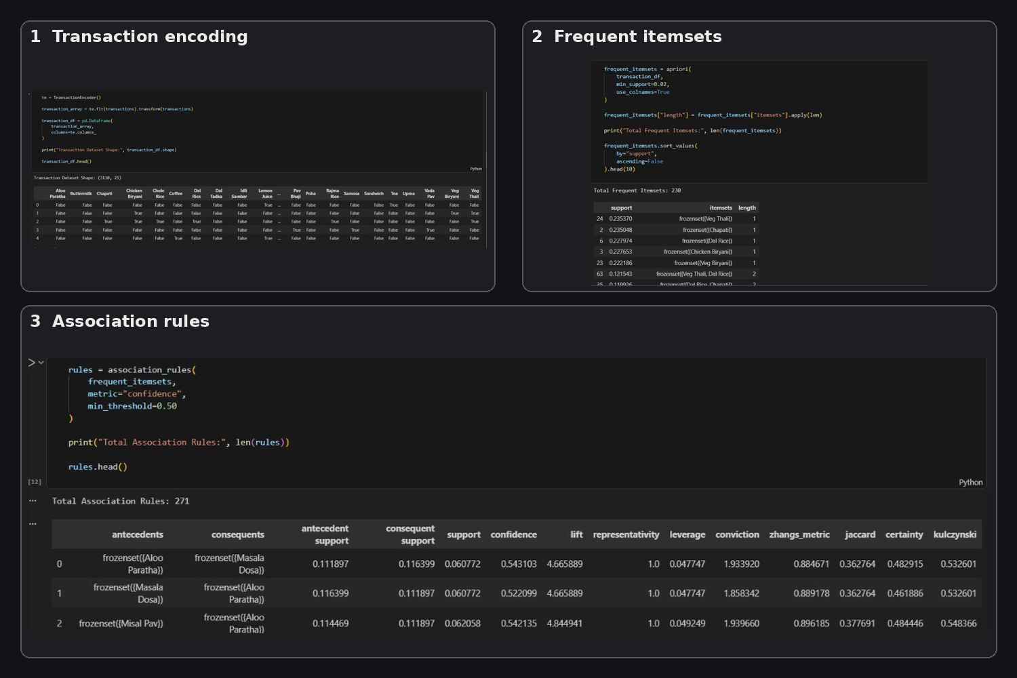
Apriori — Python Implementation & Results
271
association rules generated
Example rule from the output
Metric | Value
Rule | Lemon Juice → Coffee
Support | 0.0601
Confidence | 0.5937
Lift | 5.8611
A lift above 1 means the items occur together more often than by chance.
Actual project screenshots: transaction preparation → frequent itemsets → association rules
Notes:
From our analysis, we generated **271 association rules**."
>
Let's look at one example.
>
**Lemon Juice → Coffee.** [POINT]
>
The support is **0.0601**.
>
The confidence is **0.5937**, which is approximately 59%.
>
And the lift is **5.8611**.
>
A lift above 1 means the two items occur together more often than we would expect by chance.
>
[PAUSE]
>
So now we have a second type of insight.
>
**Linear Regression tells us about demand.**
>
**Apriori tells us about relationships between food items.**
---

Slide 11
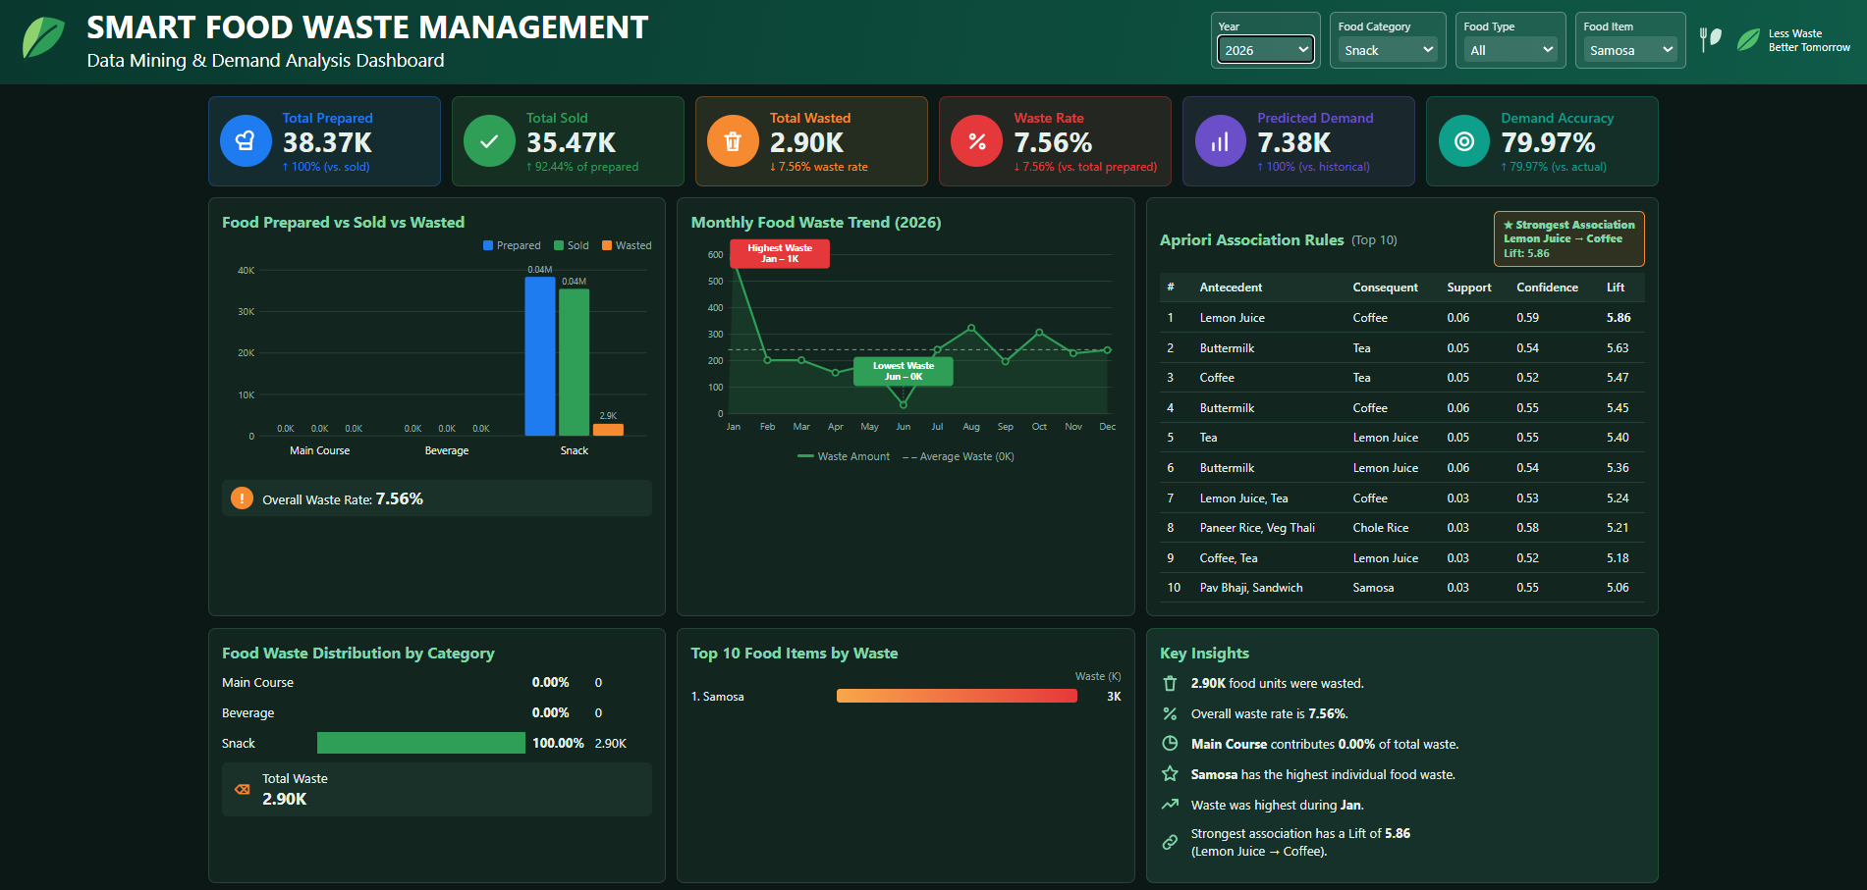
Power BI Dashboard
Dashboard views: Total Prepared, Sold, Wasted • Waste % • Average Predicted Demand • Food Waste by Category • Top Food Items by Waste • Prepared vs Sold vs Wasted • Regression results • Apriori association rules
Notes:
We had predictions.
>
We had association rules.
>
We had food-waste numbers.
>
**But there was one more problem.**
>
>
Raw Python output is not the easiest thing for a manager to understand.
>
So we used **Power BI** to turn these results into visual information.
>
[POINT TO KPI]
>
Here we can see:
>
**Total prepared — 5.65 million.**
>
**Total sold — 5.26 million.**
>
**Total wasted — 391,224.47.**
>
And the overall waste percentage is **6.92%.**
>
We can also see waste by category, top food items by waste, regression results and Apriori association rules.
> [PAUSE]
>
**"So Python helped us find the patterns, and Power BI helped us communicate those patterns."**
🔥 This should be one of your strongest lines.

Slide 12
Key Results
Linear Regression
Apriori
Food Waste
MAE
47.93
271
391,224.47
total waste (units)
RMSE
68.42
association rules generated
6.92%
of food prepared was wasted
Example: Lemon Juice → Coffee
R²
0.8828
Support
0.0601
Avg Actual Demand
239.25
Confidence
0.5937
Avg Predicted Demand
248.36
Lift
5.8611
Notes:
🧑 PARTNER
Give him the first part:
"Our main results are summarized here."
>
"For Linear Regression, the R² value is 0.8828."
>
"For Apriori, we generated 271 association rules."
>
"The total food waste is 391,224.47 units."
Then YOU:
"And the overall waste percentage is **6.92%**."
>
"Some of the highest-waste food items include Veg Thali, Dal Rice, Veg Biryani and Chapati."
>
[PAUSE]
>
"But let's not look at these numbers separately."
>
"Let's come back to the question we started with."
>
**"How much food should we prepare?"** [LONG PAUSE]
>
Our project shows how historical data can help us approach that decision in a more informed way.
>
Linear Regression helps estimate demand.
>
Apriori helps us understand food-item relationships.
>
And Power BI helps us see and communicate the results.

Slide 13
Conclusion
The project applies two Data Mining techniques to cafeteria food data.
Linear Regression is used to estimate food demand.
Apriori is used to identify associations between food items.
Power BI is used to visualize food preparation, sales, wastage, prediction results and association rules.
The combined analysis provides data-driven insights that can support better food preparation and food-waste management.
Notes:
This is his final major section.
"To conclude, our project uses two Data Mining techniques."
>
"Linear Regression is used to estimate food demand."
>
"Apriori is used to identify associations between food items."
>
"Power BI is used to visualize the results."
>
"Together, these findings can support better food preparation and food-waste management."
🧑 YOU — FINAL LINE
Look at audience.
[PAUSE]
**"So instead of looking at food waste only as something that happened at the end of the day..."**
>
[PAUSE]
>
**"...we try to understand the patterns behind it."**
[SMILE]

Slide 14
References
1
Python Documentation
docs.python.org
2
Scikit-learn Documentation – Linear Models (LinearRegression, regression metrics)
scikit-learn.org/stable
3
Mlxtend Documentation – apriori and association_rules
rasbt.github.io/mlxtend
4
Microsoft Power BI Documentation
learn.microsoft.com/power-bi
5
Agrawal, R. and Srikant, R. (1994). Fast Algorithms for Mining Association Rules. VLDB.
6
Han, J., Kamber, M. and Pei, J. Data Mining: Concepts and Techniques. Morgan Kaufmann.
7
Project dataset: Smart Food Waste (SmartPlate) cafeteria dataset and project files

