Slide 1
PORTFOLIO
(CURRICULUM VITAE)
// DECEMBER 2025 //
// AADITYA RENGARAJAN
BROOKLYN, NEW YORK

Slide 2
ABOUT ME
*
(1)
AADITYA IS A CYBERSECURITY ENGINEER AND Al
RESEARCHER WITH CORE SKILLS IN OFFSEC, SECURE WEB DEV, AND SCALABLE SYSTEMS.
HE'S PROFICIENT IN BUILDING AI-POWERED
SECURITY TOOLS OR SECURITY-FOCUSED AI USING DEEP LEARNING, DEEP RL, AND AGENTIC Al ARCHITECTURES. HIS WORK AT ISRO, INTEL & NSD BLENDS CAUSAL INFERENCE, PRIVACY PRESERVING ML, AND CONSTRAINT-BASED Al MODELS TO TACKLE REAL-WORLD SECURITY CHALLENGES.
AS A TRAINER AND SPEAKER, HE'S EDUCATED
500+ STUDENTS AND DELIVERED TALKS AT
OWASP, NULLCON, AND NATIONAL FORUMS.
HE ACTIVELY BUILDS OPEN-SOURCE SOFTWARE, LEADS SECURITY COMMUNITIES AS PRESIDENT OF THE NYU CYBERSECURITY CLUB, AND CONTRIBUTES TO OFFENSIVE SECURITY RESEARCH THROUGH THE OSIRIS LAB. HIS INTERESTS CENTER ON BUILDING RESILIENT, SCALABLE, AND REAL-WORLD SECURITY AND AI SYSTEMS.

Slide 3



SCHOOLS I’VE BEEN TO
*
NEW YORK UNIVERSITY,
TANDON SCHOOL OF ENGINEERING
MASTER OF SCIENCE
CYBERSECURITY
APPLICATION SECURITY • SOFTWARE SUPPLY CHAIN SECURITY • POST QUANTUM CRYPTOGRAPHY • NETWORK SECURITY • INFORMATION SYSTEMS SECURITY ENGINEERING & MANAGEMENT • PRIVACY IN THE ELECTRONICS SOCIETY • PENETRATION TESTING & VULNERABILITY ANALYSIS …
4.0/4.0 GPA (*^ ‿ *)
…
BUILDSPACE
*
NOT A SCHOOL
taught me entrepreneurship. iykyk
https://x.com/_buildspace/status/1820332208831254892
PSG COLLEGE OF TECHNOLOGY
BACHELOR OF ENGINEERING
COMPUTER SCIENCE & ENGINEERING
CHEMISTRY • APPLIED PHYSICS • DIGITAL ELECTRONICS • MICROPROCESSORS • CALCULUS • LINEAR ALGEBRA TRANSFORMS • DISCRETE MATH • PROBABILITY • C PROGRAMMING • PYTHON • OOP • DSA • ADVANCED DS COMPUTER ARCHITECTURE • THEORY OF COMPUTATION • OPERATING SYSTEMS • DBMS • COMPUTER NETWORKS • WIRELESS NETWORKS • DISTRIBUTED SYSTEMS • CLOUD COMPUTING • OPEN SOURCE SYSTEMS
SOFTWARE ENGINEERING • DESIGN THINKING • UI DESIGN • WEB TECHNOLOGY • ARTIFICIAL INTELLIGENCE
MACHINE LEARNING • CRYPTOGRAPHY • BLOCKCHAIN
(2)

Slide 4
DELIVERABLES
*
THREAT DETECTION SYSTEMS
INSIDER THREAT ANALYSIS
SECURITY AUTOMATION PIPELINES
CYBERSECURITY:
LLM BASED ASSISTANTS
AGENTIC AI
PRIVACY-PRESERVING MACHINE LEARNING
AI/ML:
FULL STACK WEB APPLICATIONS
API DEVELOPMENT, BACKENDS & SYSTEM DESIGN
CUSTOM CMS & PORTALS
WEB DEVELOPMENT:
OFFENSIVE SECURITY BOOTCAMPS
SECURE CODING WORKSHOPS
GUEST LECTURES
CYBERSECURITY
TRAINING:
PRIVACY PRESERVING AI
MITRE ATT&CK AND ATLAS
INTEGRATIONS
SECURITY USE CASE DESIGNING
CONSTRAINT VIOLATION-
-DETECTION SYSTEMS
RESEARCH & INNOVATION:
SECURITY ARCHITECTURE REVIEWS
INCIDENT RESPONSE STRATEGY
TOOLING RECOMMENDATIONS
CONSULTING & ADVISORY:
(3)

Slide 5
PROJECTS
(4)

Slide 6

















CLIENTS
*
HACKATHONS
*

Slide 7

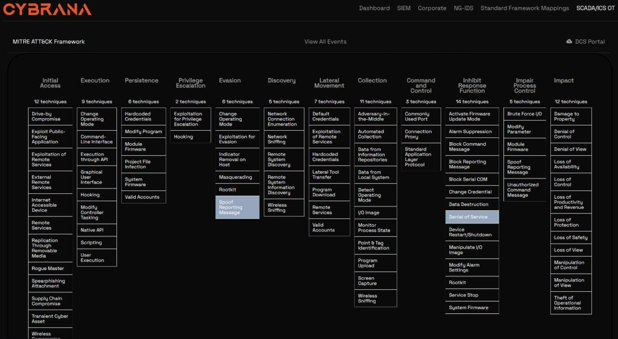
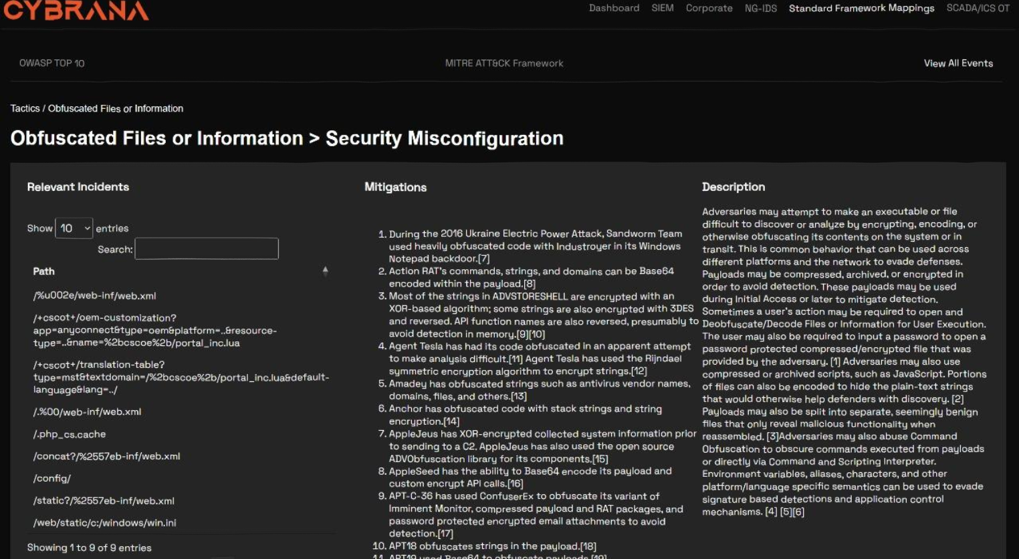

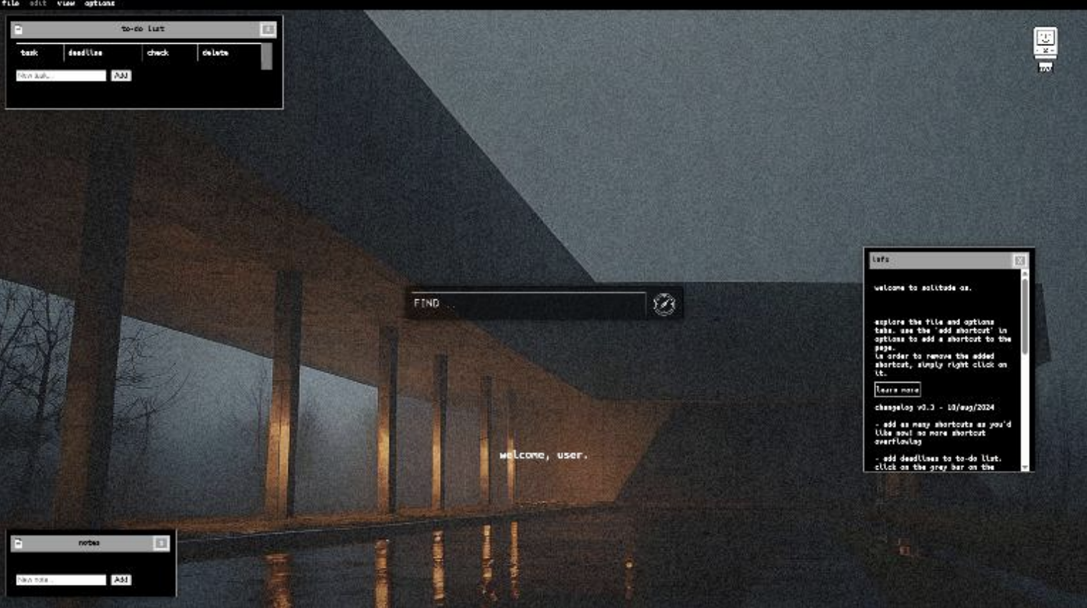
WEB DESIGN + DEV EXAMPLES
SECURITY × ENGINEERING × DESIGN
*
these are functional web applications i’ve built over time

Slide 8
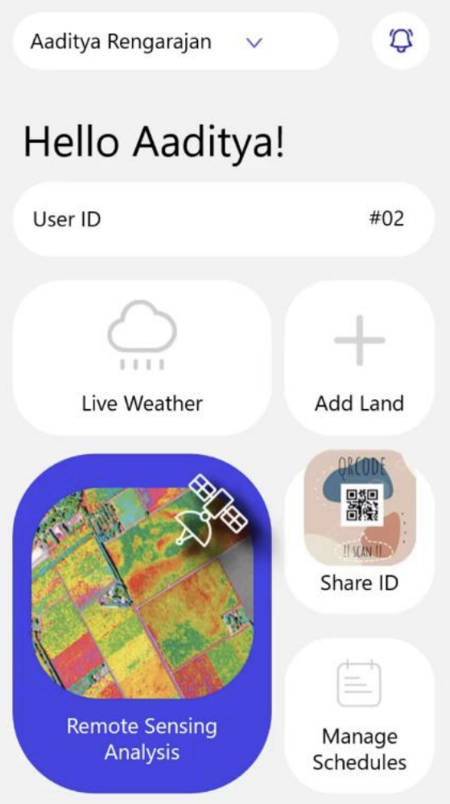
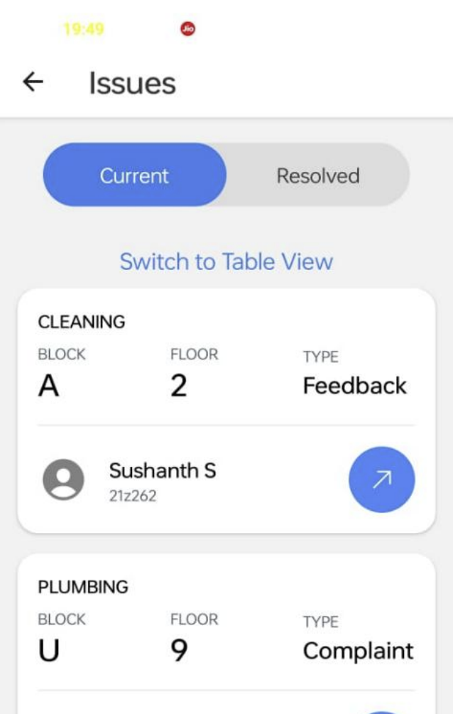
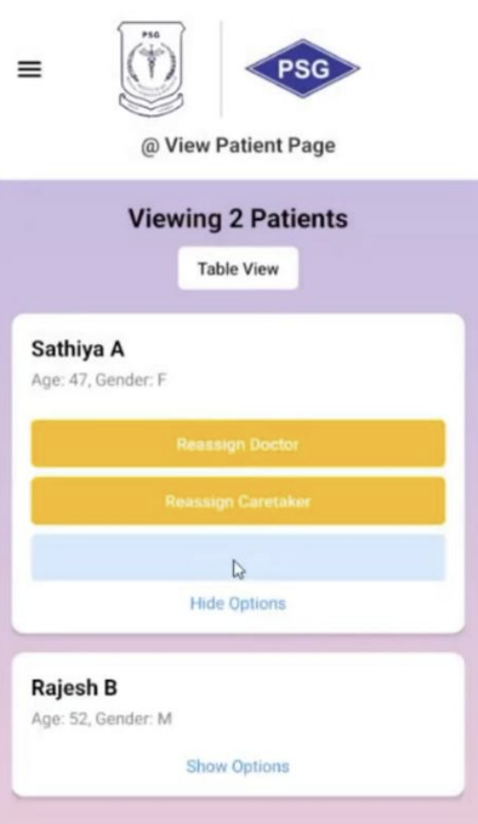
MOBILE DESIGN EXAMPLES
SECURITY × ENGINEERING × DESIGN
*
these are functional mobile applications i’ve built with people

Slide 9
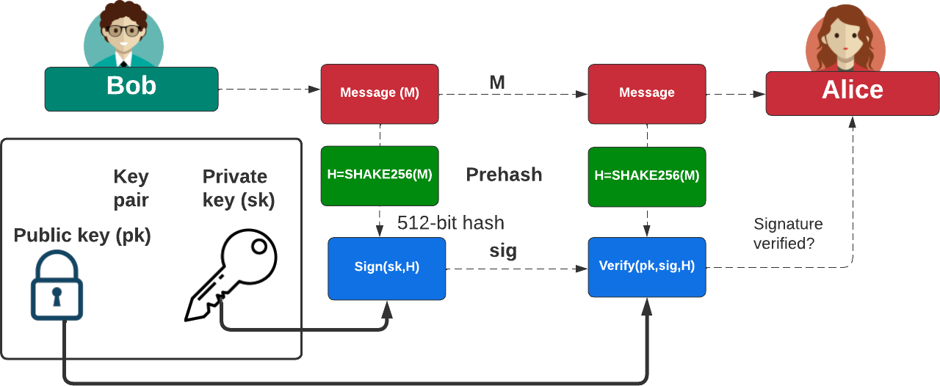
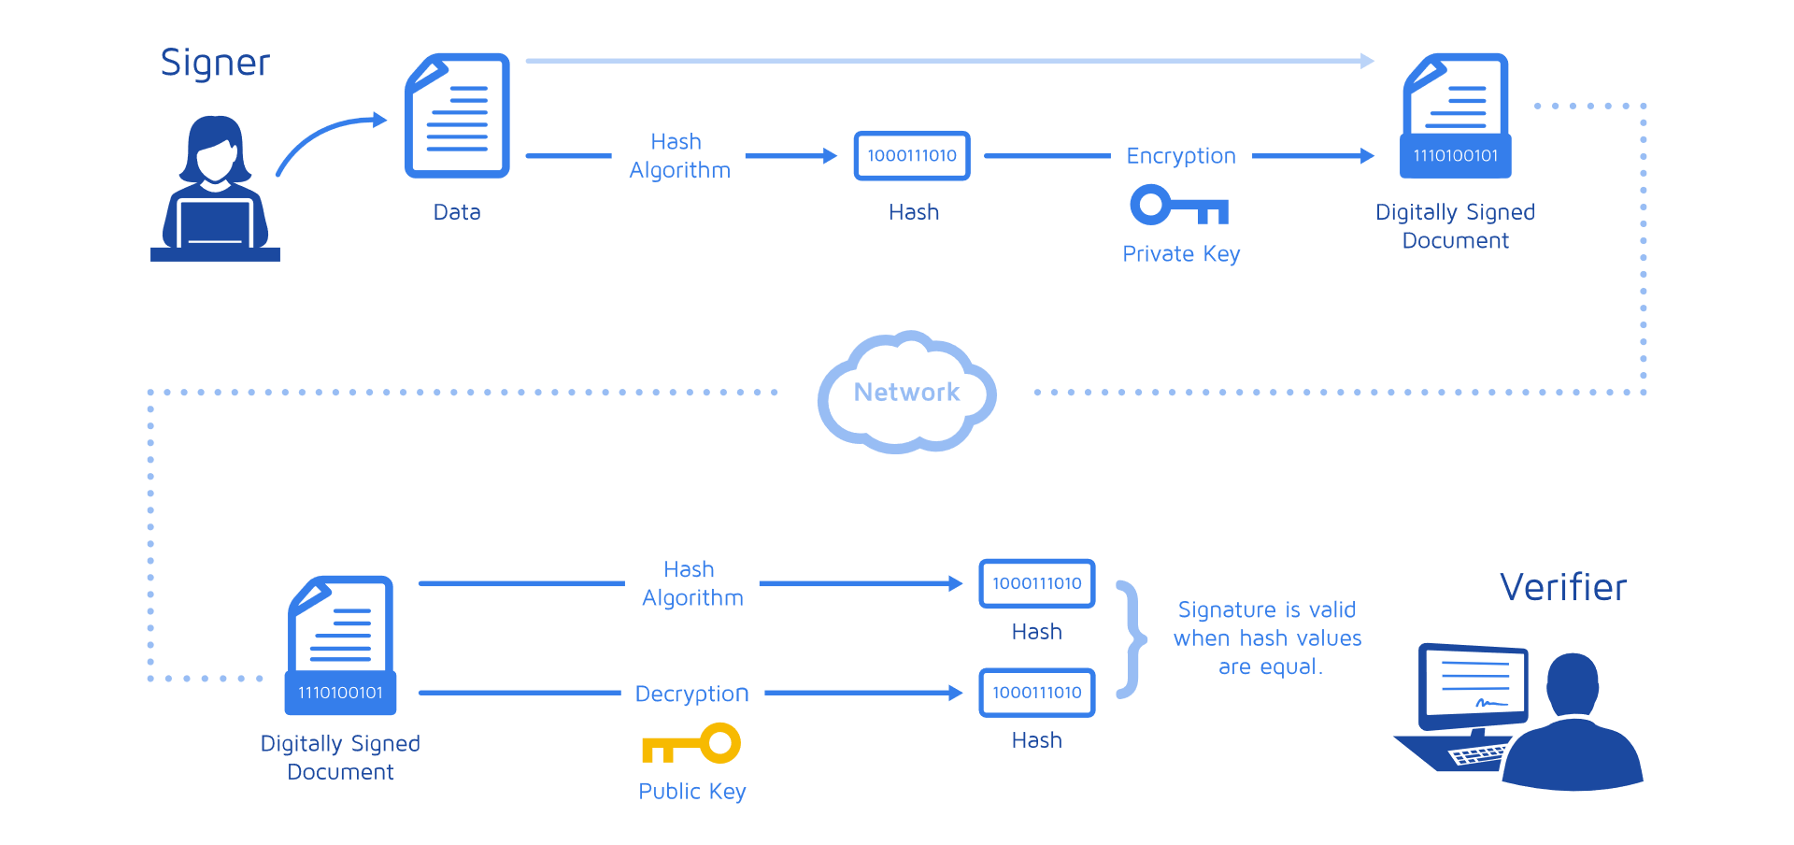
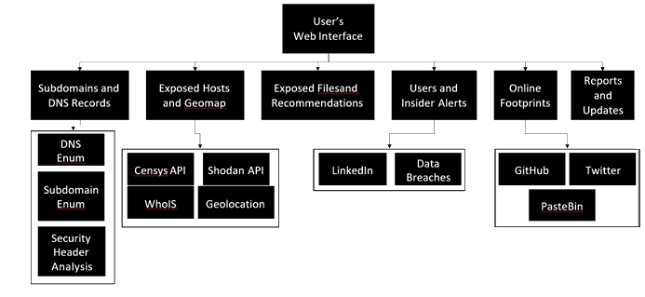
SECURITY DESIGN EXAMPLES
SECURITY × ENGINEERING × DESIGN
HAWK
a python re-implementation of a post quantum crypto framework (pedagogy)
arbitrary-order secure multi-sign algorithm for document signing
SentinelEye
public visibility security framework for organizations
*
these are functional security software i’ve built + research work i’ve published over time

Slide 10
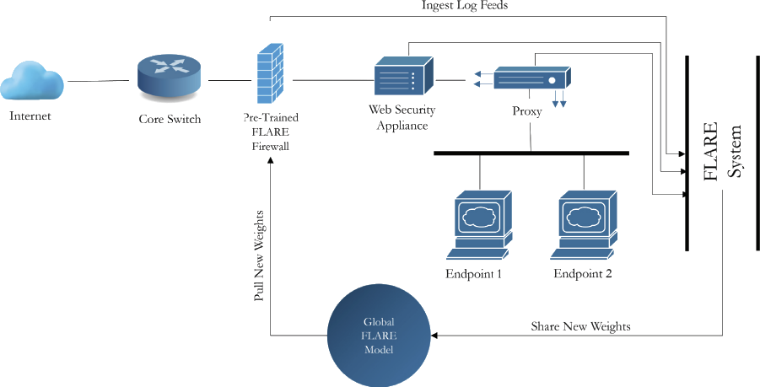
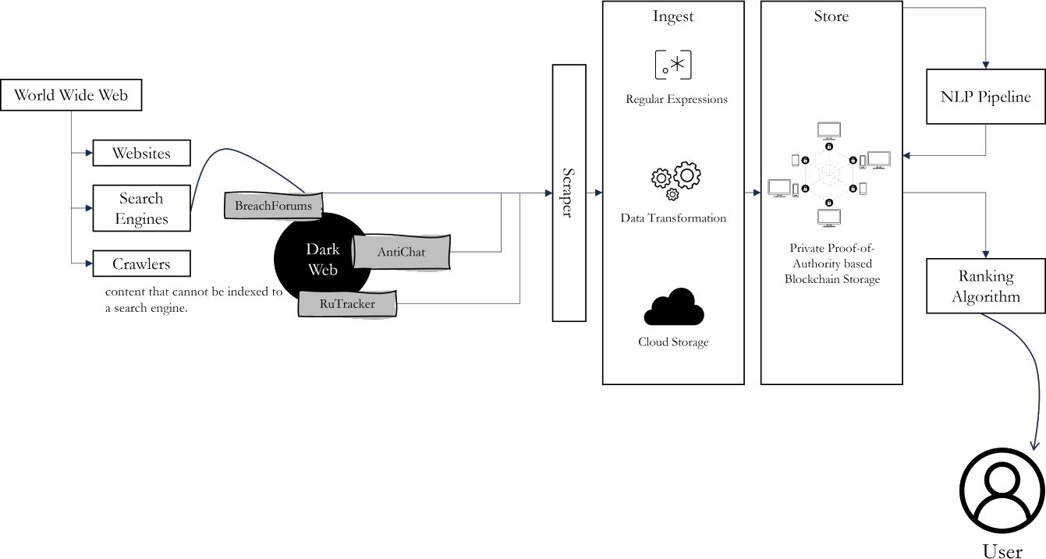
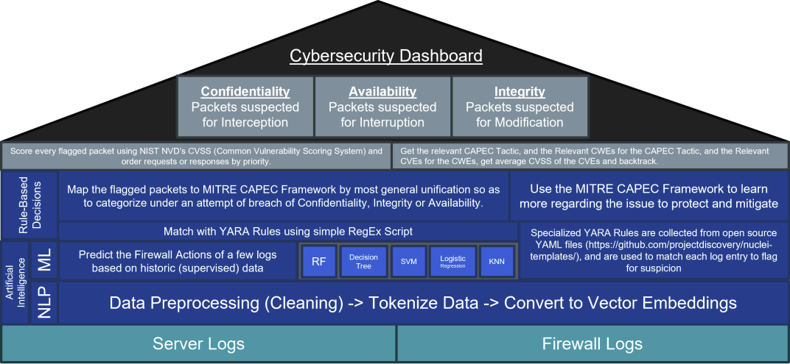
SECURITY DESIGN EXAMPLES
SECURITY × ENGINEERING × DESIGN
FLARE
a federated learning firewall architecture
SHADOW
an ML-based dark web PII-leak detection system
CYBRANA
a machine-learning based firewall
*
these are functional security software i’ve built + research work i’ve published over time

Slide 11
WORK
EXPERIENCE
(5)

Slide 12




ORG
ROLE
ai research and engineering
security software, startup research
security research and engineering
security software engineering
learning infotech and software engineering
dark web research, cybersecurity
penetration testing

Slide 13
RESEARCH
PAPERS
(6)

Slide 14
Prompt-Aware MCP Security: Using ShardGuard To Compartmentalize LLMs for Safer MCP Actions
Abstract—Large Language Models (LLMs) are powerful in part due to the wide array of prompts they can successfully handle. While many efforts have been made to improve MCP security, a prompt’s context is an essential (and missing) aspect of MCP security. This work demonstrates that it is not only necessary to consider prompt- context, but it is also possible to do so in a secure and automated manner. Our architecture shows that an LLM can be an effective tool at devising a compartmentalized, prompt-specific, least-privilege decomposition for various complex prompts. We demonstrate that this technique provides best-effort, least-privilege security which reduces the unnecessary MCP server tools available to an LLM. It does this while handling prompts an unprotected LLM could handle. This happens without substantially increasing the LLM costs. Furthermore, our design is backwards compatible with existing MCP servers / tools, LLMs, and frameworks. Our prototype, ShardGuard, is freely available with an Apache 2.0 license.
// with a team under Professor Justin Cappos at the Secure Systems Laboratory (SSL) at New York University's Tandon School of Engineering

Slide 15
Enhancing Cybersecurity Resilience with CYBRANA: A Cyber YARA/YAML-Based Resilience Firewall Solution Applied with Next-Gen AI
Abstract—The ever-increasing volume of server requests puts digital infrastructure at more risk of cyberattacks. This paper introduces CYBRANA, a cyberattack detection and mitigation system powered by AI. CYBRANA uses a Random Forest model to look into firewall and server logs for potential malicious threats. After analysis of flagged logs to extract request paths, CYBRANA then maps YAML rules to look for known attack pattern detection. Upon successful detection, CYBRANA classifies the attack type and severity (using CVSS scoring) by mapping it to the MITRE CAPEC framework®. This approach bridges the gap between existing cybersecurity frameworks and server log analysis, enabling a novel security pipeline. By automating threat detection and mitigation, CYBRANA enhances the security posture of digital infrastructure.
Index Terms—Firewall, NIDS, Log Analysis, Random Forest, MITRE, CVSS Scoring, SIEM, SOC
// with Dr. G. R. Karpagam
IEEE International Conference on Computer Vision and Machine Intelligence (IEEE CVMI), 2024 at Allahabad, India
*

Slide 16
SHADOW: A framework for Systematic Heuristic Analysis and Detection of Observations on the Web
Abstract—The cyberspace contains vast amounts of information that are crucial for cybersecurity professionals to gather threat intelligence, prevent cyberattacks, and secure organizational networks. Unlike earlier and less targeted attacks, modern cyber-attacks are more organized and sophisticated, often targeting specific groups, which leaves many users unaware of the vulnerable resources within the cyberspace. The increasing freedom on information access in the deep and dark web has led many organizations to identify their data loose on these spaces. Therefore, creating methods to crawl and extract valuable information from the deep web is a critical concern. Some deep web content can be accessed through the surface web by submitting query forms to retrieve the needed information, but it is not as simple in all cases. This paper proposes a system of framework to identify these leaks and notify relevant parties on the same in-time.
Index Terms—Data Breach , Named Entity Recognition , Ranking , Cybersecurity , Snowball Sampling , Blockchain , Attack Tree , Web Scraping , Wayback Machine
// with Lohith Senthilkumar, Neelesh Padmanabh and Akhil Ramalingam
International Conference on Artificial Intelligence, Metaverse and Cybersecurity (ICAMAC), 2024 at Dubai, UAE
*

Slide 17
FLARE: Federated Learning And Resilient Encryption for Firewalls
Abstract—Traditional firewalls rely on static rule-based mechanisms, where rules are manually defined and often written in specialized languages. While effective to a degree, these rules are inherently limited and can be easily bypassed by new and evolving types of malware, leading to significant security vulnerabilities. To address these challenges, we propose FLARE: Federated Learning And Resilient Encryption, a novel machine learning-based firewall solution. FLARE dynamically analyzes past network connections to predict and determine the appropriate actions for incoming traffic, thereby adapting to emerging threats in real-time.Given the sensitive nature of firewall data, which often contains confidential information, the training of machine learning models poses significant privacy risks. FLARE mitigates these risks by incorporating federated learning, allowing the model to learn from decentralized data sources without requiring raw data to be shared. To further enhance privacy, we introduce an encryption layer that ensures the central model learns from encrypted weights, preventing exposure of sensitive information known to the local model. This combined approach not only improves the resilience of firewalls but also safeguards the confidentiality of the data used in training, offering a robust solution for modern cybersecurity challenges.
Index Terms—Training , Adaptation models , Data privacy , Analytical models , Firewalls (computing) , Federated learning , Predictive models , Data models , Encryption , Random forests
// with Lohith Senthilkumar
IEEE Pune Section International Conference (PuneCon), 2024 at Pune, India
*

Slide 18
Enhancing the Resilience of Privacy-Preserving Machine Learning using Adversarial Techniques
Abstract—This paper introduces a novel approach to enhance privacy-preserving machine learning (PPML) by integrating adversarial techniques with Homomorphic Encryption (HE) and Differential Privacy (DP). Privacy-Preserving machine learning (PPML) plays a key role in privacy protection. Current methods like homomorphic encryption (HE) and differential privacy (DP) aim to strike a balance between keeping data private and making sure models work well. This method embeds adversarial attacks within model optimization, strengthening resistance to privacy breaches while maintaining high model performance. Experimental results across various datasets achieving an accuracy of 89% in HE and DP demonstrate that this approach effectively balances privacy and utility, outperforming traditional PPML methods in safeguarding sensitive data without compromising model accuracy.
Index Terms—Training , Resistance , Differential privacy , Accuracy , Computational modeling , Machine learning , Data augmentation , Data models , Homomorphic encryption , Resilience
// with Lohith Senthilkumar, Amitha Lakshmi Raj and Arun U S
International Conference on Distributed Systems, Computer Networks and Cybersecurity (ICDSCNC), 2024 at Bengaluru, India
*

Slide 19
Estimation of Warfarin Dosage using a Specialized XGBoost-based Pharmacogenomic Machine Learning Model and Evaluation using XAI
Abstract—Warfarin is a commonly used anticoagulant for which dosing needs to be individually optimized highly tightly to match against the potential for bleeding and thrombotic side effects. We introduce herein in this article a machine learning system that makes use of clinical, genetic, and demographic information to predict warfarin patient-specific dosing. Our method is becoming more sophisticated with various iterations starting from a baseline model, then an optimal XGBoost model incorporating polynomial feature expansions, and finally ending with an optimized gradient boosting implementation coded from scratch. Model performance is evaluated on R2 metrics complemented with explainability tests using SHAP and LIME, hence achieving accuracy and interpretability to clinical decision-making.
Index Terms—Measurement , Machine learning algorithms , Explainable AI , Computational modeling , Predictive models , Boosting , Genetics , Polynomials , Iterative methods , Hemorrhaging
// with Akshay Perison Davis, Navaneetha Krishnan K S, R Vishal, Subhasri Shreya S L and Jayashree L S
International Conference on Machine Learning and Cybernetics (ICMLC), 2025 at Bali, Indonesia
*

Slide 20
ASTRA: A Cyber-Threat Intelligence Framework for Advanced Security Threat Response and Analysis
Abstract—This paper introduces ASTRA (Advanced Security Threat Response and Analysis), a novel system designed to enhance cybersecurity operations. ASTRA connects to multiple STIX (Structured Threat Information Expression) threat feeds, offering a comprehensive dashboard that includes a lookup interface, a visualizer tool, and a log analysis tool to detect Indicators of Compromise (IOCs) from any log file. The challenge addressed by this paper lies in the limitations of current cybersecurity methods, which predominantly rely on manual signature development and static rules for threat detection and mitigation. Presently, cybersecurity strategies often struggle to keep pace with the dynamic nature of modern threats, leading to gaps in protection. ASTRA’s novelty lies in its ability to dynamically analyze and respond to threats in real-time, significantly reducing the time and effort required to identify and mitigate cyber risks. The system’s microservice architecture and private blockchain further enhances its adaptability, scalability, and security, making it an ideal solution for modern cybersecurity challenges.
System deployed at National Remote Sensing Centre (NRSC, ISRO), 2024 at Hyderabad, India
*

Slide 21
Leveraging Detection Of Data Breaches By Applying Snowball Sampling
Abstract—With the data being circulated and stored on the internet increasing, the number of data breaches occurring globally has seen a drastic rise and it is happening in an organized manner. This possess a serious threat to both individual and organizations. Though the organizations have a security team to monitor the breaches, the individuals are unaware that their data being breached is a serious issue. This paper addresses the above issue through detection using snowball sampling and preserving privacy using Blockchain technology. Efforts have been taken to validate this system through threat modelling by employing misuse case diagrams and attack trees.
Index Terms—Data Breach, Snowball Sampling, Blockchain, Attack Tree, Web Scraping
// with Dr. G. R. Karpagam, Mithilesh E N, Santhoshi R and Subhasri Shreya S L
International Conference on High Performance and Intelligent Computing (ICHPIC), 2022 at Coimbatore, India
*

Slide 22





COMMUNITY INVOLVEMENT
*
Founder, The Eye – Student-Run Society for Cybersecurity at PSG College of Technology
President, Cybersecurity Club at New York University, Tandon School of Engineering
Board Member, the Offensive Security, Incident Response, Internet Security Lab (the OSIRIS Lab), NYU
Speaker and Member, Open Web Application Security Project (OWASP)
(7)
Student Member, IEEE

Slide 23
CONTACT ME!
AADITYA.R@IEEE.ORG
AADITYA.R@NYU.EDU
A@GMAIL.COM
EMAIL(S):
***********
(+91) 430
(+1) 28
*******
PHONE(S):
********
WEBSITE(S):
AADITYA.INTELLX.IN
*
SEMI-REDACTED PERSONAL INFORMATION IS FOR VERIFICATION THROUGH # OF CHARACTERS.
(8)

