Slide 1
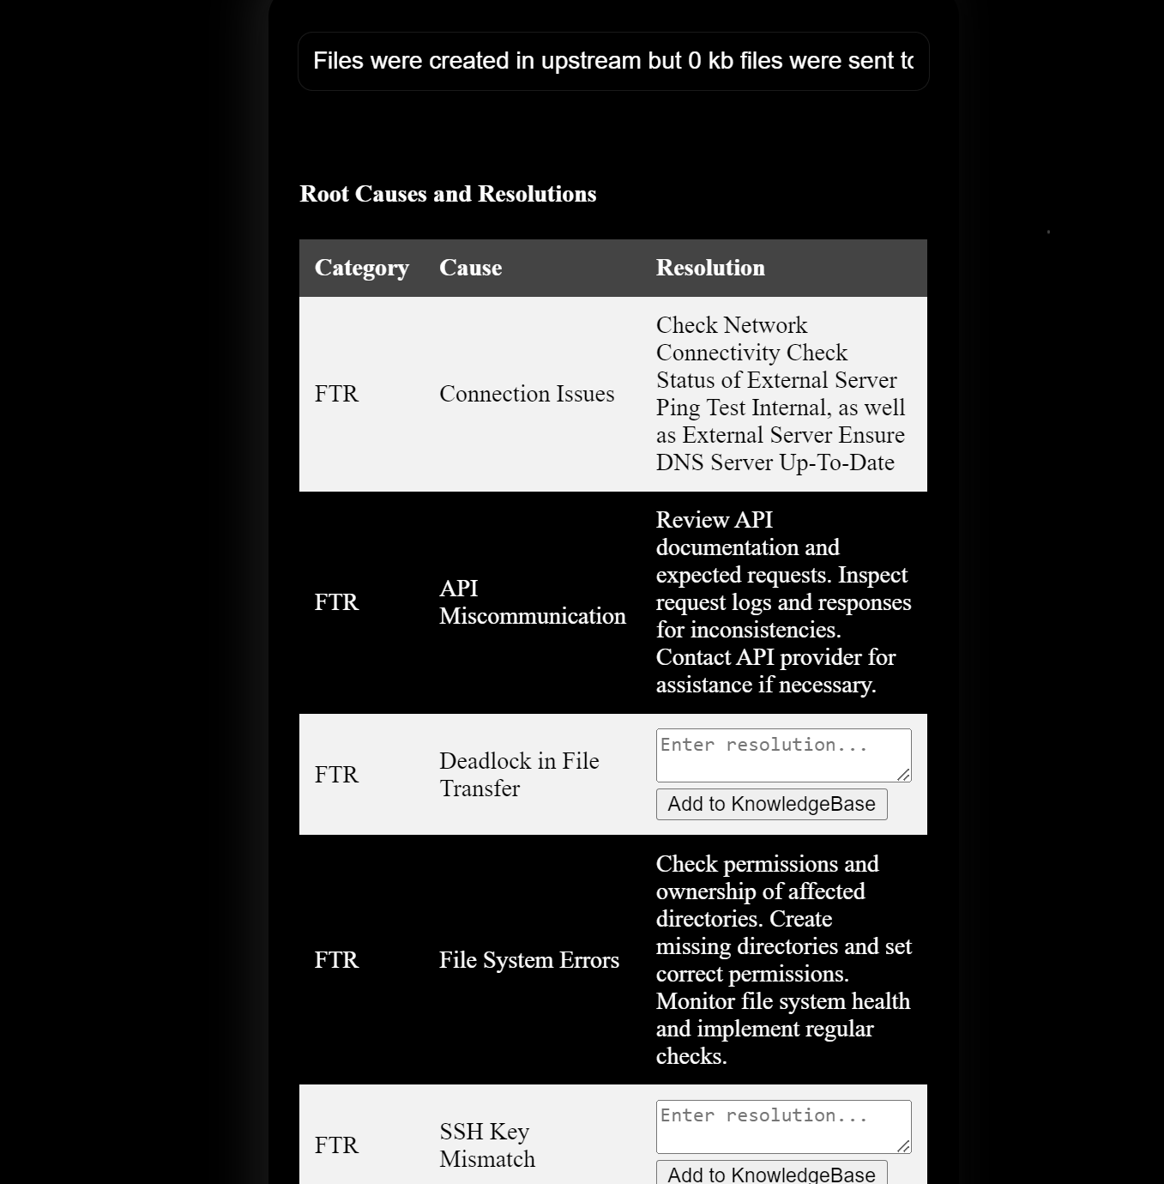
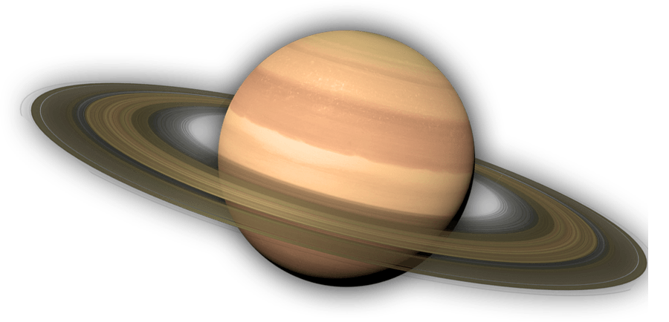
SituationPlanet
An AI Approach to Incident Management by Aaditya Rengarajan (21Z202)
PSG Hackathon

Slide 2
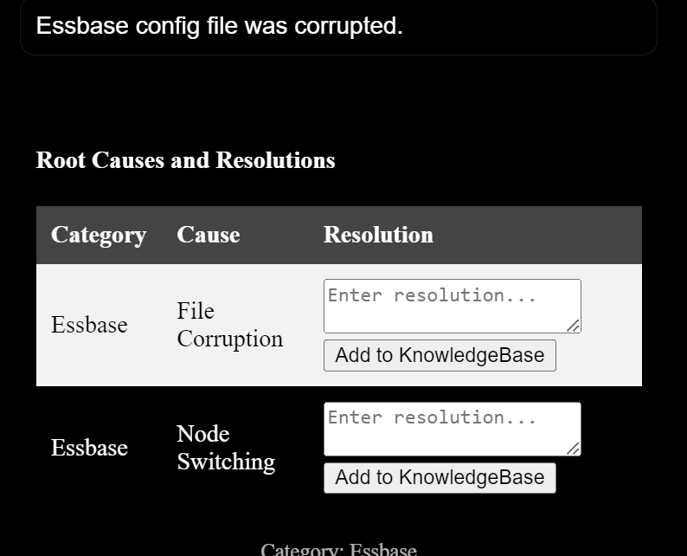
Situation Planet
ABOUT THE SOLUTION
SituationPlanet
Incident Assistant
AI-powered incident management system that utilizes advanced natural language processing (NLP) and machine learning techniques to streamline the incident resolution process. It aims to provide a comprehensive solution for identifying incident categories, suggesting resolutions, and even implementing 'SelfHeal' technology to automate the incident resolution process.
offering real-time insights and recommendations for resolving various incidents.
An AI Approach
to incident management

Slide 3
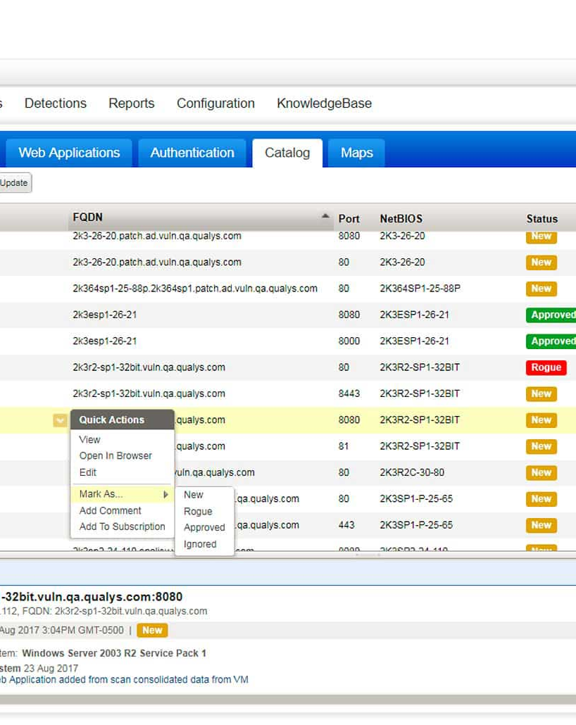
PROBLEM STATEMENT
Situation
Planet
Current
Issues with incident
management processes
AI-Based Incident
Management Approach
1. Manual and Reactive Processes
Traditional incident management often relies on manual monitoring and reaction. This approach can result in delays in identifying and addressing issues, leading to extended downtime and poor customer experiences.
2. Combinatorial Explosion
With a multitude of distinct incident types and their corresponding resolution techniques, manually exploring every combination is infeasible. By leveraging historical incident data and machine learning, SituationPlanet efficiently narrows down the immense array of options, enabling rapid and accurate resolution suggestions that significantly alleviate the burden of exhaustive manual exploration.

Slide 4
Armed with categorized incidents and their root causes, the system matches the incident's root cause to relevant resolution techniques. Drawing from the knowledge base, the system recommends a range of strategies tailored to address the specific issue's underlying causes.
When a new incident is reported, the system analyses the incident description using Natural Language Processing (NLP) techniques. This categorizes the incident into predefined types, providing a clear understanding of the problem at hand.
The system delves into the details of the incident, including logs and historical data. Machine Learning algorithms identify underlying factors contributing to the incident, enabling efficient and accurate root cause identification.
Leveraging historical incident data and a knowledge base, the system learns from the past. Machine Learning continuously evolves by integrating new incident data, enhancing its ability to make informed decisions.
01
02
03
04
Incident
Classification
Root Cause
Analysis
Learn from History and Knowledge-Base
Propose Resolutions
to specific root-causes
THE SOLUTION APPROACH
Solution
Pipeline

Slide 5
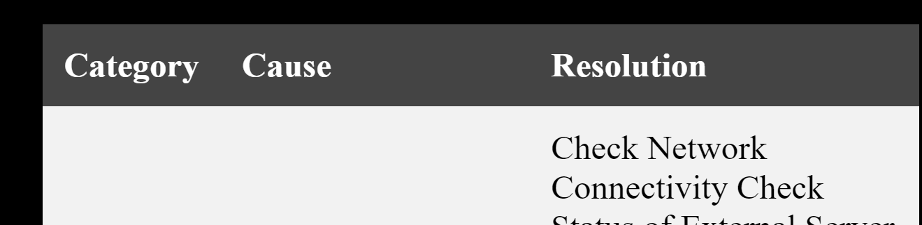
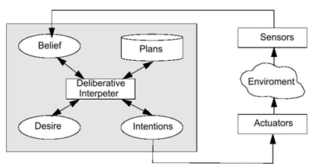
SOLUTION OVERVIEW
Solution Structure
and Posteriori
Analysis
One-Page User Interface
Intelligent Agents
Databases
Learnt Models
Incident Classifier
Root Cause Analyser
Resolution Algorithmiser
Incident History
Root Causes
Resolution Suggestions
Incident
Classification

Slide 6
INTELLIGENT AGENT
Situation
Planet
Use of AI/ML as
Deliberative Agent
How our Deliberative Agents leverage informed decision making, solving the problem of Combinatorial Explosion:
Intelligent Decision-Making:
Data-Driven Insights
Resolution Recommendation
Dynamic Learning
Complex Decision Contexts
Customized Suggestions

Slide 7
01.
02.
03.
1. Incident Classifier
2. Root Cause Analyser
3. Resolution Algorithmiser
Performance Measure:
Accuracy of incident categorization, speed of classification.
Environment:
Incoming incident descriptions, historical incident data.
Sensors:
Incident descriptions, historical incident data.
Function:
Analyzes incident descriptions using NLP techniques.
Matches incidents to predefined categories.
Provides accurate and quick incident categorization.
Performance Measure:
Accuracy of root cause identification, speed of analysis. Environment:
Incident data, system logs, historical incident data. Sensors:
Incident data, system logs, historical incident data. Function:
Analyzes incident details and relevant logs.
Identifies underlying causes of incidents.
Helps prevent recurrence by addressing root issues.
Performance Measure:
Effectiveness of resolution suggestions, relevance to incident.
Environment:
Incident data, resolution techniques knowledge base. Sensors:
Incident data, resolution techniques knowledge base.
Function:
Examines incident category and details.
Matches incidents to appropriate resolution techniques.
Offers a range of strategies for incident resolution.
INTELLIGENT AGENTS
PEAS and Description
of Intelligent
Agents

Slide 8
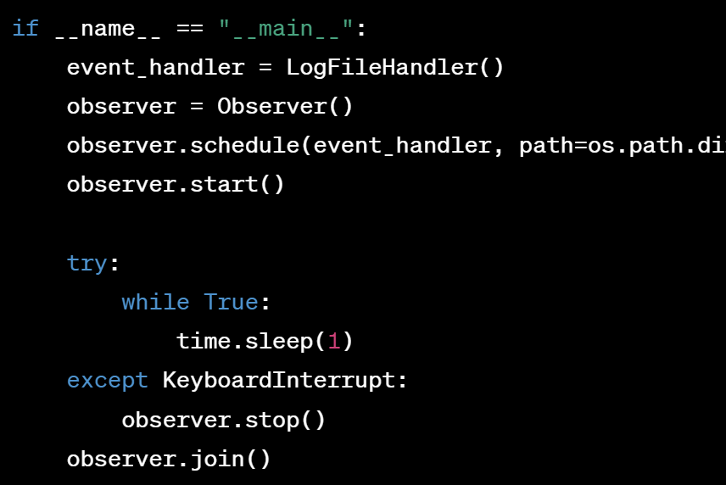
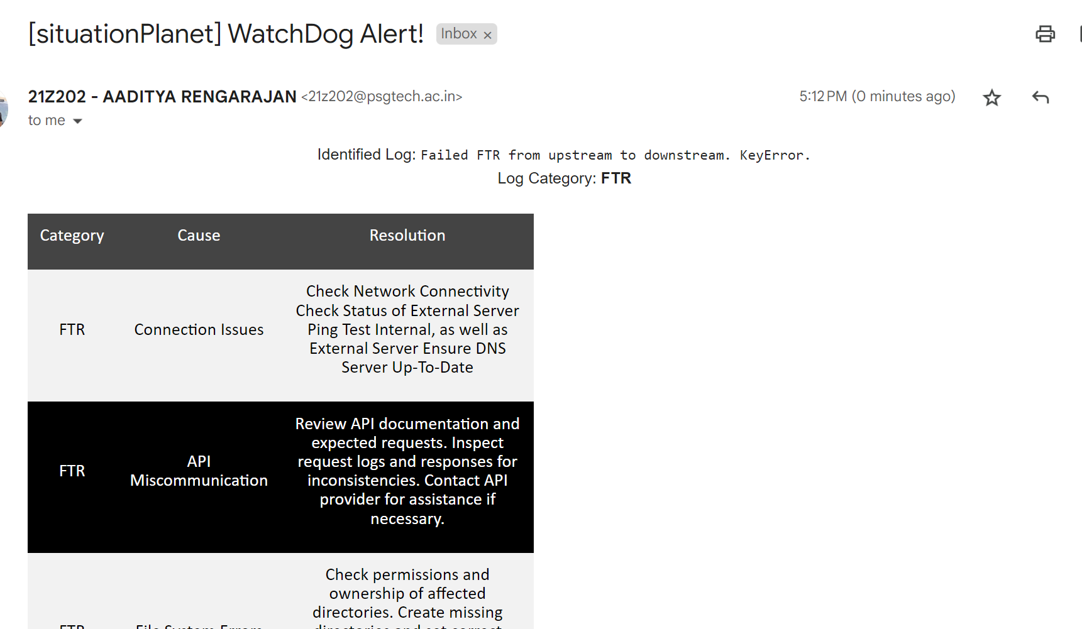
SelfHeal WatchDog Technology
SelfHeal
WatchDog
The system continuously monitors incoming incidents and uses its trained models to recognize patterns and similarities in incident descriptions. When it identifies an incident that closely matches a previously resolved issue, it triggers the 'SelfHeal WatchDog' process.
'SelfHeal' reduces the time required to resolve common and repetitive incidents by automating the remediation process.
SELF HEAL
SelfHeal
Technology
SituationPlanet

Slide 9
Python
Flask
SITUATIONPLANET
Technology
Stack
ABOUT US
User Interface
Mulang Course
Partner
HTML
CSS, JS
The 'SituationPlanet' technology stack encompasses a backend built with Python and Flask for interactive user interfaces.
Incident data is stored in non-relational databases like Excel, JSON and YAML while AI/ML tasks utilize libraries like scikit-learn for machine learning and natural language processing.
The application is hosted on a personal cloud compute instance, with Docker containers managed by Kubernetes for consistent deployment. Monitoring is facilitated through the WatchDog script.
This stack ensures efficient incident classification, root cause analysis, resolution suggestions, and user-friendly interactions in the 'SituationPlanet' solution.
Python
fuzzywuzzy
Microsoft
Excel
User Interface
NLP
History
Storage
Python
TF-IDF
JSON
Data
Term Frequency-Inverse Document Frequency
Vectorization
NLP
YAML
Data
Resolution
Knowledge-Base
RCA
Knowledge-Base

Slide 10
SituationPlanet
Thank You
SituationPlanet
a solution by Aaditya Rengarajan
21Z02@psgtech.ac.in
+91 94445 11430
PSG Hackathon
An AI-Based Approach to Incident Management

