Slide 1


:(
BREAK AND CONTINUE STATEMENT.
LOOP CONTROL STATEMENTS
PRESENTED BY : ADITYA RAJ, ADITYA, BIDYA SAGAR, ABDUL BAASIT, AKASH

Slide 2

:(
HOW DOES A LOOP WORK? HOW DOES A LOOP WORK? HOW DOES A LOOP WORK?
INITIALIZATION
CONDITION CHECK
BODY EXECUTION
VARIABLE UPDATES
End -
This cycle repeats until the condition becomes false

Slide 3

:(
The BREAK Statement
The break statement is used to terminate the nearest enclosing loop immediately, regardless of the loop condition.

Slide 4

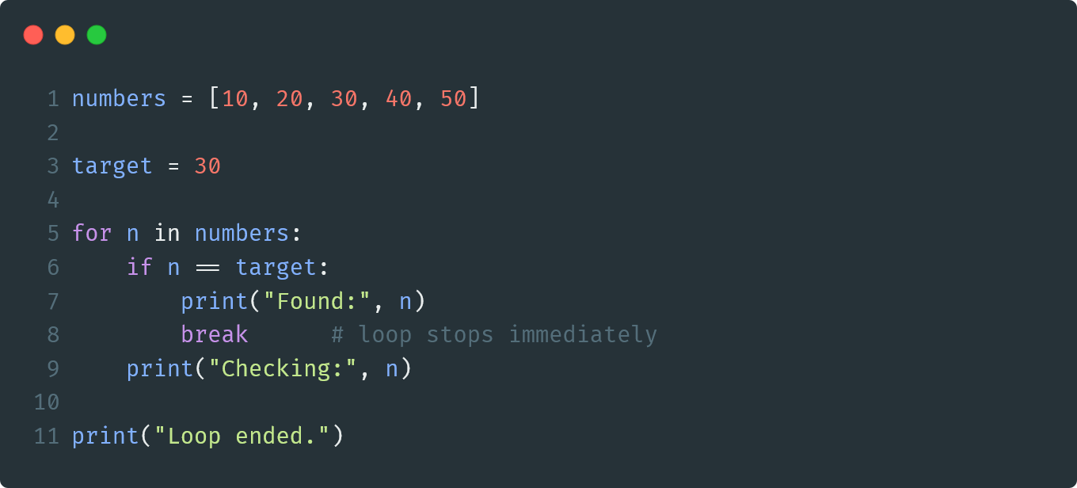
Example – To stop a search early

Slide 5

:(
The CONTINUE Statement
The continue statement is used to skip the remaining statements of the current iteration and move on to the next iteration of the loop
Unlike break, continue doesn’t exit the loop. It only skips one iteration.

Slide 6

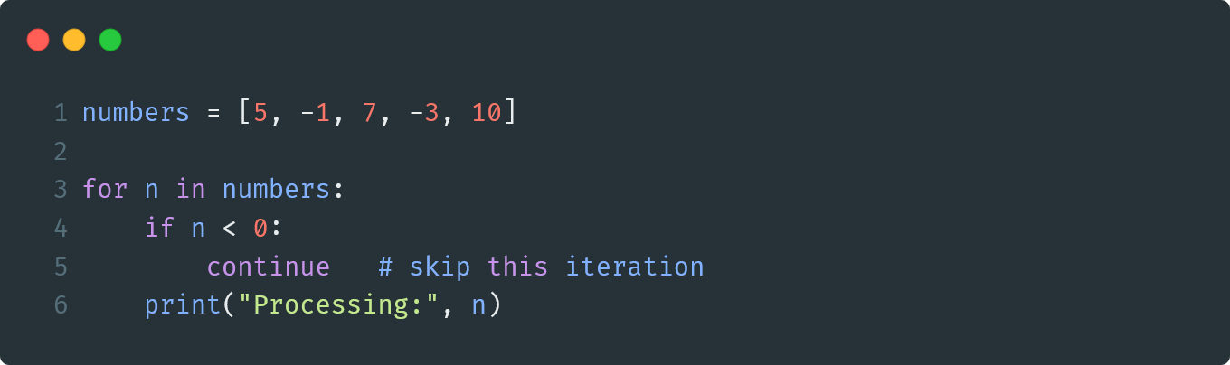
Example – To skip unwanted values

Slide 7

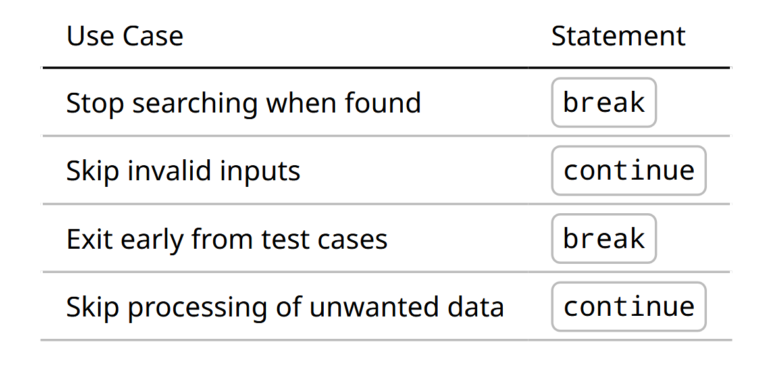
:(
Some use cases:

Slide 8

:(
Analogy?
BREAK – “Teacher says class is dismissed - everyone leaves immediately
CONTINUE – “Teacher says skip this topic – move on to next topic

Slide 9
