Slide 1


RELATIONSHIP GPS
Navigate Hearts. Avoid Crashes.
Partner
Navigate conversations
before they become conflicts.
You: "Fine."
Smart Nudge AI
Partner detected
⚠ Frustration likely
An AI assistant integrated inside your messaging app — like Grammarly, but for relationships.
Suggested reply:
"You seem upset. I'm here whenever you're ready to talk."
INVESTOR OVERVIEW
Confidential

Slide 2
A FAMILIAR MOMENT
Imagine You're Texting Your Boss
Manager
1
You type a frustrated message
Before you hit send, the moment is still recoverable.
"This deadline is impossible."
2
A small AI prompt appears
Relationship GPS recognizes tone risk in real time.
Relationship Guru suggests:
"Given the current workload, I may need an extension to maintain quality. Would that be possible?"
3
You choose, in one tap
Replace, edit, or ignore the suggestion — you stay in control.
4
Message sent. No conflict.
The same intent, delivered in a way the other person can hear.
One Tap — Message Sent
Product Walkthrough
Relationship GPS
2

Slide 3




THE PROBLEM
People Don't Know How to Say It
Every day, relationships are strained not by what people mean, but by how they say it.
Couples
Families
Employees
Arguments escalate from poor wording, not differing intentions.
Misunderstandings compound across generations and communication styles.
Rushed messages at work read as careless or rude, harming careers.
THE CURRENT ALTERNATIVE IS TOO SLOW
Open ChatGPT
Copy message
Paste
Ask for a reply
Copy again
Return & paste
Pain Point: AI exists today, but it isn't integrated into the conversation itself — so almost nobody actually uses it in the moment.
Market Problem
Relationship GPS
3

Slide 4





OUR SOLUTION
Context-Aware Coaching, Inside the Chat
Every saved contact carries a relationship type — so the AI always knows the right register before it speaks.
Partner
Work
Family
Friend
AS YOU TYPE, THE SYSTEM:
Understands context
Detects tone
Suggests a better reply
Leaves you in control
Reads the message against relationship history
Flags frustration, ambiguity, or risk before it's sent
One tap to improve, not a rewrite from scratch
Replace, edit, or ignore — every time
Same engine, every relationship. The contact's saved type drives tone, vocabulary, and risk sensitivity automatically.
Product Overview
Relationship GPS
4

Slide 5




PRODUCT
Core AI Features
Better Reply Suggestions
Traffic-Light Risk Signal
A messaging companion, not another app
Context-aware rewrites that match tone and intent.
Every message flagged Safe, Risky, or Conflict before it's sent.
Relationship GPS is an AI-powered layer that lives inside the conversation itself.
Emotion Detection
Tone Switch
Instead of opening another app, copying text, and pasting a reply back — it appears exactly where the conversation is already happening.
Reads frustration, warmth, or ambiguity in real time.
Professional, romantic, empathetic, or funny — on demand.
‘Why This Works’ Coaching
Every feature on this page runs inline, in real time, on-device where possible.
Short explanations that build communication skill over time.
Product Overview
Relationship GPS
5

Slide 6

MECHANICS
How It Works
STEP 1
STEP 2
STEP 3
Save Contacts Into Categories
AI Reads as You Type
A Nudge Appears
Partner
Relationship
No rewriting everything
Boss
Message history
Just a one-tap suggestion
Family
Emotion
You decide what to send
Friend
Tone
Mechanics
Relationship GPS
6

Slide 7







EXPANSION
Beyond Messaging — Love Mode
A shared layer for couples to manage finances and milestones together, building on the same trust established through everyday messaging.
Shared Financial Planner
Couple Goals
Relationship Streaks
Monthly income, automatically split across categories.
Shared milestones, tracked together.
Gentle, positive reinforcement — not pressure.
Rent
Date nights
Savings
7
Days without arguments
Travel bucket list
Travel
Wedding fund
Kids
1x
Weekly appreciation check-in
Insurance
Home purchase
Emergency Fund
Fitness goals
∞
Compliments exchanged
+ Built-in progress tracker
Reading challenge
Product Expansion
Relationship GPS
7

Slide 8


EXPANSION
Beyond Romance — Family & Work
The same context-aware engine adapts to every relationship type in a person's life.
Family
Work
Parent Reminders
Email Drafting
Prompts for check-ins and important dates.
Polished, professional copy in seconds.
Elder-Friendly Wording
Salary Negotiation
Adjusts tone and complexity for older relatives.
Confident phrasing for high-stakes conversations.
Resolve Misunderstandings
Feedback & Apology Assistant
Surfaces context before a small issue grows.
Delivers hard messages without damaging trust.
Product Expansion
Relationship GPS
8

Slide 9



MONETIZATION
Business Model
Free
Premium
B2B
AI reply suggestions — the core experience, available to everyone.
Unlimited AI suggestions
An enterprise version for companies, supporting clearer internal communication at scale.
Shared financial planner
Relationship dashboard
Advanced analytics
Business Model
Relationship GPS
9

Slide 10

VISION
Why This Works
Instead of blindly copying a generic AI reply, the system teaches communication — one nudge at a time.
TONE SWITCH
Professional
Empathetic
Romantic
Funny
Formal
Google Maps helps people reach places.
Relationship GPS helps people reach understanding.
Vision
Relationship GPS
10

Slide 11
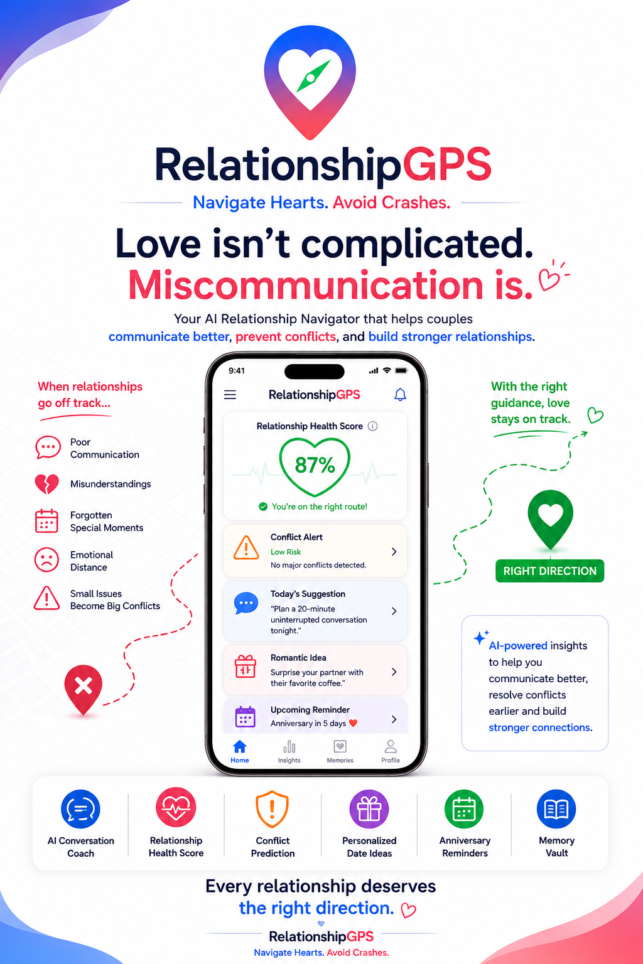

Slide 12
Relationship GPS
Navigate conversations before they become conflicts.
Thank you

