Slide 1

Formal Verification of Asynchronous FIFO
ECE-560: Assertion-Based Verification
Instructor: Venkatesh Patil
Aadityasingh Chouhan (aadityac@pdx.edu)
Manank Bhavsar(mbhavsar@pdx.edu)

Slide 2
Introduction
Asynchronous FIFOs are widely used in SoCs to safely transfer data across unrelated clock domains, making their correctness critical for silicon reliability.
Project focuses on verifying a dual-clock Asynchronous FIFO using SVA and VC Formal, as traditional simulation struggles to exhaustively test all the possible clock phase difference.
Design includes Gray-coded pointers, two-flop synchronizers.
Assertion based verification enables checking deep corner cases that can rarely appear in random or directed simulation.
Formal verification explores all timing permutations between write/read clocks.

Slide 3
Project Overview
FIFO supports parameterized depth and width, enabling resue across multiple subsystems within a digital design.
Asynchronous FIFO enables data transfer between unrelated clock domains.
Formal verification ensures correctness under all inter-clock alignments.
Full/empty detection logic is based on pointer comparison in gray code, which eliminates multi-bit metastability during synchronization.
FIFO integrates two independent synchronizer module- sync_w2r and sync_r2w to safely communicate pointer updates between domanins.
Failure mode includes incorrect flag generation, pointer divergence, wrap-around errors, and unsafe read/write operations.
The project formally verifies FIFO safety properties across all possile sequences of read/write operations.

Slide 4
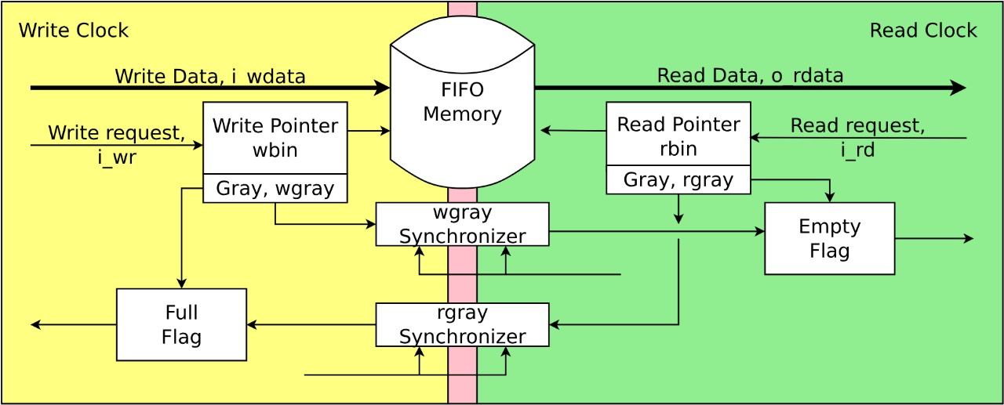
Architecture Block Diagram
Write Pointer Logic (wptr_full.sv), Read Pointer Logic (rptr_empty.sv), FIFO Memory (fifomem.sv), Pointer Synchronizers (sync_r2w.sv, sync_w2r.sv), Top-level DUT (asynch_fifo_dut.sv)

Slide 5
Design Behaviour Specifications
The FIFO must guarantee safe data transfer across asynchronous write and read clock domain without corruptions.
Write operations must only advance the write pointer when winc is asserted and the FIFO is not full.
Read operations must only advance the write pointer when rinc is asserted and the FIFO is not empty.
The FIFO must maintain data ordering- first written data must be first data must be the first read data.

Slide 6
Pointer & Flag Specifications
Write and read pointers must increment strictly according to Gray-code rules to avoid multi-bit metastability.
Full condition must assert when the write pointer is exactly one full cycle ahead of the synchronized read pointer.
Empty condition must assert when the read pointer equals the synchronized write pointer.
Synchronizers (sync_w2r, sync_r2w) must correctly propagate pointer updates across domains with a stable, two-flop delay.
Pointer wrap-around must occur correctly without skipping addresses or misalignments.

Slide 7
Specifications and Assertions
No reads when FIFO is empty.
No writes when FIFO is full.
Pointers follow Gray-code rules.
Flags accurately reflect pointer positions.
Synchronization must be stable and monotonic.

Slide 8
Assumptions
Independent, clean clocks (wclk, rclk).
Proper reset behavior - stable data during writes.
No illegal pointer driving; realistic CDC behavior.
Write enable (winc) and read enable (rinc) are single-cycle pulses with no glitches.
The input wdata remains stable throughout the entire write cycle until captured.
Reet (wrst_n, rrst_n) must not deassert simultaneously while clocks are unstable.
No simultaneous reset and data operation in same cycle.

Slide 9
Cover Properties
Cover the point when rempty deasserts for the first time after reset.
Cover when wfull transistions 1 -> 0 after reads free space.
FIFO correctly enters empty state immediately after reset.
After reset deasserts, pointer and flag logic stabilize within expected cycle.
Cover full FIFO followed immediately by emoty FIFO after continuous work.

Slide 10
Assertions:
No write when FIFO is full, write pointer must increment only when write is valid.
No read when FIFO is empty, read pointer must increment only when read is valid.
Gray-code pointer must match binary version.
Synchronizers output must settle within two receiving clock cycles after pointer changes.
Correct full/empty flag logic across domains.
Data read from FIFO must match data previously written to that location.
If system is not full, eventually a write must be possible.

Slide 11
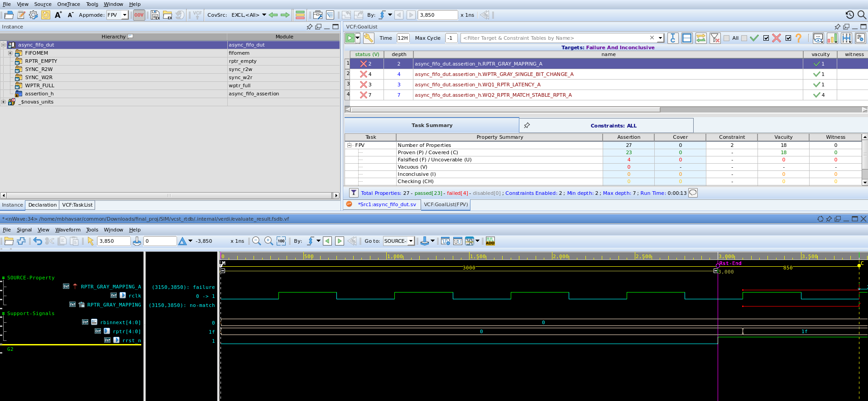
Bug Injection & Debugging Process

Slide 12
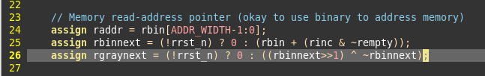

Bug Injection & Debugging Process

Slide 13
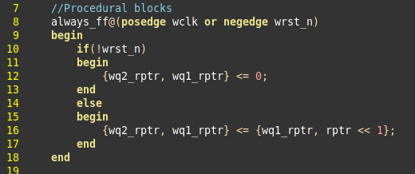
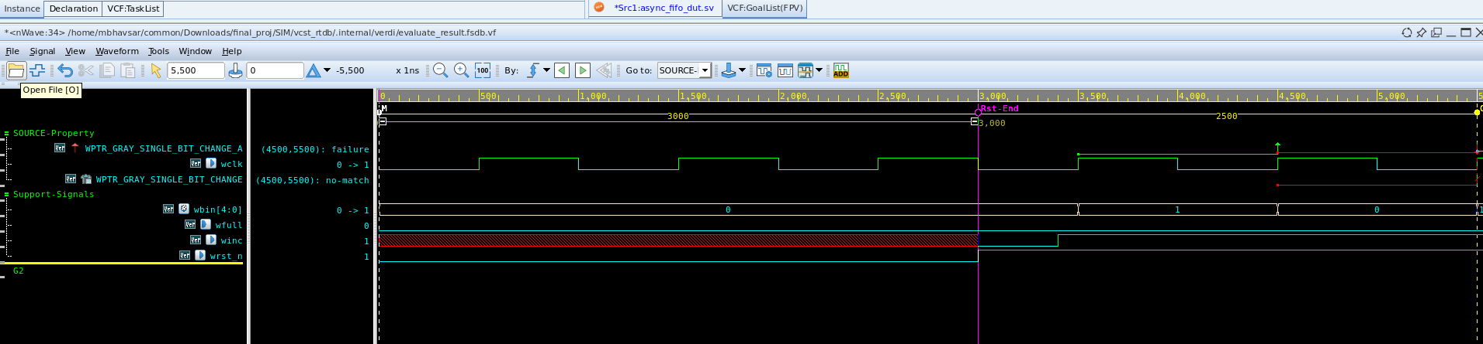

Bug Injection & Debugging Process

Slide 14

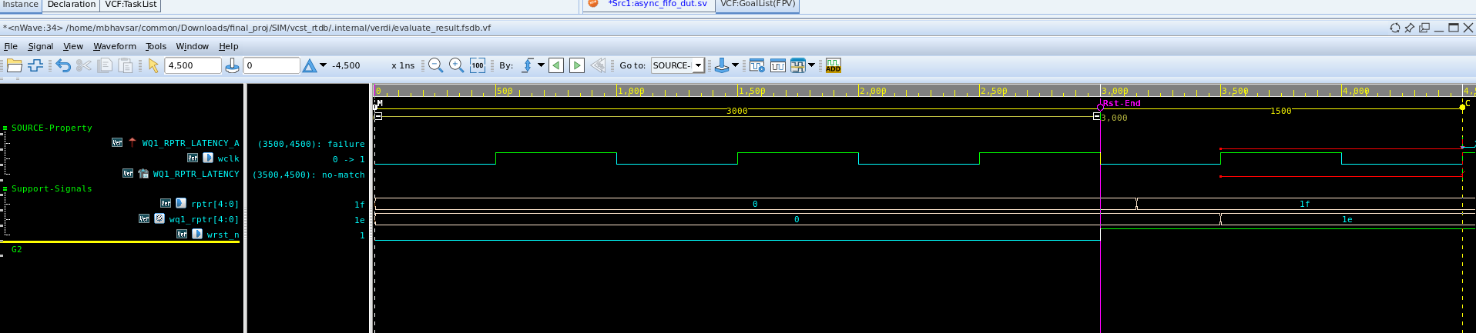
Bug Injection & Debugging Process

Slide 15
Verification Methodology
Tools: Synopsys VC Formal.
Modes: FPV, AEP, FXP, COV.
Used assumptions, assertions, and cover properties.
FPV mode was used to prove functional correctness of pointers, flag and handshake across domains.
AEP mode automatically detected potential design hazards, such as unintended X-propagation or unreachable states.
Cover properties were written to check that the solver reaches key scenarios like overflow, underflow.

Slide 16
Summary & Conclusion
Formal verification demonstrated it’s ability to expose subtle CDC issues that simulation might never observe.
The SVA properties enforced strong design gurrantees, ensuring FIFO behaves correctly regardless of clock interaction.
The project highlights how assertion-based methods reduce verification efforts whole increasing design confidence.
Formal coverage results confirmed that all major operational scenarios were reached, including pointer synchronization and wrap around.
Overall, the asynchronous FIFO passed all the formal proofs confirming the correctness of it’s architecture.

Slide 17
References
Synopsys VC Formal Documentation
SNUG FIFO 1&2.
ECE 560 course materials.
ChatGPT.

