Slide 1
Chord: A Scalable Peer-to-peer Lookup Protocol for Internet Applications
Ion Stoica Robert Morris
David Liben-Nowell David R. Karger
M. Frans Kaashoek Frank Dabek
Hari Balakrishnan
Presented By-
Nimy Sara Alex | 301325706
Master of Engineering

Slide 2
OUTLINE
Introduction
Consistent Hashing
The Chord Protocol
Chord : Scalable Key Location
Node Joins & Leaves
Benefits of Chord
Conclusion

Slide 3
Introduction
Scalable protocol for a better lookup in a dynamic peer-to-peer system.
Chord supports just one operation: given a key, it maps the key onto a node.

Slide 4
Introduction
Applications: Co-operative Mirroring, Time-shared storage, Distributed indexes, Large-Scale combinatorial search
Chord consists of
Consistent Hashing
Small routing tables
Fast join/leave protocol

Slide 5
OUTLINE
Introduction
Consistent Hashing
The Chord Protocol
Chord : Scalable Key Location
Node Joins & Leaves
Benefits of Chord
Conclusion

Slide 6
Consistent Hashing
Hashing :
Key: “john@example.ca”
Value: “John”
Key | Bucket
00 | John
01 | Jane
02 | Steve
03 | Bill
04 | Kate
HASH FUNCTION
Key: “kate@example.com”
Value: “Kate”

Slide 7
Consistent Hashing
Distributed Hashing :
The objects (and their keys) are distributed among several servers.
to overcome memory limitations
Improve performance and reduce load.

Slide 8

Consistent Hashing
Distributed Hashing : How does distribution work?
simplest way is to take the hash modulo of the number of servers
$$server=hash\left(key\right) mod N$$
KEY | HASH | HASH mod 3
“john” | 1633428562 | 2
“bill” | 7594634739 | 0
“jane” | 5000799124 | 1
“steve” | 9787173343 | 0
“kate” | 3421657995 | 2
A | B | C

Slide 9
Consistent Hashing
Distributed Hashing : How does distribution work?
simplest way is to take the hash modulo of the number of servers
$$server=hash\left(key\right) mod N$$
KEY | HASH | HASH mod 3
“john” | 1633428562 | 2
“bill” | 7594634739 | 0
“jane” | 5000799124 | 1
“steve” | 9787173343 | 0
“kate” | 3421657995 | 2
A | B | C
“bill” | “jane” | “john”
“steve” |  | “kate”
What if a server fails?

Slide 10
OUTLINE
Introduction
Consistent Hashing
The Chord Protocol
Chord : Scalable Key Location
Node Joins & Leaves
Benefits of Chord
Conclusion

Slide 11
The Chord Protocol
Uses a variant of consistent hashing:
Load tends to be balanced
When Nth node joins (or leaves) network, only O(1/N) fraction of key/value pairs are moved to different location
each node only maintains information about few other nodes

Slide 12
The Chord Protocol
Consistent hash function uses SHA1 to assign IDs nodes and keys
43
=
42
Node: hash(IP)
Key: hash(key)
54
60
=
32
=
1
=
17
=
5
10
Chord: keys are stored at successor
7

Slide 13

The Chord Protocol
Theorem:
For any set of N nodes and K keys,
Each node is responsible for at most $\frac{\left(1+∈\right)K}{N}$ keys
When an $\left(N+1\right)st$ node joins or leaves the network, responsibility for $O$(K/N) keys changes hands.
43
=
42
54
60
=
32
=
1
=
17
=
5
10
7

Slide 14
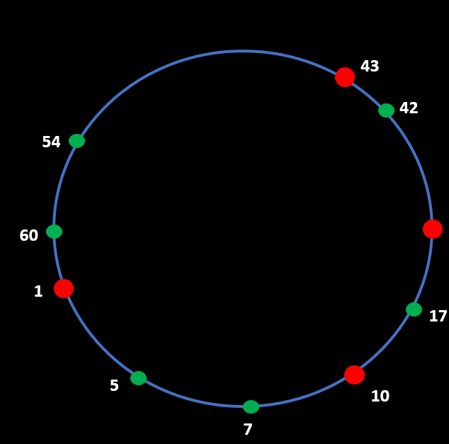

The Chord Protocol
Option 1:
Every nodes every other node.
Lookups : $O(1)$
No of Routing tables : $O(N)$
32
Routing Table
N43
N1
N10

Slide 15
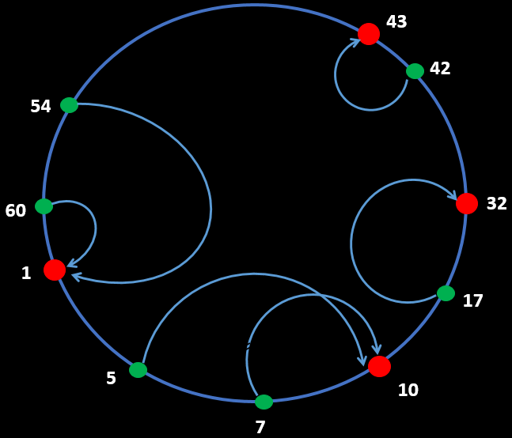

The Chord Protocol
Option 2:
Node knows only immediate successor.
Lookups : $O(N)$
No of Routing tables : $O(1)$

Slide 16
OUTLINE
Introduction
Consistent Hashing
The Chord Protocol
Chord : Scalable Key Location
Node Joins & Leaves
Benefits of Chord
Conclusion

Slide 17
Chord: Scalable Key Location
32
Consider a ring of 6-bit ID-space
Nodes
Keys

Slide 18

Chord: Scalable Key Location
First finger => always the immediate successor
$i^{th} finger=(n+2^{i−1})$, where $1≤i≤m$
32

Slide 19

Chord: Scalable Key Location
First finger => always the immediate successor
$i^{th} finger=(n+2^{i−1})$, where $1≤i≤m$
32
Finger Table = N10
N10 + 2⁰ = 11 | 32
N10 + 2¹ = 12 | 32
N10 + 2² = 14 | 32
N10 + 2³ = 18 | 32
N10 + 2⁴ = 26 | 32
N10 + 2⁵ = 42 | 43

Slide 20

Chord: Scalable Key Location
THEOREM : With high probability, the number of nodes that must be contacted to find a successor in an N-node network is $O(\log{N)}$.
32
Finger Table = N10
N10 + 2⁰ = 11 | 32
N10 + 2¹ = 12 | 32
N10 + 2² = 14 | 32
N10 + 2³ = 18 | 32
N10 + 2⁴ = 26 | 32
N10 + 2⁵ = 42 | 43

Slide 21
Chord: Scalable Key Location
CASE: Consider N10 wants to lookup the data with key id 54.
How does it locate it?
32
Finger Table = N10
N10 + 2⁰ = 11 | 32
N10 + 2¹ = 12 | 32
N10 + 2² = 14 | 32
N10 + 2³ = 18 | 32
N10 + 2⁴ = 26 | 32
N10 + 2⁵ = 42 | 43

Slide 22
OUTLINE
Introduction
Consistent Hashing
The Chord Protocol
Chord : Scalable Key Location
Node Joins & Leaves
Benefits of Chord
Conclusion

Slide 23
Node Joins & Leaves
When a node joins the ring
STEP 1: When N59 joins the ring;
N59 calls join() :
Initializes the finger table.
N59 acquires N1 as successor.
N1 acquires N59 as predecessor.
59
Finger Table = N59
32
32

Slide 24
Node Joins & Leaves
STEP 2:
N43 runs stabilize() :
Checks N1 for current predecessor = N59
Informs N59 to correct finger entries
Updates successor pointer for itself.
59
32

Slide 25
Node Joins & Leaves
STEP 3:
Each node runs fix_fingers():
Other nodes of the ring are informed about N59
Finger entries updated for all nodes.
59
32
32

Slide 26
Node Joins & Leaves
CASE 1: Correctly updated successive pointers and finger table entries.
CASE 2: Successor points are accurate but finger entries are incorrect.
CASE 3: No updates to successor pointer or finger entries.

Slide 27
Node Joins & Leaves
When a node fails:
Nodes maintains a successor list.
When a node leaves voluntarily:
Node transfer its keys to successor.
Inform predecessor and successor.

Slide 28
OUTLINE
Introduction
Consistent Hashing
The Chord Protocol
Chord : Scalable Key Location
Node Joins & Leaves
Benefits of Chord
Conclusion

Slide 29
Benefits of Chord
Efficient load balance
Decentralization
Scalability
Availability
Flexible naming conventions

Slide 30
OUTLINE
Introduction
Consistent Hashing
The Chord Protocol
Chord : Scalable Key Location
Node Joins & Leaves
Benefits of Chord
Conclusion

Slide 31
Conclusion
Chord features simplicity, decentralized resolution and efficient look up
Using Chord to detect and heal partitions whose nodes know of each other.
Can be applied for systems like cooperative file sharing, time-shared available storage systems, distributed indices for document and service discovery, and large-scale distributed computing platforms.

Slide 32
Thank You!

