Slide 1
A Comparison of Approaches to Large-Scale Data Analysis
By seven authors from five different institutions
Presented by
Zhiqin Chen

Slide 2
Why not use a parallel DBMS instead?
Parallel DBMS:
Commercially available for 20 years
e.g. Microsoft, Oracle …
Robust
High performance
Provides high-level programming environment
You can write almost any parallel processing task as either a set of database queries or a set of MapReduce jobs

Slide 3
Outline
Comparison
Architectural differences
Benchmark & Results
5 tasks
Load time
Query time
Conclusion
Show where each system is the right choice

Slide 4
Architectural Differences: Data Storage
MapReduce
Raw (in-situ) data
Parallel DBMS
Standard relational tables
Most tables are partitioned over the nodes

Slide 5
Architectural Differences
Schema:
MR doesn’t require schema; DBMS does
Write a custom parser vs. Specify the “shape”
Indexing
Optimization
MR provides no built in support

Slide 6
Architectural Differences: Programming Model
Codasyl vs. Relational
Codasyl
Presenting an algorithm for data access
“The assembly language of DBMS access”
Relational
Stating what you want
Notes:
Conference/Committee on Data Systems Languages

Slide 7
Architectural Differences: Expressiveness
Flexibility vs. Simplicity
Almost all of the major DBMS products support user-defined functions (UDFs)
*UDFs are problematic

Slide 8
Architectural Differences: Fault Tolerance
Data transfer Strategy
Pull vs. Push
MR supports mid-query fault tolerance
Output files of the Map phase are materialized locally
Pipelines of MR jobs write intermediate results to files
DBMSs typically don’t
Matters when the number of nodes gets large

Slide 9
The benchmark and experiments

Slide 10
Hardware
100-node Linux cluster at U. Wisconsin
“Shared nothing”
Local disk and local memory
Connected by LAN

Slide 11
Software
Hadoop
Publicly available open-source version of MapReduce
DBMS-X
Parallel shared-nothing row store from a major vendor
Partitioned, sorted, indexed and compressed beneficially
Vertica
Parallel shared-nothing column-oriented database
Sorted, indexed and compressed beneficially

Slide 12
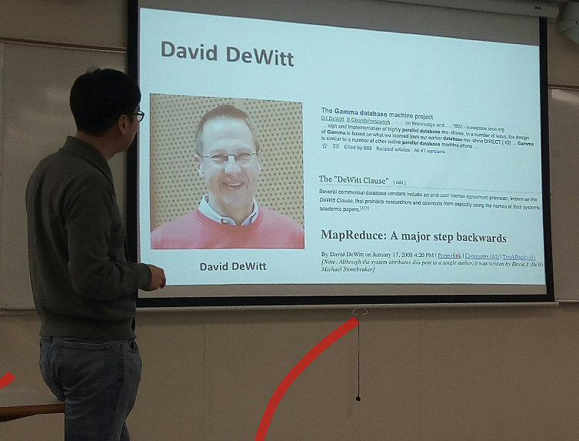
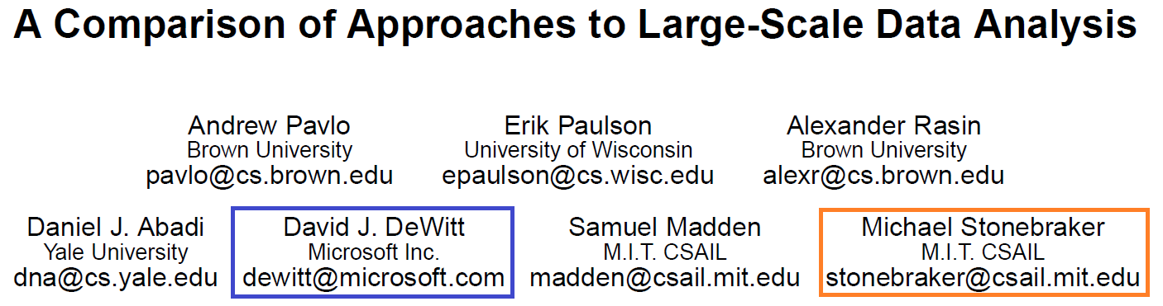
“DeWitt Clause”

Slide 13
Software
Hadoop
Publicly available open-source version of MapReduce
DBMS-X
Parallel shared-nothing row store from a major vendor
Partitioned, sorted, indexed and compressed beneficially
Vertica
Parallel shared-nothing column-oriented database
Partitioned, sorted, indexed and compressed beneficially

Slide 14
Grep
Used in original MapReduce paper
Look for 3 character pattern in 90 byte field of 100 byte records with schema
0.01% of records
CREATE TABLE Data (
key VARCHAR(10) PRIMARY KEY,
field VARCHAR(90) );
SELECT * FROM Data WHERE field LIKE '%XYZ%' ;

Slide 15
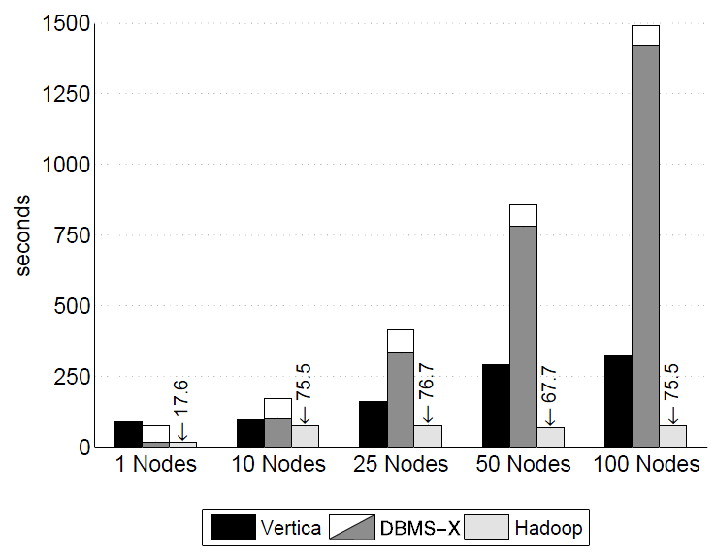
Load times – Grep (535MB/node)
DBMS-X: proportional increase , sequencial read
Hadoop: same, just copy and duplicate
optimization, compression, indexing…

Slide 16
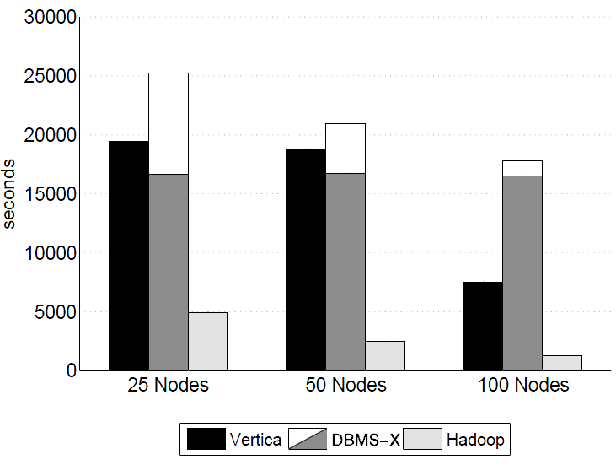
Load times – Grep (1TB/cluster)
10-40 GB/node

Slide 17
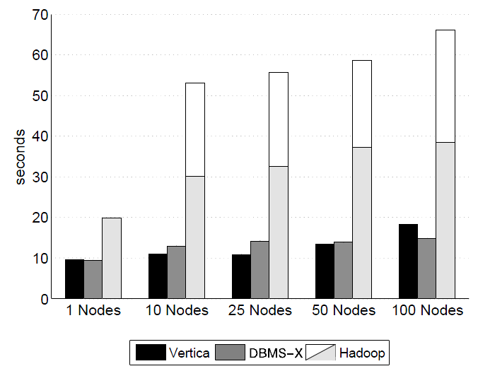
Query times - Grep (535MB/node)
MR startup cost dominates 10-25s in short running queries
additional MR job to merge results into a single file

Slide 18
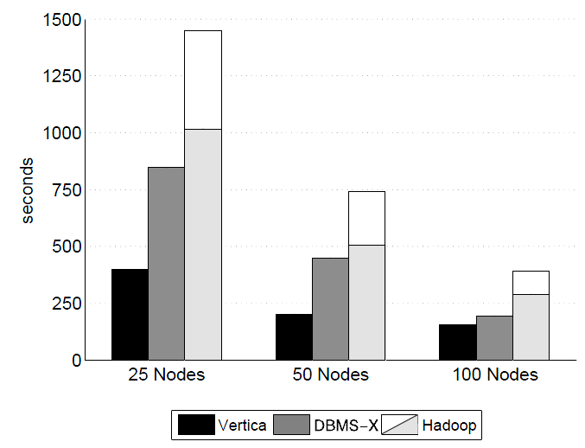
Query times - Grep (1TB/cluster)
10-40 GB/node

Slide 19
Analytical tasks
Simple HTML document processing
Documents
600,000 documents/node
~8 GB/node
Randomly generated with unique URL
Embeds random URLs to other documents
Rankings
~1 GB/node
UserVisits
~20 GB/node

Slide 20
Analytical tasks: schema
CREATE TABLE UserVisits (
sourceIP VARCHAR(16),
destURL VARCHAR(100),
visitDate DATE,
adRevenue FLOAT,
userAgent VARCHAR(64),
countryCode VARCHAR(3),
languageCode VARCHAR(6),
searchWord VARCHAR(32),
duration INT );
CREATE TABLE Documents (
url VARCHAR(100) PRIMARY KEY,
contents TEXT );
CREATE TABLE Rankings (
pageURL VARCHAR(100) PRIMARY KEY,
pageRank INT,
avgDuration INT );

Slide 21
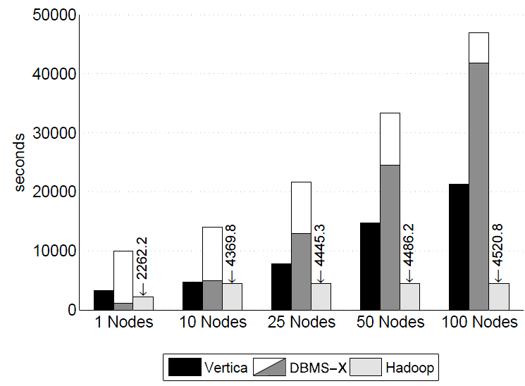
Load times – UserVisits (20GB/node)

Slide 22
Aggregation task
To calculate the total adRevenue generated for each sourceIP in the UserVisits grouped by sourceIP
Nodes need to exchange intermediate data with one another in order to compute the final value
Produces ~2.5 million records (53 MB)
SELECT sourceIP, SUM( adRevenue )
FROM UserVisits GROUP BY sourceIP;

Slide 23
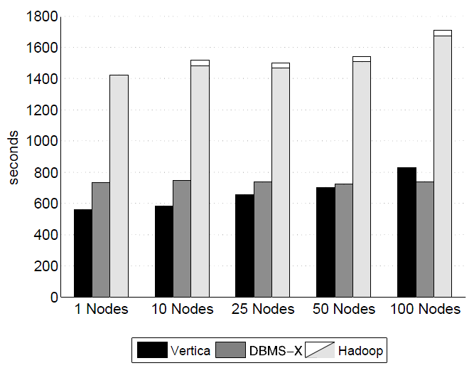
Query times - Aggregation
Runtime dominated by scanning and communication cost
Vertica fast: column store , decrease when more nodes

Slide 24
Aggregation task (variation)
To calculate the total adRevenue generated for each sourceIP in the UserVisits grouped by the seven-character prefix of the sourceIP
To measure the effect of reducing the total number of groups on query performance
Produces ~2,000 records (24KB)
SELECT SUBSTR( sourceIP, 1, 7 ), SUM( adRevenue )
FROM UserVisits GROUP BY SUBSTR( sourceIP, 1, 7 );

Slide 25
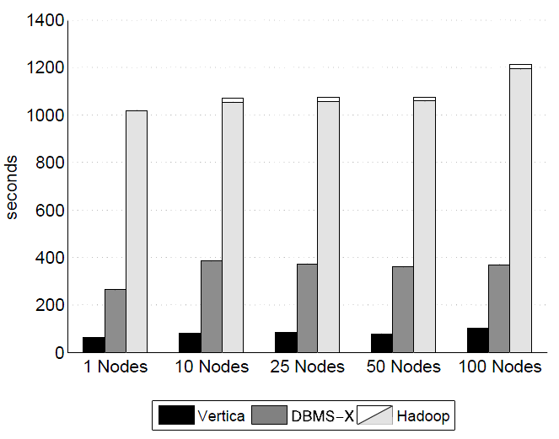
Query times – Aggregation var.
Runtime dominated by scanning the entire dataset

Slide 26
UDF task
compute the inlink count for each document in the dataset
First read each document and search for all URLs
Then, for each unique URL, count the number of unique pages that reference the URL
MR is believed to be commonly used for this type of task (should perform well)

Slide 27
UDF task
In SQL, UDF to extract URLs followed by an aggregation
Neither DBMS made this easy
Vertica didn’t support UDFs!
Use external program to populate temporary tables
DBMS-X had buggy BLOBs
UDF read documents from file system
Hadoop makes such tasks extremely easy to write
SELECT INTO Temp F( contents ) FROM Documents;
SELECT url, SUM( value ) FROM Temp GROUP BY url;

Slide 28
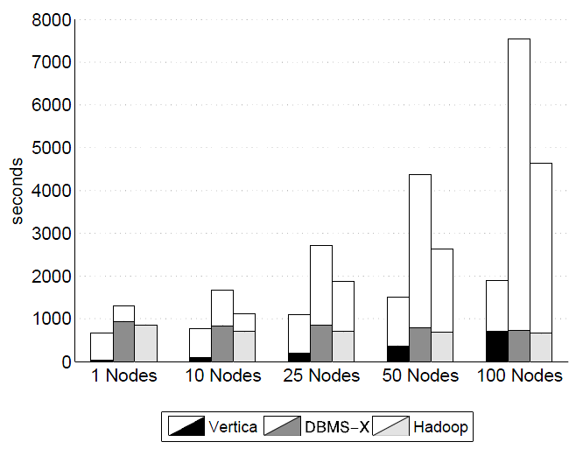
Query times - UDF
① query execution
②UDF to load the data into the table
additional MR job to merge results into a single file
1
2
Notes:
MR: additional job time increase, more data to combine
Dbms-x worse than hadoop due to UDF interaction with file sys
Vertica -> parse data outside dbms and write on local disk before load into dbms

Slide 29
Discussion
System setup
parallel DBMSs are much more challenging than Hadoop to install and configure properly
Task Start-up
Hadoop has “cold start” nature
parallel DBMSs are started at OS boot time, thus always “warm”
Notes:
On occasion, this combination of manual and automatic changes resulted in a configuration for DBMS-X that caused it to refuse to boot the next time the system started.
DBMSX,on the other hand, was difficult to configure properly and required repeated assistance from the vendor to obtain a configuration that performed well.

Slide 30
Discussion
Loading
Hadoop load times are faster
Loading is just copying
no indexing, no optimization
Hadoop query times are a lot slower
DBMS-X was 3.2 times faster than Hadoop
Vertica was 2.3 times faster than DBMS-X
“MapReduce is a GO SLOW command for OLAP Queries.”
-- from a talk in Brown University (youtube)

Slide 31
When to choose MapReduce?
Load times – UserVisits (20GB/node)

Slide 32
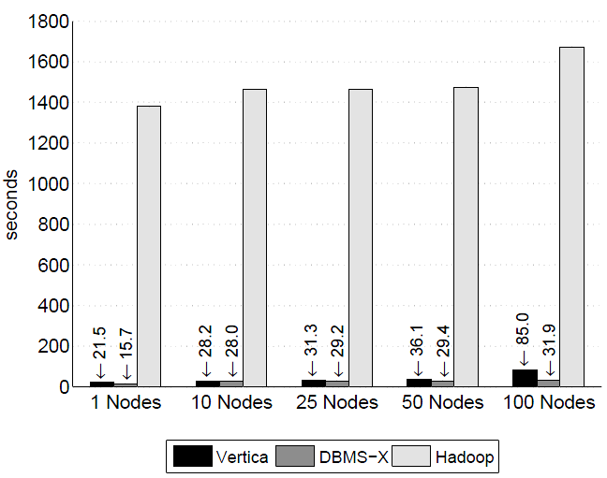
Query times - Join

Slide 33
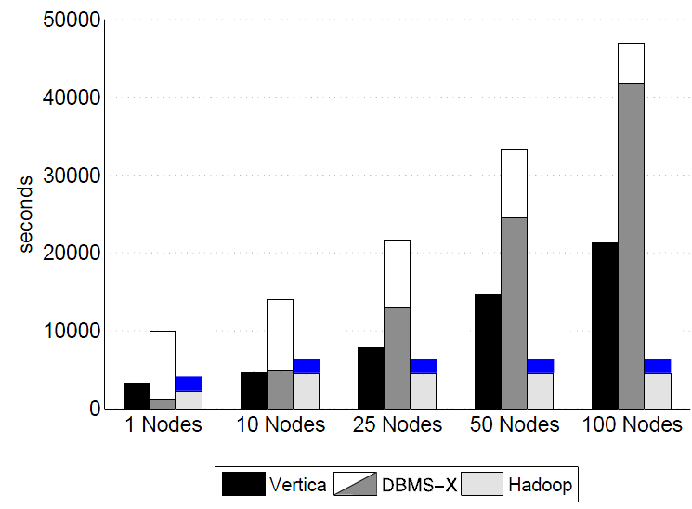
When to choose MapReduce?
Load times – UserVisits (20GB/node)
Query times - Join

Slide 34
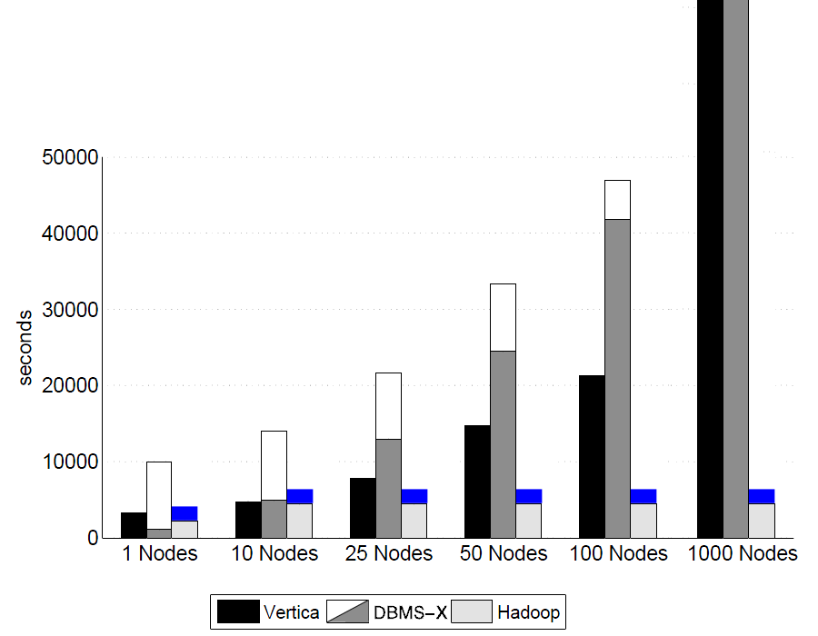
When to choose MapReduce?
Load times – UserVisits (20GB/node)
Query times - Join

Slide 35
When to choose MapReduce?
MapReduce is designed for one-off processing tasks
Where fast load times are important
No repeated access
Data with no schema or structure & UDFs
No compelling reason to choose MR over a database for traditional database workloads

Slide 36
Thank you. Q&A

Slide 37
Parallel DBMS query execution
Filtering: performed in parallel on each node
Join: based on the size of data tables
Small: replicate it on all nodes, compute in parallel
Huge: need re-hash and redistribution
Aggregation:
Each node computes its own portion
A final “roll-up”

Slide 38
Hardware
100-node Linux cluster at U. Wisconsin
“Shared nothing”
Local disk and local memory
Connected by LAN
Can 100 nodes represent real world systems?
At 100 nodes we already see significant difference
Very few applications really need 1000 nodes
eBay uses just 72 nodes
Fox Interactive Media uses 40 nodes

Slide 39
Selection task
A lightweight filter to find the pageURLs in the Rankings table with a pageRank above a userdefined threshold
~36,000 records per data file on each node
SELECT pageURL, pageRank
FROM Rankings WHERE pageRank > 10;

Slide 40
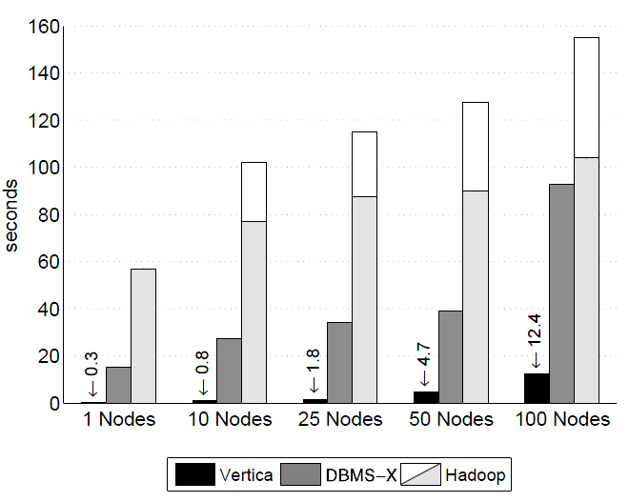
Query times - Selection
Vertica: cost low but increase
Node still execute the query using same time
System flooded with control messages

Slide 41
Join Task
Consisting two sub-tasks that perform a complex calculation on two data sets
First part: find the sourceIP that generated the most revenue within a particular date range
Second part: calculate the average pageRank of those pages visited during this interval
Produces ~134,000 records

Slide 42
Join Task
SELECT INTO Temp sourceIP,
AVG( pageRank ) as avgPageRank,
SUM( adRevenue ) as totalRevenue
FROM Rankings AS R, UserVisits AS UV
WHERE R.pageURL = UV.destURL
AND UV.visitDate BETWEEN Date( '2000-01-15' )
AND Date( '2000-01-22' )
GROUP BY UV.sourceIP;
SELECT sourceIP, totalRevenue, avgPageRank
FROM Temp
ORDER BY totalRevenue DESC LIMIT 1;

Slide 43
Join Task
MapReduce does not provide join
3 separate jobs executed one after one
Filter UserVisits, join with Rankings
Compute total adRevenue and average pageRank based on sourceIP
Get largest total adRevenue from previous outputs

Slide 44
Query times - Join
Complete scan vs. Indexed & partitioned by join key (join locally)
MR: 600 to read, 300 to parse, CPU limits

Slide 45
Discussion
Compression
parallel DBMS allows for optional compression
Vertica’s execution engine operates directly on compressed data
Hadoop supports data compression, yet not improving performance

Slide 46
Discussion
User-level Aspect
MR is easy to start but hard to maintain
MR lacks additional tools (for tuning, debugging, etc.)

Slide 47
Conclusion
MapReduce advantage
Easy to setup, easy to use
Fault tolerance
Fast load times
One-off processing
DBMS advantage
Fast query times
Supporting tools
Repeated re-access

