Slide 1
MapReduce Simplied Data Processing on Large Clusters
Jeffrey Dean and Sanjay Ghemawat, Google, Inc.
Presented by
Zhiqin Chen

Slide 2
Motivation
Parallel applications
Inverted indices
Summaries of web pages
Most frequent queries
Common issues
Parallelize computation
Distribute data
Handle failures

Slide 3
Overview
Key/Value pairs
map
Input: input Key/Value
Output: intermediate Key/Value
reduce
Input: intermediate Key/{Value}
Output: output Key/Value

Slide 4
Word Count Example
1.txt
A B C
2.txt
B B C
3.txt
C B C
4.txt
A A C
key: document name
value: document contents
map(String key, String value):
for each word w in value:
Emit_Intermediate( w, 1 );

Slide 5
Example - Map
1.txt
A B C
2.txt
B B C
3.txt
C B C
4.txt
A A C
Worker_1
Worker_2
map(String key, String value):
for each word w in value:
Emit_Intermediate( w, 1 );
A, 1
B, 1
C, 1
C, 1
B, 1
C, 1
C, 1
B, 1
C, 1
A, 1
A, 1
C, 1
(Local disk)

Slide 6
Example - Iterator
Worker_1
Worker_2
A, 1
B, 1
C, 1
C, 1
B, 1
C, 1
C, 1
B, 1
C, 1
A, 1
A, 1
C, 1
Intermediate Value Iterator
(Users don’t need to write this)
A, 1
A, 1
A, 1
A, { 1, 1, 1 }
C, { 1, 1, 1, 1, 1, 1 }
B, { 1, 1, 1 }
LAN
Worker_3
Worker_4
A, { 1, 1, 1 }
key: a word
values: a list of counts

Slide 7
Example - Reduce
A, { 1, 1, 1 }
C, { 1, 1, 1, 1, 1, 1 }
B, { 1, 1, 1 }
Worker_3
Worker_4
reduce(String key, Iterator values):
result = 0;
for each v in values:
result += v;
Emit( result );
A, 3
B, 3
C, 6

Slide 8
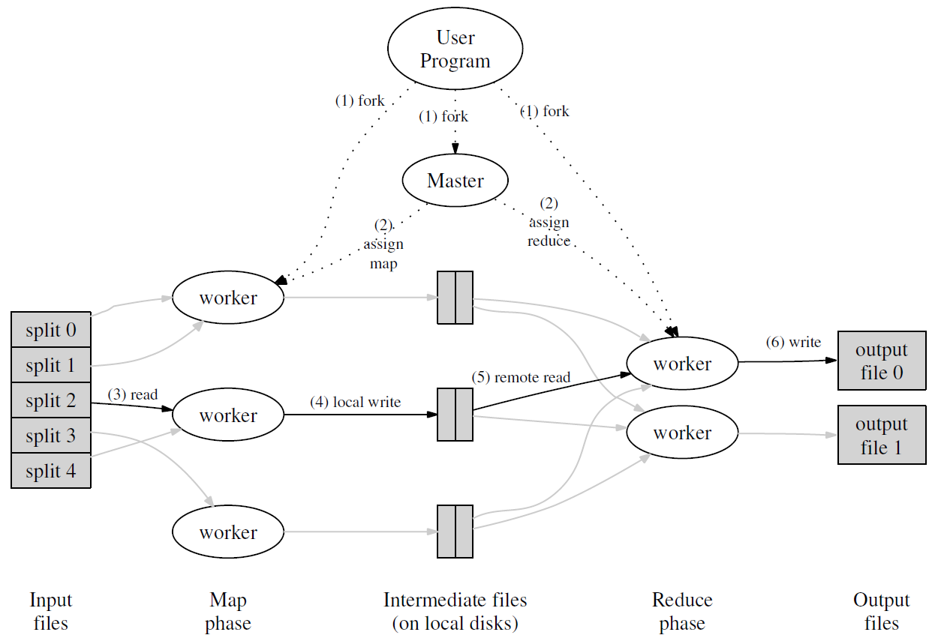
Implementation: Overview

Slide 9
Implementation: Split
Split the input files into M pieces
Start up many copies of the program on a cluster of machines

Slide 10
Implementation: Master
Picks idle workers and assigns tasks
M map tasks
R reduce tasks
Can assign multiple tasks on the same worker

Slide 11
Implementation: Map worker
Reads the input split
Parses K/V pairs
Passes K/V pairs to the map function
Intermediate pairs are periodically written to local disk

Slide 12
Implementation: Local write
Local disk is partitioned into R regions
The locations are passed back to the master
Master forwards these locations to the reduce workers.

Slide 13
Implementation: Reduce worker
Remotley reads all intermediate data
Sorts it by the intermediate keys

Slide 14
Implementation: Reduce worker
Iterates over the sorted intermediate data
Passes the Key/List pairs to the Reduce function
The output is appended to a final output file

Slide 15
Implementation: Locality
Network bandwidth is scarce
Google File System
Divides each file into blocks
Stores several copies on different machines
MapReduce master
Schedule a map task on a machine that
contains a replica of the corresponding input data
near a replica of the input data
Most input data is read locally

Slide 16
Implementation: Fault tolerance
Worker failure
Common
Master pings workers
Incomplete tasks rescheduled
Complete map rescheduled
Complete reduce ignored
Master failure
Uncommon
Checkpoints

Slide 17
Implementation: Tasks
M pieces of Map, R pieces of Reduce
Much larger than the number of workers
Improve dynamic load balancing
Speeds up recovery
Need to be tuned accordingly
e.g. 2,000 workers M = 200,000 R = 5,000

Slide 18
Implementation: Backups
Problem: Stragglers
Unusually slow machines
Solution: backups
When MR is close to completion
Re-launch backups for remaining in-progress tasks
Significantly reduce the time (44% in experiment)

Slide 19
Performance: Experimental setup
Measure I/O
Scarce resource
Cluster
Approximately 1800 machines
Each with two 2GHz Intel Xeon processors with Hyper-Threading enabled
4GB memory
Two 160GB IDE disks
Gigabit Ethernet

Slide 20
Performance: Grep
Grep for rare three-character pattern
10¹⁰ 100-byte records
~100,000 hits
Large map small reduce
M = 15,000 R = 1

Slide 21
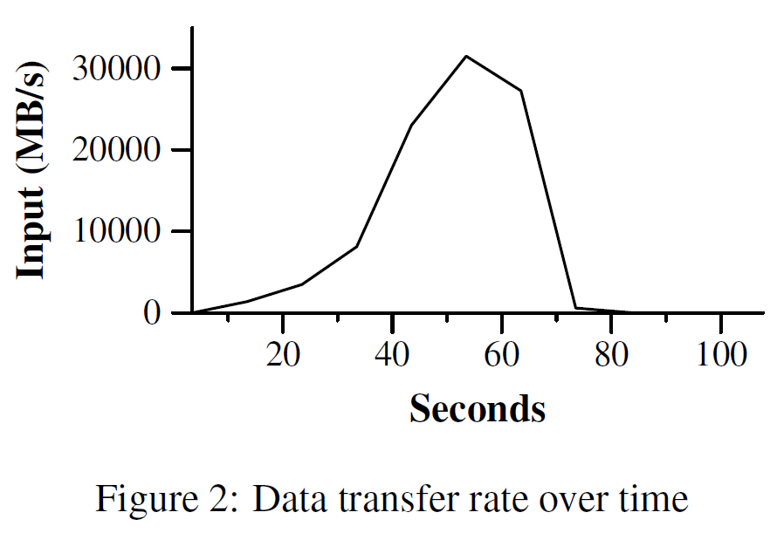
Performance: Grep
Execution time: 150 seconds
1 minute startup overhead
Propagate the program to all workers
Open 1000 input files for locality optimization

Slide 22
Performance: Sort
Large sort, based on TeraSort benchmark
1 TB data
10¹⁰ 100-byte records
Additional experiment
Turning off backups
Inducing machine failures

Slide 23
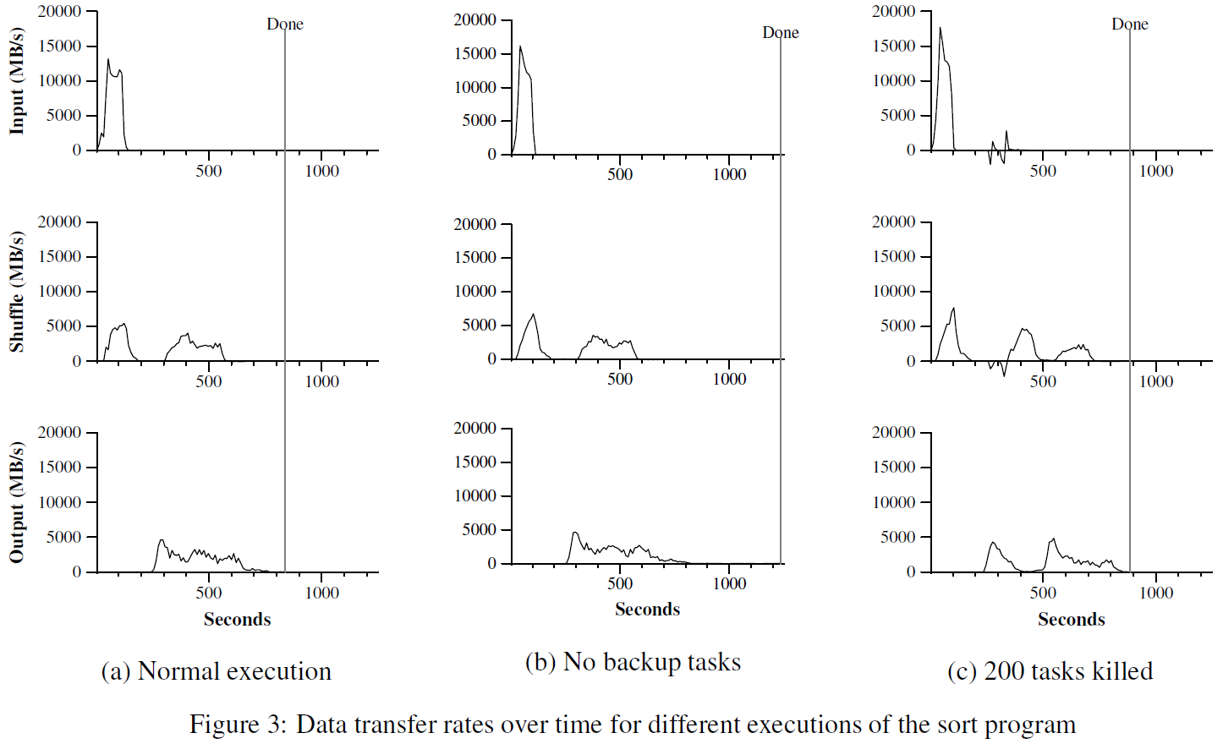
Performance: Sort
891 seconds
933 seconds
1283 seconds

Slide 24
Performance: Backups
Similar execution pattern overall
Minimal overhead
Reducing computation time
All but 5 tasks finished at 960 seconds
Without backups, finishes at 1283 seconds
Stragglers finish 300 seconds later (23%)
44% slower than backup execution

Slide 25
Performance: Sort
891 seconds
933 seconds
1283 seconds

Slide 26
Performance: Failures
Killed 200 of 1746 workers intentionally
Happens at between 200 and 300 seconds
Re-execution begins immediately
Results in only 5% total time increase

Slide 27
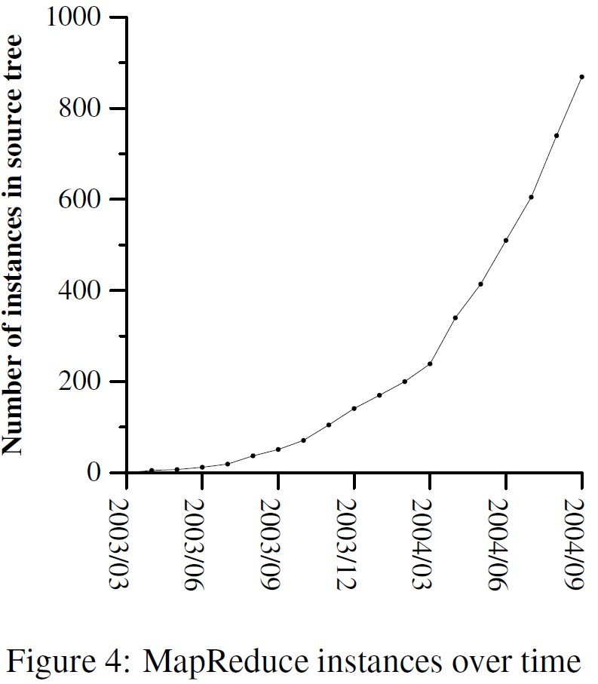
Experience
First released in February 2003
Significant improvements in August 2003
Extremely reusable
Simplified code
Applications
large-scale machine learning problems
clustering problems
extraction of data or properties
large-scale graph computations

Slide 28
Problems
Might be hard to express problem in MapReduce. (People are more familiar with SQL)
MapReduce is closed-source (to Google) C++. Hadoop is open-source Java-based rewrite.
*Why not use a parallel DBMS instead?

Slide 29
To be continued … Q&A

Slide 30
Refinements
Partitioning
Allow users to specify the partition of reduce tasks/output files
e.g Partition URLs by host
Ordering guarantees
Intermediate key/value pairs processed in increasing key order

Slide 31
Refinements
Combiner function
Optional step between map and reduce
e.g. Reducing size of word count data
Worker_2
Worker_2
C, 1
B, 1
C, 1
A, 1
A, 1
C, 1
A, 2
B, 1
C, 3

Slide 32
Refinements
Skipping bad records
Master skips records that continue to fail
Local execution
Counters
Counter* uppercase;
uppercase = GetCounter("uppercase");
Map (String name, String contents):
for each word w in contents:
if (IsCapitalized(w)):
uppercase->Increment();
EmitIntermediate(w, "1");

