Slide 1


Slide 2

Name & Brief description
Team Introduction

Slide 3
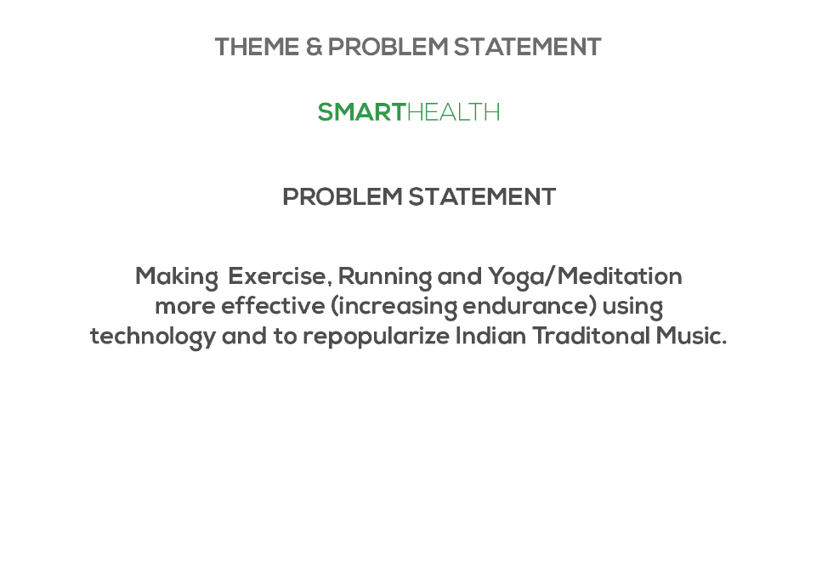
Smart Health
Problem Statement - Making Exercise more effective using technology and

Slide 4
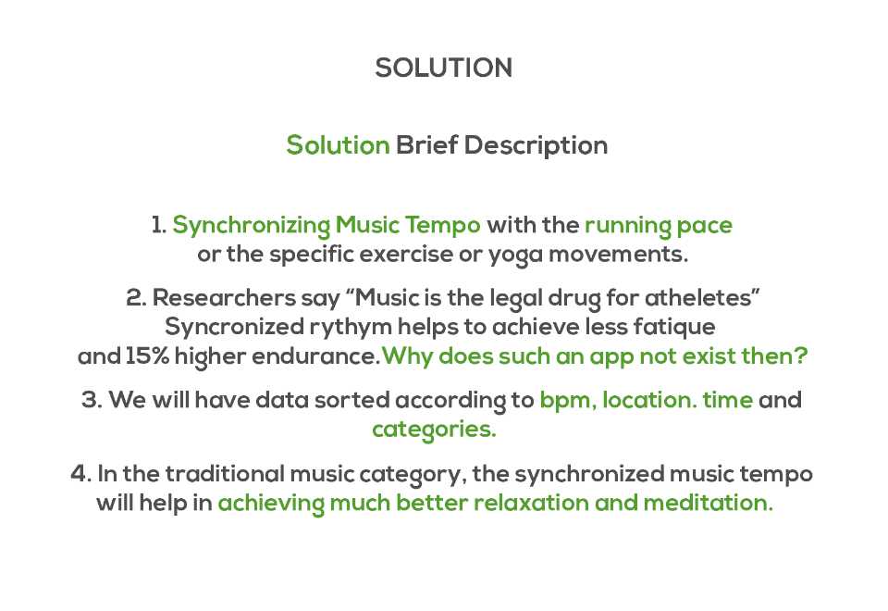
Solution Brief Description:
Please key in brief description of your solution in 4-5 bullet points.

Slide 5
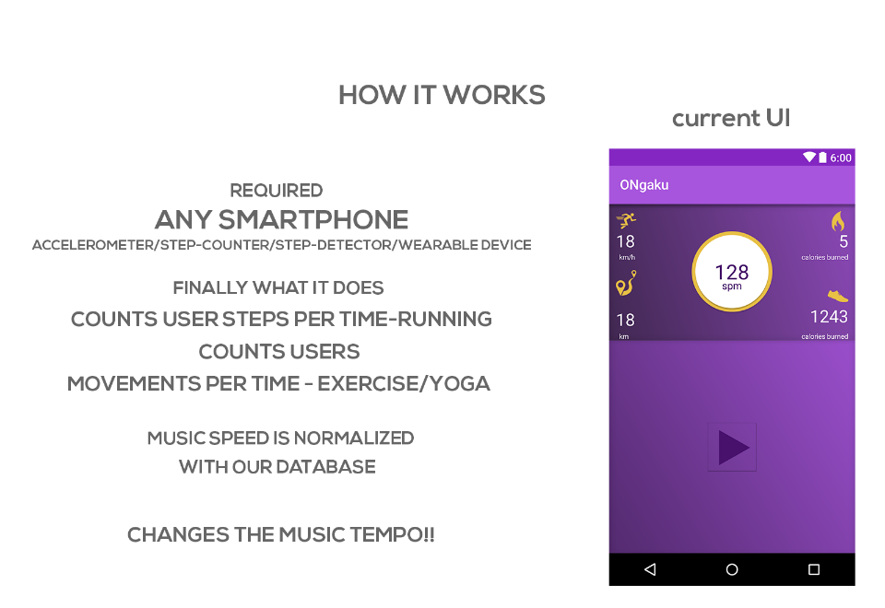
Prototype or
Walkthrough mock screens or
Demo
How it works?

Slide 6
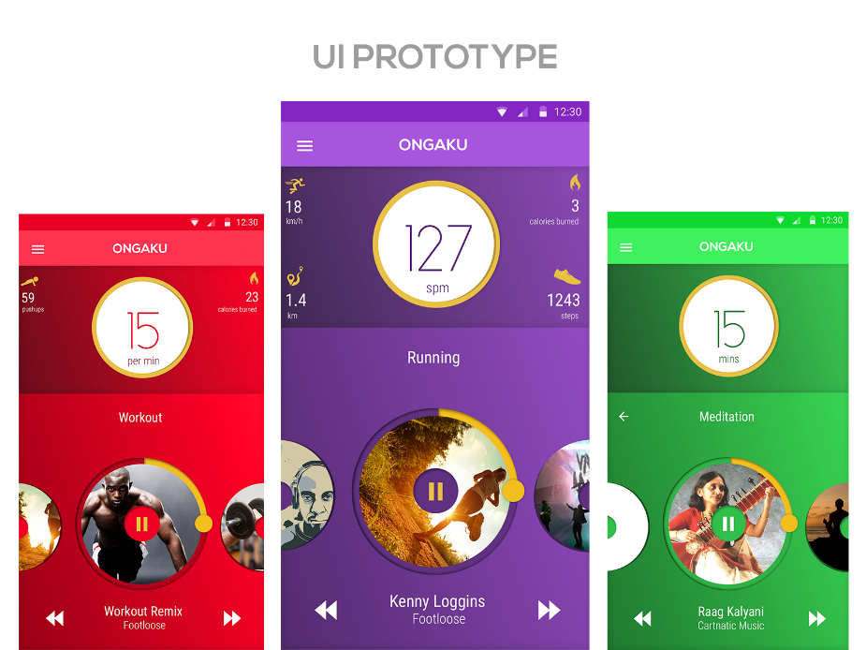

Slide 7


Slide 8
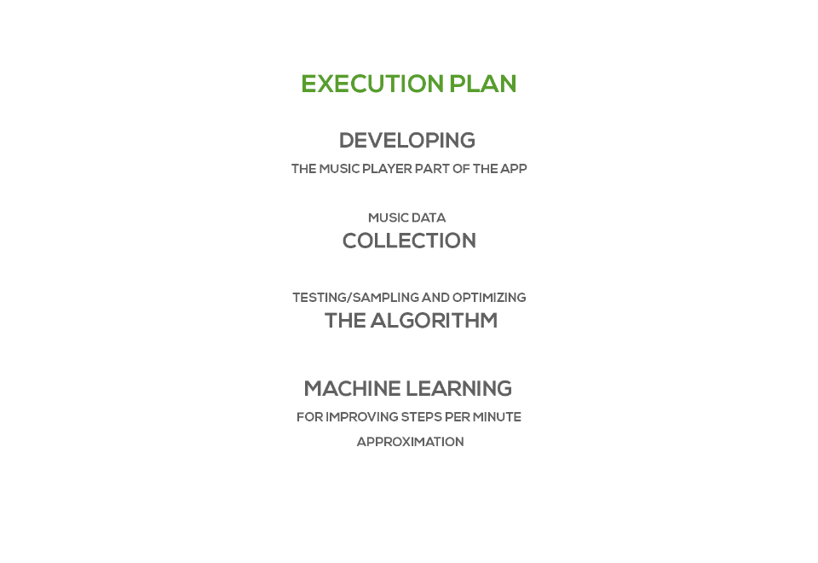
Business Model/Execution Plan

Slide 9
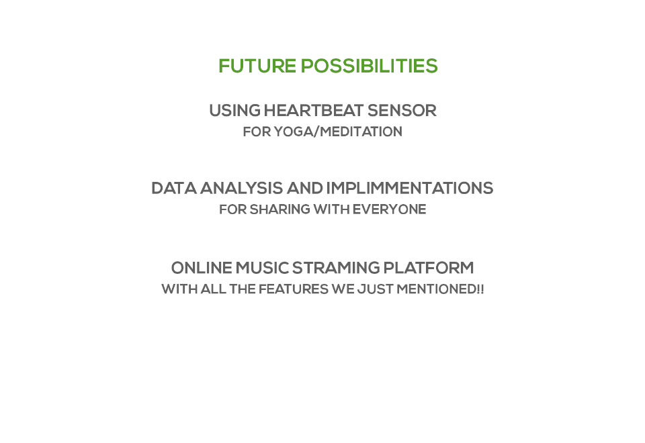
Future Possibilities

Slide 10

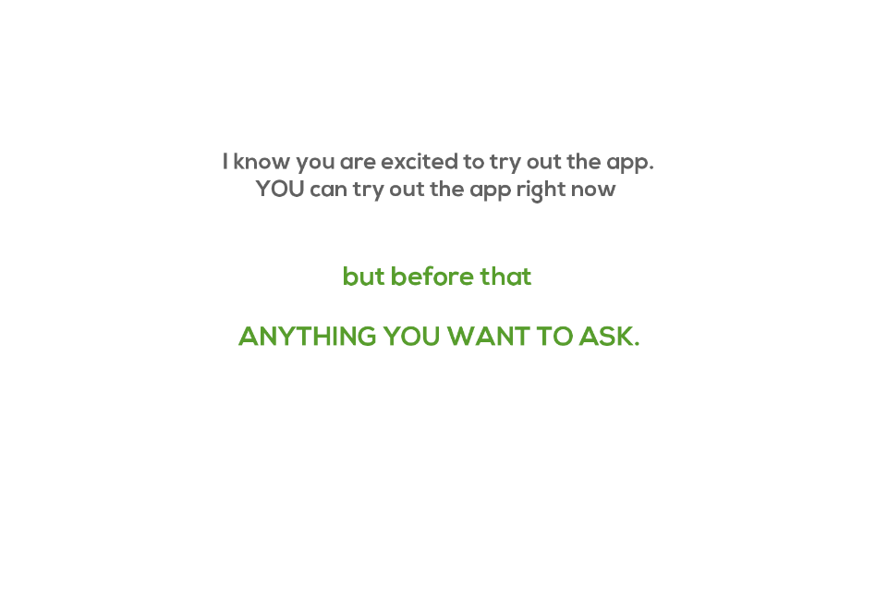
Q & A
Special Thanks to:
Levente Bagi
Pedometer Library Android

