Slide 1
Customers Like You: recommendations and customer groups
Emmanuel Adjei Danso
• GiftLane Online Retail II data (1.07M order lines, Dec 2009 - Dec 2011)
• Request: shrink the "also bought" job so it runs nightly, beat best sellers, and give Marketing named customer groups
• Targets set on Day 1: much smaller data | fast job | beat best-seller baseline on unseen purchases | nameable groups
• Solo project: both roles (Data Engineer + ML Engineer)

Slide 2
Data Engineer: from raw log to a leak-free matrix
• 1,067,371 raw lines -> 802,632 after cleaning (cancellations, quantity/price <= 0, non-product codes, no customer ID; each rule logged)
• Time split: train before 2011-10-09, test = last 2 months. Held-out = products the customer never bought in training
• Matrix 5,471 customers x 3,686 products (kept products bought by >= 10 customers), value = log(1 + units)
• 97.95% empty: 161.3 MB dense vs 4.99 MB sparse
• One command rebuilds everything: python build_matrix.py

Slide 3
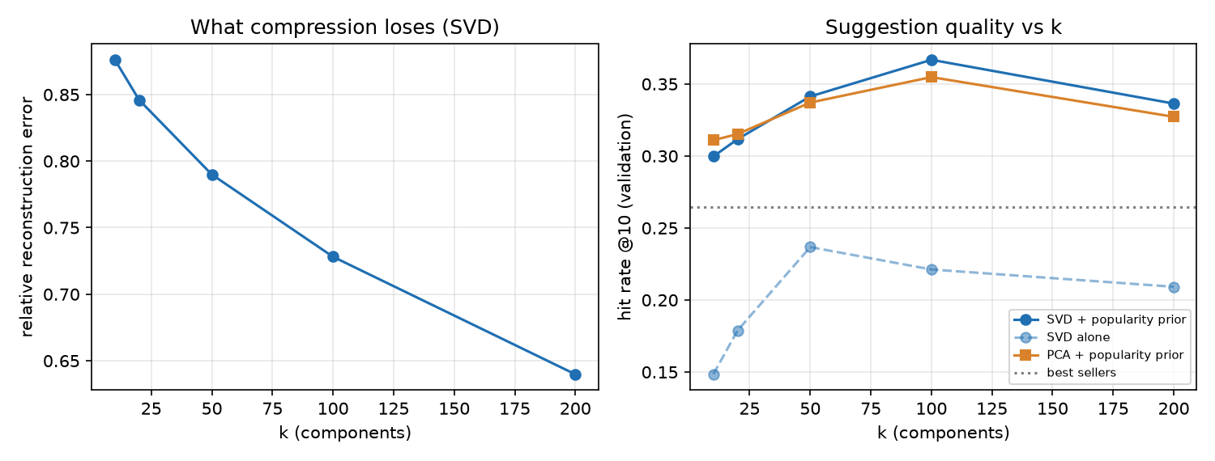
ML Engineer: SVD or PCA?
• SVD chosen for sparse purchases and direct product factors
• k = 100, alpha = 3: selected on earlier validation data
• Same-k hybrid hit rate: PCA 36.4%, SVD 36.6%
• Both first components track log purchase activity (PCA r = 0.97)
• Calculated storage: 7.33 MB factors, 161 MB dense, 4.99 MB sparse

Slide 4
Customer recommendations: held-out hit rate @10
Method | Hit rate @10 | Note
Best sellers (distinct training buyers) | 27.0% | +/-2.0 pts
SVD factors alone (k=100) | 22.5% | loses to best sellers (honest result)
SVD + popularity nudge (alpha=3) | 36.6% | +/-2.2 pts: beats baseline
PCA + popularity nudge | 36.4% | similar to SVD
No compression, item similarity alone | 32.1% | compression costs precision
Timed model stage: 0.74 s for fit, all product similarities and scoring 1,913 test customers. Excludes preprocessing and saving. Product-page suggestions use similarity alone and are not directly evaluated by this customer metric.

Slide 5
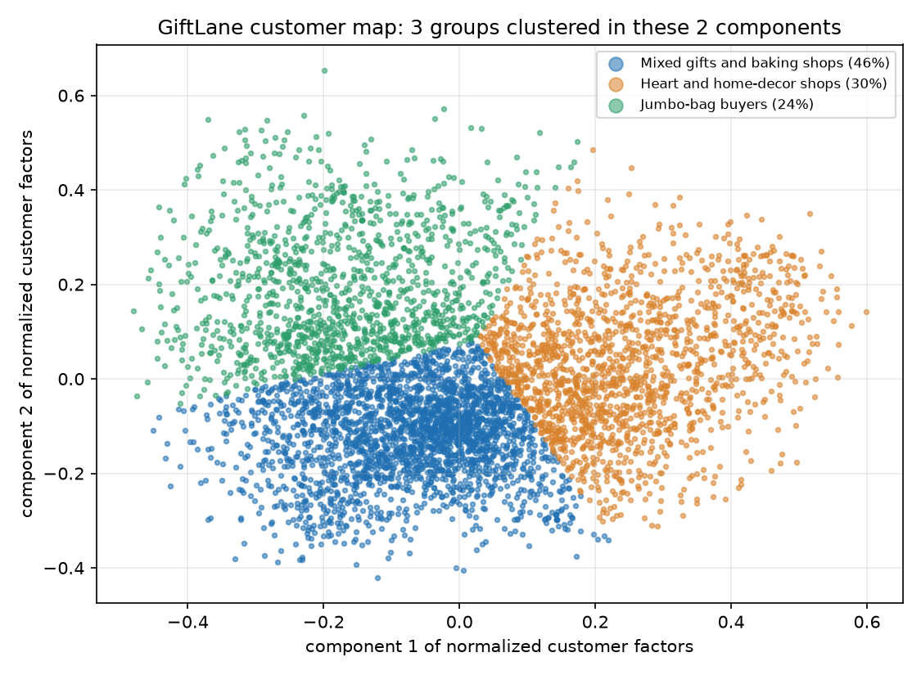
Customer map: 3 groups Marketing can name
• Mixed gifts and baking shops (46%): Vintage Snap Cards, Retrospot Tea Set Ceramic 11 Pc
• Heart and home-decor shops (30%): Heart Ivory Trellis Large, Wooden Frame Antique White
• Jumbo-bag buyers (24%): Jumbo Bag Apples, Jumbo Bag Spaceboy Design
• Project to 2 components, then cluster the same 2-D points (3-6 groups tried)
• UK buyers: 85-97% in each group; use products to plan campaigns

Slide 6
Risks and next steps
• Held-out purchases undercount good suggestions; run an A/B test on live pages
• Add a best-seller fallback for new customers/products; monitor recommendation quality
• Value choice matters: raw counts hurt (hit rate drops to 26%); log or 1/0 are good
• Next: stock/price filters, recency weighting, one campaign per group

