Slide 1
Demby Analytics™
KPI Board Deck
2025-04-19 – 2025-05-19

Slide 2
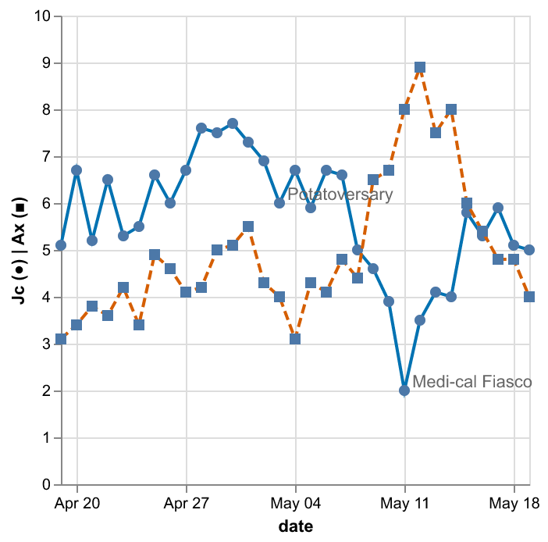
Key Metrics Snapshot
GQ: 1.25
Φf: -0.10
Ξσ: 0.40
Fortitude (Σ positive SD, 30 d): 44.0

