Slide 1
Aaron Analytics™
Psychic KPI Board Deck
2025-04-19 – 2025-05-19

Slide 2
Key Metrics Snapshot
GQ
1.25
Φf
-0.1
Ξσ
0.4
Fortitude
44.0
Flux improved +0.70 since last entry; Fortitude buffer strong.

Slide 3
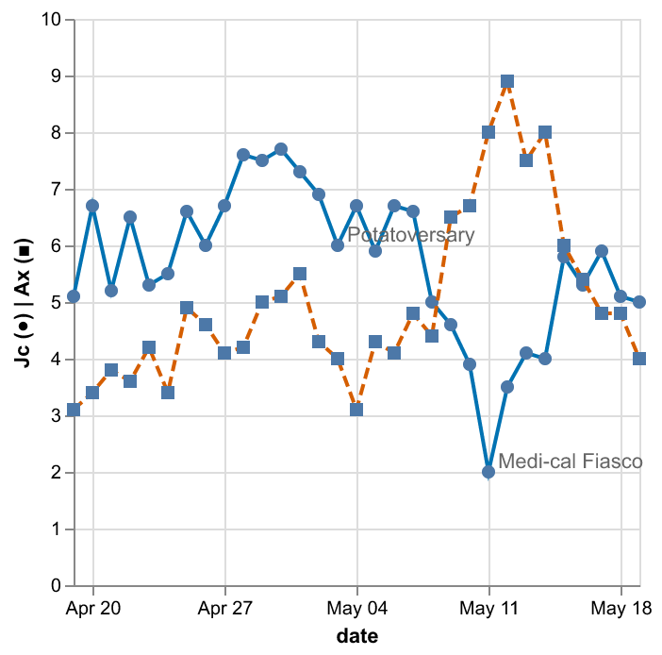
Juice vs. Anxiety Trend

