Slide 1

Confluent Platform Services Basics
FOUNDATIONAL ALIGNMENT
A practical introduction for SVB / First Citizens Bank
Psyncopate Confidential
Notes:
Good morning, everyone. Today we will build a shared understanding of the main services that make up Confluent Platform. This is an introductory session, so the goal is not to turn everyone into a Kafka administrator or application developer in two hours. Instead, I want each of us to leave with the same mental model: what each service does, why it exists, how it interacts with Kafka, and where its operational responsibilities begin and end. We will use our QA environment for a few short demonstrations. Please ask questions as we go, especially when a concept connects to something you already operate or design.

Slide 2
What we should understand by the end
The purpose of each platform service
  Kafka Broker
  Schema Registry
  Connect
  Kafka REST Proxy
  KSQLDB / Flink
How the services work together
Where each service fits in an enterprise solution
Psyncopate Confidential
Notes:
By the end of the session, you should be able to explain the platform as a connected set of capabilities rather than a list of products. The broker is the durable event foundation. Schema Registry governs data contracts. Connect moves data between Kafka and external systems. REST Proxy provides HTTP access for selected clients. ksqlDB and Flink process streams. Control Center gives operators a Kafka-focused view of the platform. We will also identify where responsibilities sit across application, platform, security, and operations teams. The demos are intended to make the concepts concrete; they are not performance tests or configuration reviews.

Slide 3
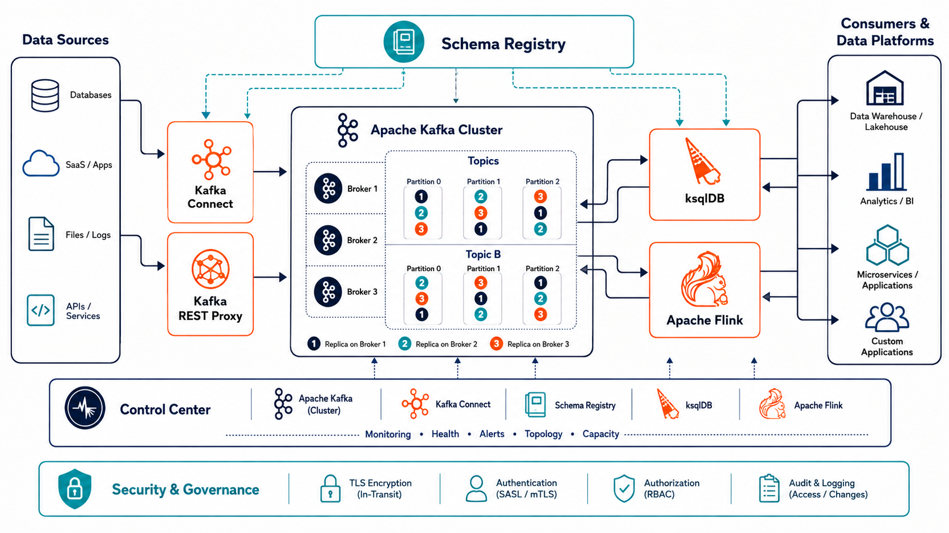
One event can use several platform services
Psyncopate Confidential
Notes:
Think about a business event, such as a payment status change. A source connector might capture it from a database, or an application might submit it through a Kafka client or REST Proxy. The Kafka brokers store the event in a topic and make it available to multiple consumers. Schema Registry can enforce the structure that producers and consumers expect. ksqlDB or Flink can filter, enrich, join, or aggregate the stream. Control Center helps operators see the Kafka-side health and activity. The important point is that these services are complementary. They solve different parts of the event-streaming lifecycle and should not be treated as interchangeable.
Connect or REST Proxy brings an event in
Kafka stores and distributes it
Schema Registry governs its structure
ksqlDB or Flink transforms it; Control Center observes it
.

Slide 4

Kafka Brokers
PLATFORM FOUNDATION
Psyncopate Confidential
Notes:
We will begin with the broker because every other service depends on Kafka in some way. Once the broker model is clear, the purpose of the remaining services becomes much easier to understand.
[Sources]
https://docs.confluent.io/platform/current/kafka/introduction.html

Slide 5
Kafka is a durable distributed event log
Events are appended to named topics
Brokers persist and serve the records
Consumers read at their own pace
Retention allows replay without asking the producer
Psyncopate Confidential
Notes:
A Kafka broker is not simply a message relay. Kafka persists events in an ordered, append-only log. Producers write events to topics, and consumers read those events independently. A consumer does not remove a record when it reads it. Retention determines how long the record remains available, which makes replay possible. This is one of the major differences between Kafka and a traditional queue. Multiple applications can use the same event stream for different purposes without tightly coupling themselves to the producing application.
[Sources]
https://docs.confluent.io/platform/current/kafka/introduction.html

Slide 6
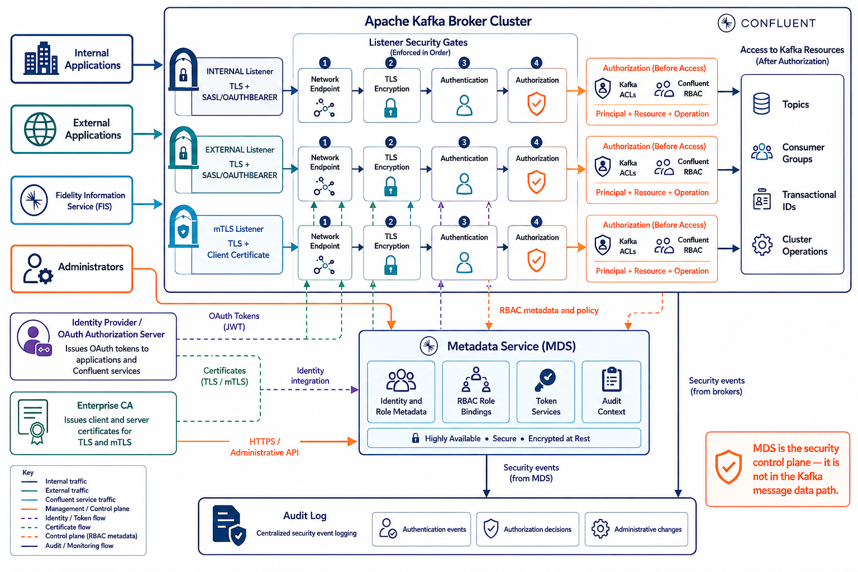
Kafka Broker and Listeners
Psyncopate Confidential
Notes:
Clients connect through dedicated Kafka listeners using TLS with OAuth or mTLS. After authentication, Kafka enforces ACLs or RBAC before granting resource access. MDS manages RBAC and identity metadata as the security control plane—not the Kafka message path—while audit logs capture security events and administrative changes.
The main takeaway is that these controls are layered:
listeners separate traffic,
TLS protects communications,
OAuth or mTLS establishes identity,
ACLs or RBAC control access, and
audit logging records security-relevant activity.

Slide 7
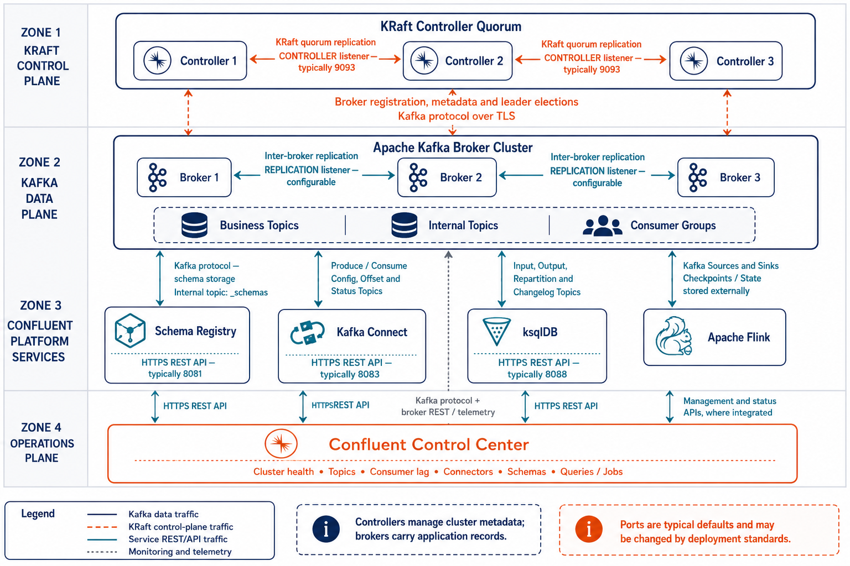
Confluent Platform Cluster Internal Network Communication
Psyncopate Confidential
Notes:
This diagram separates the platform into four communication layers. KRaft controllers manage cluster metadata and leader elections, while brokers store and replicate application records. Schema Registry, Connect, ksqlDB, and Flink communicate with brokers through Kafka protocols and their respective internal topics. Control Center uses Kafka, REST APIs, and telemetry to provide operational visibility without participating in the application data path.

Slide 8
Partitions provide scale; replicas provide resilience
A topic is divided into partitions
Ordering is guaranteed within a partition
Each partition has a leader and replicas
Replication protects availability when a broker fails
Psyncopate Confidential
Notes:
Partitions are the unit of storage and parallelism in Kafka. A topic can be spread across several brokers because its partitions are distributed across the cluster. Within one partition, records have an ordered sequence. Across separate partitions, Kafka does not promise a single global ordering. Every partition has a leader that handles reads and writes, plus replicas on other brokers. If the leader becomes unavailable, an eligible replica can take over. Partition count influences throughput and consumer parallelism, while replication factor influences resilience and storage cost.
[Sources]
https://docs.confluent.io/platform/current/kafka/introduction.html

Slide 9
Kafka Broker Architecture
THREE-BROKER CLUSTER · PARTITION LEADERS · REPLICATION · CONSUMER GROUP
BROKER 1
BROKER 2
BROKER 3
CONSUMER GROUP
produce
P0 LEADER
P0 REPLICA
P0 REPLICA
PRODUCER
Consumer 1
writes records
P1 REPLICA
P1 LEADER
P1 REPLICA
consume
Consumer 2
P2 REPLICA
P2 REPLICA
P2 LEADER
Leader: serves producer and consumer traffic
Dashed orange: broker-to-broker replication
If a leader broker fails, an in-sync replica can be elected leader.
Psyncopate Confidential
Notes:
This diagram puts the core broker concepts together. The producer sends a keyed record to the leader of a partition. Copies of that partition are maintained on other brokers. The consumer group reads the topic, with partitions assigned across its members. Notice that the leader for every partition does not sit on the same broker; leaders should be distributed to spread work. Also notice that replication is not the same as consumer duplication. Replicas protect Kafka data, while consumer groups distribute application processing. This distinction matters when we discuss availability and scaling.
[Sources]
https://docs.confluent.io/platform/current/kafka/introduction.html

Slide 10
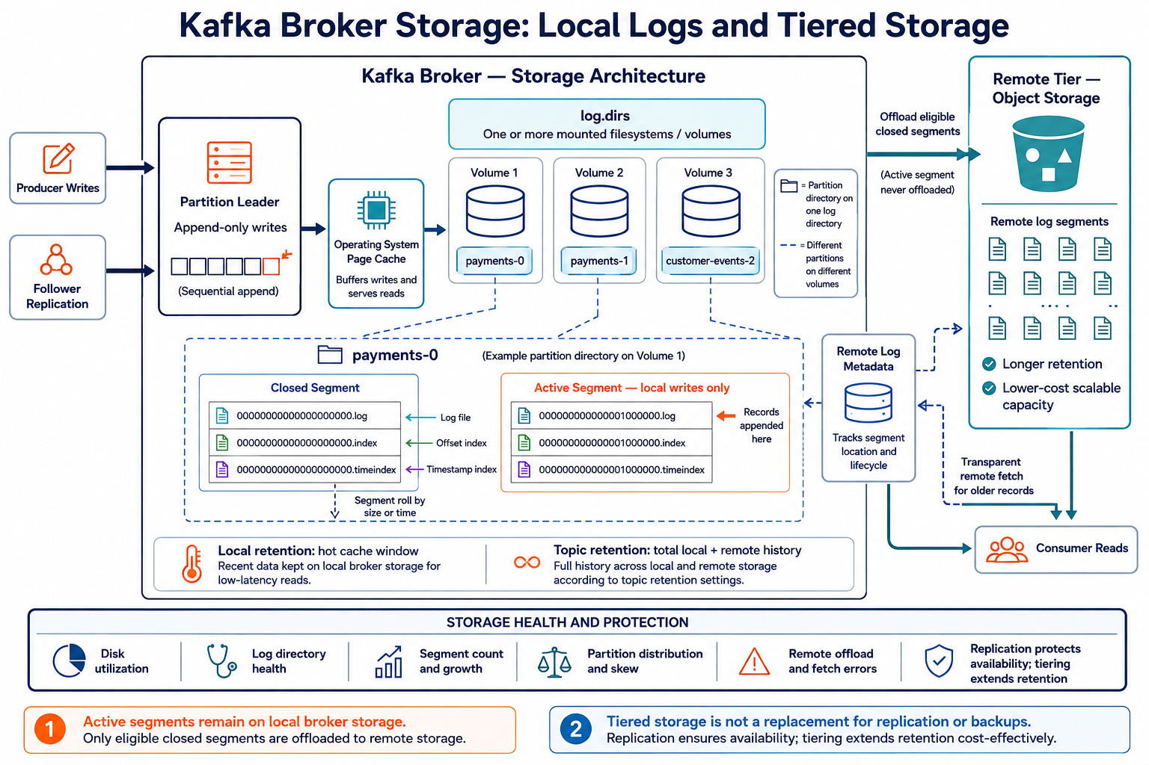
If a leader broker fails, an in-sync replica can be elected leader.
Psyncopate Confidential
Notes:
Kafka writes records sequentially to the active segment of each partition on local broker storage.
Each partition has its own directory containing log segments, offset indexes, and timestamp indexes.
log.dirs can reference multiple volumes; Kafka distributes different partitions across them but does not stripe one partition across volumes.
Tiered Storage offloads eligible closed segments to object storage while active segments remain local.
Consumers access recent records locally and older records through transparent remote fetches.
Tiered Storage extends retention and reduces local capacity requirements; it does not replace replication or backup.

Slide 11
Producers and consumers control different behaviors
Keys influence partition selection and ordering
Acknowledgments determine write durability
Consumer groups share partition work
Offsets record each group’s reading position
Psyncopate Confidential
Notes:
The broker provides the platform, but client choices influence behavior. Producers decide how records are keyed, batched, retried, and acknowledged. Keys are important because records with the same key normally go to the same partition, preserving order for that key. Consumers normally operate in groups. Within one group, a partition is assigned to only one active consumer at a time. Different groups can independently read the same topic. Offsets record how far each group has progressed and allow a consumer to resume or replay from a chosen position.
[Sources]
https://docs.confluent.io/platform/current/kafka/introduction.html

Slide 12
Schema Registry
DATA CONTRACTS
Psyncopate Confidential
Notes:
Kafka can store any bytes, but enterprise applications need agreement about what those bytes mean. Schema Registry provides that contract layer.
[Sources]
https://docs.confluent.io/platform/current/schema-registry/index.html

Slide 13
Schemas turn events into governed contracts
Schemas define fields, types and structure
Subjects organize schema versions
Schema IDs travel with serialized records
Avro, JSON Schema and Protobuf are supported
Psyncopate Confidential
Notes:
Schema Registry provides a centralized repository for schemas used during serialization and deserialization. The event payload still resides in Kafka; Schema Registry stores the schema definitions and their versions. Producers register or look up a schema, serialize the record, and include a schema identifier in the encoded message. Consumers use that identifier to retrieve the correct schema and interpret the record. Subjects are the versioned containers used to organize schemas. This model creates an explicit data contract between producers and consumers rather than relying on informal documentation or assumptions.
[Sources]
https://docs.confluent.io/platform/current/schema-registry/index.html

Slide 14
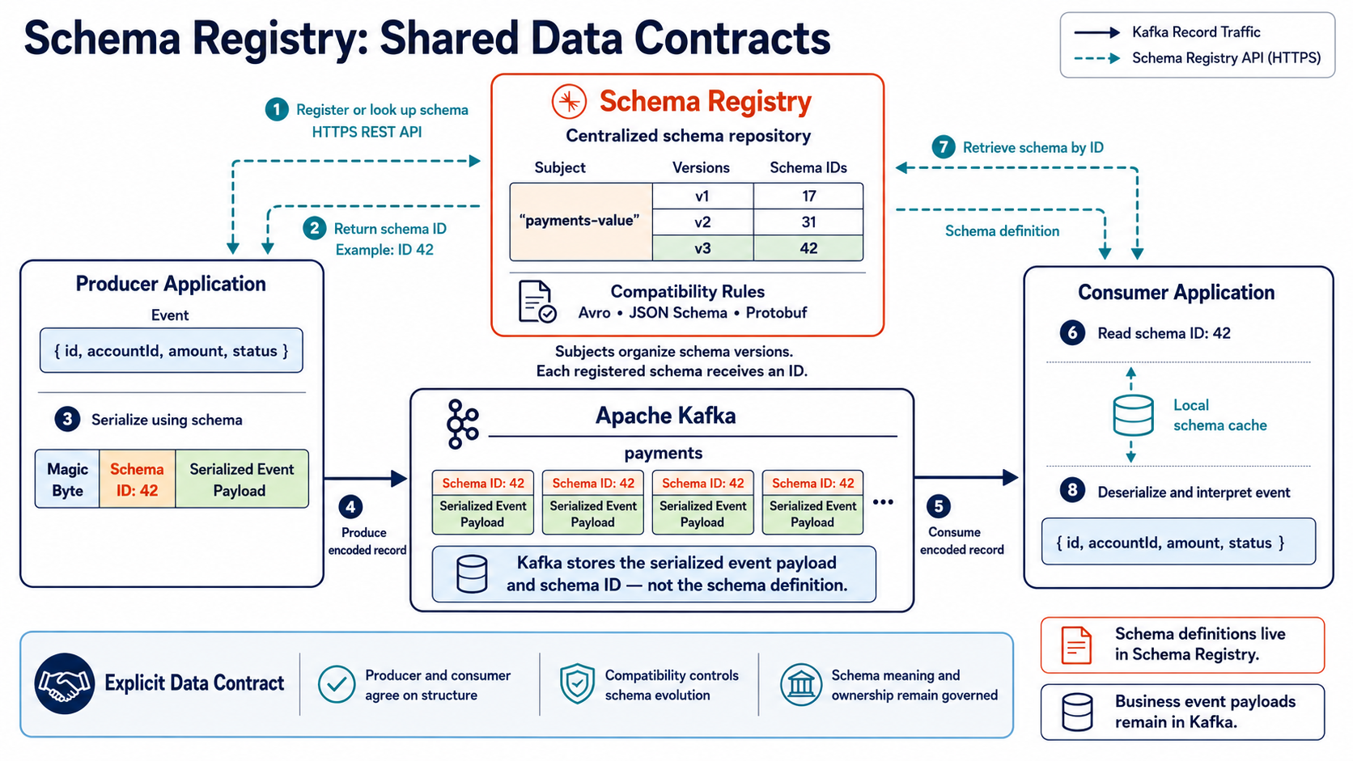
Psyncopate Confidential
Notes:
1. The producer registers or looks up the event schema in Schema Registry.
2. Schema Registry returns the unique schema ID—in this example, ID 42.
3. The producer uses the schema to serialize the event and embeds the schema ID.
4. The encoded record is written to the Kafka topic.
5. The consumer reads the encoded record from Kafka.
6. The consumer extracts schema ID 42 from the record.
7. The consumer retrieves the corresponding schema from Schema Registry—or its local cache.
8. The consumer uses the schema to deserialize and interpret the event

Slide 15
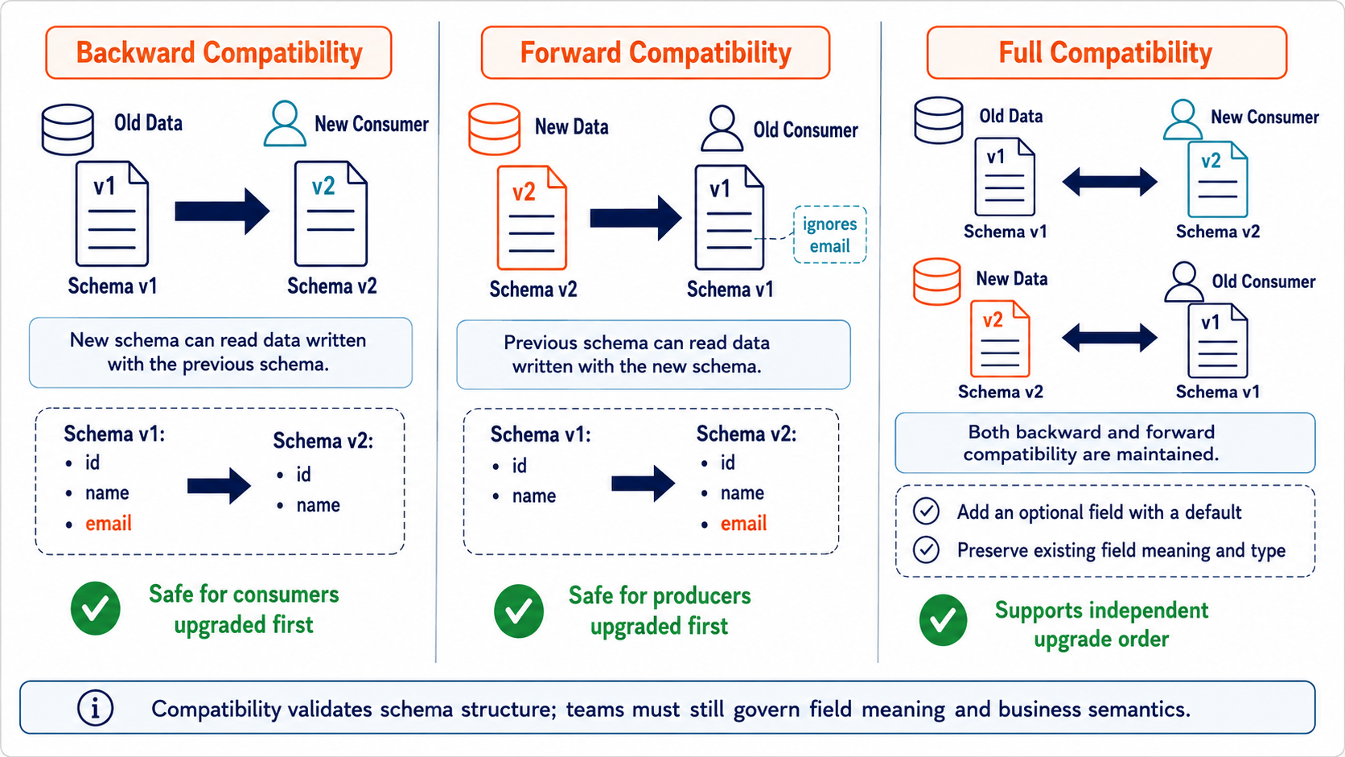
Schemas Compatibility
Psyncopate Confidential
Notes:
Schemas must evolve because business data changes. Compatibility rules determine which changes are accepted. Backward compatibility protects a new consumer reading records written with an older schema. Forward compatibility protects an older consumer when a producer writes a newer schema. Full compatibility requires both directions. Transitive modes compare against the full relevant history instead of only the latest version. The correct mode is a governance decision based on deployment practices and risk tolerance. Compatibility checks reduce accidental breakage, but they do not replace ownership, semantic review, or coordinated lifecycle management.
Backward: new consumers read older data.
Forward: older consumers read newer data.
Full: both directions remain compatible.
Safe schema-evolution examples and upgrade order.

Slide 16
Schemas Registry Best Practices
Adopt one naming strategy and apply it consistently.
Default: <topic-name>-key and <topic-name>-value.
Use lowercase, descriptive, domain-aligned topic names.
Clearly distinguish key schemas from value schemas.
Use RecordNameStrategy when multiple record types share a topic.
Use TopicRecordNameStrategy when record names must remain topic-specific.
Do not mix naming strategies.
Document the subject owner, business domain, and associated topic.
Validate subject names and compatibility through CI/CD.
Psyncopate Confidential
Notes:
We reviewed the purpose and role of each major Confluent Platform service.
Kafka provides the core event-streaming foundation, while the surrounding services add governance, integration, processing, access, and operational visibility.
These services are designed to work together, but each should be selected based on the specific use case.
The key takeaway is that an enterprise streaming platform is not just Kafka brokers—it is the combined architecture, security, governance, and operating model around them.

Slide 17
Kafka Connect
REUSABLE INTEGRATION
Psyncopate Confidential
Notes:
The next question is how data enters and leaves Kafka without every team writing and maintaining custom integration code. Kafka Connect addresses that problem.
[Sources]
https://docs.confluent.io/platform/current/connect/index.html

Slide 18
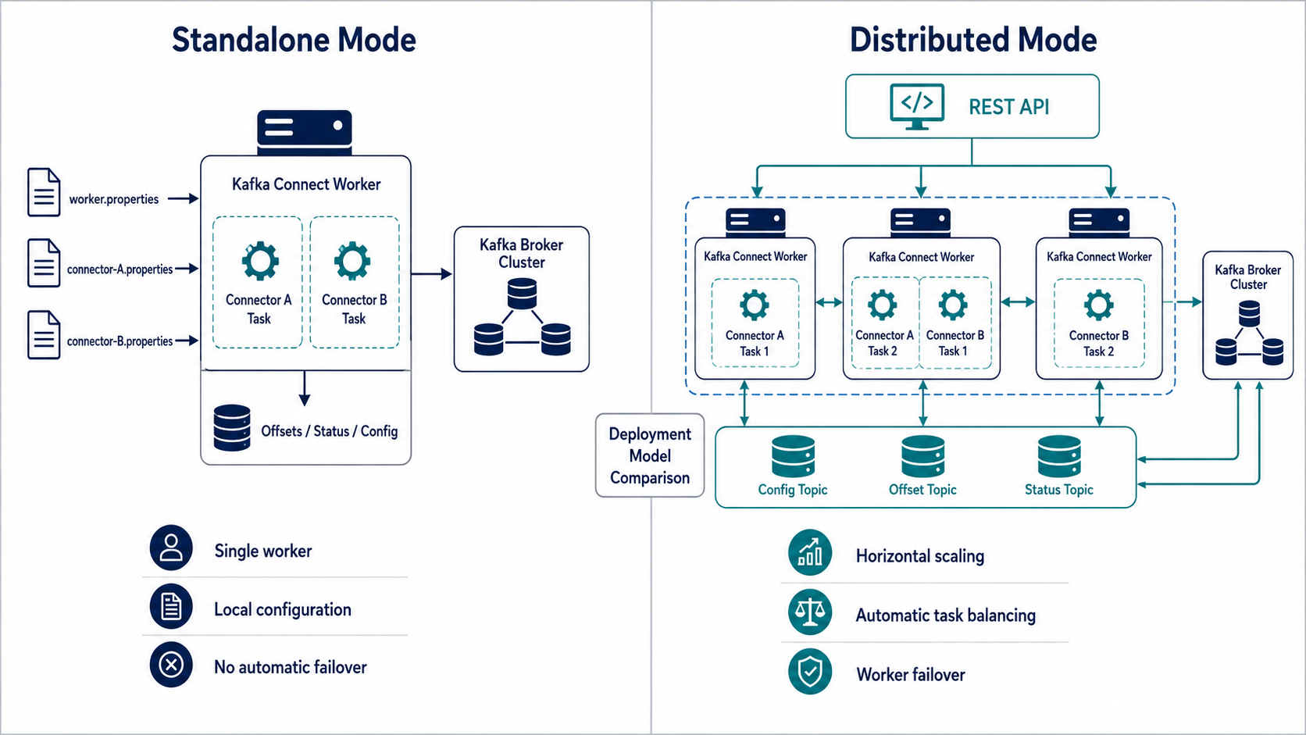
Connect standardizes movement into and out of Kafka
Psyncopate Confidential
Notes:
Standalone mode runs all connectors and tasks on one worker using local configuration and offset files—best for development or simple workloads.
Distributed mode runs workers as a coordinated group, storing configuration, offsets, and status in Kafka internal topics.
Distributed mode provides horizontal scaling, automatic task rebalancing, and worker failover, making it the preferred production model.

Slide 19
Connect standardizes movement into and out of Kafka
Source connectors bring data into Kafka
Sink connectors deliver Kafka data outward
Plugins encapsulate system-specific integration
Configuration replaces much custom plumbing code
Psyncopate Confidential
Notes:
Kafka Connect is a runtime and framework for integrating Kafka with external systems. A source connector reads from an external system and writes to Kafka. A sink connector reads Kafka topics and writes to an external system. The connector plugin contains the system-specific implementation, while teams provide configuration such as connection details, topic mappings, and conversion settings. Connect is valuable because it standardizes lifecycle management, scaling, offsets, and operational behavior. It does not eliminate design responsibility: teams must still understand source semantics, delivery guarantees, security, and failure handling.
[Sources]
https://docs.confluent.io/platform/current/connect/index.html

Slide 20
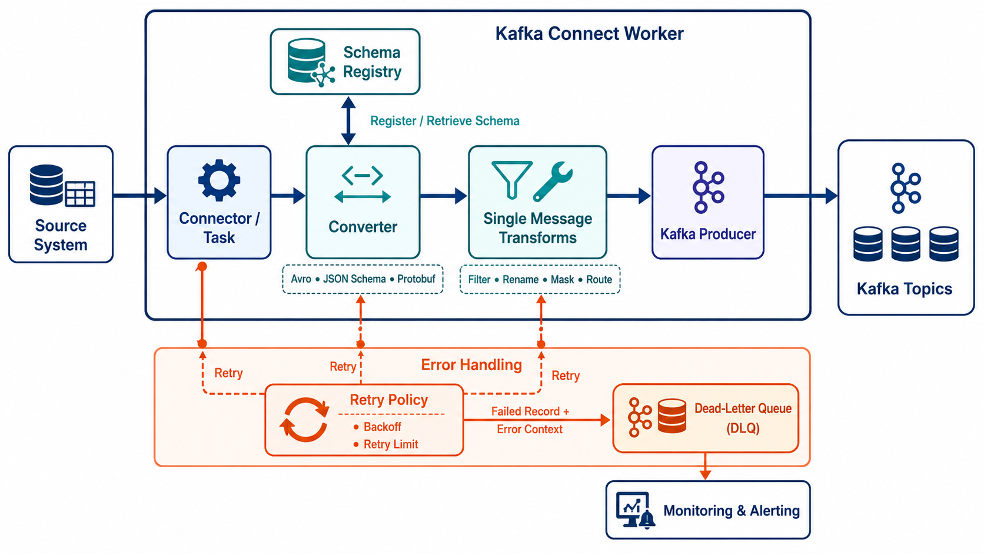
Connect standardizes movement into and out of Kafka
Psyncopate Confidential
Notes:
The connector task reads each record from the source system.
The converter serializes the record and uses Schema Registry to retrieve or register its schema.
Single Message Transforms apply lightweight changes such as filtering, renaming, masking, or routing.
Failed records are retried using the configured backoff and retry limits.
Unrecoverable records are sent to a Kafka dead-letter topic with error context for monitoring and investigation.

Slide 21
Reliability must be designed into each connector
Retries handle temporary failures
Dead-letter queues isolate problematic records
Offsets support restart and recovery
External-system behavior determines end-to-end guarantees
Psyncopate Confidential
Notes:
Connector reliability is more than checking whether the process is running. Temporary failures may be retried with backoff. Records that cannot be processed can be routed to a dead-letter queue when that is appropriate and configured. Source and sink offsets allow work to resume, but the actual end-to-end guarantee also depends on the external system and connector implementation. We should monitor failed tasks, repeated restarts, error rates, source lag, sink latency, and rejected records. Secrets should be externalized rather than embedded directly in connector configurations.
[Sources]
https://docs.confluent.io/platform/current/connect/index.html

Slide 22
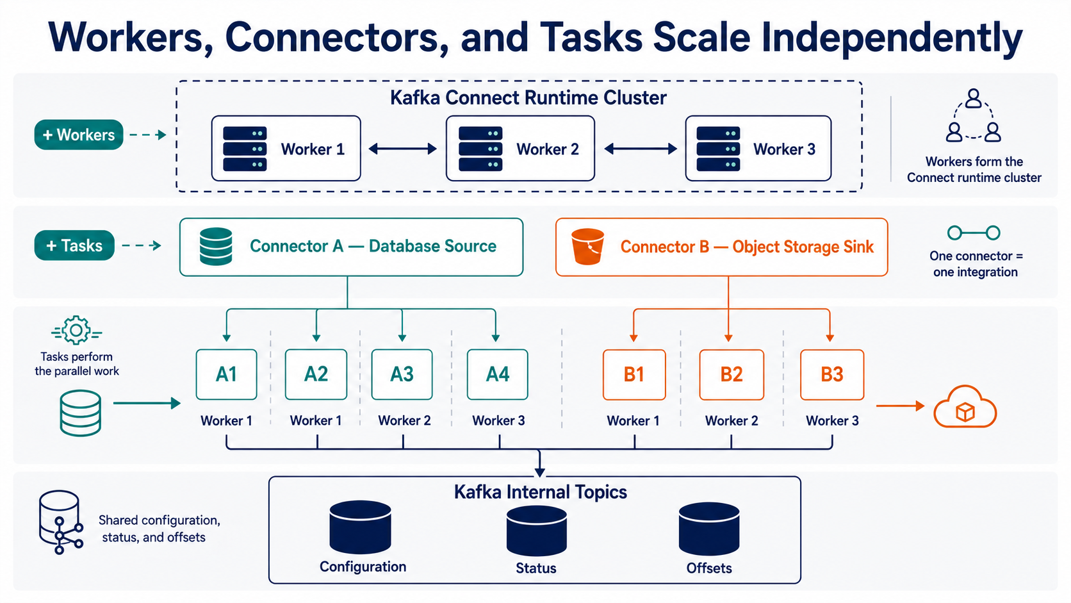
Workers, connectors and tasks scale independently
Workers form the Connect runtime cluster
A connector represents one integration
Tasks perform the parallel work
Internal topics store configuration, status and offsets
Psyncopate Confidential
Notes:
A worker is a running Connect process. In distributed mode, multiple workers form a worker group. A connector is the logical integration definition, and tasks are the units of work distributed across the workers. Increasing the task count can increase parallelism only when the connector and source or destination support it. Connect stores configuration, status, and offset information in internal Kafka topics so the worker group can coordinate and recover. This distinction is useful operationally: a healthy worker does not automatically mean every connector or every task is healthy.
[Sources]
https://docs.confluent.io/platform/current/connect/index.html

Slide 23
Kafka REST Proxy
HTTP ACCESS
Psyncopate Confidential
Notes:
Not every application can use a native Kafka client. REST Proxy provides an HTTP-based option, but it introduces important tradeoffs.
[Sources]
https://docs.confluent.io/platform/current/kafka-rest/index.html

Slide 24
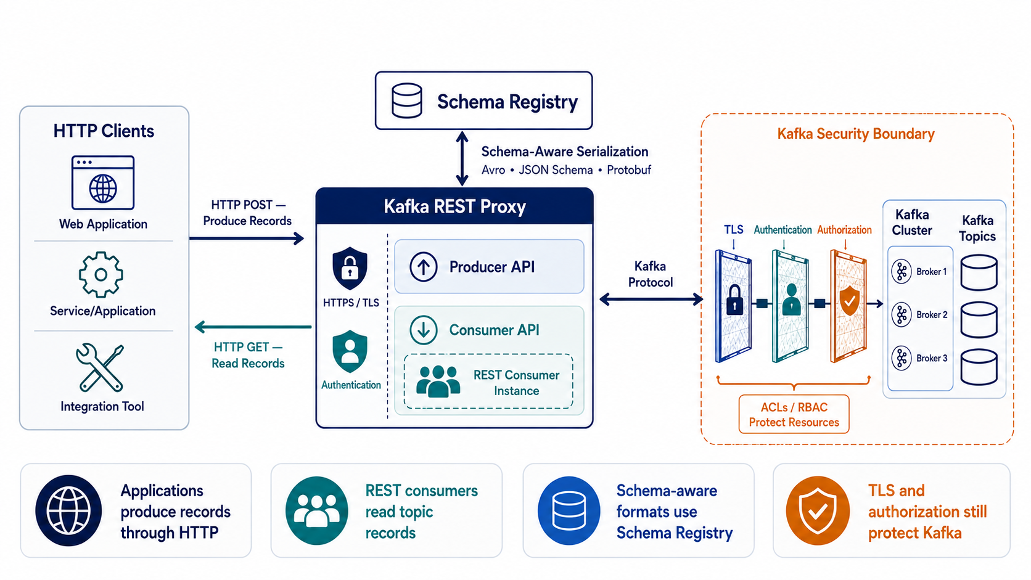
REST Proxy brings Kafka access to HTTP clients
Applications produce records through HTTP
REST consumers can read topic records
Schema-aware formats integrate with Schema Registry
TLS and authorization still protect Kafka resources
Psyncopate Confidential
Notes:
Kafka REST Proxy exposes selected Kafka operations through an HTTP interface. It is useful for applications, scripts, or platforms that cannot easily embed a native Kafka client. A client can produce records through an HTTP request, and supported consumer APIs can read records. Schema-aware requests can integrate with Schema Registry. REST Proxy does not bypass Kafka security. The service must authenticate and authorize requests appropriately and connect securely to Kafka. It becomes another component that must be capacity-planned, monitored, patched, and protected.
[Sources]
https://docs.confluent.io/platform/current/kafka-rest/index.html

Slide 25
Use REST Proxy selectively
Good fit: lightweight or legacy HTTP integration
Tradeoff: an extra network and serialization hop
Native clients offer richer control and efficiency
REST Proxy is not an API-management replacement
Psyncopate Confidential
Notes:
REST Proxy is an integration option, not the default answer for every application. It can be a practical fit for low-to-moderate volume HTTP-centric workloads, legacy systems, and controlled automation. For high-throughput or latency-sensitive workloads, native Kafka clients usually provide better efficiency and richer control over batching, acknowledgments, retries, and consumption. REST Proxy also does not replace an enterprise API gateway or API-management platform. Those layers solve different concerns such as product publishing, broader policy enforcement, developer onboarding, and API lifecycle management.
[Sources]
https://docs.confluent.io/platform/current/kafka-rest/index.html

Slide 26
REST Consumer Instance Limitations
REST consumers are stateful server-side instances that must be created and maintained.
Clients must use the returned consumer instance URL for subsequent subscribe and poll requests.
Consumer instances can expire after inactivity and require recreation.
HTTP polling adds latency and protocol overhead compared with native Kafka consumers.
Offset commits, retries, rebalances, and instance cleanup remain the client’s responsibility.
Best suited to moderate-volume integration, not high-throughput streaming workloads.
Native Kafka consumers provide better performance, control, and delivery semantics.
Psyncopate Confidential
Notes:
REST consumers provide Kafka access through HTTP, but they are stateful resources that clients must create, poll, commit, and clean up. They are useful for moderate-volume integrations where native Kafka libraries are unavailable. For high-throughput or latency-sensitive workloads, native Kafka consumers provide better performance, reliability, and control.
https://docs.confluent.io/platform/current/kafka-rest/index.html

Slide 27
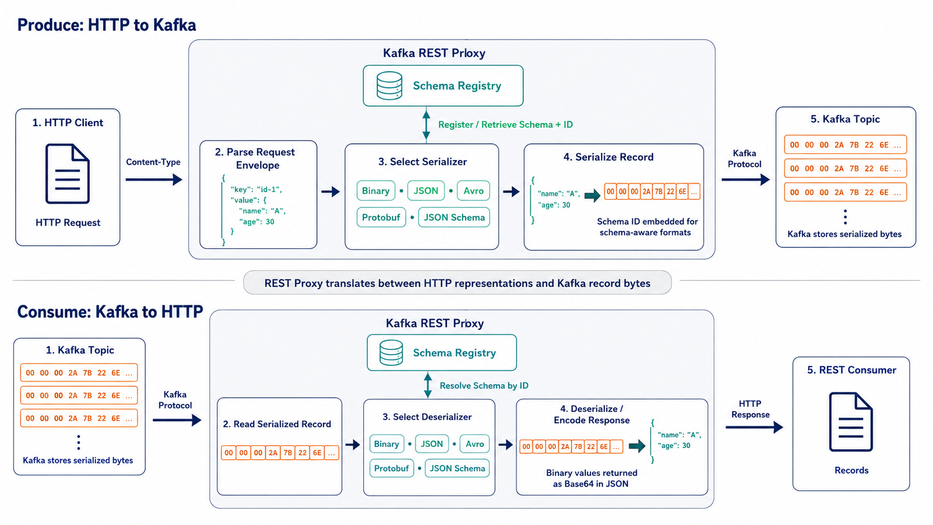
REST Producer/Consumer Instance
Psyncopate Confidential
Notes:
On produce, the client sends an HTTP request and selects the serialization format through the content type.
REST Proxy parses the request and converts the record into Kafka-compatible bytes.
For Avro, Protobuf, and JSON Schema, it registers or retrieves the schema and embeds the schema ID.
Kafka stores the resulting bytes without interpreting the payload.
On consume, REST Proxy reads those bytes, resolves the schema when required, and deserializes the record into the requested HTTP representation.
Binary values are Base64-encoded when returned inside a JSON response.

Slide 28
Stream Processing
KSQLDB AND FLINK
Psyncopate Confidential
Notes:
Kafka stores and distributes events. Stream-processing services continuously interpret and transform those events. We will compare two different levels of capability: ksqlDB and Apache Flink.
[Sources]
https://docs.confluent.io/platform/current/ksqldb/index.html

Slide 29
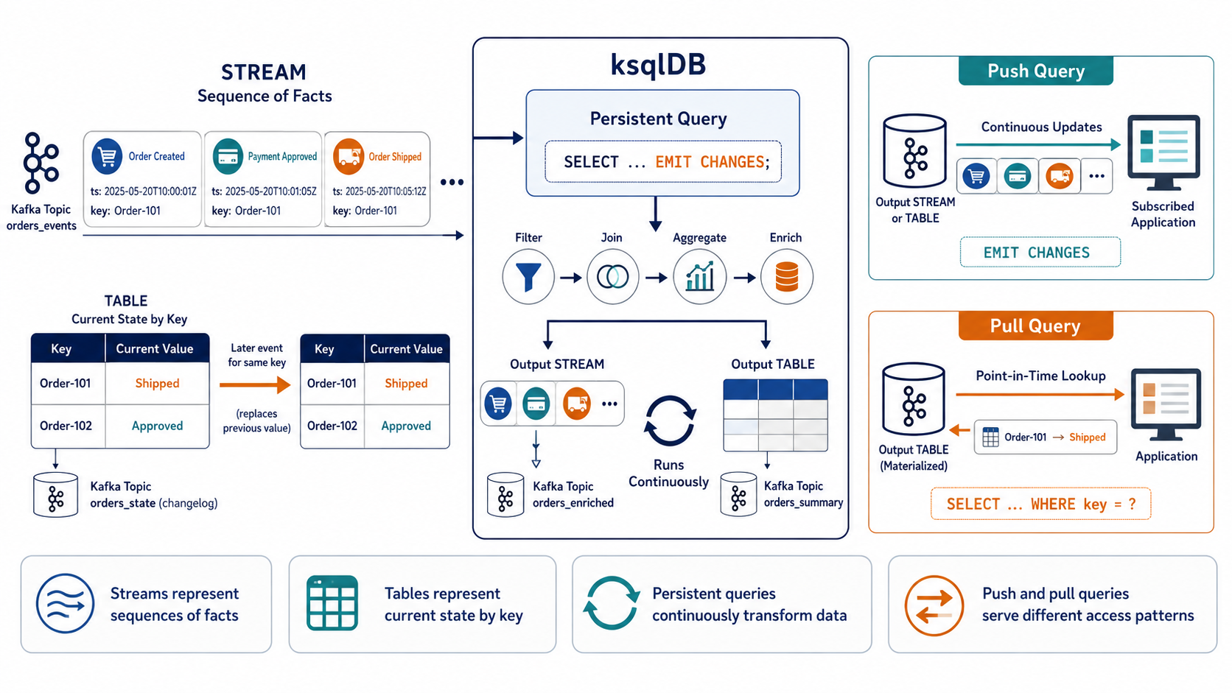
ksqlDB makes common stream processing approachable
Streams represent sequences of facts
Tables represent current state by key
Persistent queries continuously transform data
Push and pull queries serve different access patterns
Psyncopate Confidential
Notes:
ksqlDB provides a SQL-like model for processing Kafka data. A stream represents an append-only sequence of facts. A table represents the latest state for each key and is updated as new events arrive. Persistent queries run continuously and usually create new streams, tables, and Kafka topics. Push queries continuously return changes, while pull queries retrieve current materialized state. ksqlDB is well suited to filtering, projection, enrichment, joins, and windowed aggregation when a SQL-oriented approach is sufficient. Stateful queries still require careful partitioning, capacity planning, and operational monitoring.
[Sources]
https://docs.confluent.io/platform/current/ksqldb/index.html

Slide 30
Flink supports advanced stateful processing
Event time and watermarks handle delayed events
Managed state supports complex computations
Checkpoints provide automatic fault recovery
Savepoints support controlled operational changes
Psyncopate Confidential
Notes:
Apache Flink is designed for sophisticated stateful stream processing. Event time lets a job reason about when an event actually occurred rather than only when it was processed. Watermarks provide a way to manage late or out-of-order events. Flink can maintain substantial application state across a distributed job. Checkpoints are created automatically for fault recovery, while savepoints are operator-controlled snapshots commonly used for upgrades, migration, or planned changes. Flink is a strong fit when the processing logic, time semantics, or state requirements exceed what a simpler SQL pipeline should carry.
[Sources]
https://docs.confluent.io/cp-flink/current/overview.html

Slide 31
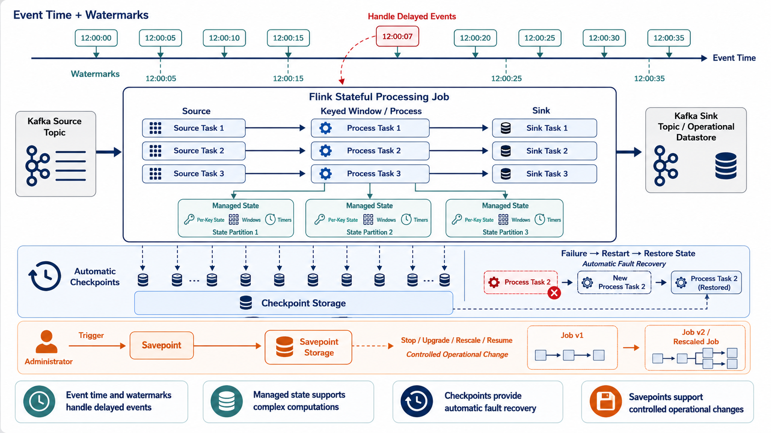
Flink supports advanced stateful processing
Psyncopate Confidential
Notes:
Apache Flink is designed for sophisticated stateful stream processing. Event time lets a job reason about when an event actually occurred rather than only when it was processed. Watermarks provide a way to manage late or out-of-order events. Flink can maintain substantial application state across a distributed job. Checkpoints are created automatically for fault recovery, while savepoints are operator-controlled snapshots commonly used for upgrades, migration, or planned changes. Flink is a strong fit when the processing logic, time semantics, or state requirements exceed what a simpler SQL pipeline should carry.
[Sources]
https://docs.confluent.io/cp-flink/current/overview.html

Slide 32
Choose the simplest engine that meets the requirement
ksqlDB
  Kafka-native stream processing using familiar SQL
  Best for filtering, joining, aggregating, and enriching Kafka data
  Simple development and lower operational complexity
  Streams and tables provide intuitive event-processing abstractions
  Persistent queries run continuously
  Best for straightforward Kafka-centric transformations
Apache Flink
  Advanced distributed engine for stateful stream processing
  Supports SQL and application APIs
  Strong event-time, watermark, windowing, and late-event handling
  Managed state supports complex, long-running computations
  Checkpoints and savepoints provide recovery and operational control
  Best for sophisticated, high-scale, low-latency processing
Rule of thumb:
  Use ksqlDB for approachable Kafka-native SQL transformations;
  Use Flink when processing requires advanced state, time semantics, or greater computational flexibility.
Psyncopate Confidential
Notes:
The choice should start with the processing requirement, not with product preference. ksqlDB is often the simplest fit for SQL-accessible filters, transformations, joins, aggregations, and materialized views. Flink is appropriate for more complex stateful processing, advanced event-time behavior, and applications that require deeper control. Both depend on sound Kafka topic design, keys, partitions, schemas, and security. A more powerful engine also brings additional operational responsibilities. The future-state design should therefore consider team skills, deployment model, recovery procedures, observability, and ownership—not only whether a feature is technically possible.
[Sources]
https://docs.confluent.io/platform/current/ksqldb/index.html
https://docs.confluent.io/cp-flink/current/overview.html

Slide 33
Control Center
PLATFORM OPERATIONS
Psyncopate Confidential
Notes:
We will close the service tour with Control Center, which brings Kafka-specific management and monitoring information into one operator interface.
[Sources]
https://docs.confluent.io/control-center/current/overview.html

Slide 34
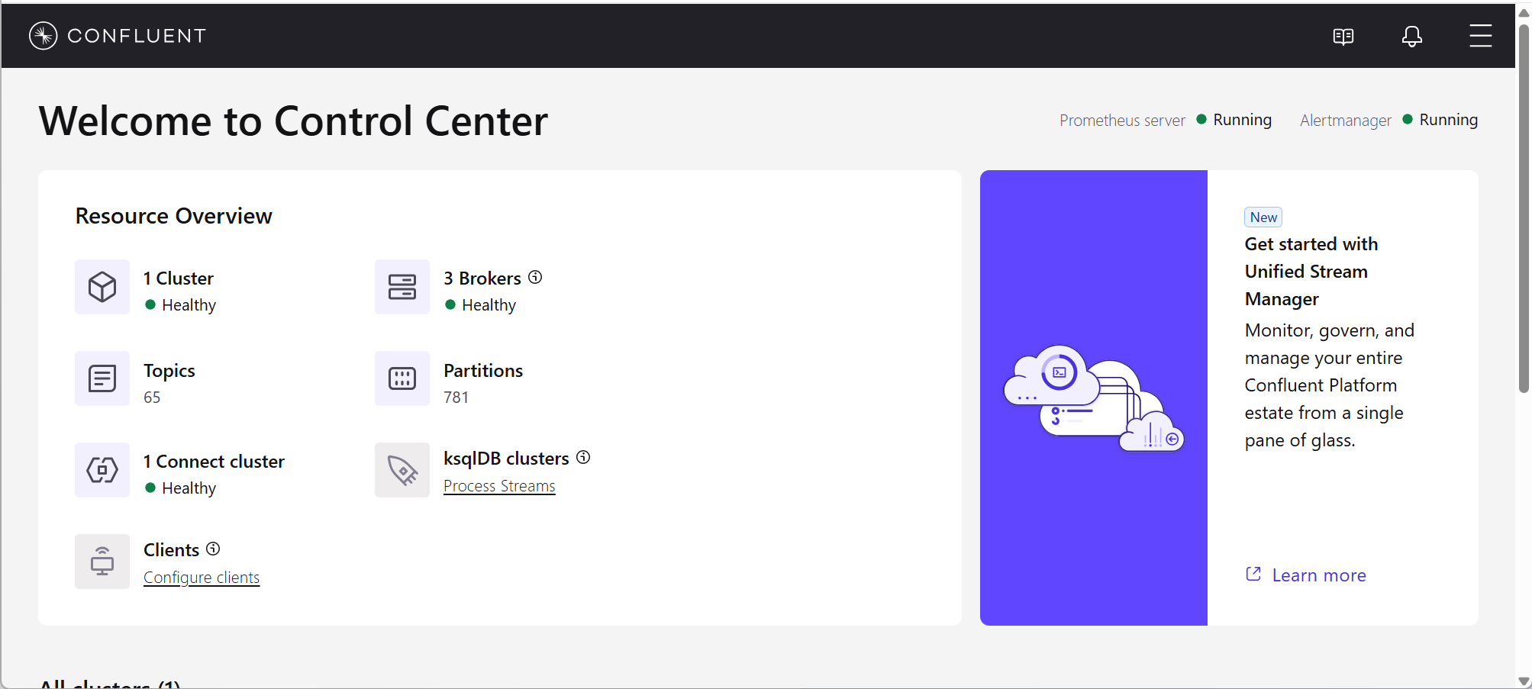
Control Center provides a Kafka-focused operator view
Cluster health, brokers, topics and partitions
Consumer-group lag and client activity
Connect, Schema Registry and ksqlDB visibility
Alerts and access depend on configuration and mode
Psyncopate Confidential
Notes:
Control Center is the platform-oriented interface for managing and monitoring Kafka and supported Confluent services. It can show cluster health, brokers, topics, partitions, production and consumption activity, and consumer-group lag. It can also display status information from services such as Connect and ksqlDB and provide schema-related functions. The exact information available depends on the Control Center version, operating mode, permissions, and required metric collection. Control Center complements enterprise tools such as Dynatrace, Prometheus, and Splunk; it does not replace infrastructure monitoring, centralized log management, or enterprise incident workflows.
[Sources]
https://docs.confluent.io/control-center/current/overview.html

Slide 35
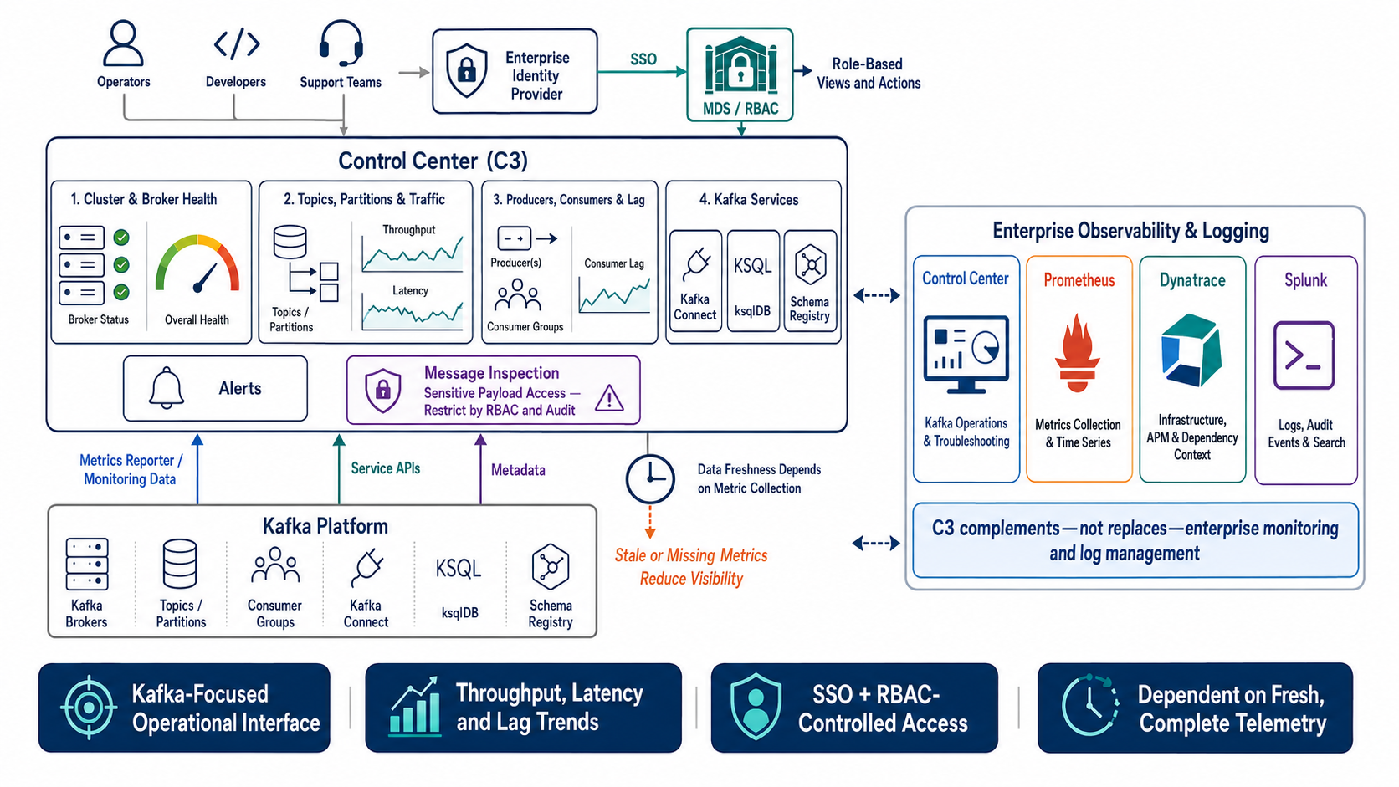
Control Center provides a Kafka-focused operator view
Psyncopate Confidential
Notes:
Users access Control Center through enterprise SSO, while MDS and RBAC determine which Kafka resources and actions they can access.
C3 provides Kafka-focused visibility into cluster health, brokers, topics, partitions, throughput, latency, producers, consumers, and consumer-group lag.
It also provides operational navigation for Kafka Connect, ksqlDB, and Schema Registry.
Message inspection can expose sensitive payloads, so access must be restricted, monitored, and audited.
C3 visibility depends on properly configured metrics reporters, monitoring data, metadata, and service APIs.
Missing or stale telemetry can create an incomplete view of platform health.
Prometheus collects metrics, Dynatrace provides infrastructure and application context, and Splunk supports logs, audit events, and search.
Control Center complements these enterprise tools; it does not replace enterprise monitoring or log management.

Slide 36
One platform, distinct responsibilities
Psyncopate Confidential
Notes:
Let me close with one message. Confluent Platform is not seven unrelated services. Kafka brokers provide the durable event foundation. Schema Registry governs data contracts. Connect standardizes integration. REST Proxy provides selective HTTP access. ksqlDB and Flink process events at different levels of complexity. Control Center gives operators a Kafka-focused view. Successful adoption depends on treating these as connected capabilities with clear ownership, security, observability, and lifecycle standards. I would now like to take final questions and capture any topics that deserve a deeper follow-up session.

Slide 37
What we covered …
The role each Confluent Platform service plays
Kafka brokers provide the durable event-streaming foundation
Schema Registry governs data contracts and schema evolution
Kafka Connect integrates Kafka with external systems
REST Proxy enables controlled HTTP-based Kafka access
ksqlDB and Flink process and transform streaming data
Control Center provides Kafka-focused operational visibility
Together, these services form an integrated enterprise streaming platform
The right service depends on the use case, scale, governance, and operational requirements
Psyncopate Confidential

