Slide 1
CrowdDb

Slide 2
History Lesson
First crowd-powered database
At that time, the state of the art was turkit
Programming library for the crowd
Two other crowd-powered databases at around the same time
Deco (Stanford, UC Santa Cruz)
Qurk (MIT)
Necessarily incomplete, preliminary

Slide 3
Motivation of CrowdDB
Two reasons why present DB systems won’t do:
Closed world assumption
Get human help for finding new data
Very literal in processing data
SELECT marketcap FROM company
WHERE name = “IBM”
Get the best of both worlds:
human power for processing and getting data
traditional systems for heavy lifting/data manip

Slide 4
Issues in building CrowdDB
Performance and variability:
Humans are slow, costly, variable, inaccurate
Task design and ambiguity:
Challenging to get people to do what you want
Affinity / Learning
Workers develop relationships with requesters, skills
Open world
Possibly unbounded answers

Slide 5
At a High Level
Modifications to QL: CrowdSQL
Automatic UI generation
Automatic interaction with marketplace
Storing data for future use

Slide 6
Modifications to SQL
Special keyword: CROWD
Used in two ways
First: crowdsourced columns
CREATE TABLE Department (
university STRING,
name STRING,
url CROWD String,
phone STRING,
primary key (university, name));
CROWD attribute cannot be PK

Slide 7
Modifications to SQL
Crowdsourced Tables
CREATE CROWD TABLE Profs (
name STRING PRIMARY KEY,
email STRING UNIQUE,
university STRING,
department STRING,
FOREIGN KEY (university, department)
REF Department (university, name) );
Still need a PK

Slide 8
How do we designate incomplete data?
Special Keyword CNULL
Constraint: we want CNULL to be filled in before query results are returned
CREATE TABLE Department (
university STRING,
name STRING,
url CROWD String,
phone STRING,
primary key (university, name));
SELECT url FROM Department WHERE name = “math”

Slide 9
Comparisons
CROWDEQUAL
SELECT name FROM Professor
WHERE department ~= “CS”
CROWDORDER
SELECT p FROM Picture
WHERE subject = “chair”
ORDER BY CROWDORDER (p,
“Which picture visualizes better %chair”)
Similar to Qurk FILTER, SORT predicates, but hides away even more details from the user

Slide 10
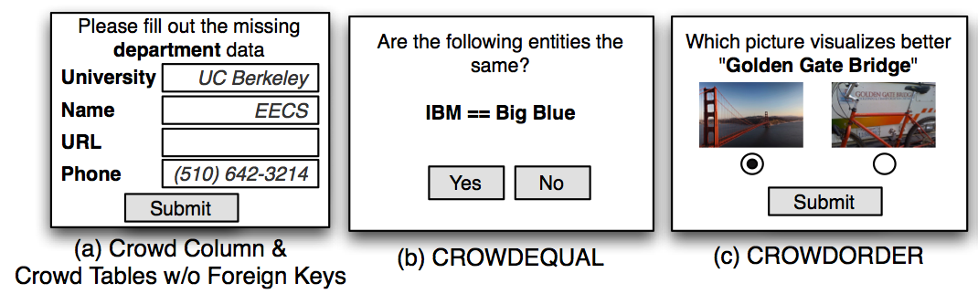
UI Generation
Instantiated at run-time for every tuple
Can also be edited
Can you think of other UIs? (Remember previous papers..)

Slide 11
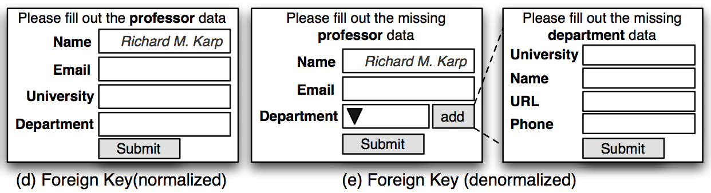
Multi-relational UI Generation
Interesting trick to deal with dependencies
If referencing a non-crowdsourced table
Drop-down box + suggest function. Why?
If referencing a crowdsourced table
Normalized interface with a suggest function
Denormalized interface getting dependent data

Slide 12
Query Processing
Given these SQL extensions, there are a handful of new operators
CROWDPROBE:
Collects missing information in CROWD columns or tables
CROWDJOIN:
Inner table is probed in a crowdsourced fashion using the other table
CROWDCOMPARE:
Used for CROWDEQUAL and CROWDORDER

Slide 13
Let’s dig deeper…
Quality management: Majority vote with 5 answers across all those whose PKs match
Issue?
CROWDPROBE on a CROWDTABLE?
Prof (name, email, univ, dep), (n, u) pk
Say I want to find 3 professors from univ = X, dep = Y; how long would I take?
Best case:
Worst case:

Slide 14
Let’s dig deeper…
Quality management: Majority vote with 5 answers across all those whose PKs match
Issue?
CROWDPROBE on a CROWDTABLE?
Prof (name, email, univ, dep)
Say I want to find 3 professors from univ = X, dep = Y
Workers may focus on different answers

Slide 15
Let’s dig deeper …
CROWDTABLE
Any other issues?

Slide 16
Let’s dig deeper …
CROWDTABLE
What if workers refer to two Professors in a slightly different manner:
Jiawei Han vs. J. Han
Spelling mistakes

Slide 17
Let’s dig deeper …
CROWDJOIN
Outer is used to probe inner crowdsourced table, asking for values of missing predicates
E.g., join between Dept and Prof
Are there similar issues here? What if workers can’t find the URL of a specific Prof?

Slide 18
Crowd Operators
Tasks
Create HITs and HIT groups
Collect results from AMT
Quality control via majority vote
Right now: simple rule-based optimizer
Batch size, # assignments, price fixed
Predicate push down, join ordering, delete optimization
Future: cost-based optimizer

Slide 19
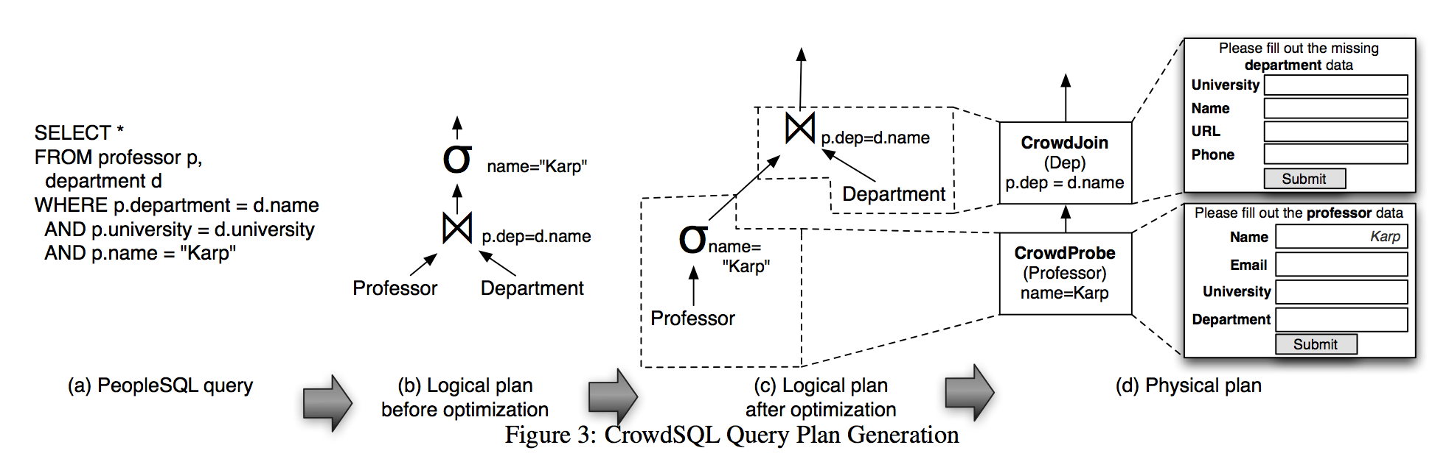
Query Processing Example

Slide 20
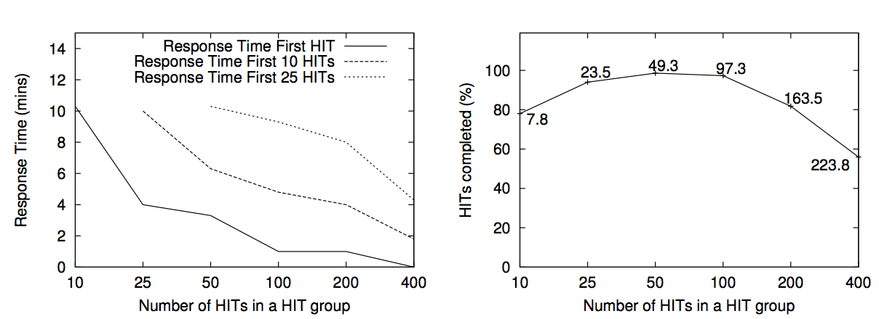
Results on benchmarks
HIT Size vs. responsiveness
Tradeoff between HITS completed/time and % completion of HITS

Slide 21
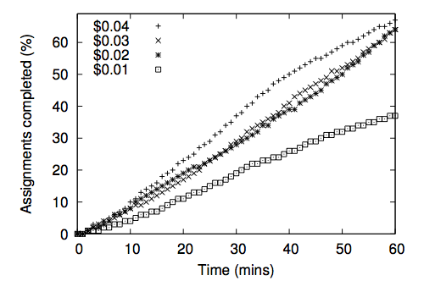
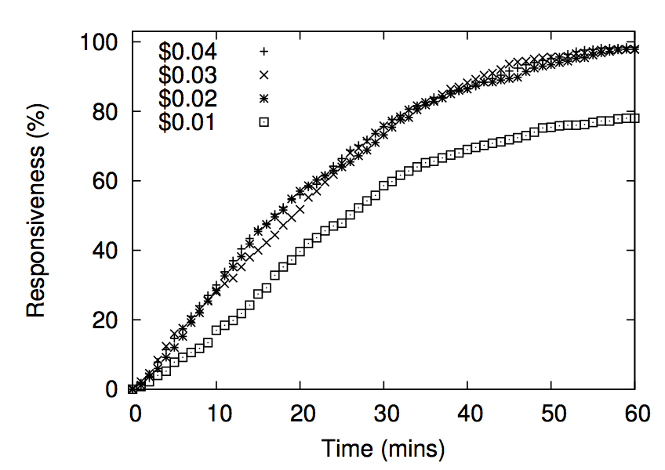
Reward vs. Responsiveness
% hits fully completed %hits with >1 done

Slide 22
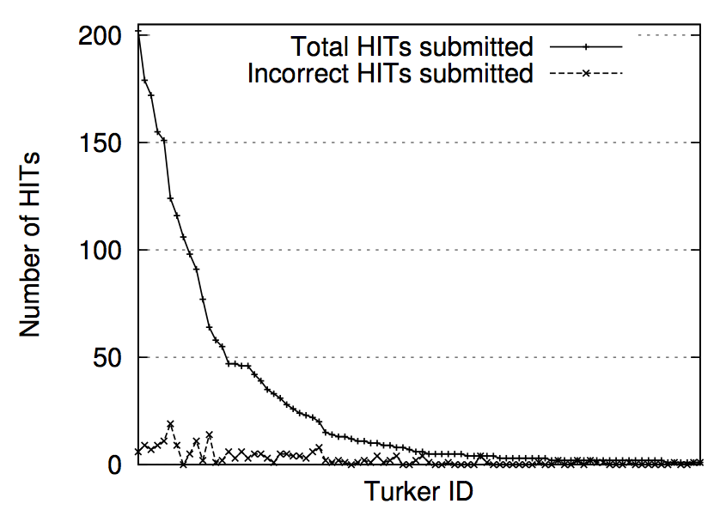
Completion across workers
Skewed distribution
No variation in error rate between high freq workers and others

Slide 23
Complex Queries
Entity resolution on company names
Matching one company name with 100 others for four separate runs
Majority vote gives the correct result
Ordering photos in terms of relevance
Majority vote matches expert ranking

Slide 24
Complex Queries
Joining professors and departments
SELECT p.name, p.email, d.name, d.phone
FROM Professor p, Department d
WHERE p.department = d.name AND
p.university = d.university AND
p.name = "[name of a professor]"
Method 1: first prof details collected, then dep details
Method 2: prof and dep details collected together via a denormalized interface
Method 2 is cheaper, but Method 1 outperforms Method 2 in accuracy:
Instructions for denormalized interface unclear

Slide 25
Other obersvations
Relationship with workers is long-term
Keep workers happy
Implement less stringent approval mechanisms
Good interface design and instructions matter
Simple choices like “none of the above” improve quality dramatically

Slide 26
History Lesson
Even now (4 years later), there is no real complete, fully-functional crowd-powered database
Why?

Slide 27
History Lesson
Even now, there is no real complete, fully-functional crowd-powered database
Why?
No one understands the crowds (EVEN NOW)
We were all naïve in thinking that we could treat crowds as just another data source.
People don’t seem to want to use crowds within databases
Crowdsourcing is a one-off task
Crowds have very different characteristics than other data

Slide 28
Still…
The ideas are very powerful and applicable everywhere you want data to be extracted
Very common use-case of crowds

Slide 29
Semantics
Semantics = an understanding of what the query does
Regular SQL has very understandable semantics because starting from a given state, you know exactly what state you will be once you execute a statement.
Does CrowdSQL have understandable/ semantics? How would you improve it?

Slide 30
Semantics
Does CrowdSQL have understandable/ semantics? How would you improve it?
Fill in CNULL; LIMIT clause
What if you had more than the limit # of tuples already filled in?
Overall, very hard. But at the least:
A specification of budget?
A specification that cost/latency is minimized?

Slide 31
Optimization Techniques
Beyond the ones presented in the paper, what other “database style” optimization techniques can you think of?

Slide 32
Optimization Techniques
Beyond the ones presented in the paper, what other “database style” optimization techniques can you think of?
Paper mentions predicate pushdown, e.g., if you only care about tuples in CA, instantiate interfaces with CA filled in.
Not always good – evaluating crowd predicates may be costly
Reorder tables such that more “complete” tables are filled first.
Reorder predicates such that more “complete” predicates are checked first.
SELECT * FROM PROEFESSOR WHERE Dept = “math” AND Email LIKE “%berkeley%”

Slide 34
Recording Data
CrowdDB only records either CNULL or the final outcome. Why might this be a bad idea?

Slide 35
Recording Data
CrowdDB only records either CNULL or the final outcome. Why might this be a bad idea?
Needs and aggregations schemes change
An application that requires more accuracy
We find that people are more erroneous than we expected
Data may get stale

Slide 36
Joins between crowdsourced relations
CrowdDB forbids joins between two crowdsourced tables. Is there a case where we may want that?

Slide 37
Joins between crowdsourced relations
CrowdDB forbids joins between two crowdsourced tables. Is there a case where we may want that?
Sure:
People in a department, courses taught in the department
What interesting challenges emerge there?

Slide 38
Joins between crowdsourced relations
CrowdDB forbids joins between two crowdsourced tables. Is there a case where we may want that?
Sure:
People in a department, courses taught in the department
What interesting challenges emerge there?
Get more tuples for one relation or the other.
Especially if not K-FK join

Slide 39
FDs?
CrowdDB assumes a primary key per table. What if there are other Functional Dependencies? Can we do better?

Slide 40
FDs?
CrowdDB assumes a primary key per table. What if there are other Functional Dependencies? Can we do better?
Example: Company, City, State

Slide 41
Other things…
What other issues did you identify in the paper?

Slide 42
Other things…
What other issues did you identify in the paper?
CROWDTABLE:
What if workers refer to two entities in a slightly different manner:
Jiawei Han vs. J. Han
Spelling mistakes
CROWDPROBE:
What if some information is just hard to crowdsource?
Bottlenecked?

