Slide 1
Making Database Systems Usable
Slides courtesy Jagadish

Slide 2
This paper…
Unusual, provocative paper
More problems than solutions
A showcase of the work the group has done
Naturally, very far from solving the problems
Better to judge the paper for the questions it raises rather than the solutions it provides!

Slide 3
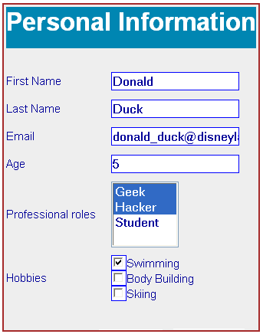
Forms
Simple, but limited.
How do we create a form to query a database?
When would it be appropriate to use?
Discuss!

Slide 4
Forms
Simple, but limited.
How do we create a form to query a database?
When would it be appropriate to use?
Discuss!
Small number of types of queries
Small number of predicates
Small number of joins
Possibly many values for attributes
Conceptual schema need not be same as actual schema (e.g., flight database)

Slide 5
Natural Language Interfaces
Pros/Cons?

Slide 6
Natural Language Interfaces
Pros/Cons?
No need for SQL:
But not clear how much one can do without knowledge of schema
Only short queries
Probably a wider space of queries than forms
Sometimes can be annoying
Imagine having to specify flight searches via NL
The feeling of less control
Lack of understanding of knobs

Slide 7
Lots of work on Provenance
Fine grained – store origin of every single record
Coarse grained – store at a schema level: this table came from these two tables
Pros/Cons?

Slide 8
Lots of work on Provenance
Fine grained – store origin of every single record
Coarse grained – store at a schema level: this table came from these two tables
Pros/Cons?
Fine-grained: too much data: all-all mappings
Coarse-grained: cannot ask interesting questions

