Slide 1
CrowdDB: Answering Queries With Crowdsourcing
Presented by:
Fareedah ALSaad

Slide 2
Motivation
Relational database systems are based on the “Closed World Assumption”.
Relational databases are extremely literal.
SELECT market_capitalization
FROM company
WHERE name = "I.B.M.";
Entity Resolution Problem
RDMS cannot deal with subjective comparison.
How to leverage human resources to extend the capabilities of database systems?

Slide 3
Motivation
Develop CrowdDB:
A relational query processing system ➔ maintain SQL semantics.
Rely on traditional RDBS to do the heavy lifting data manipulation.
Extend SQL to enable queries that involve human computation.

Slide 4
Crowdsourcing Platform
Amazon Mechanical Turk (AMT).
AMT basics:
HIT (Human Intelligent Task): Smallest entity of work ➔ one or more job, e.g. tagging 5 pictures.
Assignment: A HIT is replicated into multiple assignments for majority votes.
HIT Group: A group of similar HITs.

Slide 5
Crowdsourcing Platform
Amazon Mechanical Turk (AMT).
AMT APIs:
createHIT(title, description, question, keywords, reward, duration, maxAssignments, lifetime)→ HitID
getAssignmentsForHIT(HitID)→list(asnId, workerId , answer)
approveAssignment(asnID)
rejectAssignment(asnID)
forceExpireHIT(HitID)

Slide 6
CrowdDB Design Considerations
Performance and Variability:
People and machines differ in speed, cost, and quality.
People show tremendous variability.
Task Design and Ambiguity:
Ambiguities due to natural language.
Interface design can affect the accuracy and the speed.
Affinity and Learning:
Crowd workers develop relationships with requesters and skills for certain HIT types.
Relatively Small Worker Pool.
Open vs. Closed World.

Slide 7
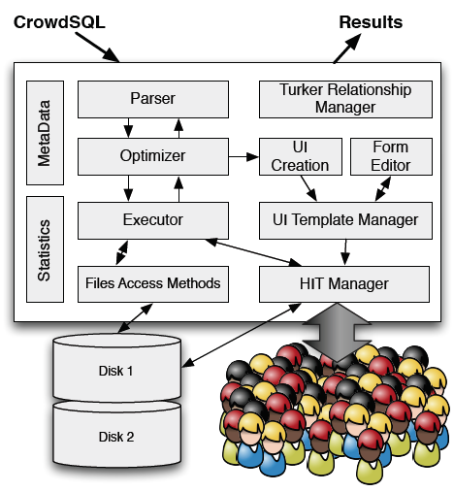
Overview of CrowdDB
An application issues requests using CrowdSQL.
The complexities of dealing with the crowd are encapsulated by CrowdDB.
Results obtained from the crowd can be stored in the database for future use.

Slide 8
CrowdSQL – Incomplete Data
Use special keyword: CROWD.
Incomplete data can occur in two flavors:
Crowdsourced Column:
CREATE TABLE Department (
university STRING,
name STRING,
url CROWD STRING,
phone STRING,
PRIMARY KEY (university, name) );
Crowdsourced Table:
CREATE CROWD TABLE Professor (
name STRING PRIMARY KEY,
email STRING UNIQUE,
university STRING,
department STRING,
FOREIGN KEY (university, department)
REF Department(university, name) );

Slide 9
CrowdSQL – Incomplete Data
Use new value type CNULL to indicates that a value should be crowdsourced when it is first used .
CNULL is the default value of any CROWD column.
CNULL values are generated as a side-effect of INSERT statements:
INSERT INTO Department(university, name)
VALUES ("UC Berkeley", "EECS");
university | name | url | phone
UC Berkeley | EECS | CNULL | NULL

Slide 10
CrowdSQL – Incomplete Data
Use new value type CNULL to indicates that a value should be crowdsourced when it is first used .
CNULL is the default value of any CROWD column.
CNULL values are generated as a side-effect of INSERT statements:
INSERT INTO Department(university, name)
VALUES ("UC Berkeley", "EECS");
Allow crowdsourcing as a side-effect of query processing:
SELECT url FROM Department
WHERE name = "Math";

Slide 11
CrowdSQL – Subjective Comparisons
Use two new built in functions: CROWDEQUAL,CROWDORDER.
CROWDEQUAL (~=)
SELECT profile FROM department
WHERE name ~= "CS";
CROWDORDER
CREATE TABLE picture (
p IMAGE,
subject STRING);
SELECT p FROM picture
WHERE subject = "Golden Gate Bridge"
ORDER BY CROWDORDER(p,
"Which picture visualizes better %subject");

Slide 12
CrowdSQL in Practice
Practical issues that limit the usage of CrowdSQL:
Cost and response time of queries can be unbounded.
Lineage: track source of data to take actions.
Cleansing of crowdsourced data ➔entity resolution.

Slide 13
User Interface Generation
Automatically generates user interfaces for incomplete information and subjective comparisons.
Create templates at a compile-time.
Templates are instantiated at a run-time for each tuple.
Templates can be edited for customized instruction.

Slide 14
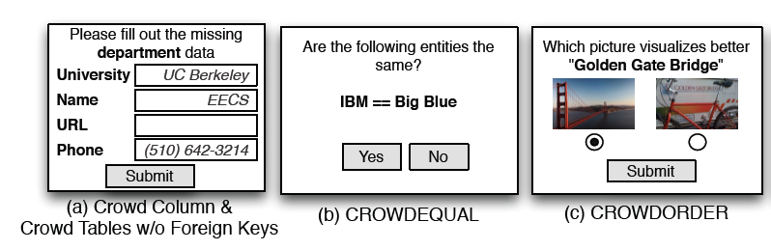
User Interface Generation
Basic Interface:
Two types of optimization:
Batch several tuples.
Prefetching of attributes of the same tuple.

Slide 15
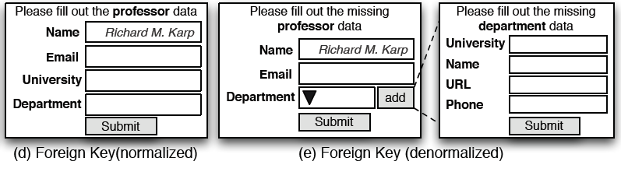
User Interface Generation
Multi-relational interface:
Foreign-key references a non-crowdsourced table:
A drop-down box of possible foreign keys.
Ajax-based “suggest” function.
Foreign-key references a crowdsourced table:
Normalized interface ➔ suggest function can be used to avoid entity resolution problem.
Denormalized interface.

Slide 16
Query Processing – Crowd Operators
Three crowd operators:
CrowdProbe: Crowdsources missing information of CROWD and new tuples.
CrowdJoin: At least one table is a crowdsourced table.
CrowdCompare: Implement the CROWDEQUAL and CROWDORDER function.
Quality control is carried out by a majority vote.

Slide 17
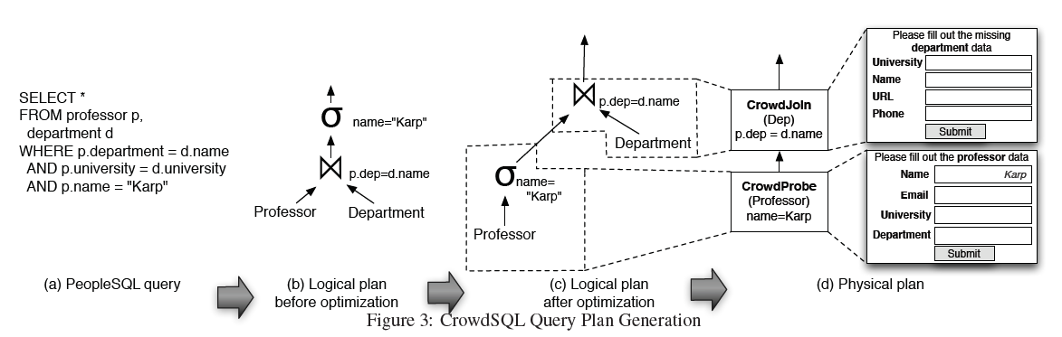
Query Processing – Physical Plan Generation
Heuristics:
Simple rule-based optimizer: e.g. predicate push-down.
Crowdsourcing rules:
Set the basic crowdsourcing parameters (price, batching-size).
Select the user interface (normalized vs. denormalized).
A cost-based optimize that considers the changing conditions on AMT, remains future work.

Slide 18
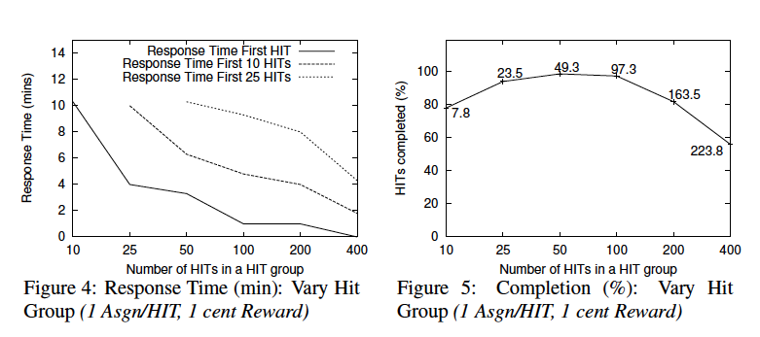
Experiments and Results – Simple Queries
Response Time, Vary HIT Group
SELECT phone_number, address FROM businesses;
Within 30 min

Slide 19
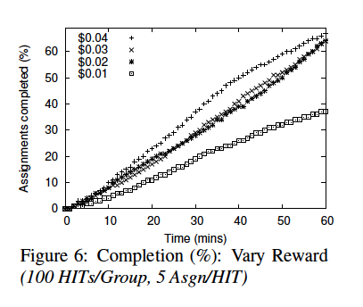
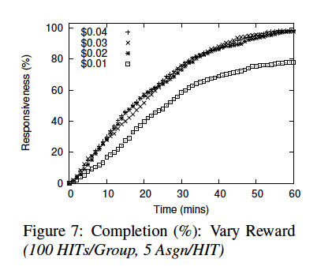
Experiments and Results – Simple Queries
Responsiveness, Vary Rewards

Slide 20
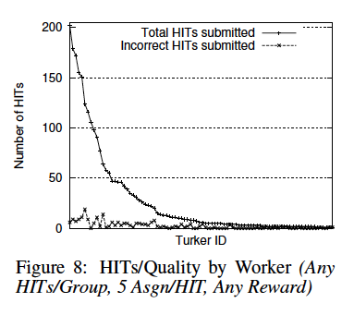
Experiments and Results – Simple Queries
Worker Affinity and Quality

Slide 21
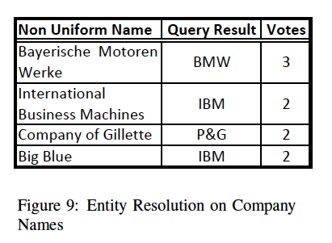
Experiments and Results – Complex Queries
Entities Resolution on Companies
SELECT name FROM company WHERE
name~="[a non-uniform name of the company]"

Slide 22
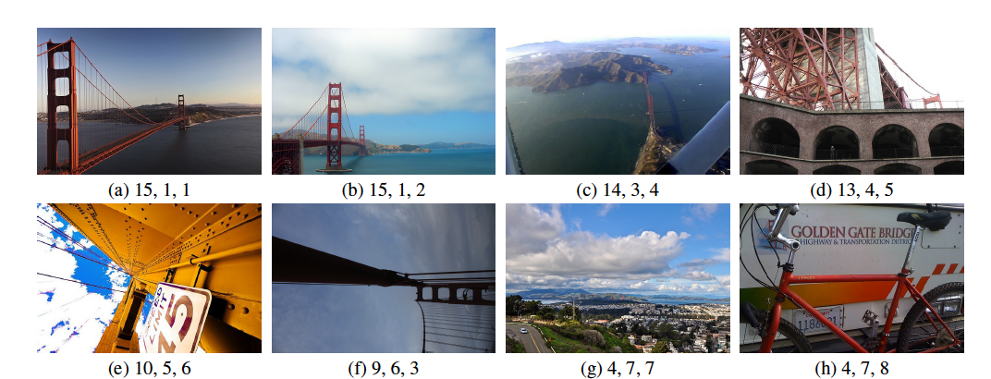
Experiments and Results – Complex Queries
Ordering Pictures
{# of votes by the workers, picture rank based on workers votes, picture rank ordered by experts}

Slide 23
Experiments and Results – Complex Queries
Joining Professors and Departments
SELECT p.name, p.email, d.name, d.phone
FROM Professor p, Department d
WHERE p.department = d.name AND
p.university = d.university AND
p.name = "[name of a professor]"
Compare the performance of two plans:
Two steps: collect professor information and then the department information.
A single step: collect professor and department information together ➔use denormalized interface
Two plans were similar in execution time and cost.
First plan (two steps) has better accuracy.
In the second plan, workers submitted the professors’ phone numbers instead of the departments.

Slide 24
Observations
Challenges in controlling the factors that impact response time, cost and result quality.
Crowd resources involve long-term memory that can impact performance ➔ Keep workers happy.
User interface design and precise instructions matter ➔ a good interface improves result quality and worker efficiency.

Slide 25
Related Work
Database Systems:
Leverages traditional techniques for relational query processing.
Top N optimizations ➔ to deal with the open-world nature of crowdsourcing.
The volatility of crowd performance ➔ needs adaptive query processing techniques.
Automatic generation of user interfaces ➔ similar to Oracle Forms.
Crowdsourcing Communities:
Ipeirotis analyzed the AMT marketplace by gathering some statistics.
CrowdSearch attempts to automatically control quality and optimize response time.
TurKit is a set of tools that enables programming iterative algorithms over the crowd.
Quark and (Parameswaran and Polyzotis, 2011): explore the use of crowdsourcing in relational query processing.

Slide 26
Thank You

