Slide 1
Sample + Seek: Approximating Aggregates with Distribution Precision Guarantee
Bolin Ding Silu Huang* Surajit Chaudhuri
Kaushik Chakrabarti Chi Wang
{bolind, surajitc, kaushik, chiw}@microsoft.com shuang86@illinois.edu
Microsoft Research University of Illinois
* Work done while in Microsoft

Slide 2
Outline
Introduction
Overview of Our Approach
Main Technical Results
Related Work
Experiments
Conclusion

Slide 3
Outline
Introduction
Overview of Our Approach
Main Technical Results
Related Work
Experiments
Conclusion

Slide 4
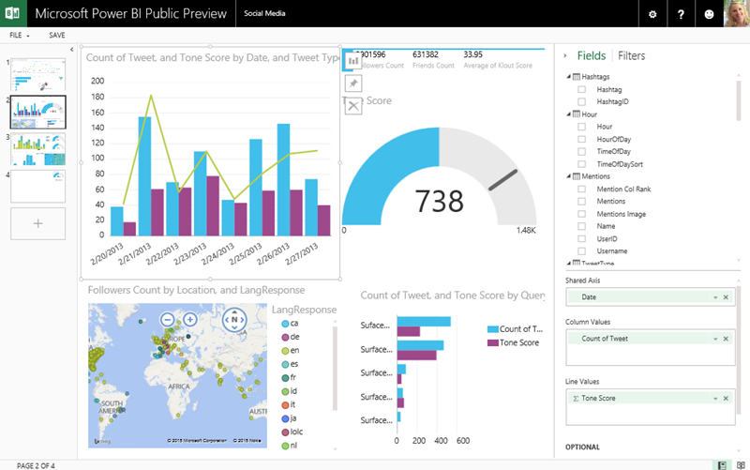
Motivation
Interactive BI queries
Aggregate queries with complicated and (maybe) selective predicates
Large data size and response in seconds
Answer with small error is fine
General trend is enough for decision making
Error exists in visualization anyway
Error guarantee is important

Slide 5



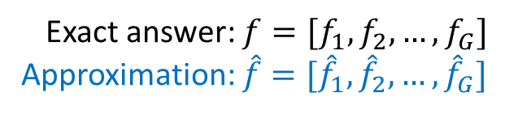

Problem Definition
Aggregate queries on a simple table $T$
Group by dimensions
Measure attribute
Extensible to SPJ queries (with foreign key joins between fact and dim tables)
SELECT $A_{1}, A_{2},… A_{d}, Agg(B)$
FROM $T$
WHERE $F$
GROUP BY $A_{1}, A_{2},…, A_{d}$
Aggregate function: count, sum, avg, count distinct
Filter predicate: AND/OR of atomic predicates, atomic predicate can be equality or range predicate
$${[f}_{1},$$
$$f_{2}]$$
Answer and Normalize
Exact answer: $f=[f_{1},f_{2},…,f_{G}]$
Approximation: $\hat{f}=[{\hat{f}}_{1},{\hat{f}}_{2},…,{\hat{f}}_{G}]$

Slide 6

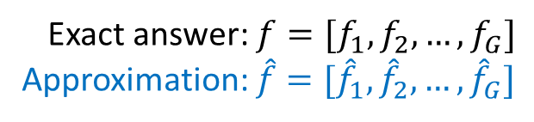




Problem Definition: Error Guarantee
Measuring error: ${\left\|\hat{f}−f\right\|}_{2}=\sqrt{\sum_{g}{{\left({\hat{f}}_{g}−f_{g}\right)}^{2}}}$
Guarantee on the whole distribution
Considering information gain in decision trees
Semantics of the guarantee
Total difference of the sector areas
Exact answer: $f=[f_{1},f_{2},…,f_{G}]$
Approximation: $\hat{f}=[{\hat{f}}_{1},{\hat{f}}_{2},…,{\hat{f}}_{G}]$
$$f={[f}_{1},$$
$$f_{2}]$$
$$\hat{f}={[\hat{f}}_{1},$$
$${\hat{f}}_{2}]$$
Error

Slide 7
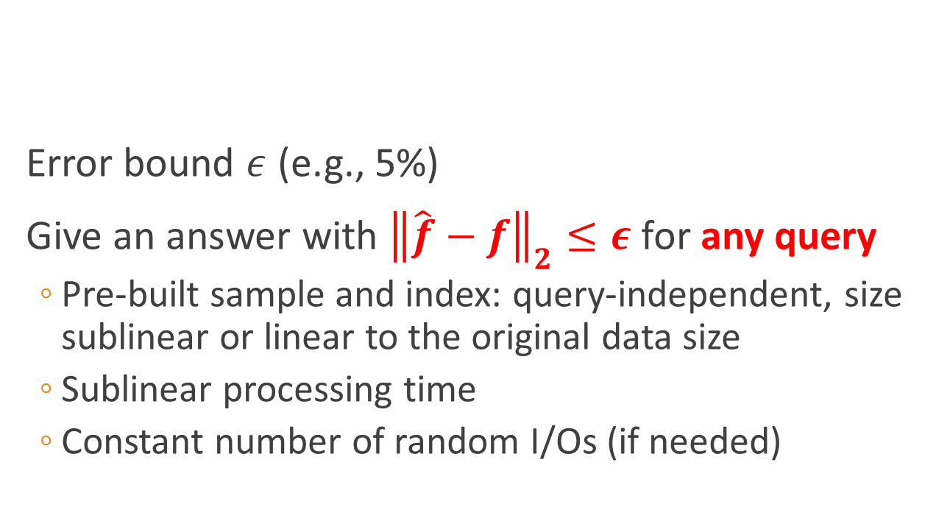
Problem Definition: Goal of Our System
Error bound $ε$ (e.g., 5%)
Give an answer with ${\left\|\hat{f}−f\right\|}_{2}≤ε$ for any query
Pre-built sample and index: query-independent, size sublinear or linear to the original data size
Sublinear processing time
Constant number of random I/Os (if needed)
Exact answer: $f=[f_{1},f_{2},…,f_{G}]$
Approximation: $\hat{f}=[{\hat{f}}_{1},{\hat{f}}_{2},…,{\hat{f}}_{G}]$
$$f={[f}_{1},$$
$$f_{2}]$$
$$\hat{f}={[\hat{f}}_{1},$$
$${\hat{f}}_{2}]$$

Slide 8
Outline
Introduction
Overview of Our Approach
Main Technical Results
Related Work
Experiments
Conclusion

Slide 9
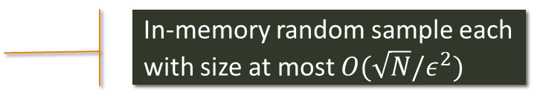
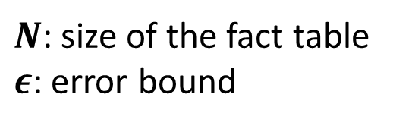
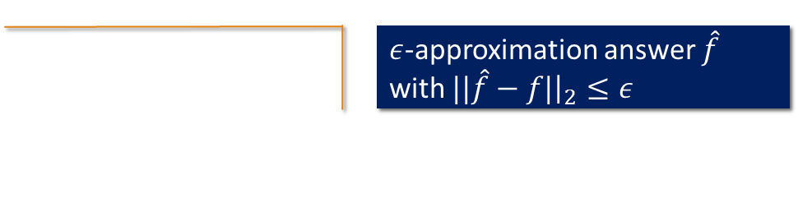
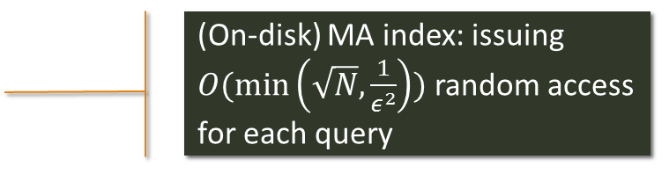
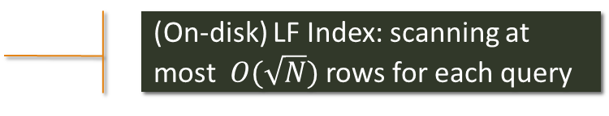
Overview of Our Approach
$ε$-approximation answer $\hat{f}$ with $||\hat{f}−f|{\left.​\right|}_{2}≤ε$
Query Processor
Online
Offline
Sample
In-memory random sample each with size at most $O(\sqrt{N}/ε^{2})$
MetaData
Dictionary
LF Index
(On-disk) LF Index: scanning at most $O(\sqrt{N})$ rows for each query
Columnizer
(On-disk) MA index: issuing $O(\min\left(\sqrt{N}, \frac{1}{ε^{2}}\right))$ random access for each query
DataConnector
MA Index
Data source
e.g., SQL DB
$N$: size of the fact table
$ε$: error bound

Slide 10
Outline
Introduction
Overview of Our Approach
Main Technical Results
Related Work
Experiments
Conclusion

Slide 11
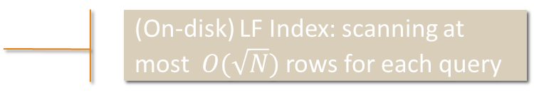
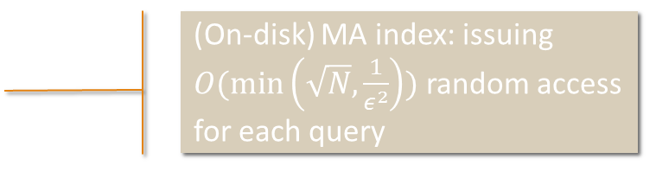
Main Technical Results
$ε$-approximation answer $\hat{f}$ with $||\hat{f}−f|{\left.​\right|}_{2}≤ε$
Query Processor
Online
Offline
Sample
In-memory random sample each with size at most $O(\sqrt{N}/ε^{2})$
MetaData
Dictionary
LF Index
(On-disk) LF Index: scanning at most $O(\sqrt{N})$ rows for each query
Columnizer
(On-disk) MA index: issuing $O(\min\left(\sqrt{N}, \frac{1}{ε^{2}}\right))$ random access for each query
DataConnector
MA Index
Data source
e.g., SQL DB
$N$: size of the fact table
$ε$: error bound

Slide 12
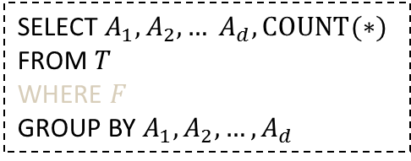
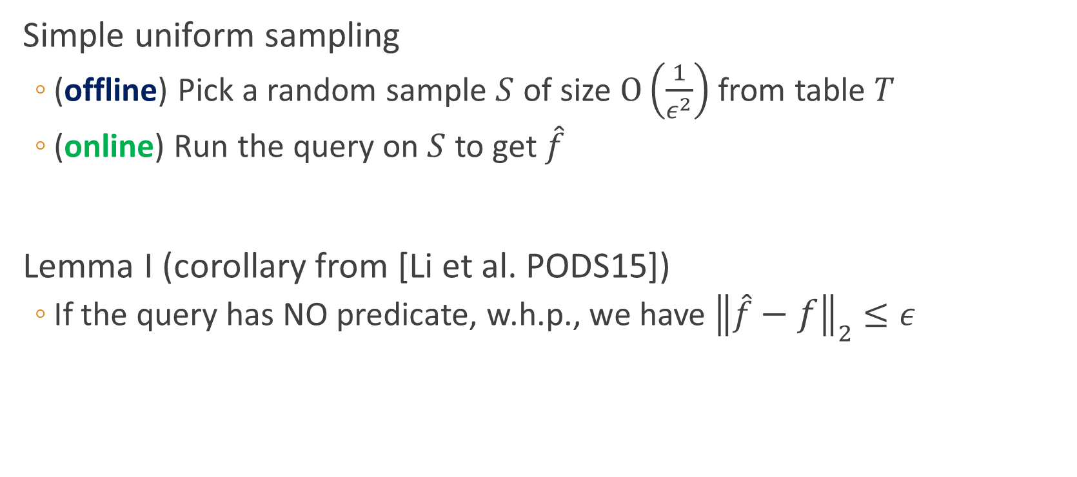
Sampling for COUNT Aggregates
Simple uniform sampling
(offline) Pick a random sample $S$ of size $O\left(\frac{1}{ε^{2}}\right)$ from table $T$
(online) Run the query on $S$ to get $\hat{f}$
Lemma I (corollary from [Li et al. PODS15])
If the query has NO predicate, w.h.p., we have ${\left\|\hat{f}−f\right\|}_{2}≤ε$
SELECT $A_{1}, A_{2},… A_{d}, COUNT(∗)$
FROM $T$
WHERE $F$
GROUP BY $A_{1}, A_{2},…, A_{d}$

Slide 13
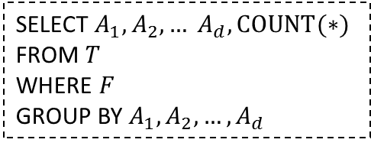
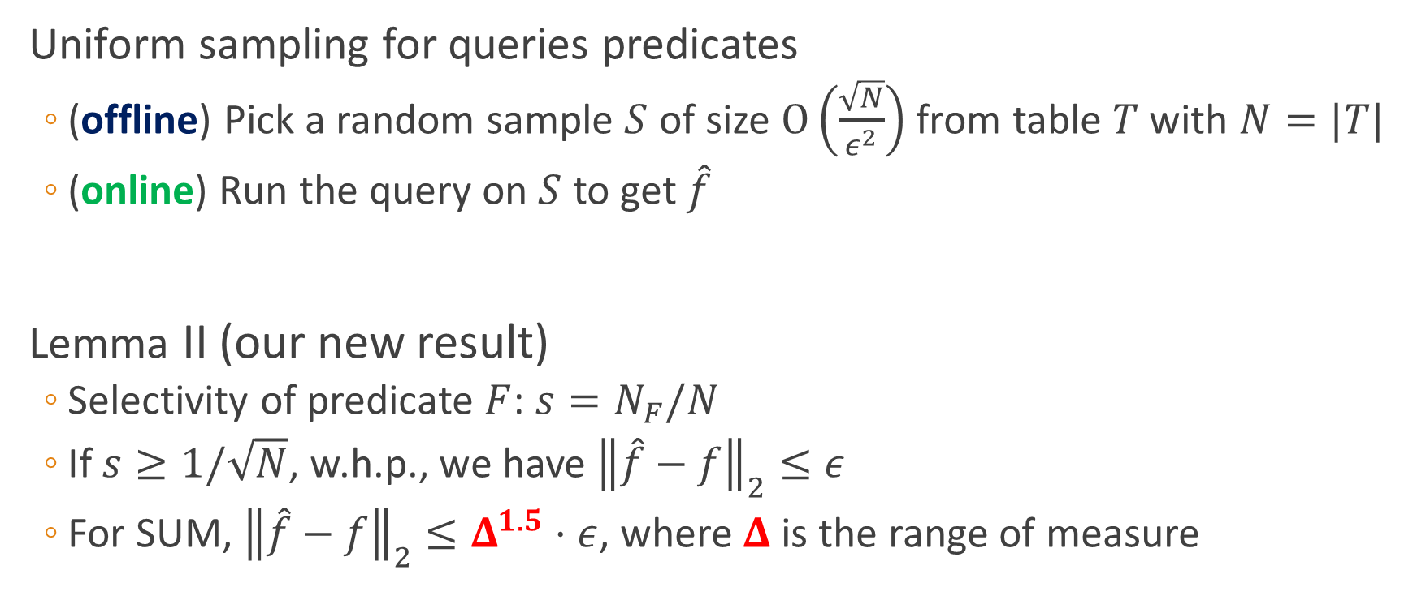
Sampling for COUNT Aggregates with Predicates
Uniform sampling for queries predicates
(offline) Pick a random sample $S$ of size $O\left(\frac{\sqrt{N}}{ε^{2}}\right)$ from table $T$ with $N=|T|$
(online) Run the query on $S$ to get $\hat{f}$
Lemma II (our new result)
Selectivity of predicate $F$: $s=N_{F}/N$
If $s≥1/\sqrt{N}$, w.h.p., we have ${\left\|\hat{f}−f\right\|}_{2}≤ε$
For SUM, ${\left\|\hat{f}−f\right\|}_{2}≤Δ^{1.5}⋅ε$, where $Δ$ is the range of measure
SELECT $A_{1}, A_{2},… A_{d}, COUNT(∗)$
FROM $T$
WHERE $F$
GROUP BY $A_{1}, A_{2},…, A_{d}$

Slide 14
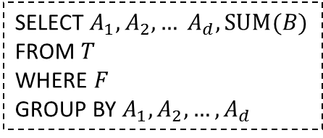
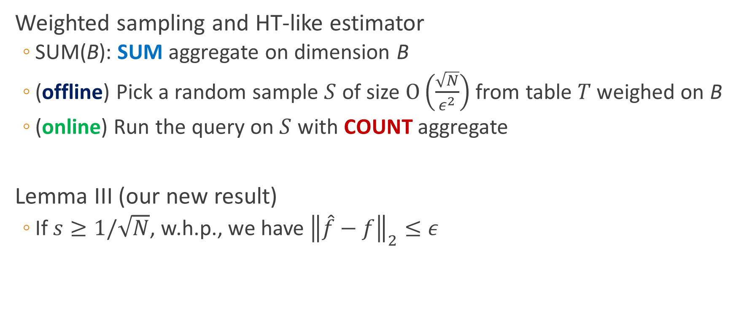
Sampling for SUM Aggregates with Predicates
Weighted sampling and HT-like estimator
SUM(B): SUM aggregate on dimension B
(offline) Pick a random sample $S$ of size $O\left(\frac{\sqrt{N}}{ε^{2}}\right)$ from table $T$ weighed on B
(online) Run the query on $S$ with COUNT aggregate
Lemma III (our new result)
If $s≥1/\sqrt{N}$, w.h.p., we have ${\left\|\hat{f}−f\right\|}_{2}≤ε$
SELECT $A_{1}, A_{2},… A_{d}, SUM(B)$
FROM $T$
WHERE $F$
GROUP BY $A_{1}, A_{2},…, A_{d}$

Slide 15
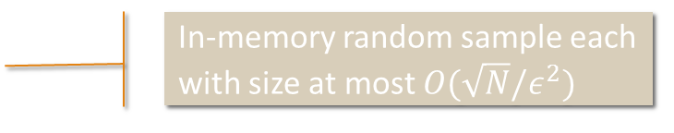
Main Technical Results
$ε$-approximation answer $\hat{f}$ with $||\hat{f}−f|{\left.​\right|}_{2}≤ε$
Query Processor
Online
Offline
Sample
In-memory random sample each with size at most $O(\sqrt{N}/ε^{2})$
MetaData
Dictionary
LF Index
(On-disk) LF Index: scanning at most $O(\sqrt{N})$ rows for each query
Columnizer
(On-disk) MA index: issuing $O(\min\left(\sqrt{N}, \frac{1}{ε^{2}}\right))$ random access for each query
DataConnector
MA Index
Data source
e.g., SQL DB
$N$: size of the fact table
$ε$: error bound

Slide 16

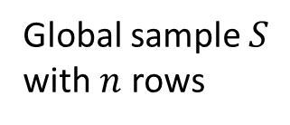
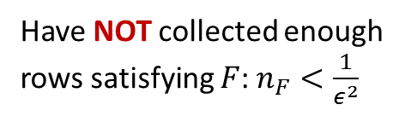

When Sampling is Not Sufficient
For low predicate selectivity
Table $T$ with $N$ rows
Global sample $S$ with $n$ rows
Given query $Q$,
rows satisfying $F$:
$$\left|N_{F}\right|<\sqrt{N}$$
Have NOT collected enough rows satisfying $F$: $n_{F}<\frac{1}{ε^{2}}$

Slide 17
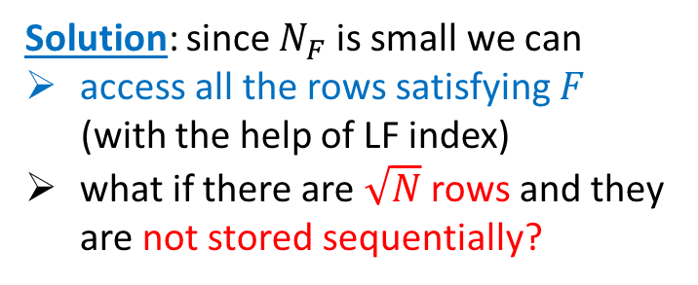
When Sampling is Not Sufficient
For low predicate selectivity
Table $T$ with $N$ rows
Solution: since $N_{F}$ is small we can
access all the rows satisfying $F$
(with the help of LF index)
what if there are $\sqrt{N}$ rows and they are not stored sequentially?
Given query $Q$,
rows satisfying $F$:
$$\left|N_{F}\right|<\sqrt{N}$$

Slide 18
Main Technical Results
$ε$-approximation answer $\hat{f}$ with $||\hat{f}−f|{\left.​\right|}_{2}≤ε$
Query Processor
Online
Offline
Sample
In-memory random sample each with size at most $O(\sqrt{N}/ε^{2})$
MetaData
Dictionary
LF Index
(On-disk) LF Index: scanning at most $O(\sqrt{N})$ rows for each query
Columnizer
(On-disk) MA index: issuing $O(\min\left(\sqrt{N}, \frac{1}{ε^{2}}\right))$ random access for each query
DataConnector
MA Index
Data source
e.g., SQL DB
$N$: size of the fact table
$ε$: error bound

Slide 19

When Sampling is Not Sufficient
For low predicate selectivity
Table $T$ with $N$ rows
Per-column non-clustered index
Solution: since $N_{F}$ is small we can
access all the rows satisfying $F$
(with the help of MA index)
what if there are $\sqrt{N}$ rows and they are not stored sequentially?
Get a $\frac{1}{ε^{2}}$-sample of row addresses
Given query $Q$,
rows satisfying $F$:
$$\left|N_{F}\right|<\sqrt{N}$$

Slide 20
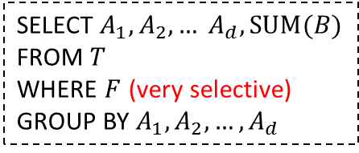
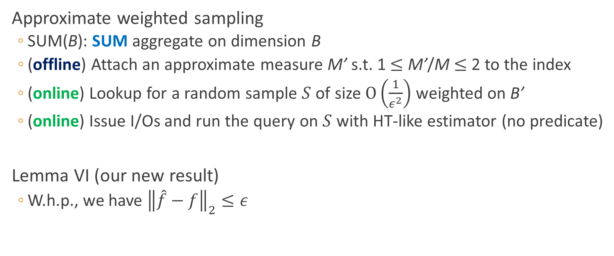
Augment Index with Approximate Measures
Approximate weighted sampling
SUM(B): SUM aggregate on dimension B
(offline) Attach an approximate measure M’ s.t. 1 $≤$ M’/M $≤$ 2 to the index
(online) Lookup for a random sample $S$ of size $O\left(\frac{1}{ε^{2}}\right)$ weighted on B’
(online) Issue I/Os and run the query on $S$ with HT-like estimator (no predicate)
Lemma VI (our new result)
W.h.p., we have ${\left\|\hat{f}−f\right\|}_{2}≤ε$
SELECT $A_{1}, A_{2},… A_{d}, SUM(B)$
FROM $T$
WHERE $F$ (very selective)
GROUP BY $A_{1}, A_{2},…, A_{d}$

Slide 21
Outline
Introduction
Overview of Our Approach
Main Technical Results
Related Work
Experiments
Conclusion

Slide 22
Related Work
OLAP (data cube) and ColumnStore index
Online aggregation
Offline sampling (BlinkDB)
Deterministic approximate query processing (DAQ)

Slide 23
Outline
Introduction
Overview of Our Approach
Main Technical Results
Related Work
Experiments
Conclusion

Slide 24
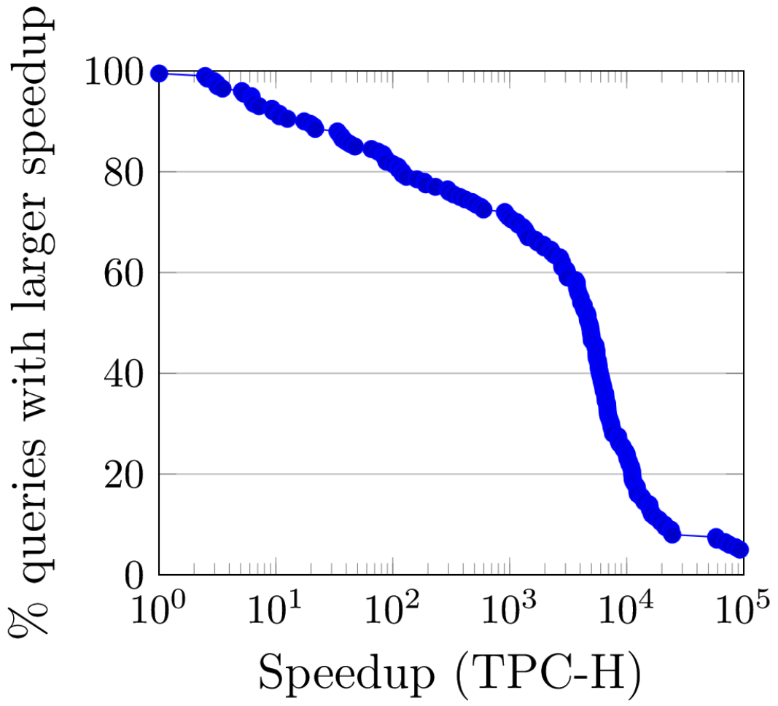
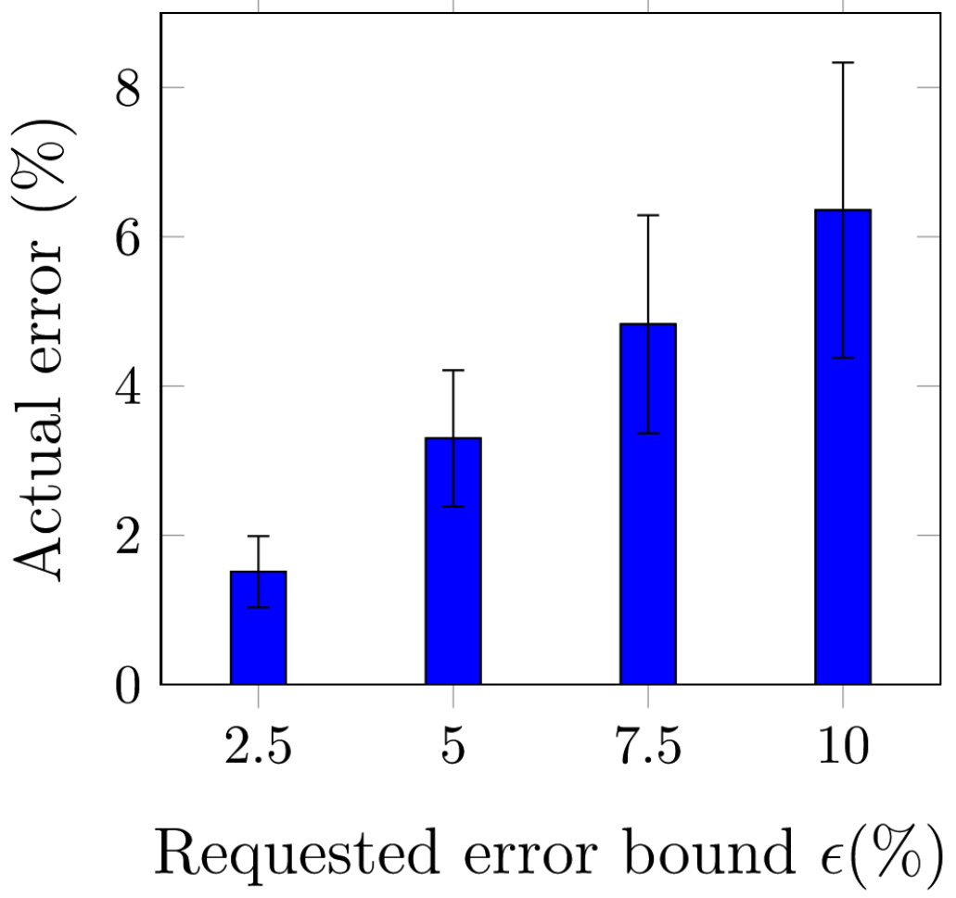
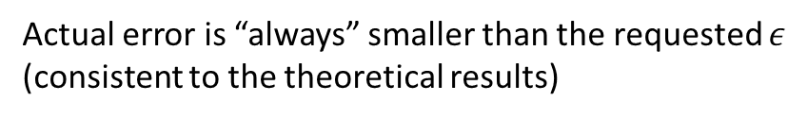

Experiments
TPC-H schema (with eight tables - 300M rows in LINEITEM)
Queries with 1-4 group-by dims, and 0-4 predicate dims
100$×$ speedup for $>80\%$ queries
Actual error is “always” smaller than the requested $ε$
(consistent to the theoretical results)

Slide 25
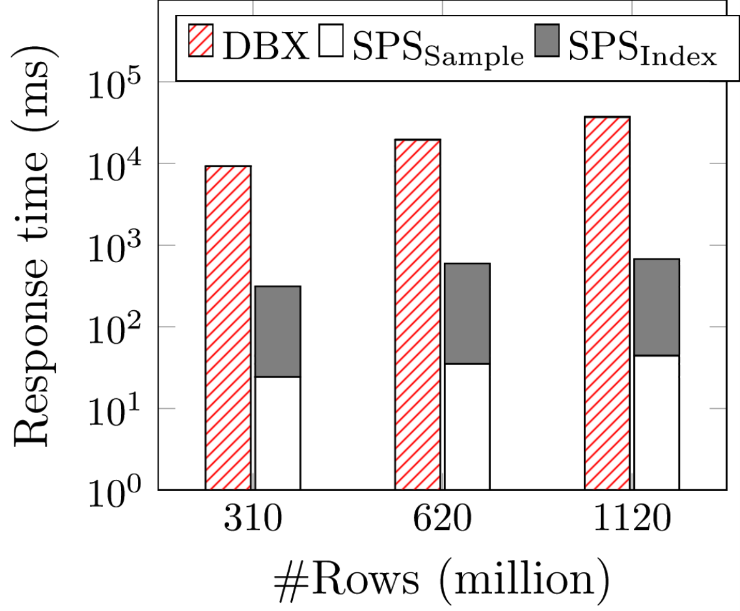
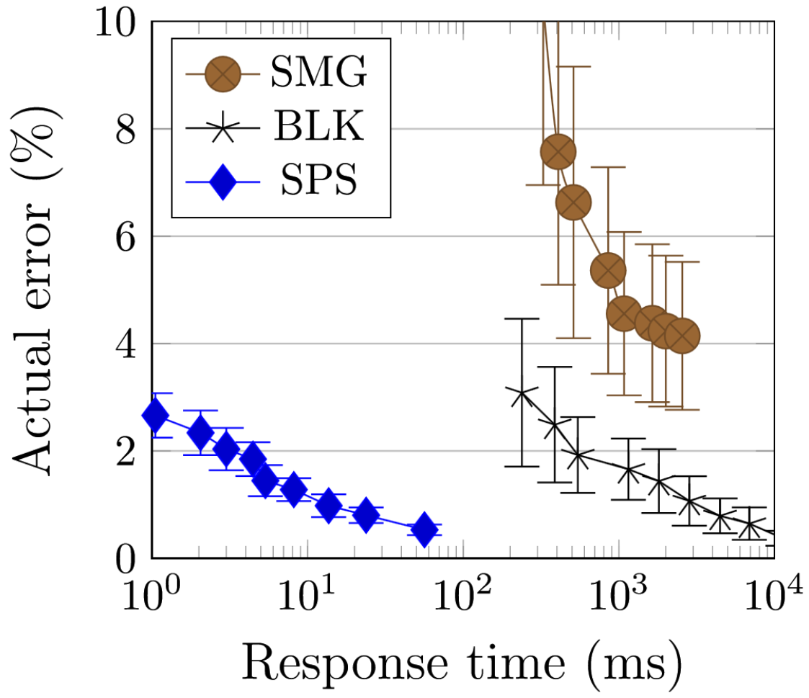
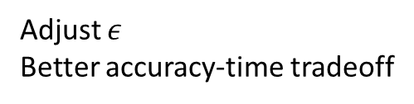
Experiments
A real enterprise log table with 30 dimensions and 1B+ rows
Queries with 1-4 group-by dims, and 0-4 predicate dims
SPS: Our method
DBX: A commercial RDBMS
with columnstore
BLK: BlinkDB
SMG: SmallGroup sampling
Sample part scales sublinearly
Index part tends to be constant
Adjust $ε$
Better accuracy-time tradeoff

Slide 26
Outline
Introduction
Overview of Our Approach
Main Technical Results
Related Work
Experiments
Conclusion

Slide 27
Conclusion
Time flies! Let’s process everything faster!

Slide 28


Slide 29

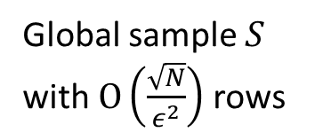
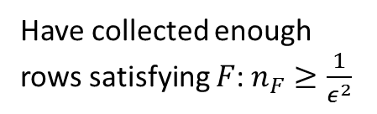

When Sampling is Sufficient
For high predicate selectivity
Global sample $S$ with $O\left(\frac{\sqrt{N}}{ε^{2}}\right)$ rows
Table $T$ with $N$ rows
Given query $Q$,
rows satisfying $F$:
$$\left|N_{F}\right|≥\sqrt{N}$$
Have collected enough rows satisfying $F$: $n_{F}≥\frac{1}{ε^{2}}$

Slide 30




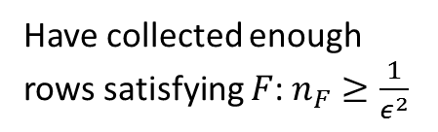
When Sampling is Sufficient
For high predicate selectivity
Global sample $S$ with $O\left(\frac{\sqrt{N}}{ε^{2}}\right)$ rows
Table $T$ with $N$ rows
Run $Q$ on $S$
$ε$-approximation
Given query $Q$,
rows satisfying $F$:
$$\left|N_{F}\right|≥\sqrt{N}$$
Use Lemma II (COUNT)
and Lemma III (SUM)
Have collected enough rows satisfying $F$: $n_{F}≥\frac{1}{ε^{2}}$

