Slide 1
Gestural Query Specification

Slide 2
Key Ideas from GestureDB & DBTouch
Touch-based interfaces to manipulate data
GestureDB is more complete
DBTouch is ``half-baked’’
Pros: people not used to databases can manipulate data

Slide 3
Questions
Was the user study “fairly” conducted? What else would you have done?

Slide 4
Questions
Was the user study “fairly” conducted? What else would you have done?
GestureDB may be easy to specify small q but may be hard to specify more complex ones
Discoverability only on join: not clear if more complex queries are discoverable

Slide 5
Questions
GestureDB
Provides feedback as queries are being composed. Can there be issues?

Slide 6
Questions
GestureDB
Provides feedback as queries are being composed. Can there be issues?
Will only work for small tables. What about predicate pushdown after a cross-product?
Going against the declarative nature of databases if query results are composed iteratively.

Slide 7
Alternatives: Excel
When would these tools be better than Excel?
When would they be worse?

Slide 8
Alternatives: Excel
When would these tools be better than Excel?
More tactile and therefore more intuitive
Relational operations not supported by Excel
Joins not supported
Primarily formulae rather than relational expressions
When would they be worse?
Plotting charts
Looking at all your data at once

Slide 9
Alternatives: Visual Analytics Tools
When would these tools be better than Tableau?
When would they be worse?

Slide 10
Alternatives: Visual Analytics Tools
When would these tools be better than Tableau? When would they be worse?
When selection, creation of new tables, joins, is key rather than aggregate queries

Slide 11
Alternatives: Query By Example
Moshe Zloof, IBM, ‘70s
Print all sailor tuples with rating 10
Print names, ratings, ages of all sailors ordered by a, r
Print all sailors with a reservation
Print colors of interlake boats reserved by sailors on 8/24/94, with age > 25

Slide 12
Alternatives: Query By Example
Print average age grouped by rating
Print sailors <30 or < 20
Print sailors <30 and > 20

Slide 13
Alternatives: Query By Example
Advantages, Disadvantages?

Slide 14
Alternatives: Query By Example
Advantages, Disadvantages?
Advantages: more powerful, requires less visual manipulation, few keystrokes
Disadvantages: less “fun”? Less “intuitive”?

Slide 15
Alternatives: Keyword Search in DB
Key Idea of a Data Graph: Captures relationships and their strengths, among data and metadata items
Nodes
Classes, tables, attributes, field values
May be weighted – representing authoritativeness, quality, correctness, etc.
Edges
is-a and has-a relationships, foreign keys, hyperlinks, record links, possible joins, …
May be weighted – representing strength of the connection, probability of match, etc.

Slide 16
Alternatives: Keyword Search in DB
Queries are expressed as sets of keywords
We match keywords to nodes, then seek to find a way to “connect” the matches in a tree
The lowest-cost tree connecting a set of nodes is called a Steiner tree
Formally, we want the top-k Steiner trees
NP-Hard

Slide 17
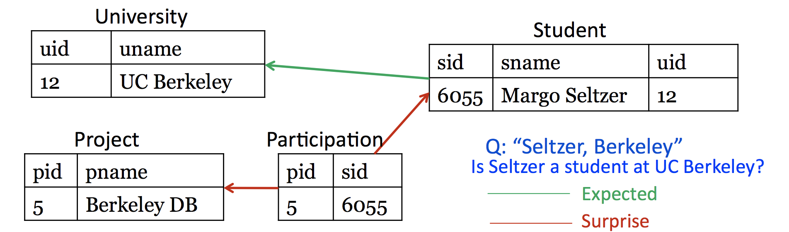
Examples (from original papers)
May be one way of reaching all keywords
BANKS: Keyword search…
Multi-Query Optimization
paper
writes
Soumen
Sudarshan
Prasan Roy
author
Or multiple ways

Slide 18
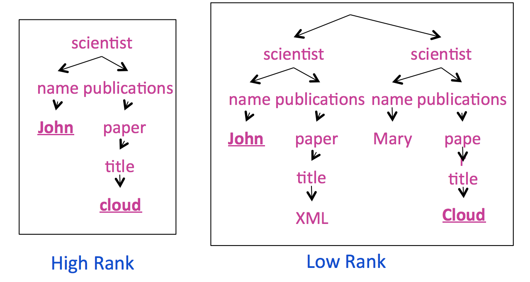
How to rank these?
Simple rule: Longer paths are worse

