Slide 1
Making Database Systems Usable
Presented by: Assma Boughoula
CS 598 Fall 2017

Slide 2
“As computer scientists,…we are not typical database users.”
User
DB Admin Person
DB

Slide 3
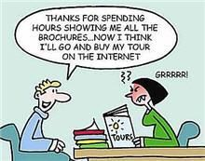
“As computer scientists,…we are not typical database users.”
User
DB Admin Person
DB

Slide 4
“As computer scientists,…we are not typical database users.”
User
Google??
DB Admin Person
DB

Slide 5
Web search vs DB querying
Keyword search is sufficient
At least some relevant results
Result is set of links
More sophisticated queries that make use of DB structure
Complete & perfect precision results
Structured results
Ability to create/update DBs

Slide 6
What’s out there today?
Visual Interface:
Polaris, Zenvisage, ImMens, DataPlay?
Form-based
Text Interface:
keyword search across tuples
natural language queries & extracting hidden semantic structure of query
Context & Personalization:
Mine query logs to discover user characteristics
Interpret queries in context of previous queries

Slide 7
What’s out there today?
Visual Interface:
Polaris, Zenvisage, DataPlay?
Form-based
Text Interface:
keyword search across tuples
natural language queries & extracting hidden semantic structure of query
Context & Personalization:
Mine query logs to discover user characteristics
Interpret queries in context of previous queries

Slide 8
What’s out there today?
Visual Interface:
Polaris, Zenvisage, ImMens, DataPlay?
Form-based
Text Interface:
keyword search across tuples
natural language queries & extracting hidden semantic structure of query
Context & Personalization:
Mine query logs to discover user characteristics
Interpret queries in context of previous queries

Slide 9
What’s out there today?
Visual Interface:
Polaris, Zenvisage, ImMens, DataPlay?
Form-based
Text Interface:
keyword search across tuples
natural language queries & extracting hidden semantic structure of query
Context & Personalization:
Mine query logs to discover user characteristics
Interpret queries in context of previous queries

Slide 10
The MiMI adventure
Started as application for Timber (usability not on the horizon)
MiMI integrated several protein interactions DBs

Slide 11
The MiMI adventure
Started as application for Timber (usability not on the horizon)
MiMI integrated several protein interactions DBs
Biologists MiMI Usability Issues

Slide 12
The MiMI adventure
Proficient
Technophobe
Middle
XQuery
MQuery
Form-based UI
MiMI

Slide 13
The MiMI adventure
MiMI schema too complex…
XQuery
MQuery
Form-based UI
MiMI

Slide 14
The MiMI adventure
Some users preferred keyword search…
Schema-Free XQuery
Schema Summary
XQuery
MQuery
Form-based UI
MiMI

Slide 15
The MiMI adventure
Users misspelled keywords…
Key-word based search across tuples
Schema-Free XQuery
Schema Summary
XQuery
MQuery
Form-based UI
MiMI

Slide 16
The MiMI adventure
Autocompletion
Users wanted to use English language to query…
Key-word based search
Schema-Free XQuery
Schema Summary
XQuery
MQuery
Form-based UI
MiMI

Slide 17
The MiMI adventure
Autocompletion
Users couldn’t explore data directly in graphical setting
DaNaLIX
Key-word based search
NaLIX
Schema-Free XQuery
Schema Summary
XQuery
MQuery
Form-based UI
MiMI

Slide 18
The MiMI adventure
Autocompletion
Still:
Inconsistencies between interfaces
Inputting new data is difficult
DaNaLIX
Key-word based search
NaLIX
Schema-Free XQuery
Schema Summary
Cytoscape
XQuery
MQuery
Form-based UI
MiMI

Slide 19
Why are DB systems so frustrating for users?
The Five Pains:
Painful Relations
Painful Options
Unexpected Pain
Unseen Pain
Birthing Pain

Slide 20
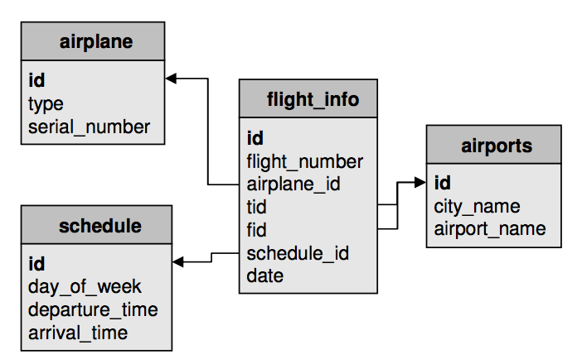
Painful Relations
Normalization is central in RDBMS, but:
No concept of “flight” → painful to locate a specific piece of data
Painful to compute joins
Painful to express queries across multiple tables
Notes:
“Find all flights from Detroit to Beijing”
Normalization saves space

Slide 21
Painful Options
Too much functionality leads to:
Irrelevant options competing with relevant options
Regret for “paths not taken”
Must simplify querying for novices & provide experts with necessary tools
Notes:
Apple Inc. example
“It is not the number of offers that counts, but rather the quality of the one offer that you accept.”
Choosing which options to keep is difficult: “what do users want?”

Slide 22
Unexpected Pain
When users’ mental data model does not match actual data model:
Unable to Query:
Forced to specify date without knowing why
Unexpected Results:
Where it came from?
Why that result?
Must provide explanations to users
Notes:
Example 2. Consider a world traveler who has infinite flexibility, many destinations to visit but limited money. She visits her favorite airline reservation site, and chooses “Flex- ible Dates”. After filling in a bit more information, she at- tempts to specify multiple stops. Suddenly, she is forced to enter fixed dates into the system!
Example 3. A user books a trip through the airline reser- vation system and requests lowest fare and a window seat. However, the system keeps giving him an aisle seat without any error message. Where does the aisle seat come from? Is it from the pool of general seats or is it from the pool of seats with the lowest fare?
Example 4. A user, looking for an escape, peruses the list of cheap flights provided by her favorite airline. She can get to Los Angeles for $75, Boston for $100 and San Francisco for $400. Why is San Francisco on this list? It is not a particularly cheap fare, but it must have satisfied some criteria to be placed there.

Slide 23
Unseen Pain
Querying requires prediction by user
Prediction is difficult for novices
Want WYSIWYG for DB
Want query refined as it’s being typed
Must shift prediction load from user to system
Notes:
Querying requires prediction by user

Slide 24
Birthing Pain
Creating/updating DBs is painful
Understanding/designing DB schema is painful
Final structure may be unknown
Structure may be heterogeneous
Must provide interfaces to easily create and fluidly manipulate the structure
Notes:
Example 5. Consider our user, Jane, who started to keep track of her shopping lists. The first list she created simply contained a list of items and quantities of each to be pur- chased. After the first shopping trip, Jane realized that she needed to add price information to the list to monitor her expenses and she also started marking items that were not in stock at the store. A week before Thanksgiving, Jane created another shopping list. However, this time, the items were gifts to her friends, and information about the friends there- fore needed to be added to create this “gift list.” A week after Christmas, Jane started to create another “gift list” to track gifts she received from her friends. However, the friends in- formation were now about friends giving her gifts. In the end, what started as a simple list of items for Jane had be- come a repository of items, stores, and more importantly, friends – an important part of Jane’s life.

Slide 25
Which Pain still hurts?
Polaris
Zenvisage
dbTouch
Gestural Query Spec
DataPlay
DataSpread
Painful Relations
Painful Options
Unexpected Pain
Unseen Pain
Birthing Pain
Notes:
Polaris: joins
Zenvisage:
dbTouch: unseen, birthing
Gestural : unexpected(unable to query)
Dataplay:
Dataspread:

