Slide 1
MAD skills: New Analysis Practices for Big Data 2009
CS598 Yue Sun (yuesun3)

Slide 2
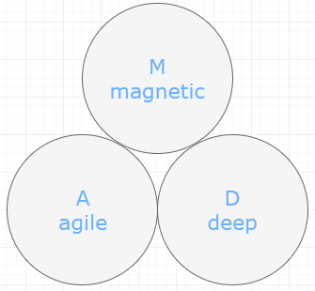

Trend: collect, leverage data in multiple organizational units
Data:
Fox Audience Network
using Greenplum parallel database system
Motivation ?
Cheap storage
Growing number of large-scale databases
Value of data analysis
Complement statisticians with software skills

Slide 3
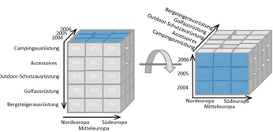
background
EDW
enterprise data warehouse
Problems?
discourage integration of uncleaned new data sources
“architected environment”
Based on long-range design and planning
Limited statistical functionalities
Require data to fit in RAM
OLAP & data cubes
Provides descriptive statistics

Slide 4




Background continue…
MapReduce and Parallel programming
Data-parallel fashion via summations
Data mining and Analytics
correspond to only statistical libraries that ship with a stat package
Statistical packages
Spreadsheets

Slide 5
MAD database design
Objectives:
1. get the data into the warehouse as soon as possible 2. intelligent cleaning of data 3. intelligent integration of data
3 layer approach
1. staging schema
2. production data warehouse schema
3. reporting schema

Slide 6
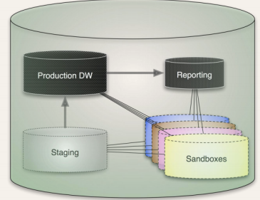
Fourth class of schema: Sandbox
Why sandbox?
used for managing experimental processes 1. track and record work and work products 2. materialize query results and reuse the results later

Slide 7
Data parallel statistics
Layers of abstraction in traditional SQL database
1. Simple arithmetic
2. Vector arithmetic
3. Functions
4. Functionals

Slide 8



Vectors and Matrices
Matrix addition:
Matrix transpose:
Matrix-matrix multiplication

Slide 9

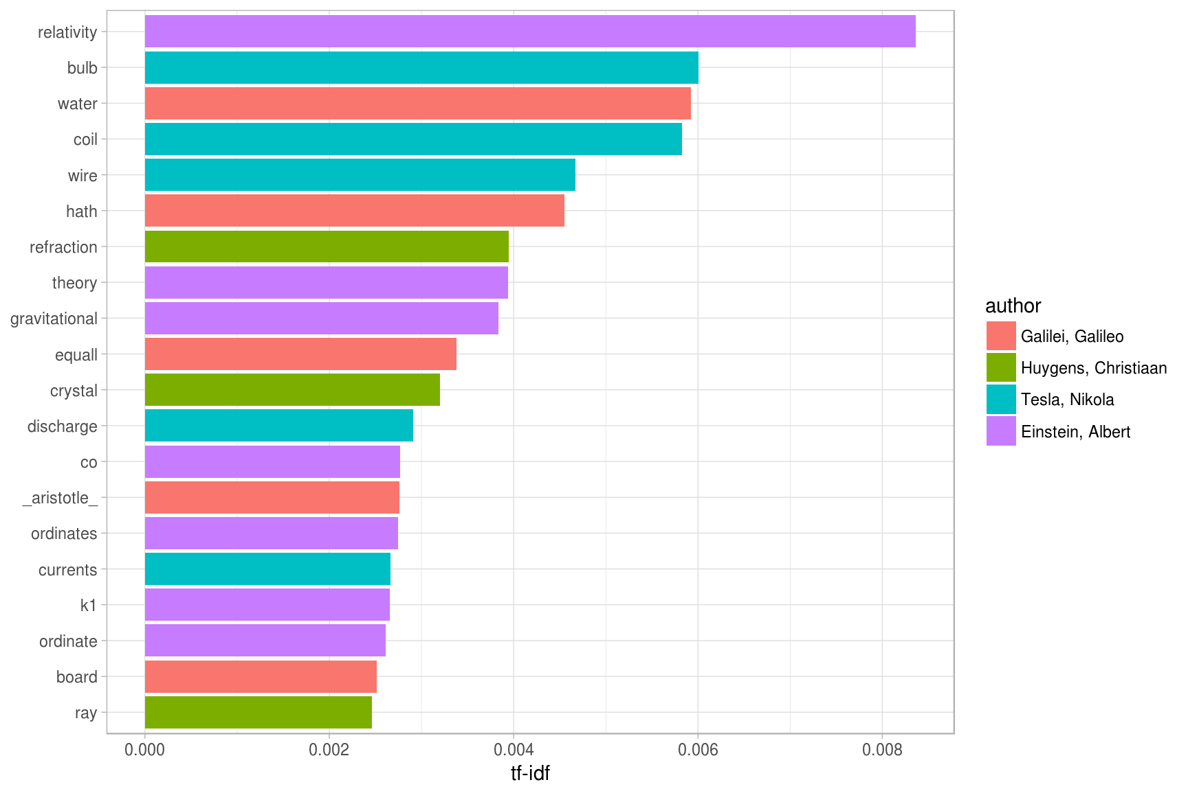
Tf-idf document similarity

Slide 10
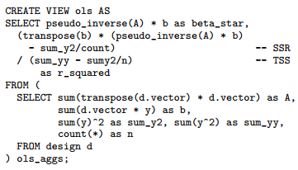
Matrix based analytical methods
Ordinary least squares

Slide 11
Matrix based analytical methods continue…
Conjugate gradient
update alpha(r_i, p_i, A)
update x(x_i, alpha_i, v_i)
update r(x_i, alpha_i, v_i, A)
update v(r_i, alpha_i, v_i, A)
Construction of these functions allow user to insert one full row at a time

Slide 12
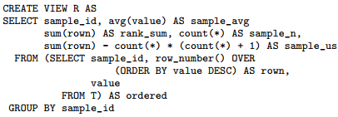
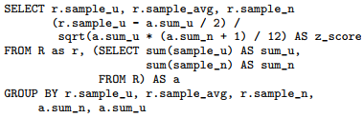
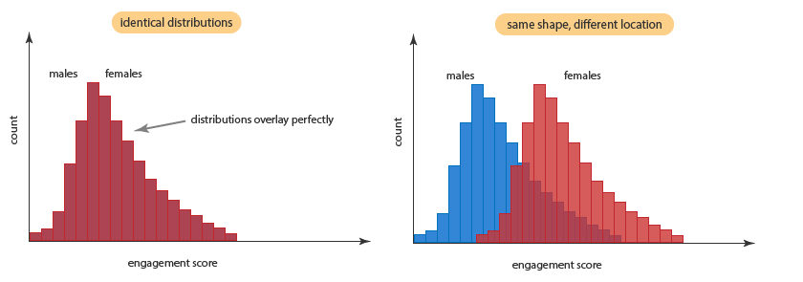
functional: data-parallel implementations of comparative statistics expressed in SQL
Mann-Whitney U Test

Slide 13



Log-likelihood ratios useful for comparing a subpopulation to an overall population on a particular attributed
Example: multinomial distribution

Slide 14

Resampling techniques
2 standard resampling techniques:
1. bootstrap
from a population of size N, pick k members randomly, compute statistic; replace subsample with another k random member…
2. jackknife
Repeatedly compute statistic by leaving out one or more data items

Slide 15
MAD DBMS requirements?
Easy and efficient to put new data source into the warehouse
Make physical storage evolution easy and efficient
Provide powerful, flexible programming environment

Slide 16
Storage and partitioning
Require multiple storage mechanisms
1. [early stage]
iterate over tasks frequently; load databases quickly; allow users to run queries directly against external tables
2. [for “detail tables”]
well served by traditional transactional storage techniques
3. [for fact tables]
better served by compressed storage because it handles appends and reads more efficiently

Slide 17

MAD DBMS
loading & unloading
Parallel access for external tables via Scatter/Gather Streaming
Require coordination with external processes to “feed” in parallel
More
Support transformations written in SQL
Support MapReduce scripting in DBMS

Slide 18
MAD DBMS
Support external tables
traditional “heap” storage format for frequent updates data
Highly-compressed “append-only” (AO) table feature for data with no updates
With compression off: bulk loads run quickly
With most aggressive compression: use as little space as possible
With medium compression: improved table scan time with slower loads

Slide 19
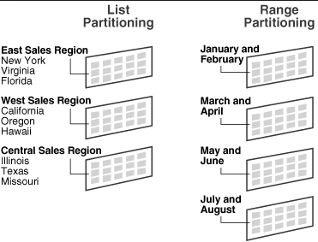
MAD DBMS
Multiple ways to partition tables:
distribution policy
partitioning policy (for a table)
range partitioning policy
list partitioning policy
Note that partitioning structure is completely mutable
Partition

