Slide 1



OrpheusDB: Bolt-on Versioning for Relational Databases
Silu Huang¹, Liqi Xu¹, Jialin Liu¹, Aaron J. Elmore², Aditya Parameswaran¹
¹University of Illinois (UIUC) ²University of Chicago

Slide 2

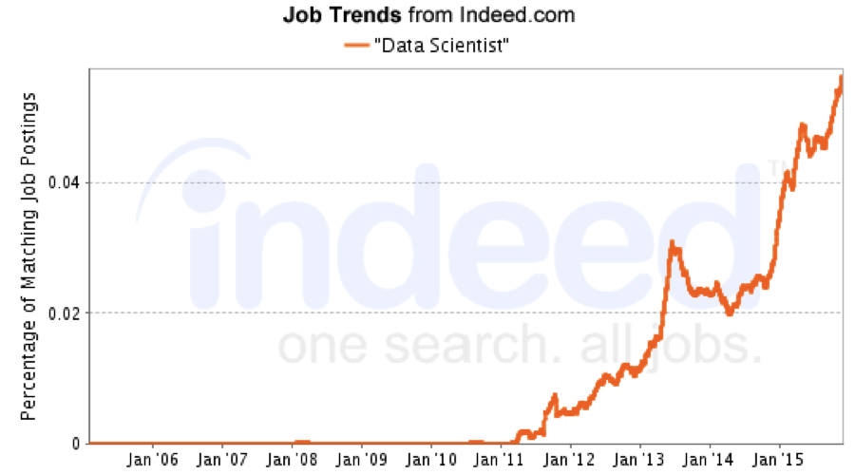


Motivation: Dataset Versioning
Data Science is Popular
Dataset Versioning Arises

Slide 3

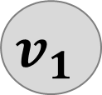
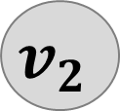



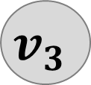


Motivation: Example from Biological Domain
 |  | Neighborhood | Cooccurrence
ENSP1 | ENSP2 | 0 | 53
ENSP1 | ENSP3 | 0 | 87
ENSP4 | ENSP5 | 426 | 0
Protein1
Protein2
Download and Analyze
$$v_{5}$$
$$v_{7}$$
$$v_{1}$$
$$v_{2}$$
$$v_{4}$$
$$v_{6}$$
$$v_{8}$$
Add New
Record/Column
Non-Linear Process
Hundred to Thousand of Versions
$$v_{3}$$
Correct and Curate
Merge Back

Slide 4


Versioned Dataset Management In the Wild
Shared System/Folder: everyone can access
Massive Redundancy
No True Collaboration
No Querying Capability
Make Private Copies, Modify, Analyze, and Integrate back.

Slide 5
Existing Management Systems: Alternatives
I. SC-VC, GitHub
II. Temporal Databases
Cannot scale to large dataset
Limited functionalities
Only support a linear chain of versions
“Bolt-on” Approach ?
III. Decibel [1], DEX [2]
Build “from the ground up”
No parser, query optimizer, transaction manager for now
[1] Decibel: The relational dataset branching system. PVLDB 2016.
[2] DEX: Query Execution in a Delta-based Storage System. SIGMOD 2017

Slide 6

Bolt-on Versioning: “Reuse” Relational Databases
Issues to address:
Client
SQL Commands
Version Control Commands
How to Support Compact Storage?
How to Support True Collaboration?
Allow branching, checkout, commit, merge
How to Support Advanced Querying?
Issue query against versioning provenance
Identify versions satisfying some property
Show aggregate statistics across versions
Versioning Layer
Unmodified DBMS

Slide 7
Bolt-on Versioning: “Reuse” Relational Databases
Issues to address:
Client
SQL Commands
Version Control Commands
How to Support Compact Storage?
Data Representation
How to Support True Collaboration?
Allow branching, checkout, commit, merge
How to Support Advanced Querying?
Issue query against versioning provenance
Identify versions satisfying some property
Show aggregate statistics across versions
Versioning Layer
Unmodified DBMS

Slide 8
Outline
Strawman Approach
Data Representation
Access/Storage Optimization

Slide 9
Strawman Approach : Issues
Augment each tuple with a version ID (VID)
 |  | Neighborhood | Cooccurrence
ENSP1 | ENSP2 | 0 | 53 | V1
ENSP1 | ENSP2 | 0 | 53 | V2
ENSP1 | ENSP2 | 225 | 53 | V3
ENSP1 | ENSP3 | 0 | 87 | V1
ENSP1 | ENSP3 | 0 | 87 | V2
ENSP1 | ENSP3 | 0 | 87 | V3
ENSP4 | ENSP5 | 426 | 0 | V1
ENSP4 | ENSP5 | 426 | 36 | V3
Two Issues
Protein1
Protein2
VID
1. Storage is Huge
Optimized Representation Scheme
2. Checkout is Costly
Partition Scheme

Slide 10
Outline
Strawman Approach
Data Representation
Access/Storage Optimization

Slide 11
Data Representation: Alternatives
 |  | Neighborhood | Cooccurrence
ENSP1 | ENSP2 | 0 | 53 | V1
ENSP1 | ENSP2 | 0 | 53 | V2
ENSP1 | ENSP2 | 225 | 53 | V3
ENSP1 | ENSP3 | 0 | 87 | V1
ENSP1 | ENSP3 | 0 | 87 | V2
ENSP1 | ENSP3 | 0 | 87 | V3
ENSP4 | ENSP5 | 426 | 0 | V1
ENSP4 | ENSP5 | 426 | 36 | V3
 |  | Neighborhood | Cooccurrence
ENSP1 | ENSP2 | 0 | 53 | {V1,V2}
ENSP1 | ENSP2 | 225 | 53 | {V3}
ENSP1 | ENSP3 | 0 | 87 | {V1,V2,V3}
ENSP4 | ENSP5 | 426 | 0 | {V1}
ENSP4 | ENSP5 | 426 | 36 | {V3}
Protein1
Protein2
VID
Protein1
Protein2
Vlist
(b) Combined Table
Commit is Costly
Example:
Clone V3 as V4
(a) Table with Versioned Records
Storage is Huge

Slide 12
Data Representation: Alternatives
 |  | Neighborhood | Cooccurrence
ENSP1 | ENSP2 | 0 | 53 | V1
ENSP1 | ENSP2 | 0 | 53 | V2
ENSP1 | ENSP2 | 225 | 53 | V3
ENSP1 | ENSP3 | 0 | 87 | V1
ENSP1 | ENSP3 | 0 | 87 | V2
ENSP1 | ENSP3 | 0 | 87 | V3
ENSP4 | ENSP5 | 426 | 0 | V1
ENSP4 | ENSP5 | 426 | 36 | V3
 |  | Neighborhood | Cooccurrence
ENSP1 | ENSP2 | 0 | 53 | {V1,V2}
ENSP1 | ENSP2 | 225 | 53 | {V3,V4}
ENSP1 | ENSP3 | 0 | 87 | {V1,V2,V3,V4}
ENSP4 | ENSP5 | 426 | 0 | {V1}
ENSP4 | ENSP5 | 426 | 36 | {V3,V4}
Protein1
Protein2
VID
Protein1
Protein2
Vlist
(b) Combined Table
Commit is Costly
Example:
Clone V3 as V4
(a) Table with Versioned Records
Storage is Huge

Slide 13










Data Representation: Alternatives
R1 | {V1,V2}
R2 | {V3}
R3 | {V1,V2,V3}
R4 | {V1}
R5 | {V3}
RID
Vlist
Commit is Costly
 |  |  | Neighborhood | Cooccurrence
R1 | ENSP1 | ENSP2 | 0 | 53
R2 | ENSP1 | ENSP2 | 225 | 53
R3 | ENSP1 | ENSP3 | 0 | 87
R4 | ENSP4 | ENSP5 | 426 | 0
R5 | ENSP4 | ENSP5 | 426 | 36
RID
Protein1
Protein2
$${ R}_{1}$$
$${ v}_{1}$$
$${ R}_{2}$$
$${ v}_{2}$$
$${ R}_{3}$$
(i) Split-by-Vlist
$${ R}_{4}$$
V1 | {R1,R3,R4}
V2 | {R1,R3}
V3 | {R2,R3,R5}
VID
Rlist
$${ v}_{3}$$
$${ R}_{5}$$
(c) Data Table + Versioning Table
Mapping between Records and Versions
Experiments in the Paper
(ii) Split-by-Rlist

Slide 14
Outline
Strawman Approach
Data Representation
Access/Storage Optimization

Slide 15
Access and Storage Trade Off: Partitioning
Checkout Latency increases
As “Irrelevant” records increase
Records scatter across the table
 |  |  | Neighborhood | Cooccurrence
R1 | ENSP1 | ENSP2 | 0 | 53
R2 | ENSP1 | ENSP2 | 225 | 53
R3 | ENSP1 | ENSP3 | 0 | 87
R4 | ENSP4 | ENSP5 | 426 | 0
R5 | ENSP4 | ENSP5 | 426 | 36
R6 | ENSP1 | ENSP3 | 169 | 87
R7 | ENSP6 | ENSP7 | 207 | 35
V1 | {R1,R3,R4}
V2 | {R1,R3}
V3 | {R2,R3,R5}
V4 | {R2,R5,R6}
V5 | {R1,R3,R7}
VID
Rlist
RID
Protein1
Protein2
Checkout V5
Access EntireTable
(7 Records)

Slide 16


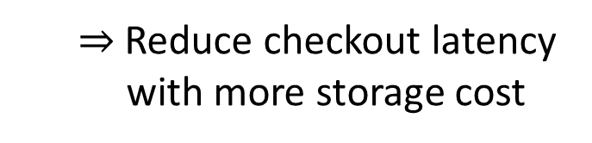
Access and Storage Trade Off: Partitioning
Our Approach: Partitioning
Break up the table into partitions
 |  |  | Neighborhood | Cooccurrence
R2 | ENSP1 | ENSP2 | 225 | 53
R3 | ENSP1 | ENSP3 | 0 | 87
R5 | ENSP4 | ENSP5 | 426 | 36
R6 | ENSP1 | ENSP3 | 169 | 87
V3 | {R2,R3,R5}
V4 | {R2,R5,R6}
VID
Rlist
RID
Protein1
Protein2
$⇒$ Reduce checkout latency
with more storage cost
$$P_{1}$$
Repeated
V1 | {R1,R3,R4}
V2 | {R1,R3}
V5 | {R1,R3,R7}
 |  |  | Neighborhood | Cooccurrence
R1 | ENSP1 | ENSP2 | 0 | 53
R3 | ENSP1 | ENSP3 | 0 | 87
R4 | ENSP4 | ENSP5 | 426 | 0
R7 | ENSP6 | ENSP7 | 207 | 35
VID
Rlist
RID
Protein1
Protein2
Checkout V5
Access Smaller Table
(4 Records)
$$P_{2}$$

Slide 17



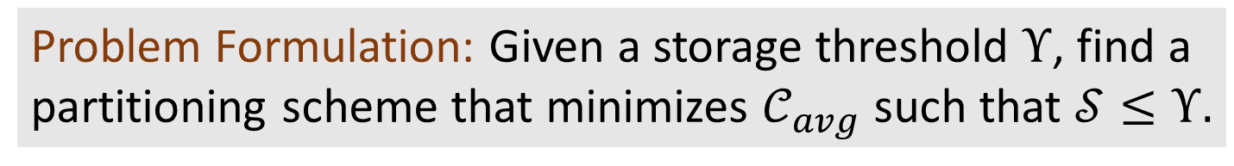
Access and Storage Trade Off: Cost Model
Storage Cost $𝒮$
Average Checkout Cost $𝒞_{avg}$
Total # of records in all partitions
Checkout cost for version $v_{i}:$
the size of the partition $v_{i}$ belongs to
$𝒞_{avg}$: checkout cost across all versions, divided by # of versions
NP-Hard! (Reduction from 3-Partition)
Problem Formulation: Given a storage threshold $Υ$, find a partitioning scheme that minimizes $𝒞_{avg}$ such that $𝒮≤Υ.$

Slide 18



Access and Storage Trade Off: Two Extremes
All in One Table
Each Version as One Table
Smallest Storage Cost $𝒮^{∗}$
Smallest Average Checkout Cost${ 𝒞}_{avg}^{∗}$

Slide 19
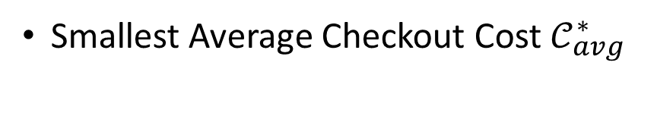





Access and Storage Trade Off: Two Extremes
All in One Table
Each Version as One Table
Smallest Storage Cost $𝒮^{∗}$
Smallest Average Checkout Cost${ 𝒞}_{avg}^{∗}$
$$𝒞_{avg}$$
Single Partition
Intuition:
Group Similar Versions
Optimal Scheme
$${ 𝒞}_{avg}^{∗}$$
Partition Per Version
$$𝒮^{∗}$$
$$Υ$$
$$𝒮$$

Slide 20









Partitioning: LyreSplit
Clustering Approach
Group versions with similar records together
$⇒$ Need to examine every single record; Costly
~10M Records
vs. ~1K Versions
LyreSplit: Operate on Version Graph
$⇒$ Light-Weight
$${ v}_{1}$$
7
6
4
Encodes the derivation information
Indicates similarity among versions
8
$${ v}_{2}$$
$${ v}_{3}$$
10
6
8
6
7
$${ v}_{4}$$
$${ v}_{5}$$
$${ v}_{6}$$
$${ v}_{7}$$
30
12
10
8

Slide 21



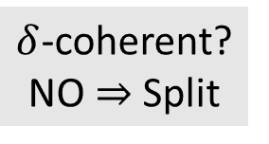
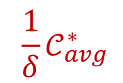
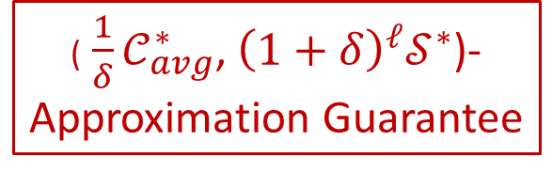







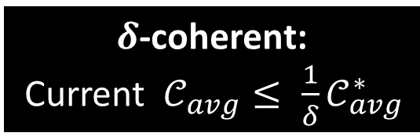
Partitioning: High-level Idea of LyreSplit
$${ v}_{1}$$
7
$$𝒞_{avg}$$
Single Partition
6
4
$δ$-coherent? NO $⇒$ Split
8
$${ v}_{2}$$
$${ v}_{3}$$
10
6
8
6
7
$${ \frac{1}{δ}𝒞}_{avg}^{∗}$$
$${ v}_{4}$$
$${ v}_{5}$$
$${ v}_{6}$$
$${ v}_{7}$$
30
12
10
8
$$𝒮^{∗}$$
$$𝒮$$
$δ$-coherent:
Current $𝒞_{avg}{≤ \frac{1}{δ}𝒞}_{avg}^{∗}$
(${ \frac{1}{δ}𝒞}_{avg}^{∗}$, ${\left(1+δ\right)}^{ℓ}𝒮^{∗}$)- Approximation Guarantee

Slide 22






















Partitioning: LyreSplit Illustration
$${ v}_{1}$$
7
$${ v}_{1}$$
7
$${ v}_{1}$$
7
6
4
6
6
8
$${ v}_{2}$$
$${ v}_{3}$$
10
8
$${ v}_{2}$$
$${ v}_{3}$$
10
8
$${ v}_{2}$$
$${ v}_{3}$$
10
6
8
6
7
6
8
6
7
8
6
7
$${ v}_{4}$$
$${ v}_{5}$$
$${ v}_{6}$$
$${ v}_{7}$$
$${ v}_{4}$$
$${ v}_{5}$$
$${ v}_{6}$$
$${ v}_{7}$$
$${ v}_{4}$$
$${ v}_{5}$$
$${ v}_{6}$$
$${ v}_{7}$$
30
12
10
8
30
12
10
8
30
12
10
8

Slide 23
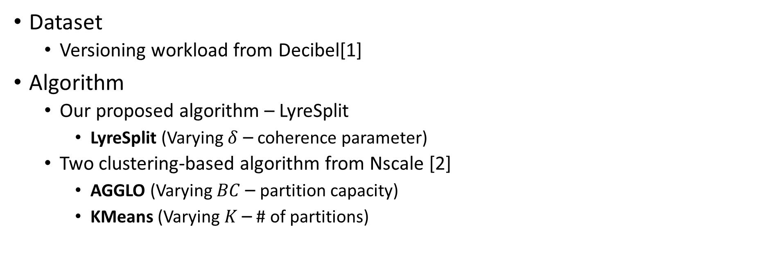
Partitioning: Experimental Setting
Dataset
Versioning workload from Decibel[1]
Algorithm
Our proposed algorithm – LyreSplit
LyreSplit (Varying $δ$ – coherence parameter)
Two clustering-based algorithm from Nscale [2]
AGGLO (Varying $BC$ – partition capacity)
KMeans (Varying $K$ – # of partitions)
[1] Decibel: The relational dataset branching system. PVLDB 2016
[2] NScale: neighborhood-centric large-scale graph analytics in the cloud. VLDB Journal 2016

Slide 24
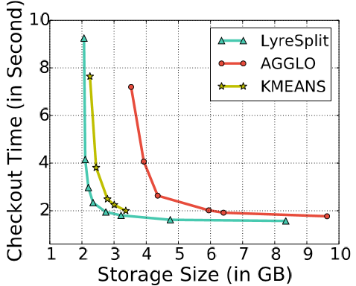
Comparison of Partitioning Algorithms: Effectiveness
Storage: 2.3GB
Checkout: 2.9s
Access and Storage Trade Off

Slide 25
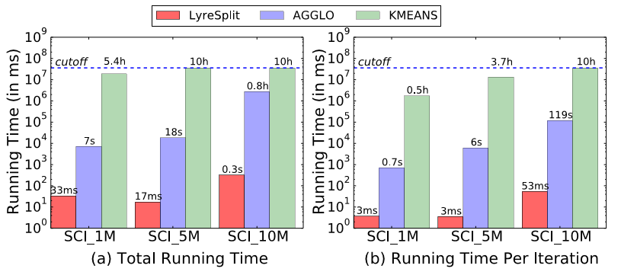
Comparison of Partitioning Algorithms: Efficiency
10³ X faster on average
1M 5M 10M
Dataset Size (# of Records)
Running Time Comparison

Slide 26
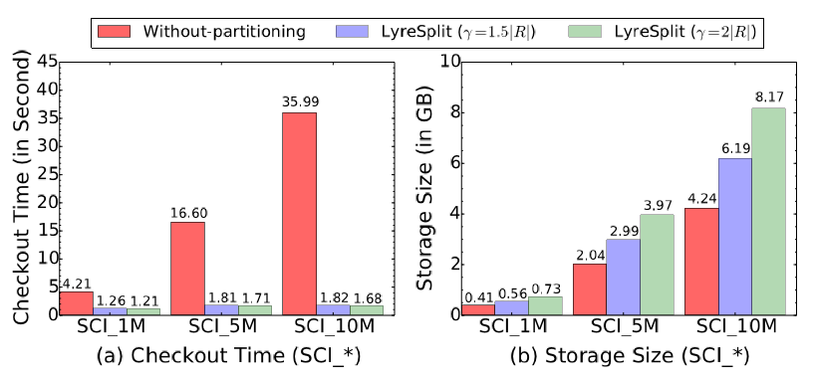
Benefits of Partitioning: Storage vs. Access
Storage:
2X Increase
Checkout:
21X Reduction
1M 5M 10M
1M 5M 10M
Comparison With and Without Partitioning

Slide 27
Summary
Bolt-on versioning for relational databases [OrpheusDB]
Optimized data representation [Split-by-rlist]
Designed partition scheme [LyreSplit]

Slide 28


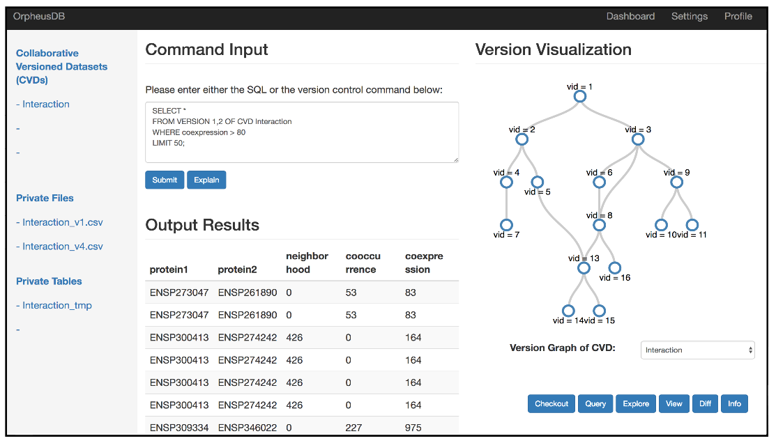
http://orpheus-db.github.io/ [Fully Open-Source]

Slide 29
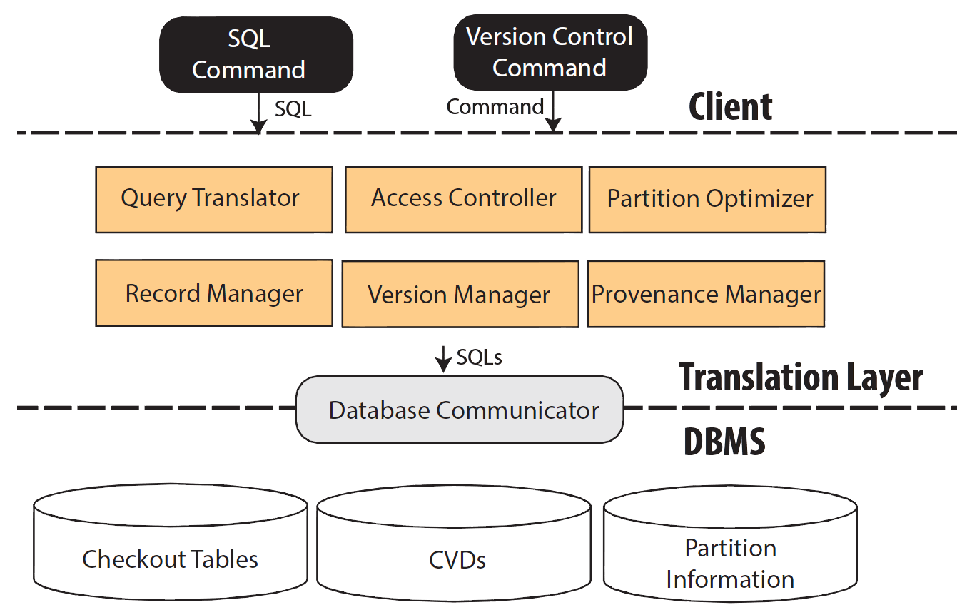
Proposal: “Reuse” Relational Database
Checkout
Commit
Diff
Traditional SQL
Identify Version
Aggregates Across Versions
Translate and Rewrite Query
Optimize Performance
How data is stored

Slide 30
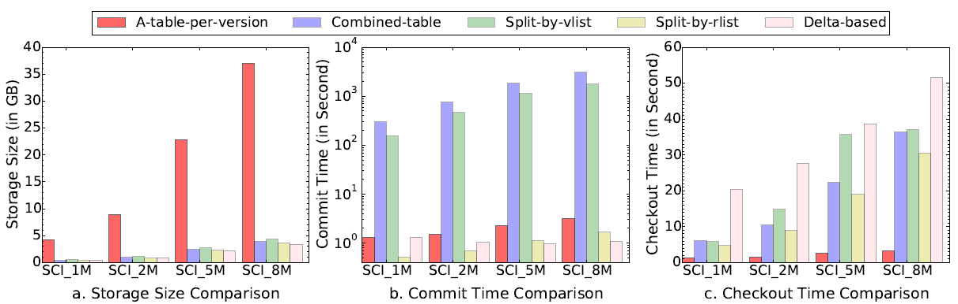
Data Representation: Performance Comparison

Slide 31
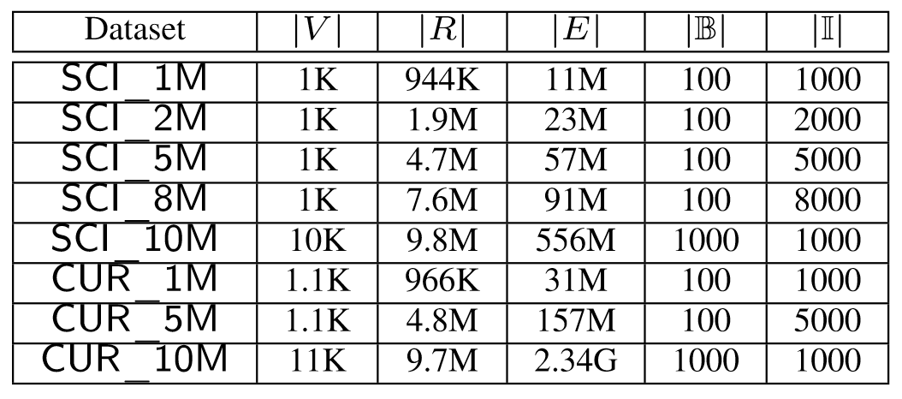
Access and Storage Trade Off: Dataset
# of records
# of branches
Sum of records
In all versions
# of updates from its parent
# of versions
Science Workload
Curation Workload
Versioning Benchmark Datasets [1]
[1] Maddox, Michael, David Goehring, Aaron J. Elmore, Samuel Madden, Aditya Parameswaran, Amol Deshpande. Decibel: The relational dataset branching system. PVLDB 2016

Slide 32
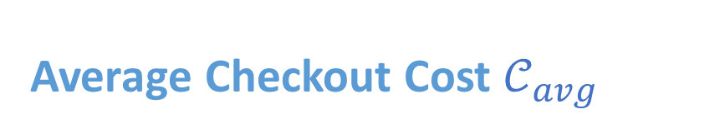



Access and Storage Trade Off: Formulation
Average Checkout Cost $𝒞_{avg}$
Storage Cost $𝒮$
Version $v_{i}∈𝒫_{k}$: $𝒞_{i}=$ ${|ℛ}_{k}|$
$𝒞_{avg}=\frac{\sum_{i}{𝒞_{i}}}{n}=\frac{\sum_{k}{\left|ℛ_{k}\right| {|𝒱}_{k}|}}{n}$
Total # of records in all partitions
$𝒮=\sum_{k}{|ℛ_{k}|}$

Slide 33
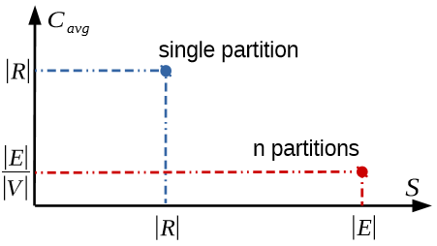


Access and Storage Trade Off: Two Extremes
All in One Table
Each Version as One Table
Storage Cost: $|R|$
Average Checkout Cost: $|R|$
Storage Cost: $|E|$
Average Checkout Cost: $\frac{\sum_{i}{R_{i}}}{n}=\frac{|E|}{n}$

Slide 34
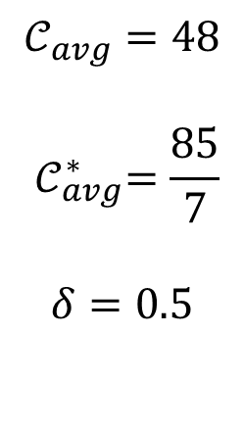
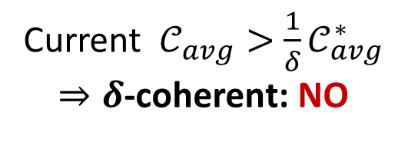







Partitioning: LyreSplit Illustration
$${ v}_{1}$$
7
6
4
$$𝒞_{avg}=48$$
$${ 𝒞}_{avg}^{∗}=\frac{85}{7}$$
$$δ=0.5$$
8
$${ v}_{2}$$
$${ v}_{3}$$
10
Current $𝒞_{avg}>{ \frac{1}{δ}𝒞}_{avg}^{∗}$
$⇒δ$-coherent: NO
6
8
6
7
$${ v}_{4}$$
$${ v}_{5}$$
$${ v}_{6}$$
$${ v}_{7}$$
30
12
10
8

Slide 35
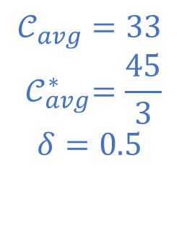







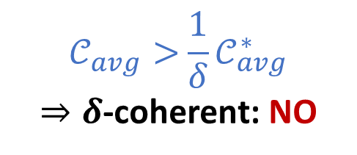
Partitioning: LyreSplit Illustration
$${ v}_{1}$$
7
$${ v}_{1}$$
7
$$𝒞_{avg}=33$$
$${ 𝒞}_{avg}^{∗}=\frac{45}{3}$$
$$δ=0.5$$
$$𝒞_{avg}>{ \frac{1}{δ}𝒞}_{avg}^{∗}$$
$⇒δ$-coherent: NO
6
4
6
8
$${ v}_{2}$$
$${ v}_{3}$$
10
8
$${ v}_{2}$$
$${ v}_{3}$$
10
6
8
6
7
6
8
6
7
$${ v}_{4}$$
$${ v}_{5}$$
$${ v}_{6}$$
$${ v}_{7}$$
$${ v}_{4}$$
$${ v}_{5}$$
$${ v}_{6}$$
$${ v}_{7}$$
30
12
10
8
30
12
10
8

Slide 36
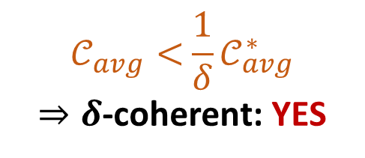
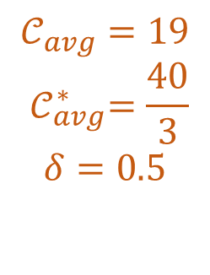
Partitioning: LyreSplit Illustration
$${ v}_{1}$$
7
$${ v}_{1}$$
7
$$𝒞_{avg}=33$$
$${ 𝒞}_{avg}^{∗}=\frac{45}{3}$$
$$δ=0.5$$
$$𝒞_{avg}>{ \frac{1}{δ}𝒞}_{avg}^{∗}$$
$⇒δ$-coherent: NO
6
4
6
8
$${ v}_{2}$$
$${ v}_{3}$$
10
8
$${ v}_{2}$$
$${ v}_{3}$$
10
6
8
6
7
6
8
6
7
$$𝒞_{avg}=19$$
$${ 𝒞}_{avg}^{∗}=\frac{40}{3}$$
$$δ=0.5$$
$$𝒞_{avg}<{ \frac{1}{δ}𝒞}_{avg}^{∗}$$
$⇒δ$-coherent: YES
$${ v}_{4}$$
$${ v}_{5}$$
$${ v}_{6}$$
$${ v}_{7}$$
$${ v}_{4}$$
$${ v}_{5}$$
$${ v}_{6}$$
$${ v}_{7}$$
30
12
10
8
30
12
10
8

