Slide 1
dbTouch: Analytics at your Fingertips
Authors: Stratos Idreos, Erietta Liarou
Presenter: Peter Liu

Slide 2
Introduction
Brief Overlook
Motivation: Interactive Data Exploration
Vision: dbTouch
Interface: Touch Input
Challenges: From Gestures to Query Processing
Exploiting dbTouch
Interactive Exploration
Front-end
Slide to Explore
From Touch to Tuple Identifiers
Data Access and Touch Granularity
Storing and Accessing Data
Interactive Summaries
Schema and Storage Layout Gestures
Query Plans and Complex Queries
dbTouch Prototype
Challenges and Opportunities

Slide 3
The Big Data Era
Exploit the map reduce and the cloud paradigms [1, 12, 34, 2, 38, 32]
Database kernels for approximate query processing [3, 31, 40]
Adaptive indexing [26, 27, 28, 18, 16, 29]
Adaptive data loading [24, 4]
High performance column-store [43, 8, 25]
Hybrid database kernels [6, 30, 11, 17, 13]
Crowdsourcing and anthropocentric systems [35, 15, 39, 14, 44]
Crowdscreen: algorithms for filtering data with humans. (39)
Crowddb: answering queries with crowdsourcing (15)
Exploitation of modern hardware [20, 10, 36, 7]
Usability [37]
Energy aware system [21, 33]

Slide 4
Motivation: Interactive Data Exploration
When we are in search for interesting patterns often not knowing a priori exactly what we are looking for.
An astronomer wants to browse parts of the sky to look for interesting effects.
A data analyst of an IT business browses daily data of monitoring streams to figure out user behavior patterns.
Identifying candidate features for machine learning models.

Slide 5
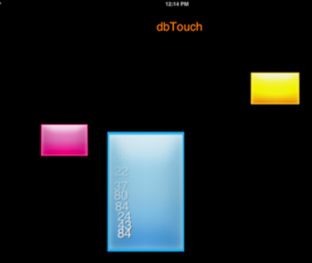
Vision: dbTouch
Core database research + touch interfaces
Redefine query plan and data flow
Touches and gestures
The database system does not have control anymore on the data flow.
Challenges?

Slide 6
Touch Input
IOs from Apple (2008), Android from Google, Windows 8 from Microsoft and WebOS from Palm
Simplicity and interactive
More people use and interact with touch interfaces.
New kinds of applications appear.

Slide 7
Challenge: From Gestures to Query Processing
Database architectures and visualization
Translation:
How we translate touch gestures to database query processing algorithms/operators?
How we translate different gestures speed or movement to database processing algorithms/operators?
Interactive and continuously changing mode
The user is now in control of the data flow.
Optimization:
How we avoid stalling when a user giving interactive requests?
Efficiently access, prefetch and precompute

Slide 8
Contribution
The vision of dbTouch system
Algorithms and functionalities for several basic gestures
Optimizations, challenges and opportunities
First implementation, evaluation and demo of an early prototype

Slide 9
dbTouch: Interactive Exploration
Interactive Exploration
Quality of the data
Possible patterns and properties
Interactive feeling (touching the data)
Incremental and adaptive
Requirements:
Low level query processing action
Visualization techniques

Slide 10
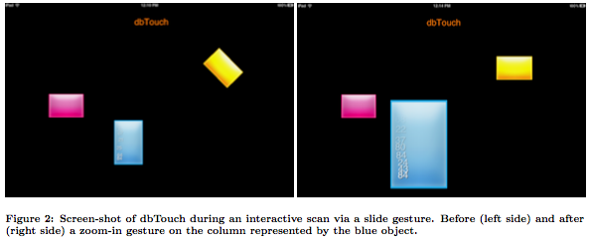
dbTouch: Front-end
Question: what users experience and what they expect when interacting with a dbTouch system?
Data Objects
Schema-less Querying

Slide 11
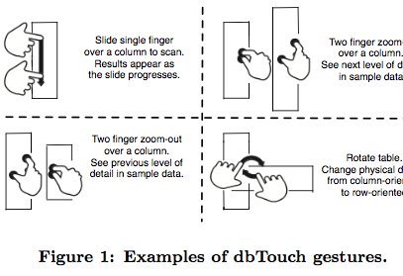
dbTouch: Slide to Explore
Slide
What are the challenges here?
Data storage and data access decisions
Scan and Aggregates
Slide speed
Data object size
Exact area touched
Query Processing
Which operation in traditional database kernels is equivalent to the slide gesture?
The next operation

Slide 12
dbTouch: Slide to Explore
Slide Example
Inspecting Results
Challenges
How should data be stored and accessed?
What happens when the slide patterns such as speed and directions change?
Which data tuples exactly do we process with every touch?

Slide 13
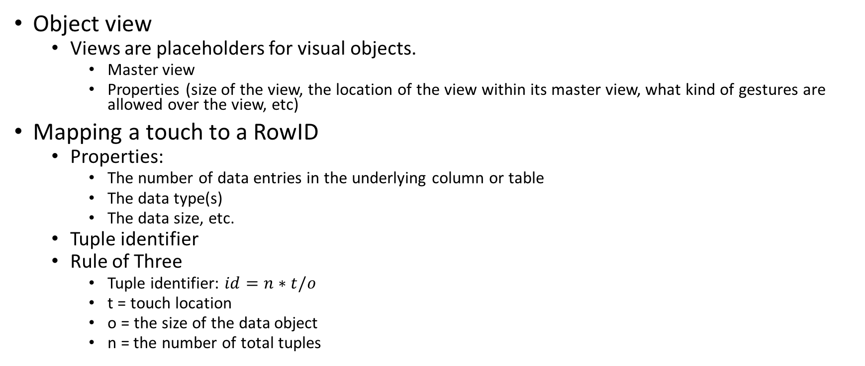
dbTouch: From Touch to Tuple Identifiers
Object view
Views are placeholders for visual objects.
Master view
Properties (size of the view, the location of the view within its master view, what kind of gestures are allowed over the view, etc)
Mapping a touch to a RowID
Properties:
The number of data entries in the underlying column or table
The data type(s)
The data size, etc.
Tuple identifier
Rule of Three
Tuple identifier: $id=n∗t/o$
t = touch location
o = the size of the data object
n = the number of total tuples

Slide 14
dbTouch: From Touch to Tuple Identifiers
Mapping a touch to a RowID
Single column -> height dimension
Full table -> both dimensions
vertical slide
horizontal slide
Rotation

Slide 15
dbTouch: Data Access and Touch Granularity
Touching sample
Physical constraints (what are those?)
Finger size
Object size
Exploration speed
Faster slide -> fewer tuples
Slower slide -> more tuples
Granularity
Zoom-in/Zoom-out

Slide 16
dbTouch: Storing and Accessing Data
Gesture Evolution
Physical Layout
Fixed-width per attribute (Pros? Cons?)
Sample-based Storage
Factors: size of the object and speed of the gesture
Issue: continuous variation
Prefetching Data
Caching Data
Indexing

Slide 17
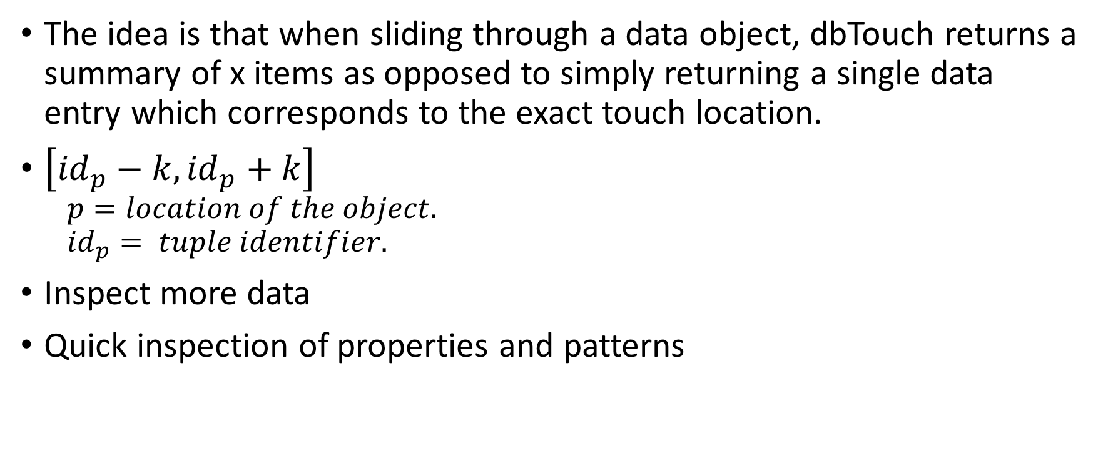
dbTouch: Interactive Summaries
The idea is that when sliding through a data object, dbTouch returns a summary of x items as opposed to simply returning a single data entry which corresponds to the exact touch location.
$\left[{id}_{p}−k,{id}_{p}+k\right]$
$$p=location of the object.$$
$${id}_{p}= tuple identifier.$$
Inspect more data
Quick inspection of properties and patterns

Slide 18
dbTouch: Schema and Storage Layout Gestures
Pan gesture
Group or ungroup
Rotate gesture

Slide 19
dbTouch: Query Plans and Complex Queries
Complex Queries
where, select, join
Joins
Blocking operator
Optimization

Slide 20
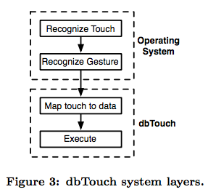
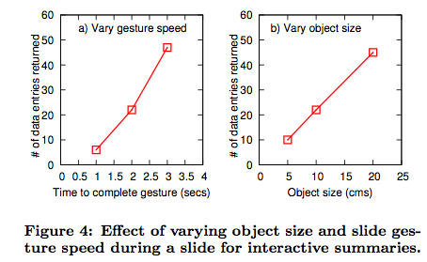
dbTouch Prototype
Implementation
slide or single tap for scan, aggregation and interactive summaries
zoom-in/zoom-out for a more detailed or a more high level exploration.
Evaluation
Varying Gesture Speed
Varying Object Size

Slide 21
Challenges and Opportunities
Interactive Behavior
Data Visualization
Remote Processing
Alternative Interfaces

Slide 22
Related Work
Data Exploration
Online Aggregation
Visual Analytics
Polaris: A system for query, analysis, and visualization of multidimensional relational databases. (41)
Data3

Slide 23

Q&A

