Slide 1
Gestural Query Specification
Arnab Nandi Lilong Jiang Michael Mandel
Saar Kuzi

Slide 2
Gestural Interfaces
Are widely used, given the proliferation of touch-based devices such as smartphones
User
User Interface
Application
Gesture Recognition
Actions Inference
Gesture
Gesture Type + Metadata

Slide 3
Gestural Databases
Gestures performed by the user are mapped to queries
Mapping to queries might be challenging:
Depends on the query language, the schema, and the data
Solution: multi modal interface
Fluidity?
What if the user is not sure what query to use?

Slide 4
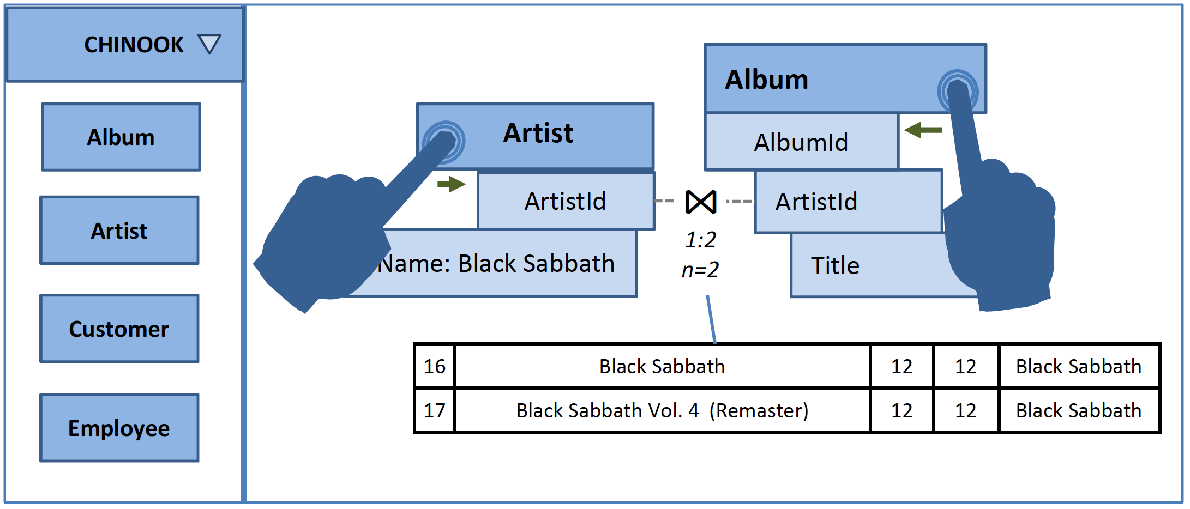
Motivating Example
Task: find the titles of all the albums created by the artist “Black Sabbath”.

Slide 5
Challenges
Interaction is continuous
Different from the query→result interaction
The user expects to receive constant feedback
Direct manipulation interface
Performing actions on the data by interacting with it
The system is expected to guide the user through the process

Slide 6
Query Specification
Query Task: find the titles of all the albums created by the artist “Black Sabbath””
Query Intent Transition
Sequence of Gestures
Query
Intent #1
Drag the Artist relation into the workspace
Query
Context
Query
Intent #2
Select “Black Sabbath”
Query
Intent #3
Bring the Artist and Album relations close to each other
Feedback
The most likely result
Query
Intent #4
Select ArtistId as the join attribute

Slide 7
Gestural Query Language Principles
Data Manipulation
Closure & Composition
Feedback
Expressivity

Slide 8
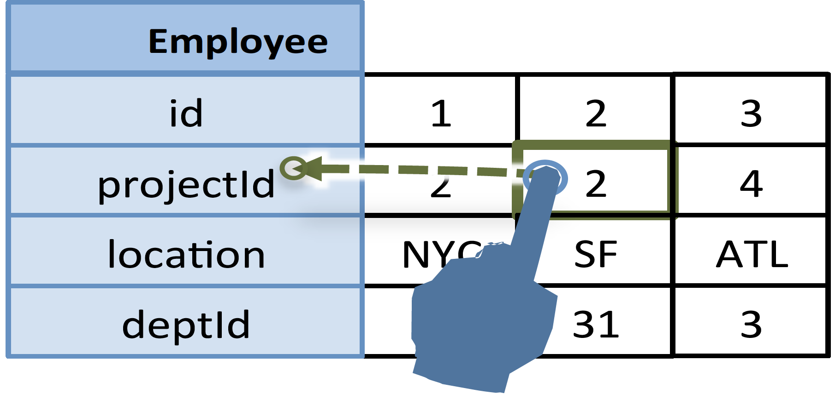
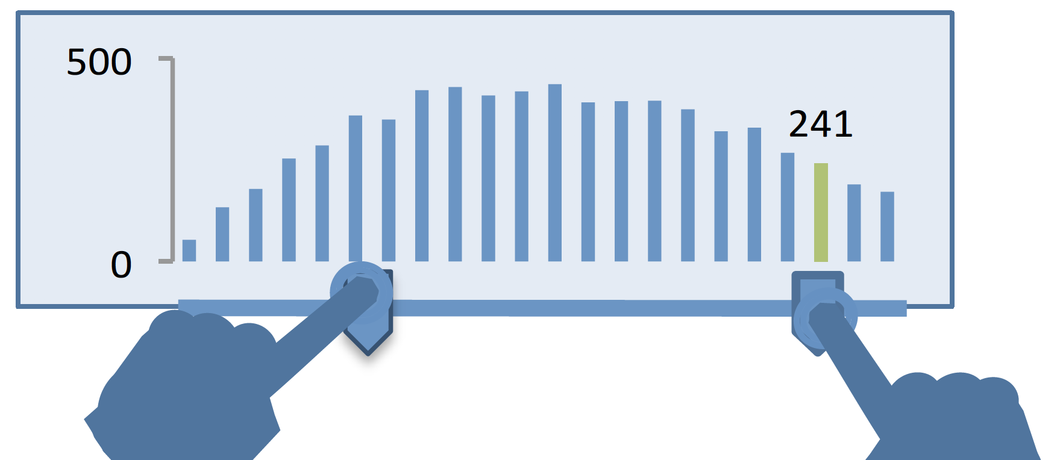
FILTER

Slide 9
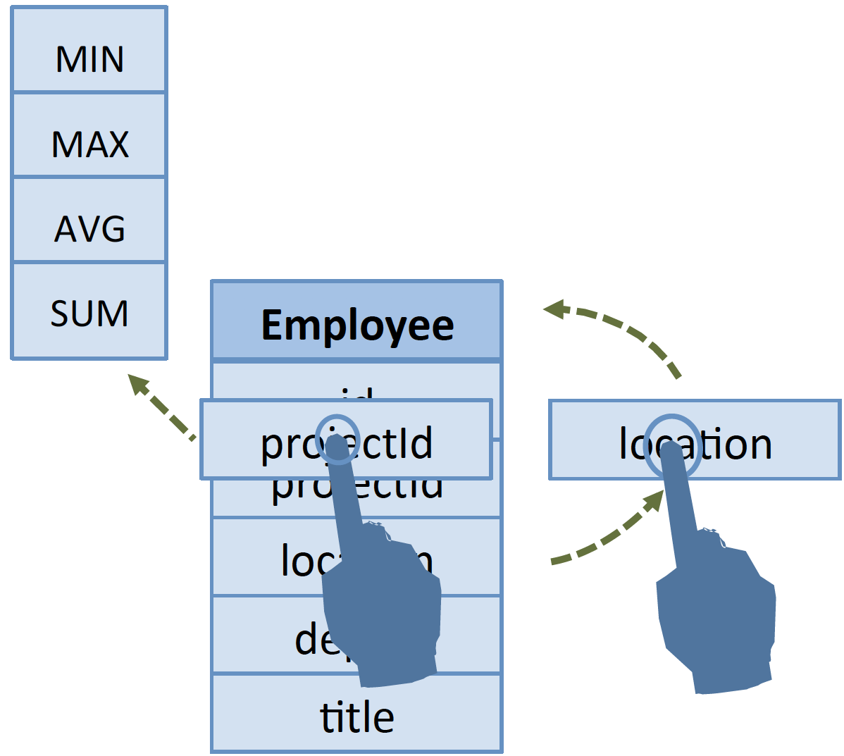
AGGREGATE

Slide 10
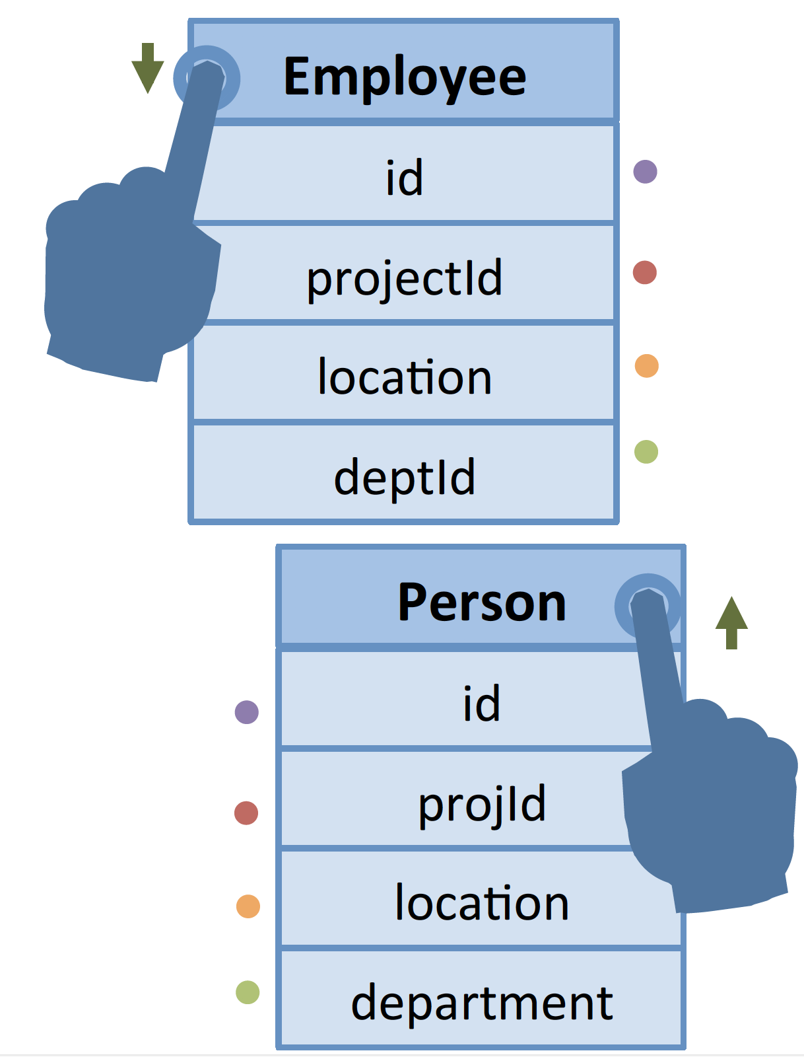
UNION

Slide 11
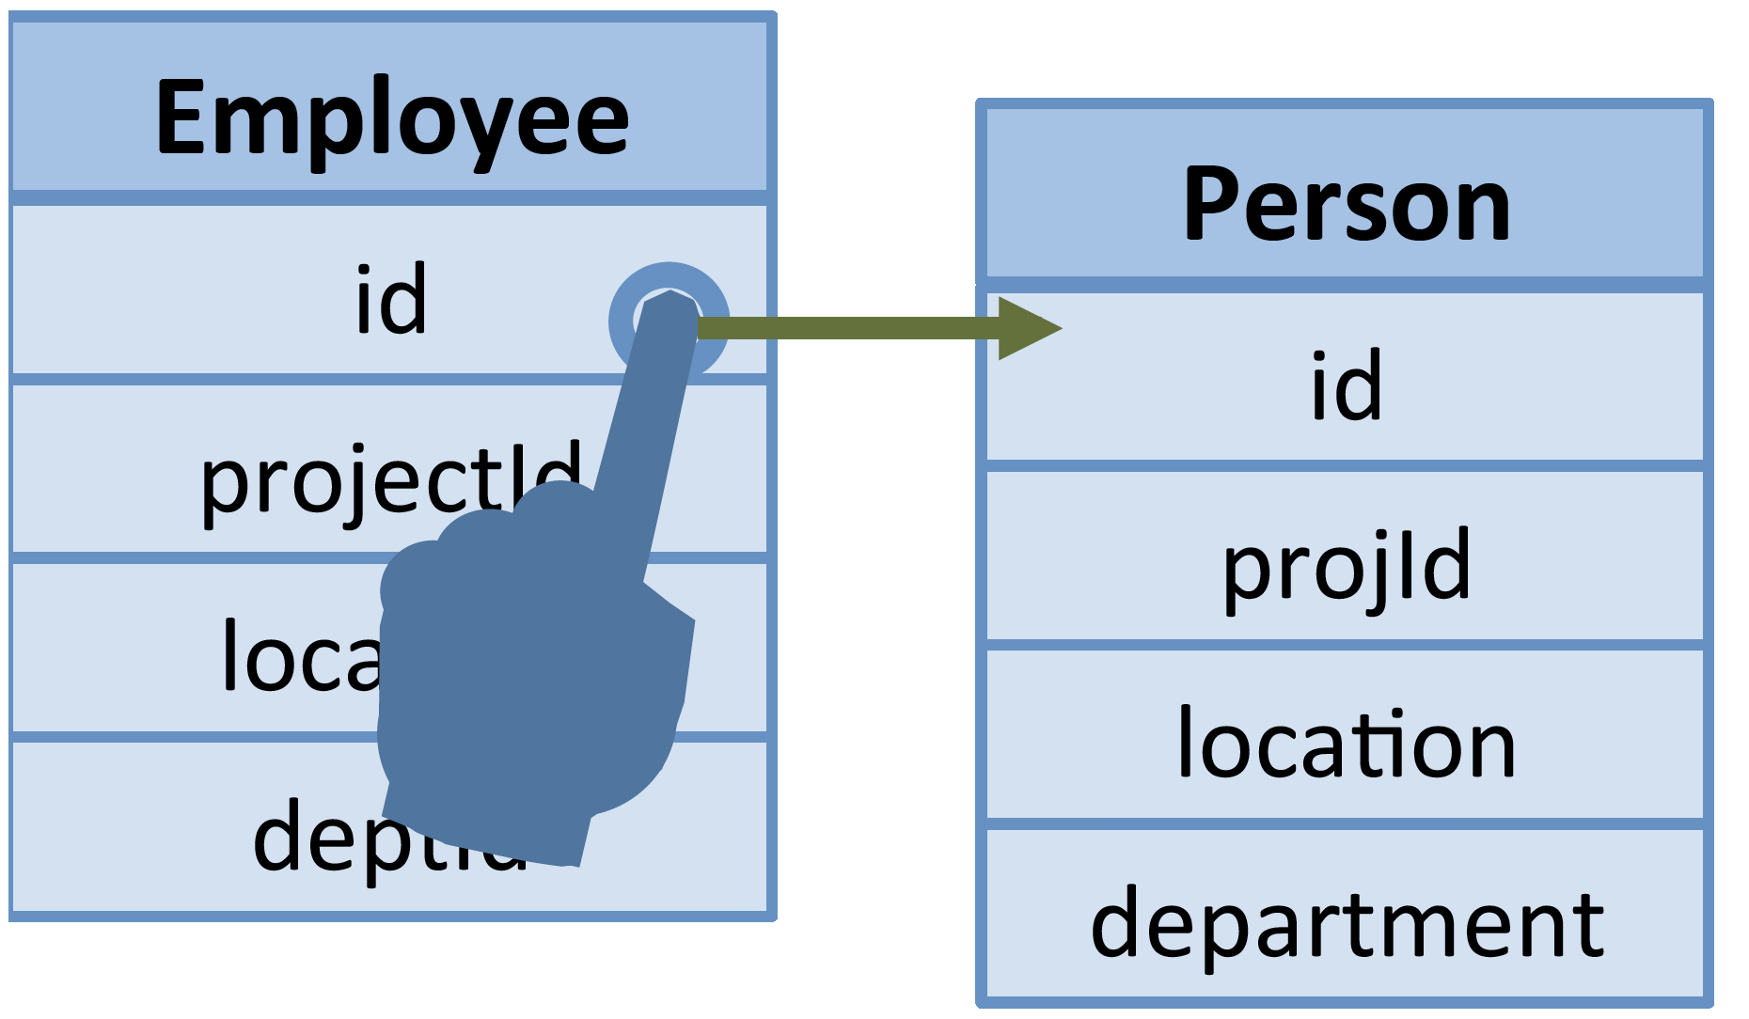
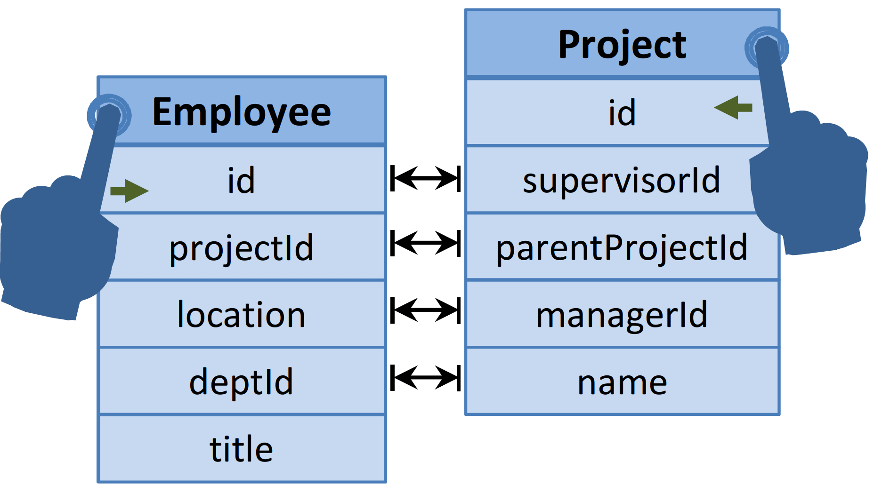
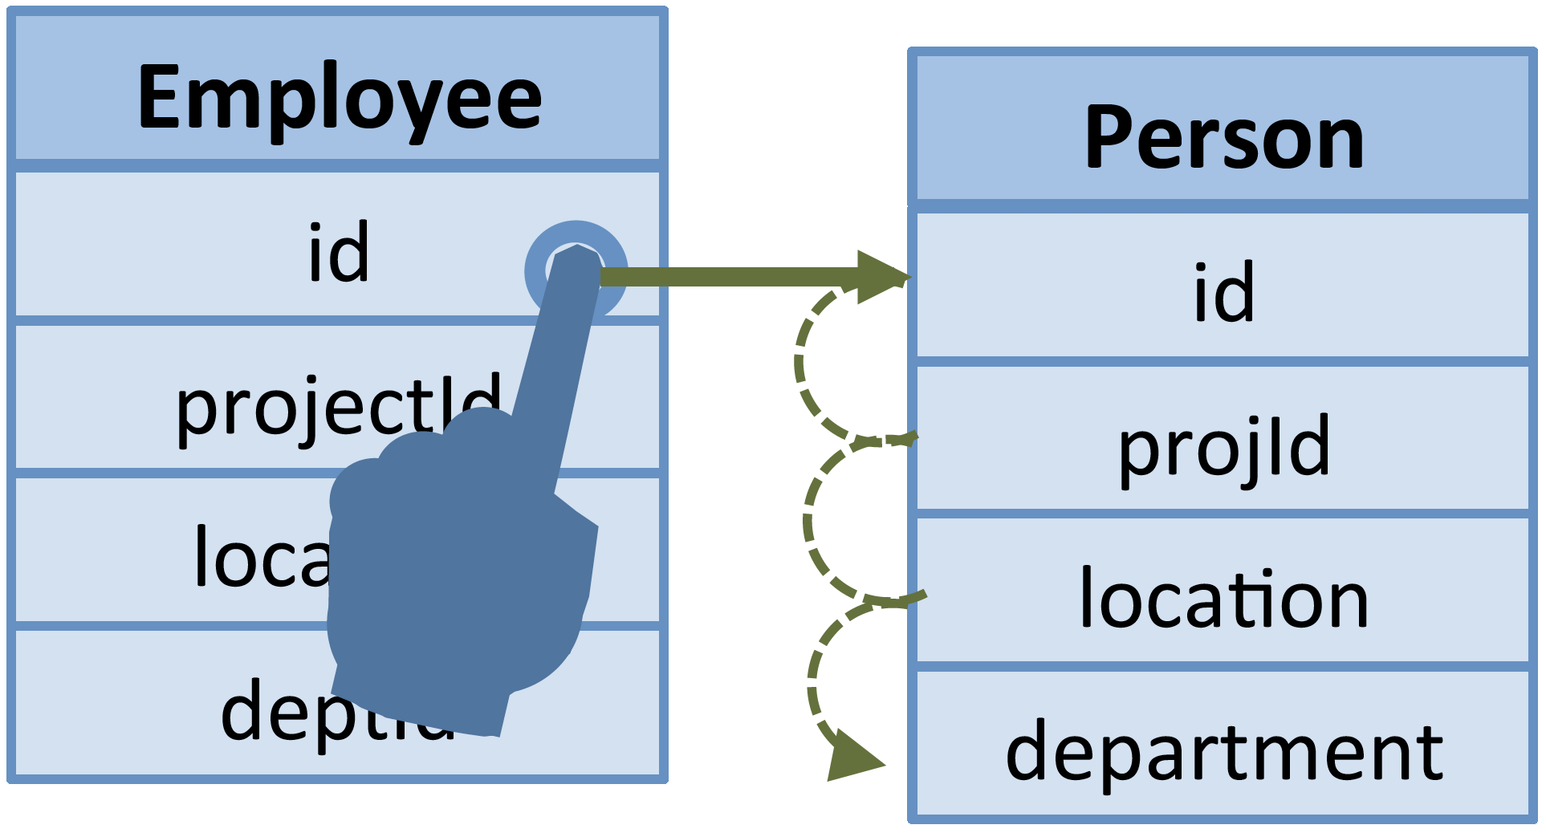
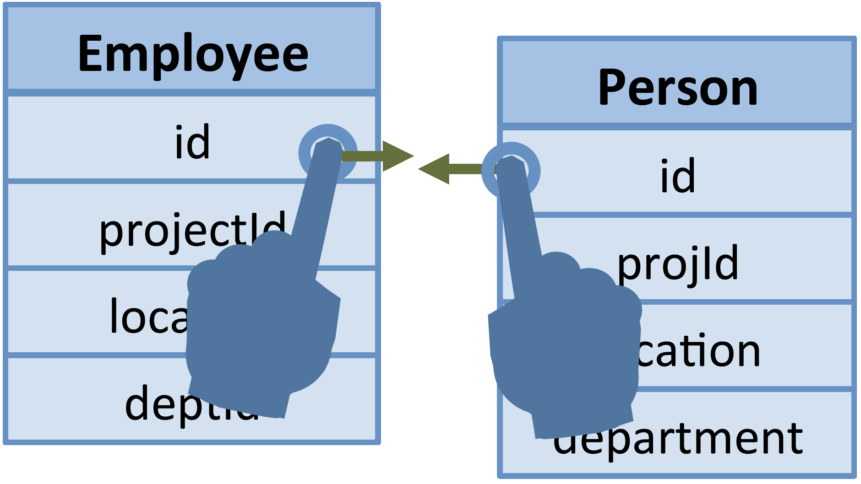
Design Considerations Interactive Join
Number of gestures
M X N
1
MIN(N,M)
M X N

Slide 12
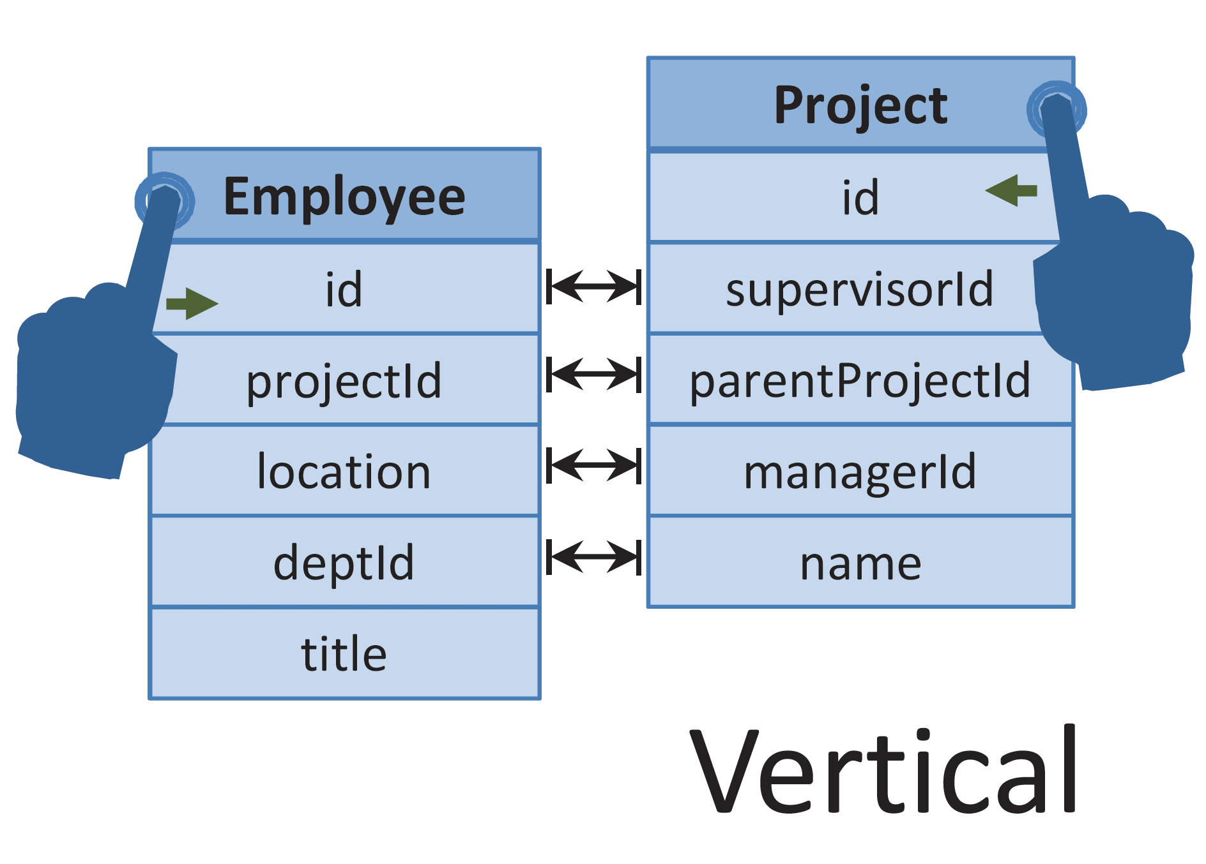
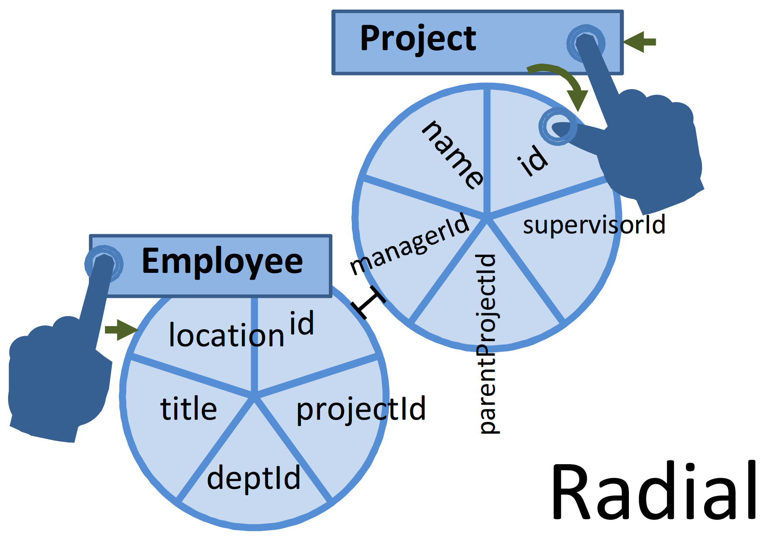
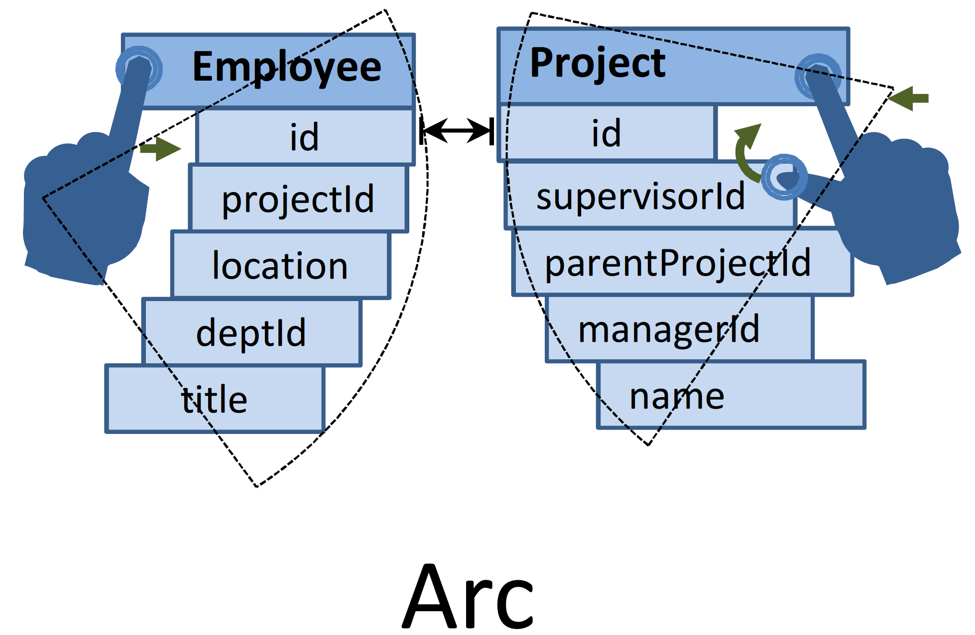
Design Considerations (Cont.) Interactive Join
Readable and pragmatic layout

Slide 13
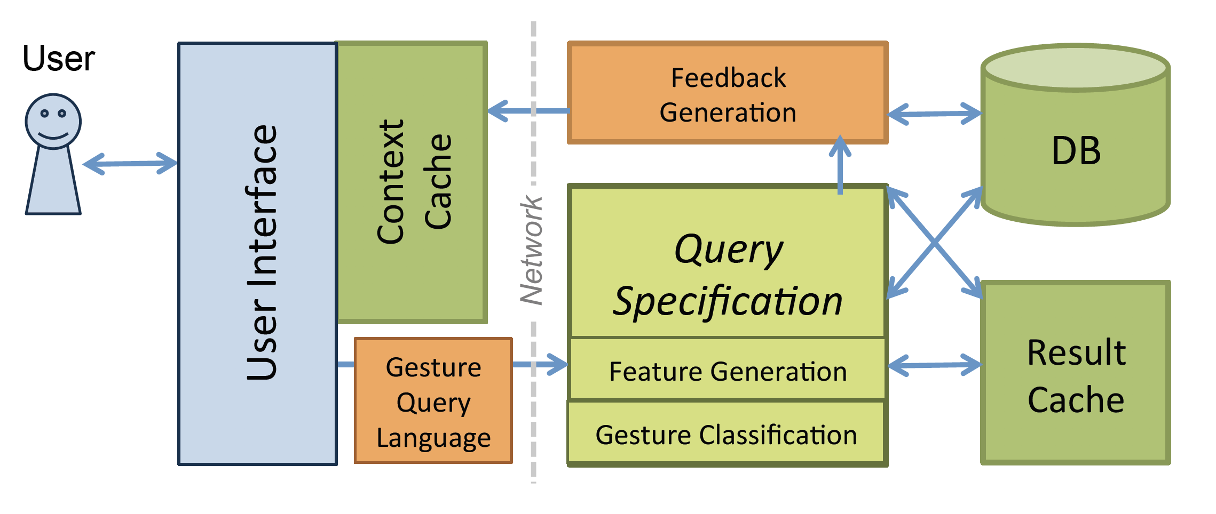
System Architecture

Slide 14
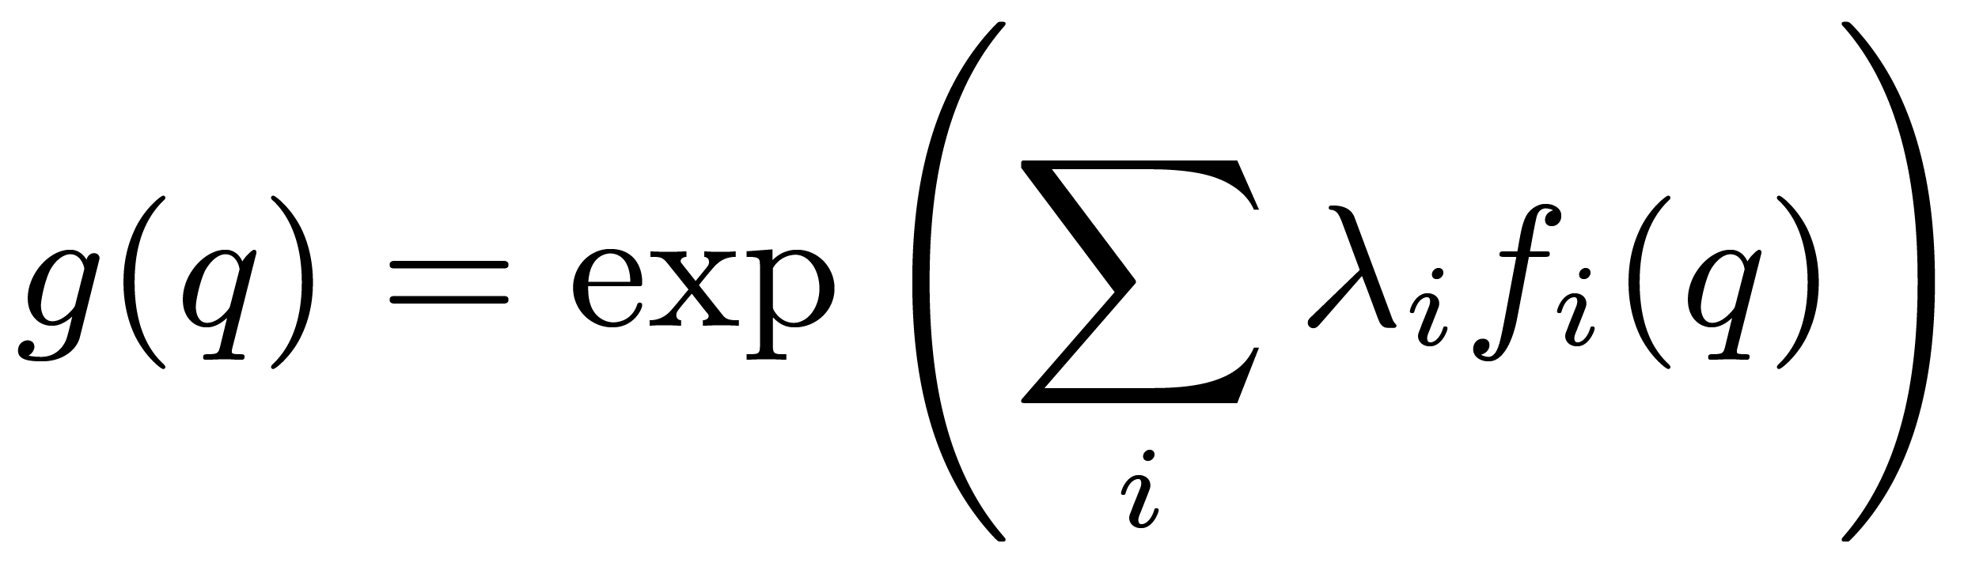
Gesture Recognition as Classification
Predicting the most likely query based on the gesture features and the DB state
Proximity
Gesture
Query
(q)
+
=
Compatability
The goodness of query q
DB

Slide 15
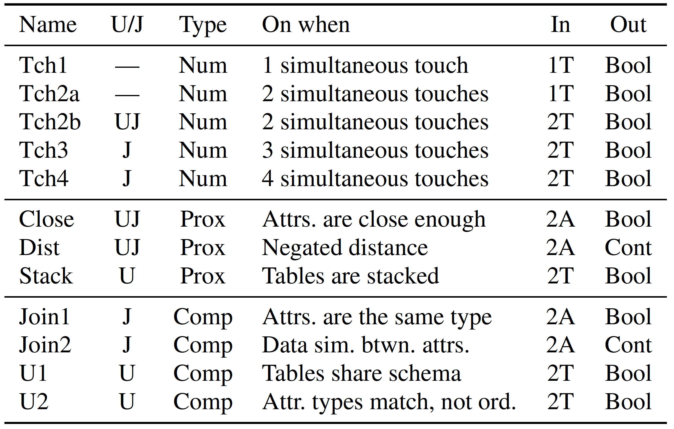
Feature Design

Slide 16
Classification Example
User Gestures | Features
Before the user begins the gesture | “Touching” features receive -∞ for all possible queries
User touches the headers of the tables | “2 touching points” feature is on Queries that do not include 2 tables are ruled out ”Close” feature is -∞ for all queries
User brings the tables close to each other | ”Close” feature is turned on “Stacked” feature is -∞ We remain only with Join queries Use the “Join” feature to identify the most compatible attributes

Slide 17
User Studies
Experimental Setup:
30 users
Even distribution of proficiency
Randomized order of tasks (Learning effects)
Limited time (Fatigue effects)
Baselines:
Console-based SQL (SQLite)
Visual Query Builder

Slide 18
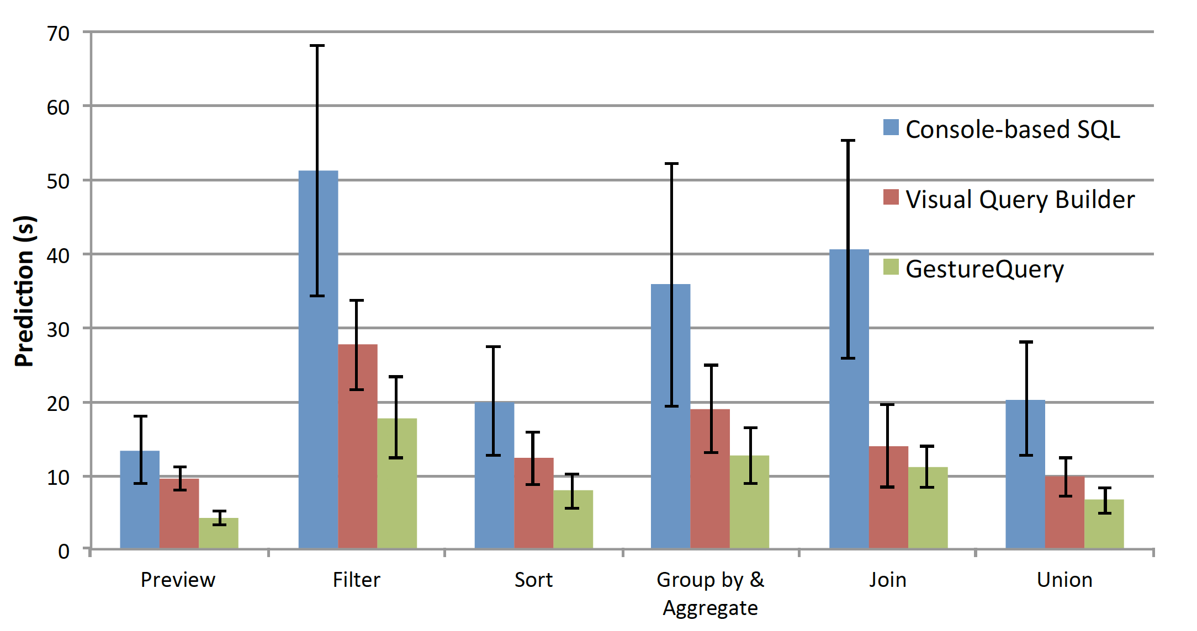
Completion Time
The total time it takes, on average, to complete a task in a given interface

Slide 19
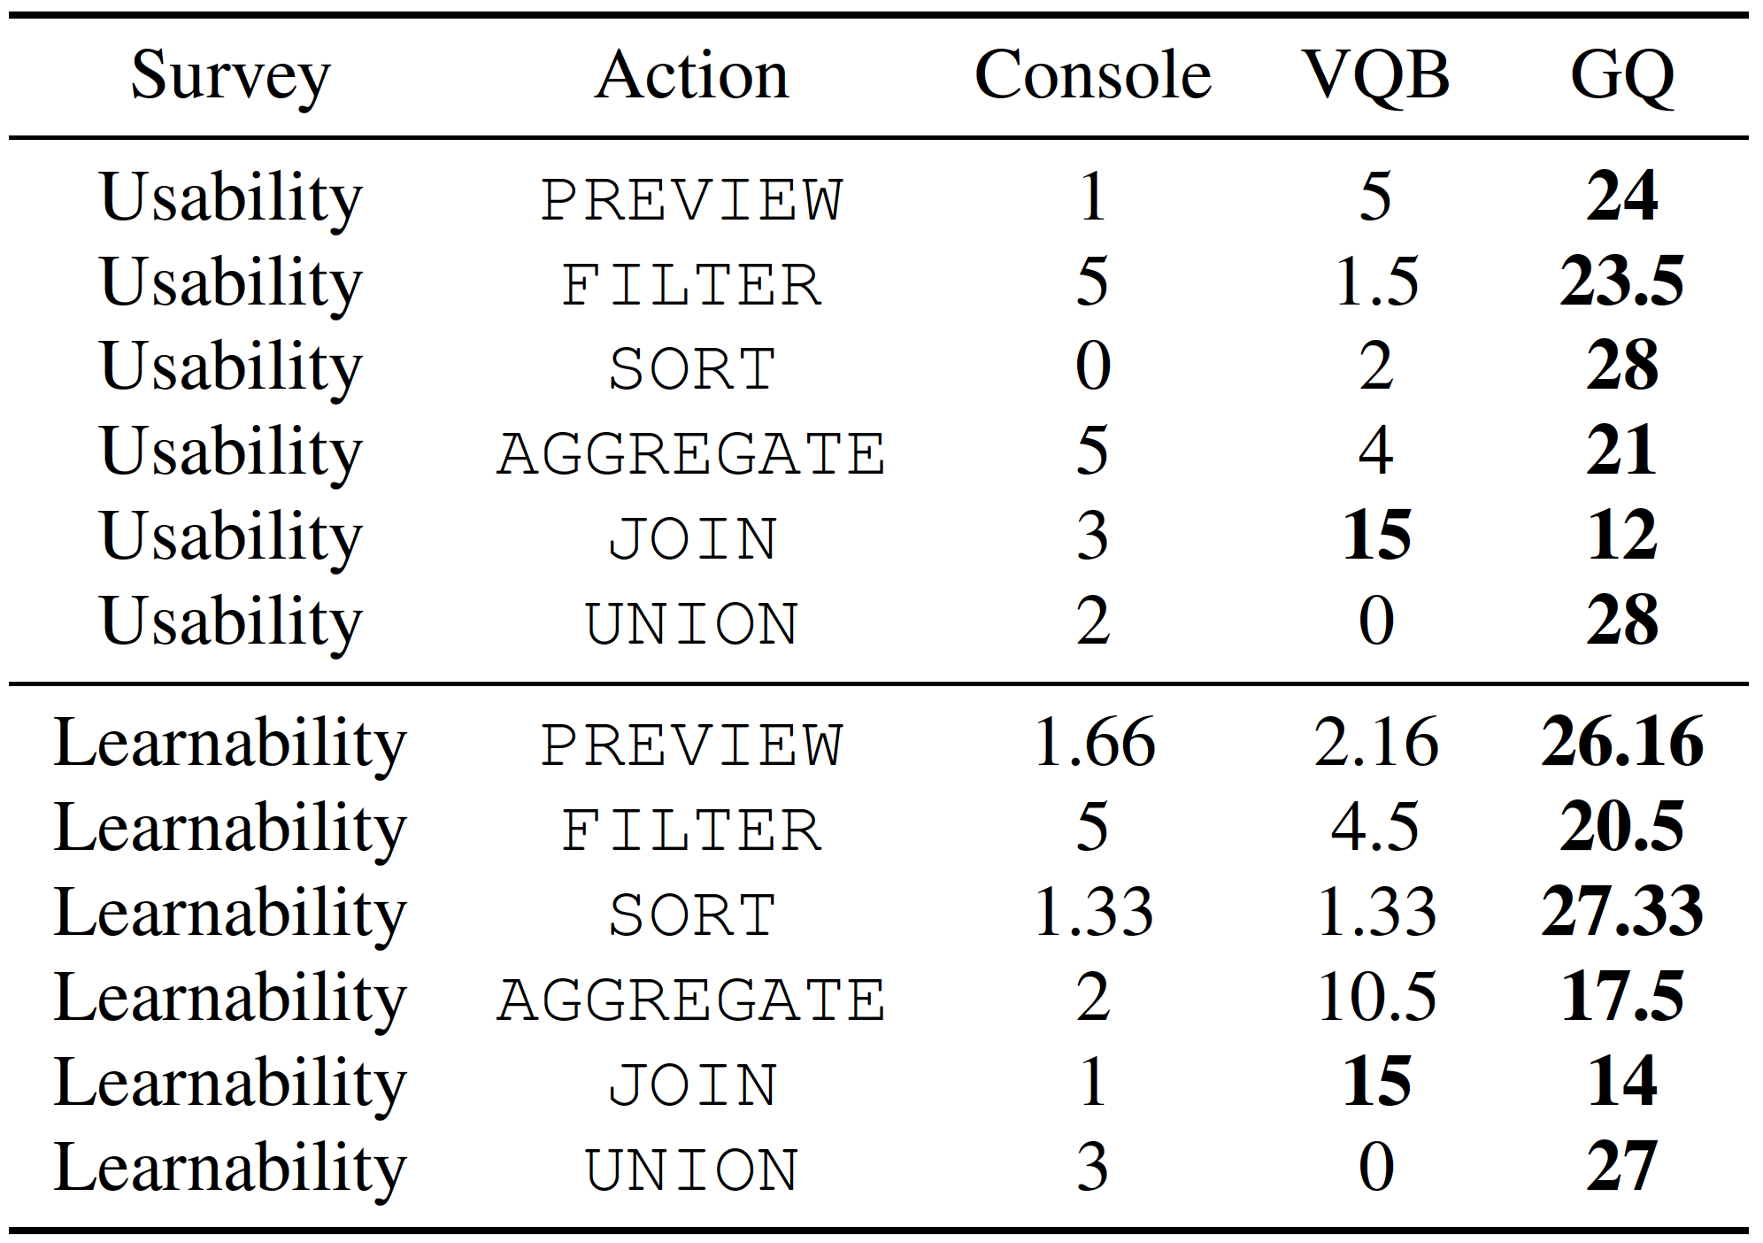
User Survey

Slide 20
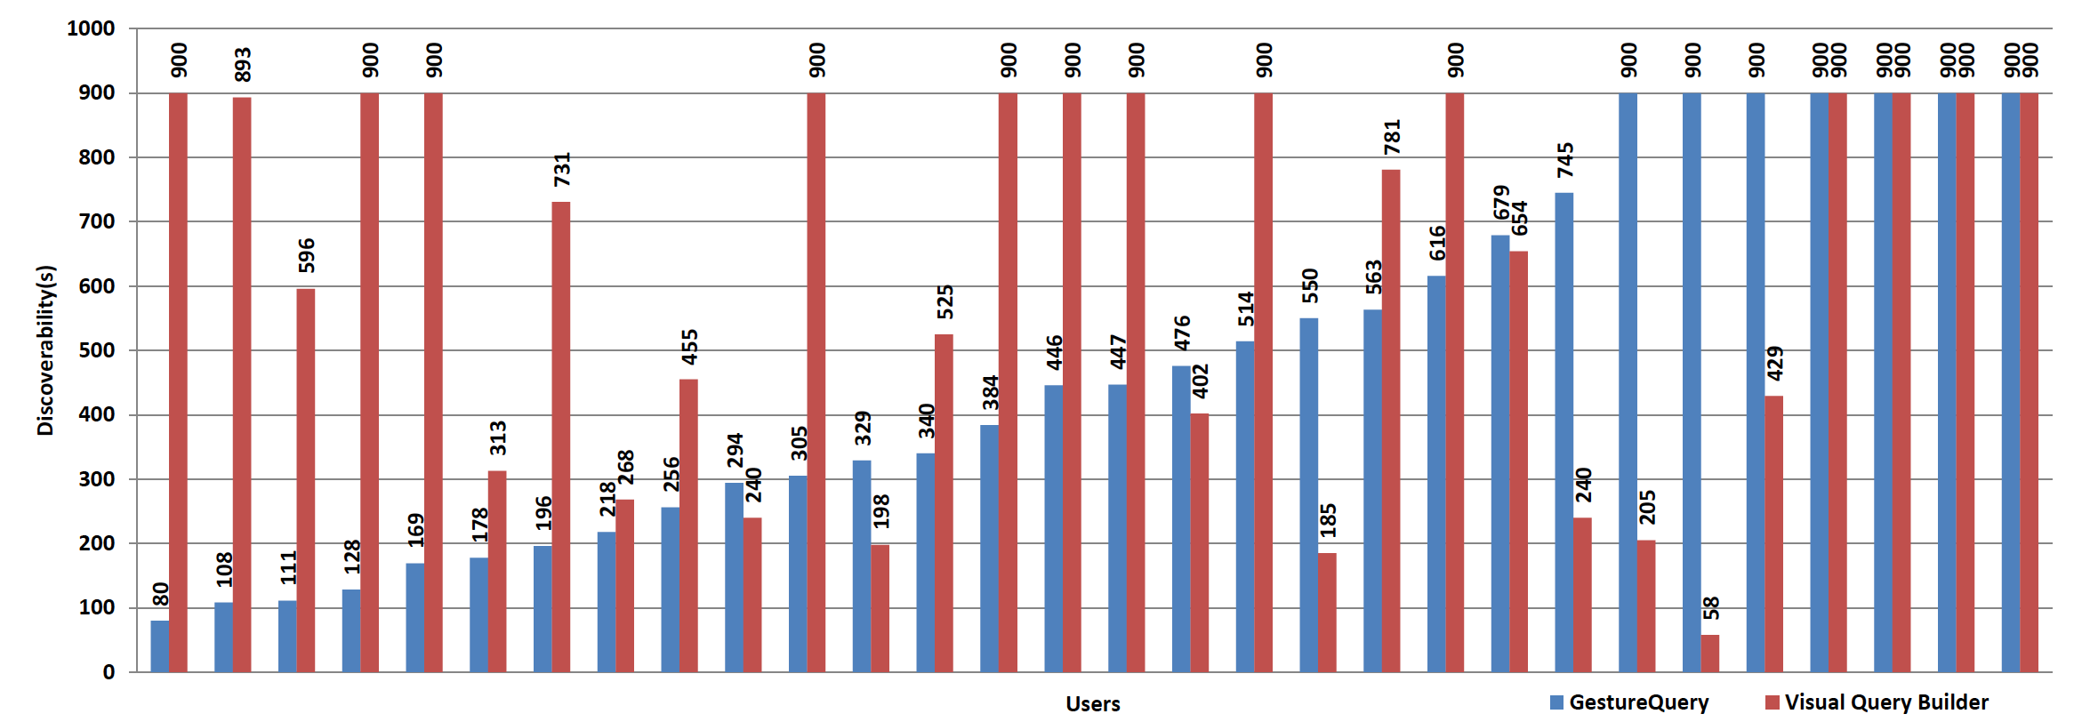
Discoverability
How intuitive the interactions of the interface are?

Slide 21
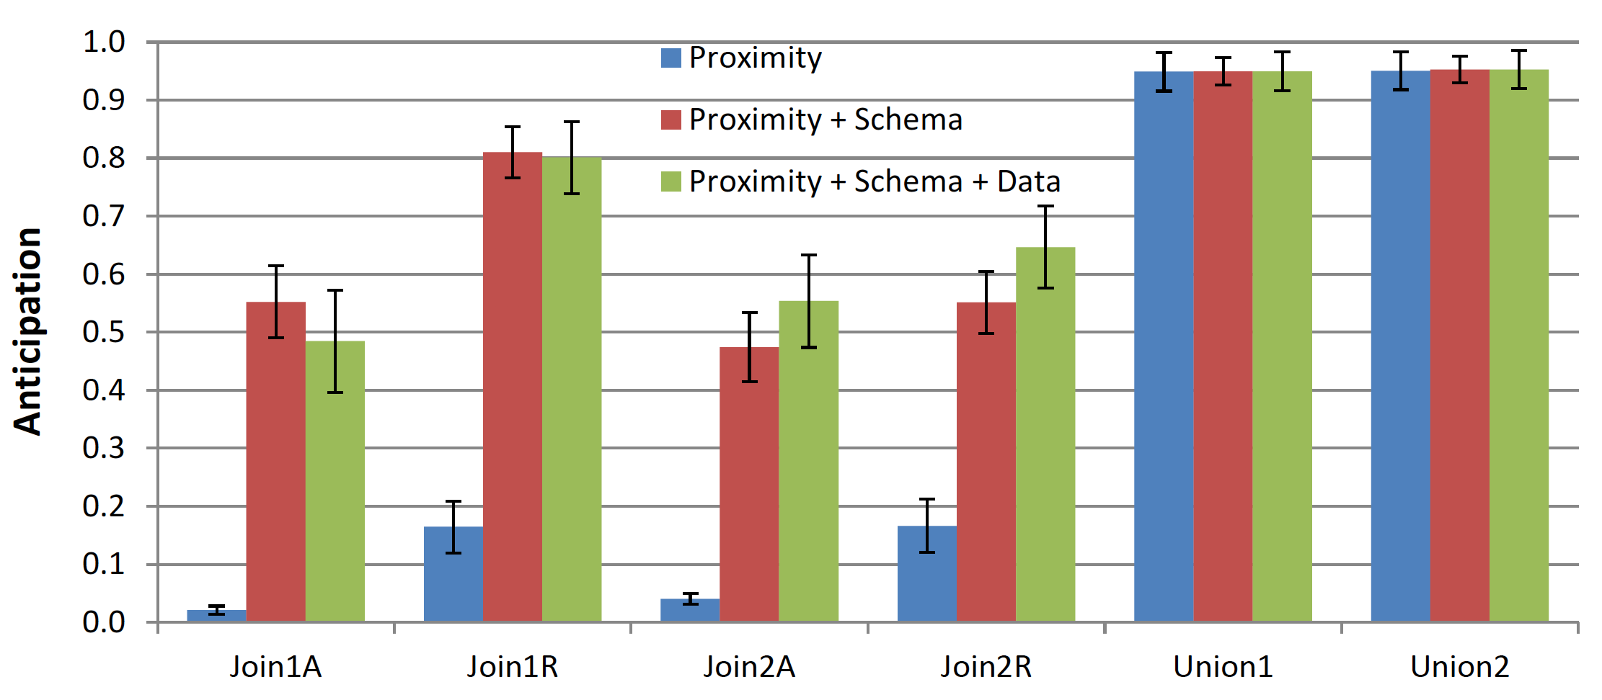
Anticipation
What is the ability of three different classifiers to anticipate user’s intent?

Slide 22
Summary
Introducing the gestural query specification problem
Proposing a novel gestural querying framework, and system
Exhaustive user studies
Open Challenges:
Complex queries
Big Data

