Slide 1
Zenvisage
Edward Xue

Slide 2
Motivation
Visual data exploration can be tedious, manual trial and error process
Other Visual Analytic tools support one visualization at a time
Finding patterns in large datasets is tough
A lot of data exploration falls into a few key operations
Composing visualization collections
Filtering visualization collections
Comparing visualizations
Sorting visualizations
What if we can automate this search for desired visual patterns?
Notes:
Ask class: how can we automate this search for desired visual patterns?
Zenvisage provides a novel approach that allows makes data exploration on large datasets much easier for data analysts.
One espeically useful case is when data analysts want to “play around” and test some hypotheses. Rather than taking time to create a custom data analytic pipeline they can first use our tool to explore their hypotheses and see if it’s worth pursuing

Slide 3
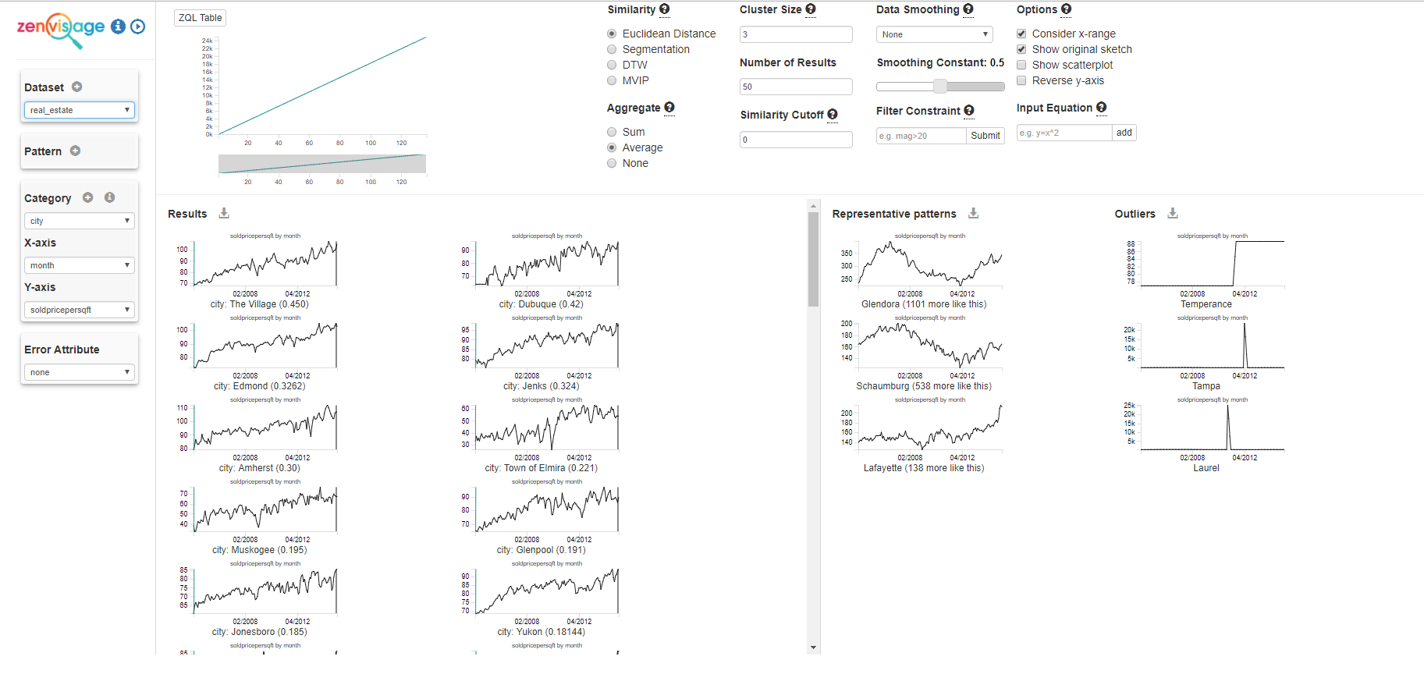
Zenvisage Interface
Notes:
Explain interface, then switch to working version, run a few sketch and drag and drop searches
How does this work? => Query sent to ZQL, which I will explain next

Slide 4
Zenvisage Query Language (ZQL)
ZQL treats visualizations as first class citizens
Can be assigned to a variable
Can be passed as an argument
Can be returned from a function
Can be modified
Allows users to operate on collections of visualizations in a declarative fashion
Notes:
SQL allows users to work with relational data (usually in tables) in a declarative fashion: we write what we want to see, and the system does the steps and optimizations to return to result desired

Slide 5

ZQL High Level Overview
A ZQL Query consists of one or more rows
Each row has well defined columns:
Name column
Columns that define a collection of visualization
X,Y,Z
Constraints
Viz
Process column
Operates on collections of visualizations
Filtering, sorting, comparing

Slide 6
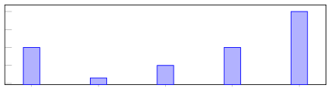
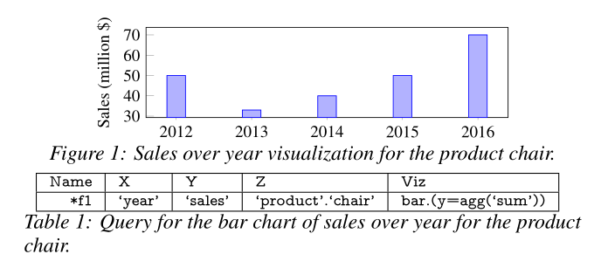


ZQL Table Based Queries
Notes:
X and Y columns specify the attributes for the x and y axes
Z column specifies the subsets of data that make different visualizations in a collection ‘attribute_name’.’attribute_value’
Viz allows support for visualization type, binning, and aggregation functions <type>.<bin+aggr>

Slide 7
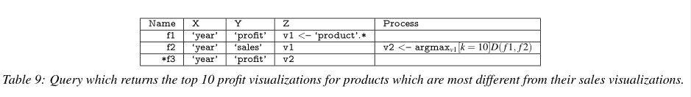
ZQL: Process Column
The power of ZQL lies in the ability to operate on collections of visualizations in an effective manner
ZQL uses dimension-based iteration over collections of visualizations
Each column has an iterator called an axis variable
Notes:
Axis variables: v1 iterates over all the product values
axis variable x1 <- {‘year’, ‘month’} iterates over year and month
Find the top 10 products (v1) whose distance values are the largest
This is one example of a process, let us continue to the general form

Slide 8
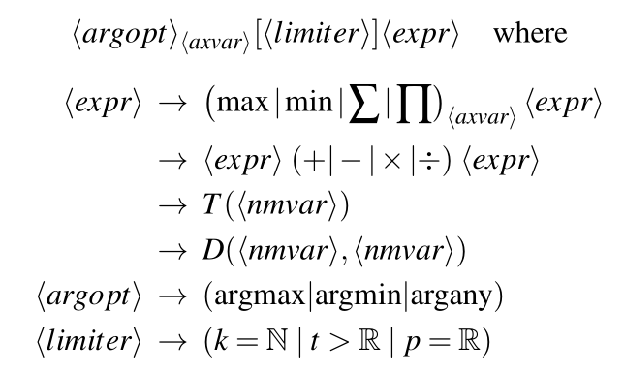



Process Column Formal Structure
Notes:
Two function primitives are supported through this structure
T(f) -> R takes a visualization f and returns a real number measuring some visual property of the trend f
Eg, Increasingness/growth (how increasing)
D(f1, f2) -> R Takes two visualizations and measures distance (euclidean, earth movers)
User defined functions

Slide 9
Process Function Questions
What are some interesting t functions? What properties or patterns can these t functions express?
What do different distance functions show? How do we know what distance metric is best?
Our process structure can allow for user defined functions. What would be some useful functions that do not fall under the two functional primitives ZQL supports?

Slide 10
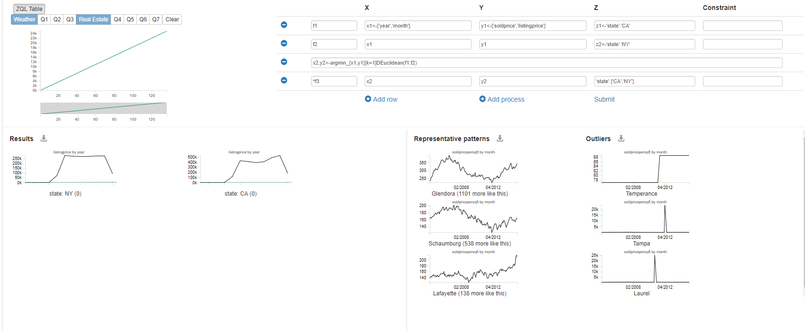
ZQL examples

Slide 11
General ZQL Questions
What are some limitations of ZQL?
How to improve those limitations?
How easy is it to understand a ZQL query?
Notes:
While ZQL is pretty general, each query has to be tailored to a specific dataset -> how to improve that
How to improve the understandability of a ZQL Query?

Slide 12
Query execution
ZQL queries are parsed and executed by the back end
The backend translate ZQL queries into a query plan in the form of a directed acyclic graph.
Two kinds of nodes:
Collection Nodes
Process Nodes

Slide 13
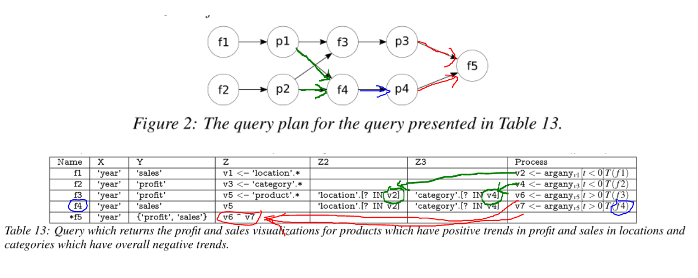
Query Execution

Slide 14
Optimization Techniques
Parallelization
Some nodes can run in parallel
Concurrent SQL queries
Speculation
Fetch sql queries ahead of time by using superset of the necessary info for a collection node
Query Combination
Overall runtime depends on number of queries being issued
Combine queries to reduce overall runtime
Cache Aware Execution
Cache optimizations for process nodes (multiple nested loops)
Tries to maximize the time blocks of data remain in L3 cache
Notes:
Speculation: . So, a superset of f3, the set of profit over year visualizations for various products for all locations and categories (as opposed to just those that satisfy p1 and p2), could be retrieved pre-emptively

Slide 15
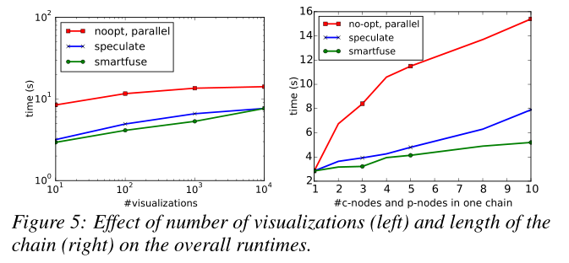
Optimization Techniques
Why no improvements with parallelism?
Notes:
PostgreSQL

Slide 16
Thanks for listening!

Slide 17
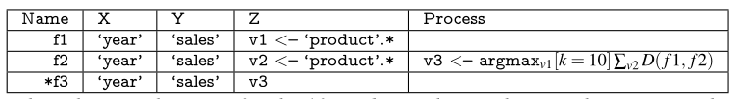
Another example
Notes:
Query which returns the sales visualizations for the 10 products whose sales visualizations are the most different from the others.
(our frontend just uses one axis variable -- causes issues!)

