Slide 1
Deco: Declarative Crowdsourcing
Litian Ma

Slide 2
Presentation Outline
Overview
Running Examples
Data Model
Query Language
Query Processing
System Architecture
Experiments

Slide 3

Overview
Conventional data management, incorporate “human computation”.
Declarative queries
DBMS like thing
Web

Slide 4
Main Challenges
Resolve disagreeing human opinions.
How does database system interact with human workers? How to enable usage of external sources in addition to crowd?
Right data model and query language.
Materialization of crowdsourced data.
Efficient query processor.

Slide 5


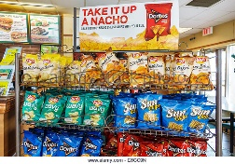
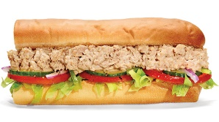

Running Example
Restaurant(name, address, rating, cuisine)
AddInfo(address, city, zip)
Notes:
One restaurant one cuisine.

Slide 6

Data Model
Schema
designer
End
user
relations and
other stuff
relations
Conceptual Schema
automatic (system)
Raw Schema
DBMS

Slide 7
Conceptual Schema
Relations
Like Restaurant and AddrInfo.
Partitioning of attributes in conceptual relation
Anchor attributes (Identifier).
Dependent attribute-groups (Property).
Fetch rules
How to obtain data from external sources including humans.
Resolution rules
Reconcile inconsistent or uncertain values.

Slide 8
Raw Schema
Tables actually stored in DBMS.
For each relation R in the conceptual schema:
One anchor table whose attributes are the anchor attributes of R
One dependent table for each dependent attribute-group D in R, containing the attributes in the resolution rule for D.

Slide 9
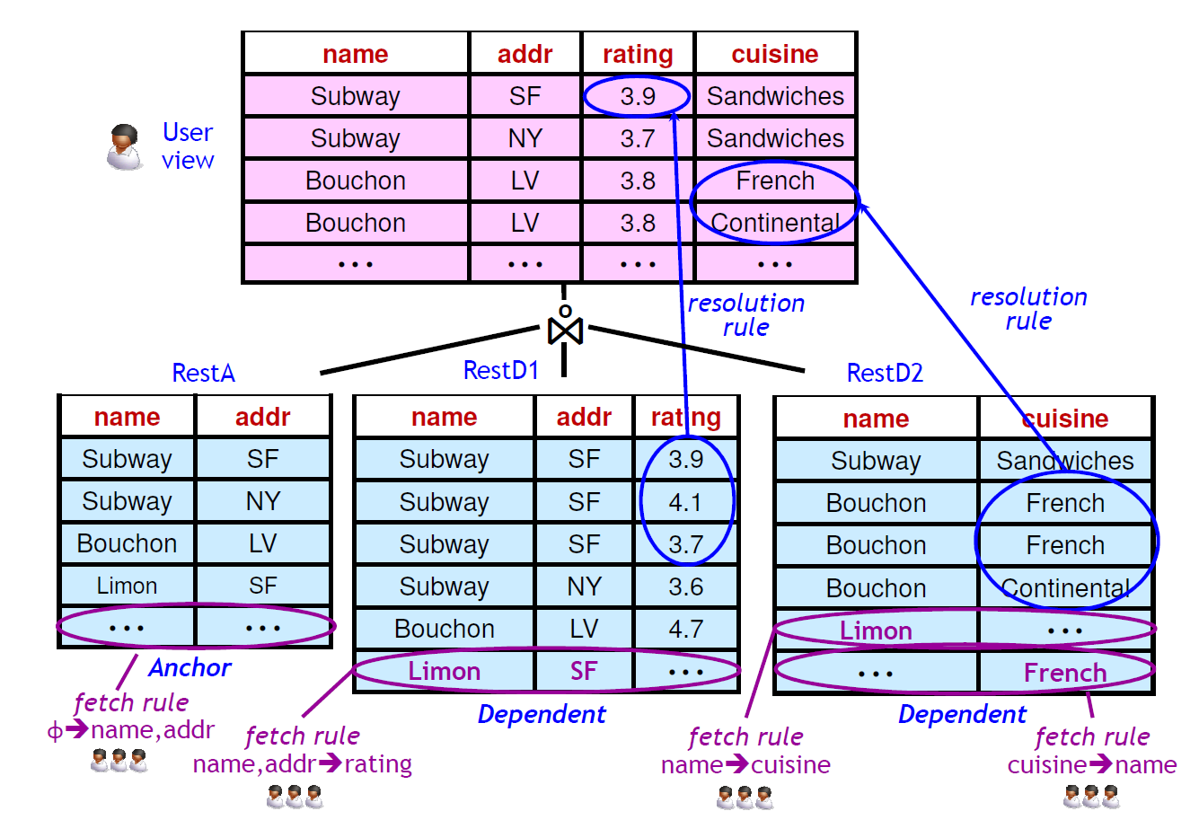
Component of Data Model
Fetch-Resolve-Join Sequence is a logical concept.
May interleave.
No materialization for conceptual data.

Slide 10
Conceptual Relations - Restaurant
Restaurant(name, address, rating, cuisine)
AddrInfo(address, city, zip)
Restaurant(name, address, [rating], [cuisine])
AddrInfo(address, [city, zip])
Enclose dependent attribute-groups
Notes:
In our example, the pair of anchor attributes name
and address identify individual restaurants, while rating and cuisine
are dependent attributes that are independent of each other.
(We assume ratings are not associated with specific cuisines of a
restaurant.) In relation AddrInfo, address is the anchor attribute; attributes
city and zip are not independent of each other with respect
to an address, so they form a single dependent attribute-group.

Slide 11
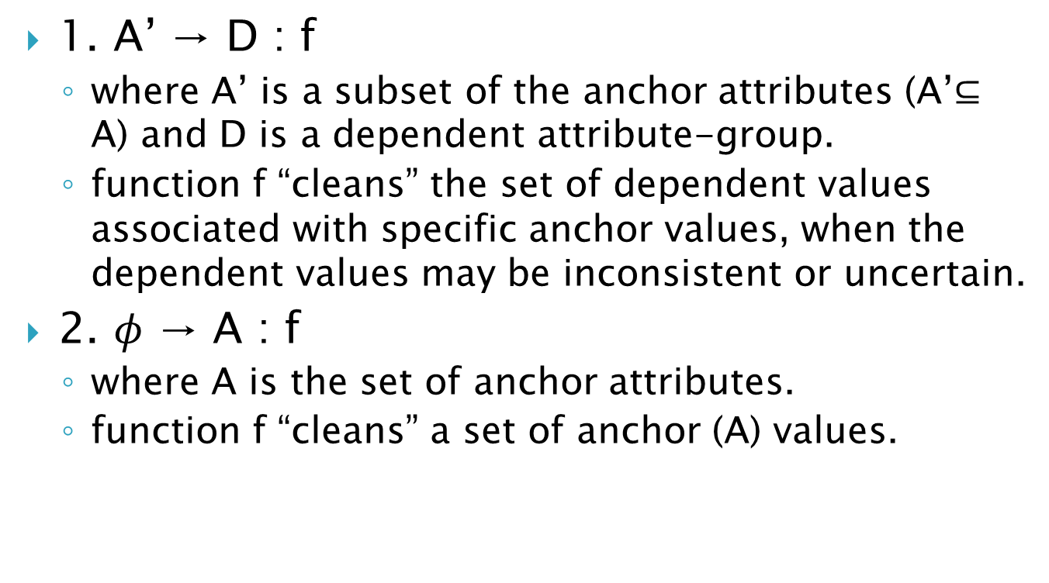
Resolution Rules
1. A’ → D : f
where A’ is a subset of the anchor attributes (A’$⊆$ A) and D is a dependent attribute-group.
function f “cleans” the set of dependent values associated with specific anchor values, when the dependent values may be inconsistent or uncertain.
2. $φ$ → A : f
where A is the set of anchor attributes.
function f “cleans” a set of anchor (A) values.

Slide 12
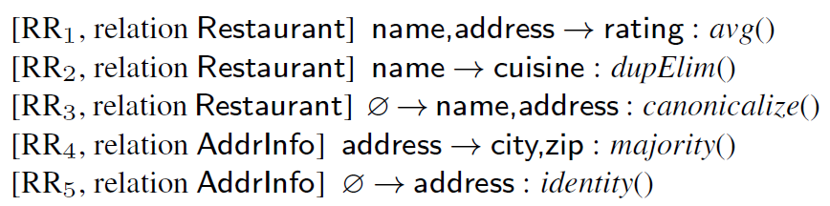
Resolution Rules

Slide 13

Fetch Rules
A fetch rule takes the following form:
A1 $≫$ A2 : P
where A1 and A2 are sets of attributes from one relation and P is a fetch procedure that implements access to human workers or other external sources.

Slide 14
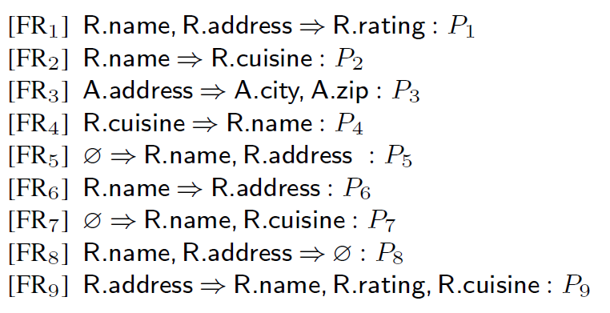
Fetch Rules
Verification

Slide 15
Raw Schema
Recap:
One anchor table
One dependent table for each dependent attribute-group.
RestA(name,address)
RestD1(name,address,rating)
RestD2(name,cuisine)
AddrA(address)
AddrD1(address,city,zip)

Slide 16
Valid Instance
Starting with the current contents of the raw tables and logically performing:
Fetch: add tuples to Deco tables.
Resolve: resolve dependent attributes.
Join: full outerjoin of Deco tables for each relation.
Resulting in a set of data for the conceptual relations.
Logical steps, not necessarily perform, not necessarily in order.

Slide 17
Metadata
Extra column in the raw tables.
Not first-class of data model, but crucial for some crowdsourcing applications.
Deal with messy aspects of using crowdsourced data.
Examples:
Data expiration
Worker quality
Voting
Confidence scores
Etc.

Slide 18

Query Language
A Deco query Q is a relational query over the conceptual relations. The answer to Q is the result of evaluating Q over some valid instance of the database.
Empty!
AtLeast 5
At least 5 tuples of non-NULL attributes will return.

Slide 19
Query Processing
Push-Pull Hybrid Execution Model
Incremental Push
Borrow ideas from incremental view maintenance.
Result of a fetch rule -> update to one/more base tables -> propagated to view (conceptual table).
Asynchronous Pull
Borrow ideas from asynchronous iteration.
Initiate multiple new fetches in parallel and feed more tuples back to plan ASAP.
Two Phase
Materialization: try to answer using raw tables.
Accretion: Issues fetch rules to obtain more results.

Slide 20
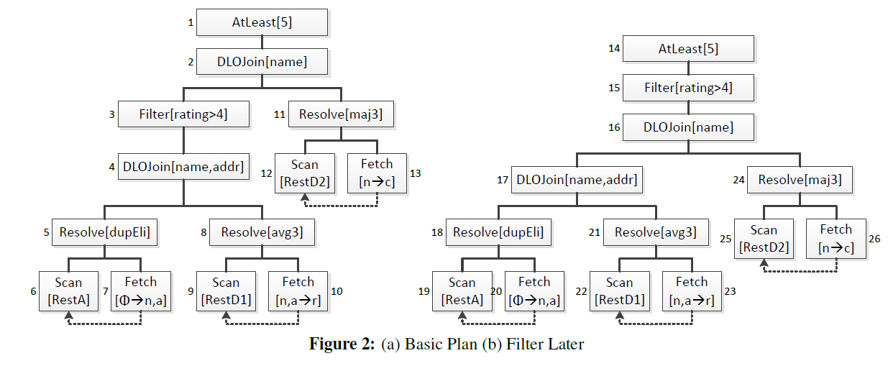
Query Plans
Notes:
To show the flexibility of our execution model

Slide 21
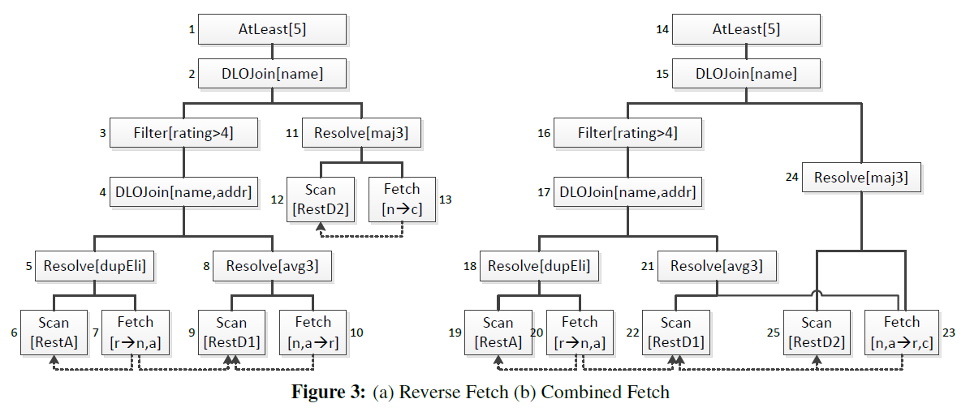
Query Plans

Slide 22
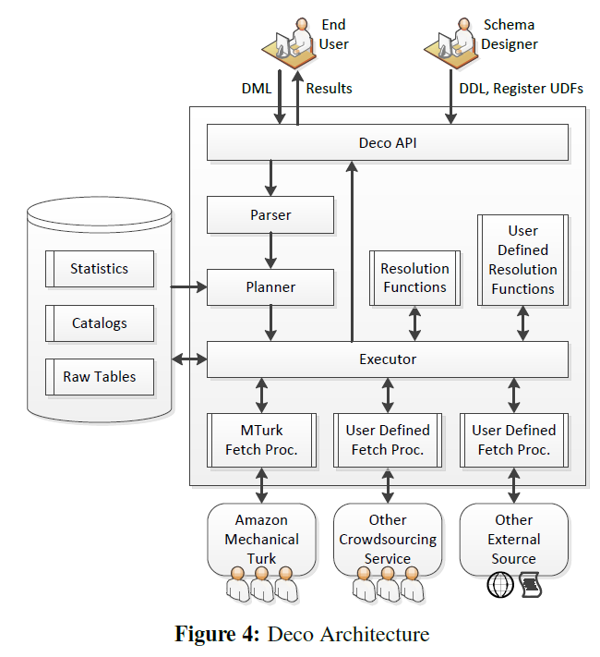
System Design

Slide 23
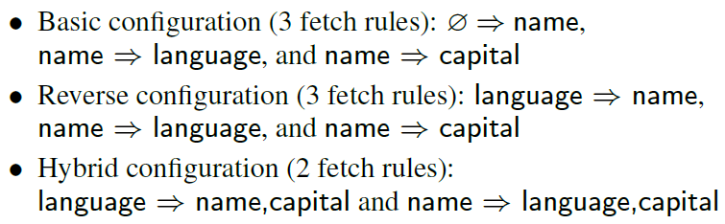
Experiment Setup
County(name, [language], [capital])

Slide 24

Benchmark Query
County(name, [language], [capital])

Slide 25
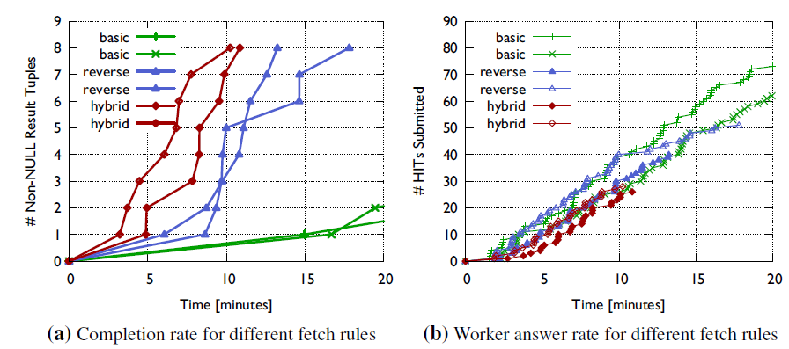
Experiment 1- Fetch Configurations

Slide 26
Experiment 2 – Query Plans
Plan “Down”
Push all predicates down as much as possible
Similar to reverse fetch query plan.
Plan “Up”
Predicate pull-up transformation.
Similar to filter later query plan.

Slide 27
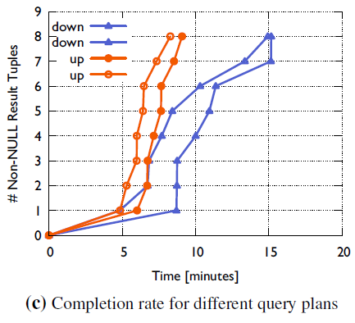
Experiment 2 – Query Plans

Slide 28
Thanks!

