Slide 1
BlinkDB

Slide 2
BlinkDB: My main takeaways
IDEA 1: Organize sampling around query column sets
(a) A small set may “cover” all queries
From workloads
(b) MILP formulation which picks these column sets
IDEA 2: Determine on the fly, the qcs that gives the best “bang for the buck”
Cute idea of selectivity – number of rows selected divided by the number of rows read
Both of these are nice, novel ideas.

Slide 3
Where could the BlinkDB approach fail?

Slide 4
Where could the BlinkDB approach fail?
QCSes are not stable
# of rare subgroups are high, dimensionality bad
For example, if three groups have dimensionality 10000 each, the stratified sample of the cross-product could be GIGANTIC
Aqua would also fail

Slide 5
What are the drawbacks of the BlinkDB system?
Let’s talk about
Optimization Techniques
Query Class
Repeated Queries

Slide 6
What are the drawbacks of the BlinkDB system: Optimization Techniques?

Slide 7
What are the drawbacks of the BlinkDB system: Optimization Techniques?
Not clear
how to tune various parameters: K, M
whether the MILP is indeed optimal
if techniques will apply to other workloads or case studies (two datasets is very limited)
Could have done bootstrapping

Slide 8
What are the drawbacks of the BlinkDB system: Query Classes?

Slide 9
What are the drawbacks of the BlinkDB system: Query Classes?
Does not handle joins/nesting
Very simple queries

Slide 10
Other Drawbacks
A QCS either receives K or none at all. Is this wise?
Should depend on variance, distribution
If all values of cost of sale is 1 for this product, why keep a sample of K, 1 would suffice.
If variance is small, a smaller sample may suffice
Paper claims partial covering is OK if need be. Is that true?
Partial covering may lead to a biased sample
May completely miss some groups

Slide 11
Aqua vs. BlinkDB
Very similar ideas for offline precomputed samples
Aqua
Is query agnostic, will take full collection of group-by columns to construct stratified sample
May be too much
Broader class of queries
General enough to apply to joins (foreign key)

Slide 12
Alternatives for speeding up latency
Offline Approximate Query Processing
Better or more hardware
Leveraging main memory (e.g., spark)
Parallelism (e.g., dremel)
Data Cube Materialization (NEXT)
Online Approximate Query Processing (NEXT)

Slide 13
OLAP
From the 90s
Analytics: Business Intelligence
Without aggregates, the underlying data can be represented as a snowflake schema
The key idea of a data cube to materialize and store aggregates for this snowflake schema

Slide 14
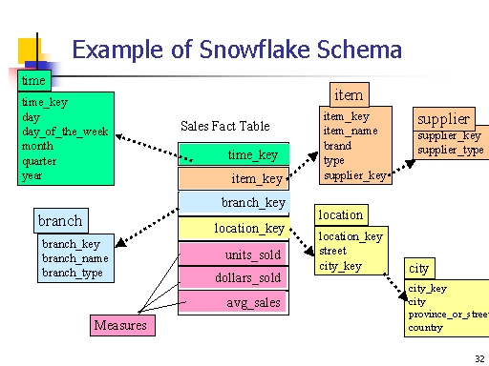

Slide 15
Two representations
Normalized Representation
Fact tables and dimension tables
Denormalized representation
One row per transaction

Slide 16
A Sample Data Cube
Date
Total annual sales
of TV in U.S.A.
1Qtr
2Qtr
3Qtr
4Qtr
sum
Product
TV
PC
U.S.A
VCR
sum
Canada
Country
Mexico
sum
All this data is completely precomputed before any queries arrive!

Slide 17
Data Cube Materialization: Idea from the 90s
Sales volume as a function of product, month, and region
Country
Also called
Data Warehousing
Product
Month

Slide 18
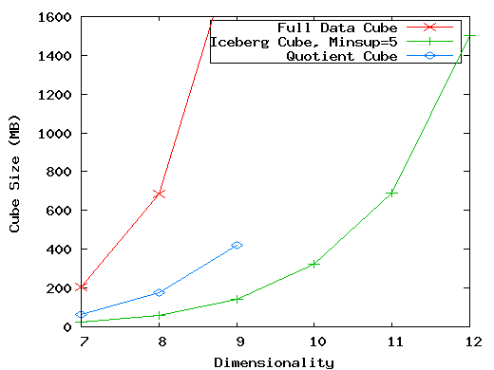
The curse of dimensionality
That said, not clear if any of the queries in their set are greater than 7-8 dimensions

Slide 19
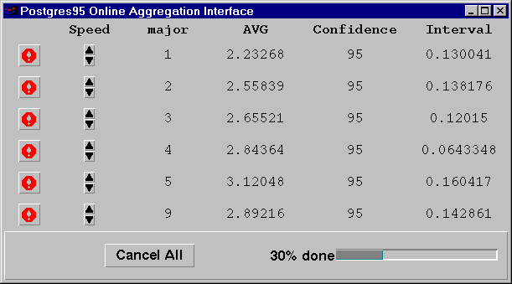
Online AQP: Aggregation: Another Idea from the 90s
No upfront computation or storage.
Sample from each group in a random fashion
If you have indexes, can even do stratified sampling
Display results + place control in hands of the user
Why is this bad??

Slide 20
Why is OLA bad?
Random I/O sucks!
Remember:
Disk seek 10,000,000 ns
Read 1 MB sequentially from disk 30,000,000 ns
Thus, 1 random I/O seek = reading 1/3 MB sequentially.

Slide 21
Why is OLA bad?
Not the case with memory, however!!
OLA may still be important
That said, memory is FAST, so unless you’re dealing with large datasets (unlikely to keep in memory due to $$$), scanning entire data may still be pretty fast

Slide 22
When is ONAQP/OFAQP/materialization better?

Slide 23
ONAQP, OFAQP, materialization
OFAQP, materialization both better when you have space (disk/memory) and a high predictive power
Materialization better when (small) fixed set of queries or report generation
OFAQP better for ad-hoc queries, ad-hoc measures
Both OFAQP and materialization are bad for time-varying data!
ONAQP is better only if done in memory, but only LARGE memory – if small memory, not much performance difference between scanning entire thing vs. seeking around

