Slide 1
Announcements:
By Tuesday midnight, start submitting your class reviews:
First paper: Human-powered sorts and joins
Start thinking about projects!!

Slide 2
Question
How much time should you spend reading the paper before a class?
A: Not too long! Min: 1-2 hours, Max: 3-4 hours (only if you’re lacking necessary background or have a genuine interest)

Slide 3
An Introduction to Crowdsourced Data Management + Crowdscreen: Algorithms for Filtering Data using Humans (if time permits) Optimal Crowd-Powered Rating and Filtering Algorithms

Slide 4


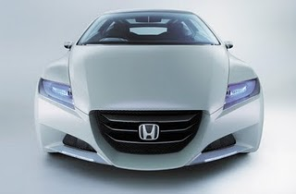
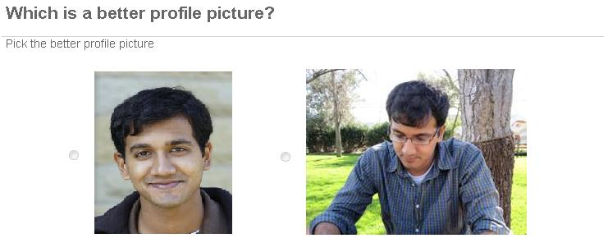
Crowdsourcing: A Quick Primer
Asking the crowd for help to solve problems
Why? Many tasks done better by humans
Pick the “cuter” cat
Is this a photo of a car?
How? We use an internet marketplace
Requester: Aditya Reward: 1$ Time: 1 day

Slide 5
At a high level…
I (and other requesters) post my tasks to a marketplace
one such marketplace is Mechanical Turk, but there are 30+ marketplaces
Workers pick tasks that appeal to them
Work on them
I pay them for their work
Pay anywhere from a few cents to dollars for each task; get the tasks done in any time from a few seconds to minutes

Slide 6
Why should I care?
Most major companies spend millions of $$$ on crowdsourcing every year
This includes Google, MS, Facebook, Amazon
Represents our only viable option for understanding unstructured data
Represents our only viable option for generating training data @ scale

Slide 7
OK, so why is this hard?
People need to be paid
People take time
People make mistakes
And these three issues are correlated:
If you have more money, you can hire more workers, and thereby increase accuracy
If you have more time, you can pay less/hire more workers, and thereby increase accuracy/reduce costs
…

Slide 8
Fundamental Tradeoffs
How long can I wait?
Which questions do I ask humans?
Do I ask in sequence or in parallel?
How much redundancy in questions?
How do I combine the answers?
When do I stop?
Latency
Uncertainty
What is the desired quality?
Cost
How much $$ can I spend?

Slide 9
Need to Revisit Basic Algorithms
Given that humans are complicated unlike computer processors, we need to revisit even basic data processing algorithms where humans are “processing data”
Max: e.g., find the best image out of a set of 1000 images
Filter: e.g., find all images that are appropriate to all
Categorize: e.g., find the category for this image/product
Cluster: e.g., cluster these images
Search: e.g., find an image meeting certain criteria
Sort: e.g., sort these images in terms of desirability
Using human unit operations:
Predicate Eval., Comparisons, Ranking, Rating
Goal: Design efficient crowd algorithms

Slide 10
Assumption: All humans are alike
A common assumption to make in many papers of crowdsourcing is that humans are identical, noisy, independent oracles
If the right answer (for a bool q.) is 1, humans will give 0 with equal probability p, and 1 with probability (1-p).
Humans will also answer independent of each other.
E.g., if I ask any human if a image contains a dog, they answer incorrectly with probability p.

Slide 11
Discussion Questions
Why is it problematic to assume that humans are identical, independent, noisy oracles with fixed error rates?

Slide 12
Discussion Questions
Why is it problematic to assume that humans are identical, independent, noisy oracles with fixed error rates?
Humans may be different
Error rates change over time, over questions
Difficulty of question affects independence

Slide 13
Our Focus for Today
Filtering

Slide 14

Filter
Single
Is this an image of Paris?
Dataset of Items
Predicate 1
Is the image blurry?
Predicate 2
Filtered Dataset
Predicate
……
Does it show people’s faces?
Predicate k
Y
Y
N
Item X satisfies predicate?
Applications: Content Moderation, Spam Identification, Determining Relevance, Image/Video Selection, Curation, and Management, …

Slide 15
Our Visualization of Strategies
continue
No
decide PASS
5
decide FAIL
4
3
2
1
1
2
3
4
5
Yes

Slide 16
Strategy Examples
continue
No
No
decide PASS
5
5
decide FAIL
4
4
3
3
2
2
1
1
Yes
1
Yes
1
2
2
3
3
5
4
5
4
What’s a short description for this strategy?

Slide 17
Common Strategies
Always ask X questions, return most likely answer
Triangular strategy
If X YES return “Pass”, Y NO return “Fail”, else keep asking.
Rectangular strategy
Ask until |#YES - #NO| > X, or at most Y questions
Chopped off triangle

Slide 18
Simplest Version
Given:
Human error probability (FP/FN)
Pr [Yes | 0]; Pr [No | 1]
A-priori probability
Pr [0]; Pr[1]
We will discuss if this is reasonable to assume later.
Probability of mistakes; all humans alike
Via Sampling
Or Prior History
Selectivity

Slide 19
Illustration
If we have error prob = 0.1, selectivity 0.7, then:
Pr. (reaching (0,0)) = 1
Pr. (reaching (0,0) and item = 1) = 0.7
Pr. (reaching (1,0) and item = 1) =
Pr (reaching (0, 0) and item = 1 and human answers Yes) = 0.7 * 0.9
The ability to perform computations like this on the state space (x, y) means that this a Markov Decision Process (MDP)
no
2
2
yes

Slide 20
Simplest Version
Given:
Human error probability (FP/FN)
Pr [Yes | 0]; Pr [No | 1]
A-priori probability
Pr [0]; Pr[1]
Find strategy with minimum expected cost (# of questions)
Expected error < t (say, 5%)
Cost per item < m (say, 20 questions)
Via Sampling
Or Prior History
No Latency for now!
m
x+y=m
m

Slide 21
Evaluating Strategies
continue
decide PASS
No
decide FAIL
5
Cost = (x+y) Pr [reach(x,y)]
Error = Pr [reach ∧1] + Pr [reach ∧0]
∑
4
∑
∑
y
3
2
Pr. [reach (4, 2)] =
Pr. [reach (4, 1) & get a No]+ Pr. [reach (3, 2) & get a Yes]
1
1
2
3
4
5
Yes
x

Slide 22
Brute Force Approach
For each grid point
Assign , or
For all strategies:
Evaluate cost & error
Return the best
O(3^{g}), g = O(m²)
No
5
4
3
2
1
1
2
3
4
5
Yes

Slide 23
Brute Force Approach 2
Try all “hollow” strategies
Too Long!
Sequence of blue + Sequence of red, connected
Why: Decisions to be made at boundary instead of internal
YESs
YESs
4
4
3
3
2
2
1
1
1
2
3
4
NOs
1
2
3
4
5
6
NOs
What’s weird about this strategy?

Slide 24
Trick: Pruning Hollow Strategies
YESs
For every hollow strategy, there is a ladder strategy that is as good or better.
4
3
2
1
1
2
3
4
5
6
NOs
There are portions of the strategy that are unreachable and redundant.
If we prune them, we get a ladder strategy.

Slide 25
Other Pruning Examples
YESs
YESs
6
6
5
5
4
4
3
3
2
2
1
1
1
2
3
4
5
6
1
2
3
4
5
6
NOs
NOs
Hollow
Ladder

Slide 26
Comparison
Computing Strategy
Money
$$
Brute Force
Not feasible
Ladder
Exponential; feasible
$$$
Now, let’s consider a generalization of strategies

Slide 27
Probabilistic Strategy Example
No
continue
decide PASS
6
decide FAIL
5
4
3
2
1
(0.2, 0.8, 0)
1
2
3
4
5
Yes

Slide 28
Comparison
Computing Strategy
Money
Brute Force
Exponential;
not feasible
$$
Ladder
Exponential; feasible
$$$
The best probabilistic
Polynomial(m)
$
THE BEST

Slide 29
Key Property: Path Conservation
P = # of (fractional) paths reaching a point
Point splits paths: P = P₁ + P₂
No
P₁
Ask
P₁
P₁
P₂
P
Stop
Yes

Slide 30
Path Conservation in Strategies
No
continue
decide PASS
decide FAIL
2
1
Yes
1
2

Slide 31
Finding the Optimal Strategy
Use Linear Programming:
Using Paths:
Paths P into each point X
Only decision at X is the split of P
Also:
Pr [reach X] = c P
Pr [reach X ∧1] = c’ P
Saying PASS/FAIL at X does not depend on P
O(m²) variables

Slide 32
Experimental Setup
Goal: Study cost savings of probabilistic relative to others
Parameters → Generate Strategies → Compute Cost
Two sample plots
Varying false positive error
(other parameters fixed)
Varying selectivity
(other parameters varying)
Probabilisitic
Deterministic
Hollow
Ladder
Rect
Growth
Shrink

Slide 33
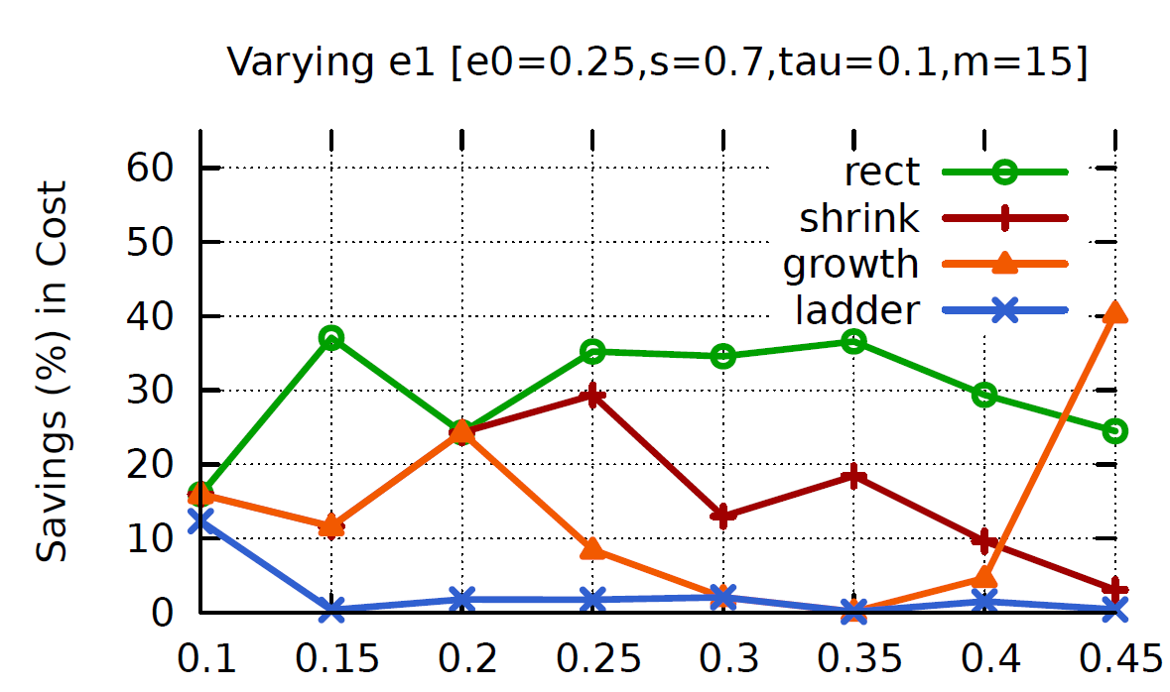
Varying false positive error

Slide 34
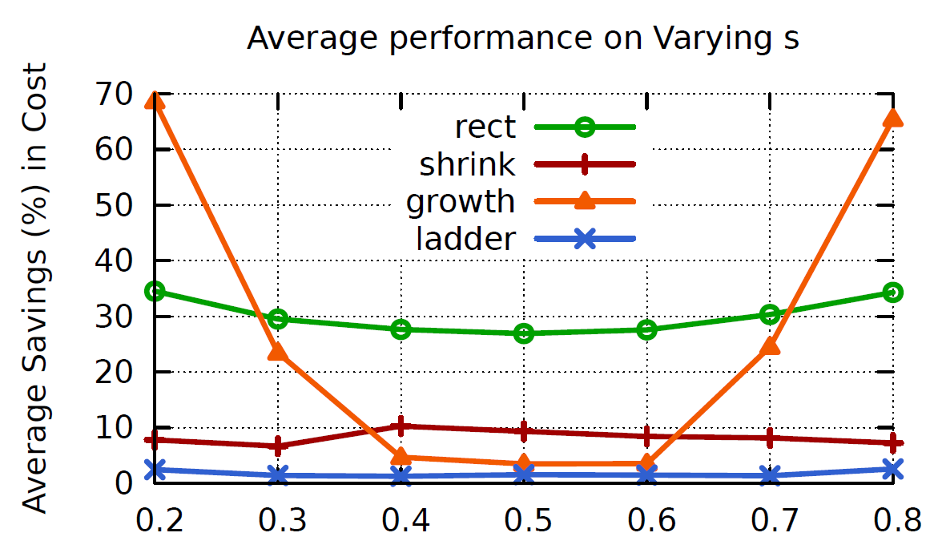
Varying selectivity

Slide 35
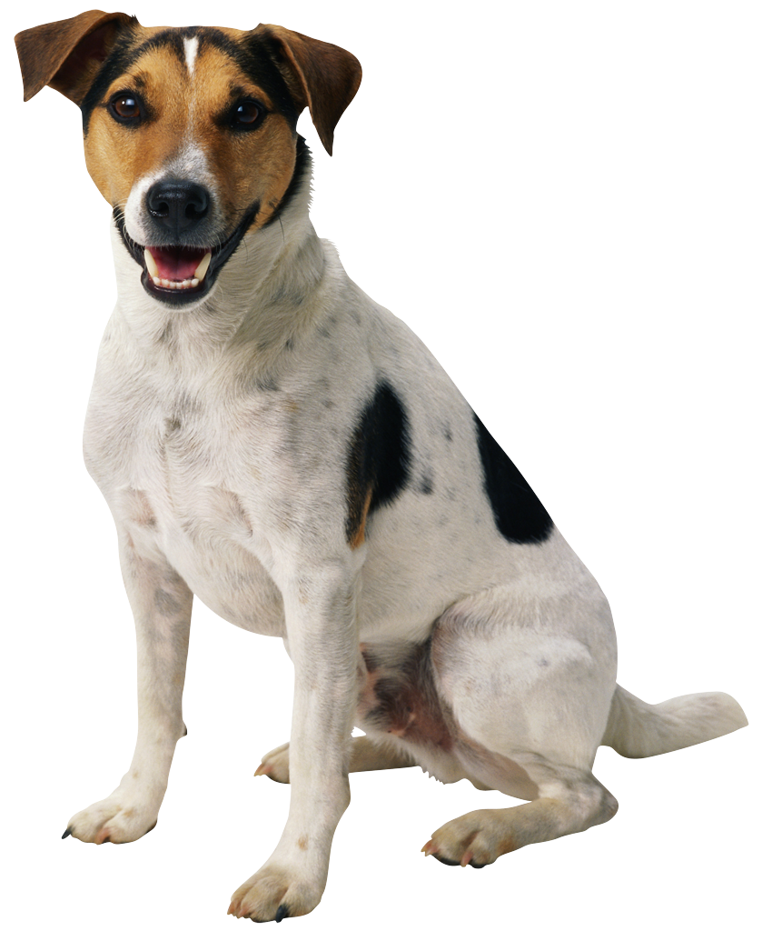
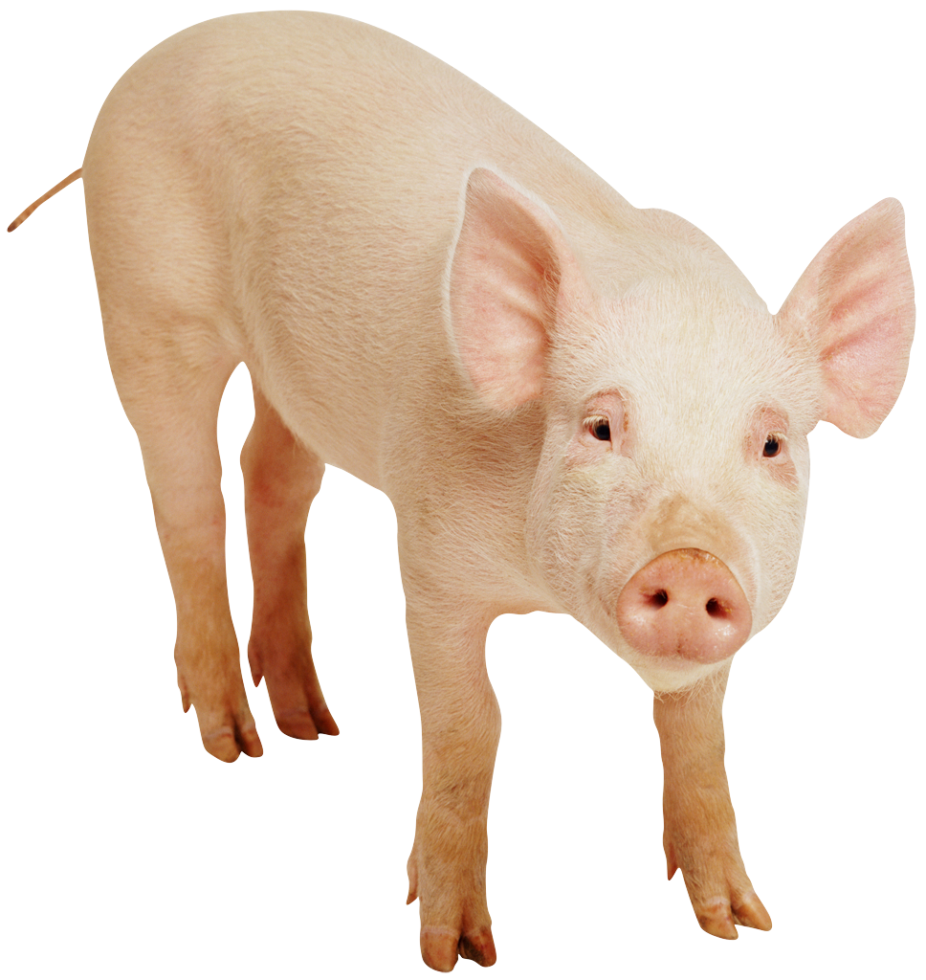
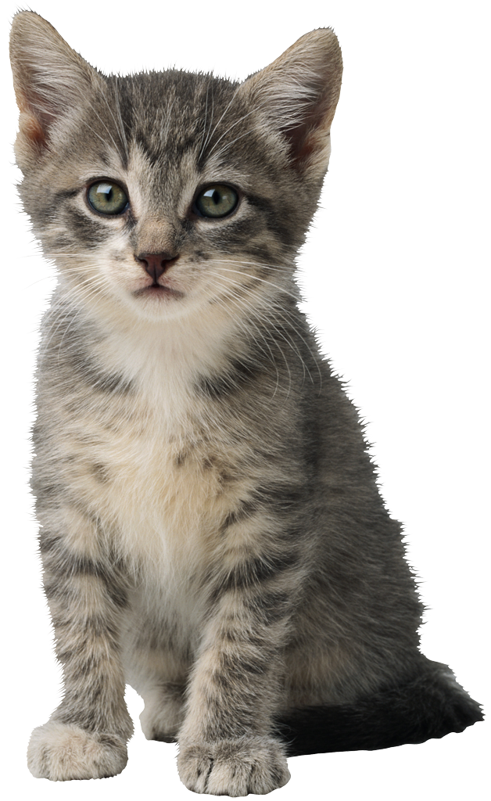
Two Easy Generalizations
Multiple Answers
`( , , )
(0, 1, 2, 3, 4, 5)
Multiple
Filters
(Image of Paris) ∧ (Not Blurry)
(F₁ Yes, F₁ No, …, F_{K} Yes, F_{K} No)
Ask F₁, …, Ask F_{K}, Stop

Slide 36
Time for discussion!
Any questions, comments?

Slide 37
Discussion Questions
1: This paper assumes that error rates are known; why is that problematic?

Slide 38
Discussion Questions
1: This paper assumes that error rates are known; why is that problematic?
How do you test? Testing costs money
If error rates are imprecise, optimization is useless

Slide 39
Discussion Questions
2: How would you go about gauging human error rates on a batch of filtering tasks that you’ve never seen before?

Slide 40
Discussion Questions
2: How would you go about gauging human error rates on a batch of filtering tasks that you’ve never seen before?
You could have the “requester” create “gold standard” questions, but hard: people learn, high cost, doesn’t capture all issues
You could try to use “majority” rule but what about difficulty, what about expertise?

Slide 41
Discussion Questions
3: Let’s say someone did all you asked: they created a gold standard, tested humans on it, generated an optimized strategy, but that is still too costly. How can you help them reduce costs?

Slide 42
Discussion Questions
3: Let’s say someone did all you asked: they created a gold standard, tested humans on it, generated an optimized strategy, but that is still too costly. How can you help them reduce costs?
Improve instructions & interfaces
Training and elimination
Only allow good workers to work on tasks
Use machine learning

Slide 43
Discussion Questions
4: What other scenarios (beyond crowdsourcing) can these algorithms be useful?

Slide 44
Discussion Questions
4: What other scenarios (beyond crowdsourcing) can these algorithms be useful?
Anywhere you have noisy oracles!
Lab experiments
Automobile testing
Medical diagnosis

Slide 45
Discussion Questions
`( , , )
(0, 1, 2, 3, 4, 5)
5. Why is this generalization problematic? How would you fix it?
Multiple Answers

Slide 46
Discussion Questions
Multiple Answers
`( , , )
(0, 1, 2, 3, 4, 5)
5. Why is this generalization problematic? How would you fix it?
You need O(n^k) data points
Use generic error model, bucketize
Priors

Slide 47
Discussion Questions
6. What are the different ways crowd algorithms like this can be used in conjunction with machine learning?

Slide 48
Discussion Questions
6. What are the different ways crowd algorithms like this can be used in conjunction with machine learning?
Input/training
Active learning
ML feeds crowds

Slide 49
New Stuff
From “Optimal Crowd-Powered Rating and Filtering Schemes” VLDB 2014.

Slide 50
Generalization: Worker Abilities
 | Item 1 | Item 2 | Item 3
Actual | 0 | 1 | 0
W₁ | 0 | 1 | 0
W₂ | 1 | 1 | 1
W₃ | 1 | 0 | 1
(W₁Yes, W₁ No, …, W_{n} Yes, W_{n} No)
O(m^{2n}) points
n ≈ 1000
Explosion of state!

Slide 51
A Different Representation
Pr [1|Ans]
No
1
3
0.8
2
0.6
1
0.4
0.2
1
2
3
Yes
1
2
3
Cost

Slide 52
Worker Abilities: Sufficiency
Pr [1|Ans]
1
( W₁Yes, W₁ No,
W₂ Yes, W₂ No,
…,
W_{n} Yes, W_{n} No)
0.8
0.6
0.4
0.2
1
2
3
4
5
Cost
Recording Pr[1|Ans] is sufficient:
Strategy ➔ Optimal

Slide 53
Different Representation: Changes
Pr [1|Ans]
O(n) transitions
1
0.8
0.4
0.2
1
2
3
4
5
Cost

Slide 54
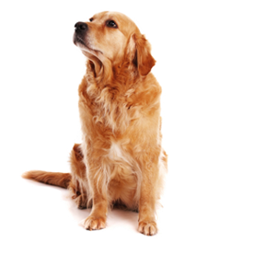
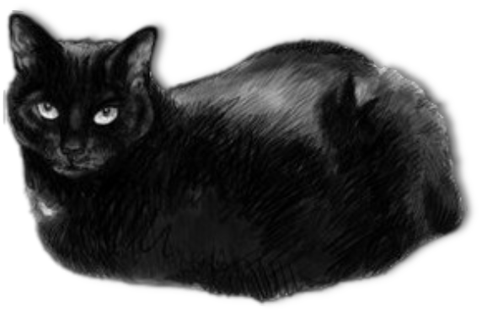


Generalization: A-Priori Scores
ML algorithm providing, for each item,
a probability estimate of passing filter
Higher
Prob.
Pr [1|Ans]
1
0.8
Lower Prob.
0.6
0.4
0.2
1
2
3
4
5
Cost

Slide 55
Generalizations
Multiple answers (ratings, categories)
Multiple independent filters
Difficulty
Different worker abilities
Different worker probes
A-priori scores
Latency
Different penalty functions

Slide 57
Hasn’t this been done before?
Solutions from elementary statistics guarantee the same error per item
Important in contexts like:
Automobile testing
Medical diagnosis
We’re worried about aggregate error over all items: a uniquely data-oriented problem
We don’t care if every item is perfect as long as the overall error is met.
As we will see, results in $$$ savings

