Slide 1


Diamonds

Slide 2
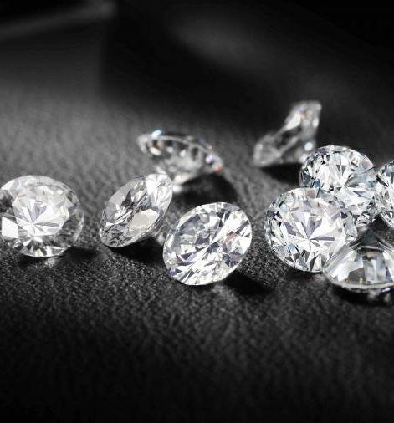
Data Source
Kaggle
More than 53,000 data on the measurements and price of diamonds
Diamond data:
Price
4Cs
Proportion and Measurements
Assumption:
Price = Sale price
Limitation:
No cost price
Methodology of pricing

Slide 3

Characteristics

Slide 4
4Cs
Carat
Color
Cut
Clarity

Slide 5
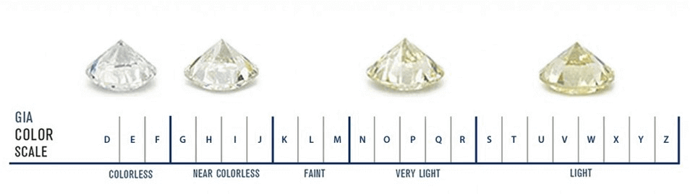
Carat
Weight of the diamond
Color
Color of the diamond with D (best) and Z (worst)
Source: Petragems
Cut
Cut quality of the diamond
GIA classify as Excellent, Very Good, Good, Fair and Poor
In the data, Ideal (best), Premium, Very Good, Good and Fair (worst)

Slide 6
Clarity
Visible inclusions under 10X magnification
Symbol | Name
FL | Flawless
IF | Internally Flawless
VVS1/VVS2 | Very, Very Slightly Included
VS1/VS2 | Very Slightly Included
SI1/SI2 | Slightly Included
I1/I2/I3 | Included

Slide 7
Proportion & Measurements

Slide 8
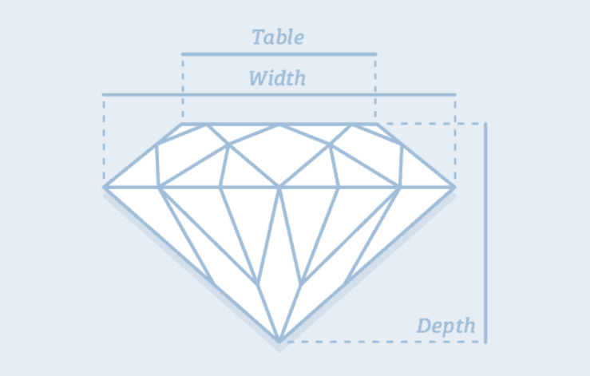
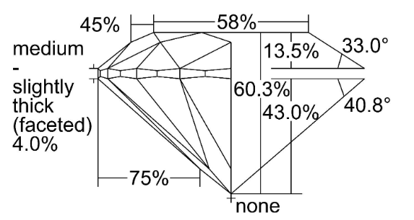
Proportion
Depth %
Measurement from top to bottom
Total height divided by total width (e.g. 60.3%)
Table %
Flat facet on diamond’s surface
Table width as a percentage of the total width (e.g. 58%)
Source: diamonds.pro
Source: GIA

Slide 9
Measurements
“X”
Length in mm
“Y”
Width in mm
“Z”
Depth in mm

Slide 10

Dashboard

