Slide 1
Address Generator
Ashwin Adulla

Slide 2
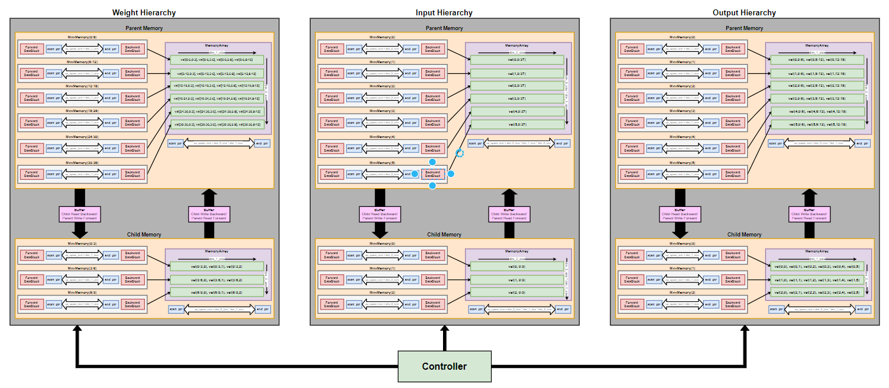
Block Diagram

Slide 3
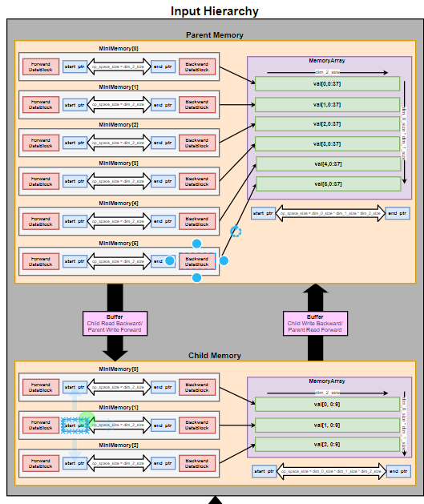
Example Convolution
-------------- Level 1 --------------
for channel: 0 to 2
for filter: 0 to 2
for output: 0 to 3
for weight: 0 to 3
--------------Level 0 --------------
for channel: 0 to 3
for filter: 0 to 3
for output: 0 to 6
for weight: 0 to 3

Slide 4
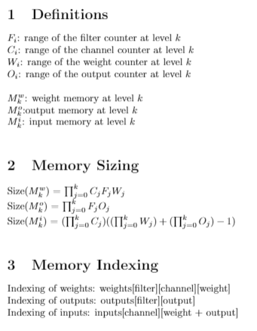
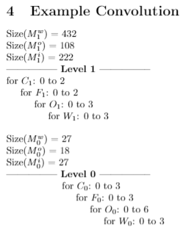
Basics

Slide 5
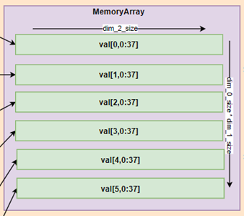


Inside the Memory
Memory Array: flat 1D array representation of the values stored in memory
MiniMemory: data structure containing information about a contiguous sub-region of the memory array
Buffer: FIFO queue to handle read/write requests between parent and child memories

Slide 6
Memory Array
[[ 1, 2, 3, 4, 5],
[ 6, 7, 8, 9, 10],
[11, 12, 13, 14, 15],
[16, 17, 18, 19, 20]]
[1, 2, 3, 4, 5, …, 16, 17, 18, 19, 20]
Row-Major Ordering
Higher-Dimensional Array
1-Dimensional Array

Slide 7
MiniMemory
Forward DataBlock: data structure containing information about stale data before the “start ptr”
start/end ptrs: pointers which enclose the memory subregion that is currently being used
Backward DataBlock: data structure containing information about stale data after the “end ptr”
When size of mini-memory == op_space_size (i.e. working set size/prefetch size):
start ptr and end ptr will point to the same index
Forward DataBlock and Backward DataBlock will be empty

Slide 8
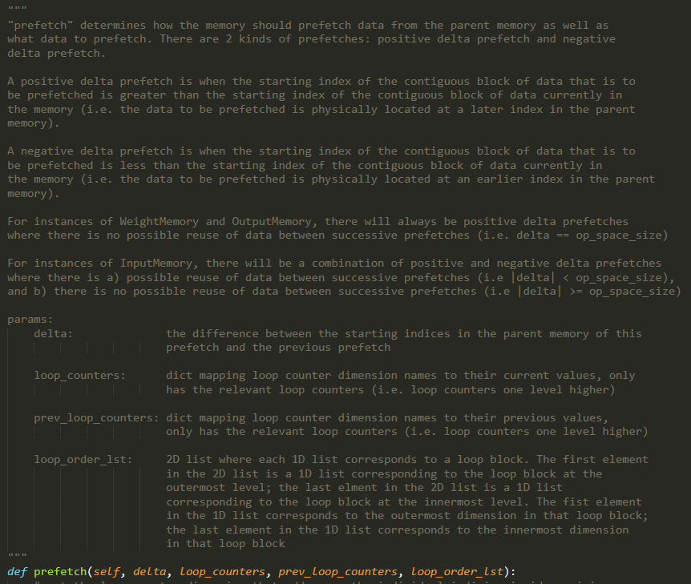
Memory Prefetch
Whenever we enter level i in the convolution loop, all memories at level i must prefetch the values they will need from their parent memories at level i+1
Delta denotes the difference between the absolute index of the last prefetch and the absolute index of the current prefetch
Weight and Output Memories prefetch an entirely new region of data from the parent memory that was previously never touched (i.e delta = size of memory)
Input Memories sometimes prefetch a region of that from the parent memory that was previously touched
(i.e. |delta| <= size of memory)

Slide 9
Positive Delta Prefetch
Occurs when abs(delta) < prefetch_size && delta > 0
New value that is prefetched is inserted at end ptr
Before inserting value, need to determine if value at end ptr needs to be written back (3 cases)
Case 1: Intersection with Backward DataBlock of next MiniMemory (external collision)
Case 2: Intersection with Start Ptr of next MiniMemory (external collision)
Case 3: Intersection with Forward DataBlock of current MiniMemory (internal collision)
for i in range(num_values_to_prefetch) {
for mini_memory in mini_memory_lst {
determine collision
if collision, write back()
insert new value
increase Backward DataBlock size by 1 to cover the value at start ptr
shift start and end ptrs right by 1 index
}
}

Slide 10
Positive Delta Prefetch: Collisions
Case 1: Intersection with Backward DataBlock of next MiniMemory (external collision)
The end ptr of the current MiniMemory is pointing to the start of the Backward DataBlock of the next MiniMemory
(1) Writeback value, (2) reduce size of Backward DataBlock of next MiniMemory, (3) insert new value at end ptr of current MiniMemory
Case 2: Intersection with Start Ptr of next MiniMemory (external collision)
The end ptr of the current MiniMemory is pointing to the same index as the start ptr of the next MiniMemory
(1) Writeback value, (2) shift right Backward DataBlock of next MiniMemory, (3) insert new value at end ptr of current MiniMemory
Case 3: Intersection with Forward DataBlock of current MiniMemory (internal collision)
The end ptr of the current MiniMemory is pointing to the start of the Forward DataBlock of the current MiniMemory
(1) Writeback value, (2) reduce size of Forward DataBlock of current MiniMemory, (3) insert new value at end ptr of current MiniMemory

Slide 11
Negative Delta Prefetch
Occurs when abs(delta) < prefetch_size && delta < 0
New value that is prefetched is inserted at the left of start ptr (i.e. (start ptr – 1) % memory_size)
Before inserting value, need to determine if value at end ptr needs to be written back (3 cases)
Case 1: Intersection with Forward DataBlock of previous MiniMemory (external collision)
Case 2: Intersection with End Ptr of previous MiniMemory (external collision)
Case 3: Intersection with Backward DataBlock of current MiniMemory (internal collision)
for i in range(num_values_to_prefetch) {
for mini_memory in mini_memory_lst {
determine collision
if collision, write back()
insert new value
increase Forward DataBlock size by 1 to the left to cover the value left of end ptr
shift start and end ptrs left by 1 index
}
}

Slide 12
Negative Delta Prefetch: Collisions
ret ptr = (start ptr – 1) % memory_size
Case 1: Intersection with Forward DataBlock of previous MiniMemory (external collision)
The ret ptr of the current MiniMemory is pointing to the end of the Forward DataBlock of the prev MiniMemory
(1) Writeback value, (2) reduce size of Forward DataBlock of prev MiniMemory, (3) insert new value at ret ptr of current MiniMemory
Case 2: Intersection with End Ptr of previous MiniMemory (external collision)
The ret ptr of the current MiniMemory is pointing to the same index as the end ptr of the prev MiniMemory
(1) Writeback value, (2) shift left Forward DataBlock of prev MiniMemory, (3) insert new value at ret ptr of current MiniMemory
Case 3: Intersection with Backward DataBlock of current MiniMemory (internal collision)
The ret ptr of the current MiniMemory is pointing to the end of the Backward DataBlock of the current MiniMemory
(1) Writeback value, (2) reduce size of Backward DataBlock of current MiniMemory, (3) insert new value at ret ptr of current MiniMemory

Slide 13
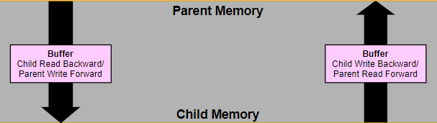
Data Communication
Child always initiates data transaction with parent
Child sends request to parent
Request is a dictionary mapping dimension name to dimension index
E.g. input memory request = {“channel”: 1, “input”: 7}
E.g. weight memory request = {“filter”: 2, “channel”: 1, “weight”: 9}
E.g. output memory request = {“filter”: 5, “output”: 3}
Parent transforms request into an absolute index into its memory array
If child is reading from parent, parent sends back data value at requested index and child inserts value in its memory array
If child is writing to parent, child sends data value to parent and parent inserts it at requested index in its memory array

Slide 14
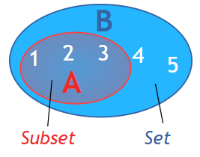
Data Communication: Requests
The data in the child’s memory array is a strict subset of the data in the parent’s memory array
Each memory can be addressed by specific loop counters in its “dependency_set”
Input Memory:
Weight Memory:
Output Memory:
How is a request generated?
(1) Determine from which index in the parent memory the data currently in the child memory was prefetched from
(2) Determine the offset into the prefetched region to find a specific index
Example: want to get index of value 2
set A: child memory array; set B: parent memory array
Child memory can store any continuous set of 3 integers from 1-5
Step (1) determines from which where in set B that set A starts
Step (2) determines which index in set A corresponds to value 2

Slide 15
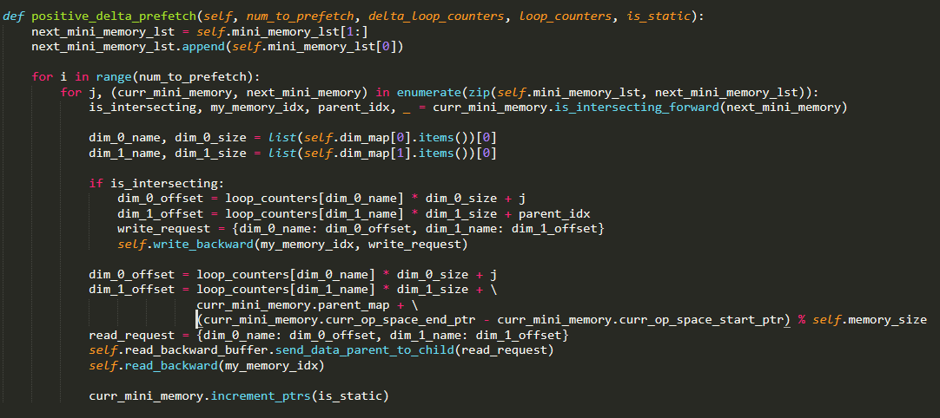
Putting it All Together

