Slide 1
Netflix Movies and TV Shows – Exploratory Data Analysis (EDA)
Presented by
Aayushman Dutta
ID – 231003003121
BTECH CSE-AI 3(A)

Slide 2
Netflix Movies and TV Shows – Exploratory Data Analysis (EDA)
To explore and visualize Netflix’s Movies & TV Shows dataset to uncover insights on content trends, genres, countries, and audience sentiments.

Slide 3
About the Project
Goal:
Understand Netflix’s global content trends and production behavior.
Dataset:
File: netflix_titles.csv (~8,800 rows × 12 columns)
Columns include: show_id, type, title, director, cast, country, date_added, release_year, rating, duration, listed_in, description
Tools Used:
NumPy / Pandas – Data cleaning and analysis
Plotly Express – Interactive visualizations
TextBlob – Sentiment analysis
Google Cloud – Execution environment

Slide 4
Data Loading & Exploration
show_id type title director \
0 s1 Movie Dick Johnson Is Dead Kirsten Johnson
1 s2 TV Show Blood & Water NaN
2 s3 TV Show Ganglands Julien Leclercq
3 s4 TV Show Jailbirds New Orleans NaN
4 s5 TV Show Kota Factory NaN
cast country \
0 NaN United States
1 Ama Qamata, Khosi Ngema, Gail Mabalane, Thaban... South Africa
2 Sami Bouajila, Tracy Gotoas, Samuel Jouy, Nabi... NaN
3 NaN NaN
4 Mayur More, Jitendra Kumar, Ranjan Raj, Alam K... India
date_added release_year rating duration \
0 September 25, 2021 2020 PG-13 90 min
1 September 24, 2021 2021 TV-MA 2 Seasons
2 September 24, 2021 2021 TV-MA 1 Season
3 September 24, 2021 2021 TV-MA 1 Season
4 September 24, 2021 2021 TV-MA 2 Seasons
listed_in \
0 Documentaries
1 International TV Shows, TV Dramas, TV Mysteries
2 Crime TV Shows, International TV Shows, TV Act...
3 Docuseries, Reality TV
4 International TV Shows, Romantic TV Shows, TV ...
description
0 As her father nears the end of his life, filmm...
1 After crossing paths at a party, a Cape Town t...
2 To protect his family from a powerful drug lor...
3 Feuds, flirtations and toilet talk go down amo...
4 In a city of coaching centers known to train I...
Code Snippet:
df = pd.read_csv('netflix_titles.csv')
print(df.shape)
print(df.head())
Findings:
Dataset Shape: (8807, 12)
Columns contain mixed data types (strings, numerics, dates).
Some missing values found in director, cast, and country.
Needed cleaning before analysis.

Slide 5
Data Cleaning & Preparation
Steps Performed:
Handling Missing Values:
  director, cast, country → “Not specified”
  listed_in → “No Genre Specified”
Normalization:
  Split multi-valued columns (director, cast, genres).
  Removed duplicates and standardized names.
  Renamed columns for clarity (e.g., release_year → Release Year).
Purpose:
Ensured consistent and structured data for accurate aggregation and plotting.

Slide 6
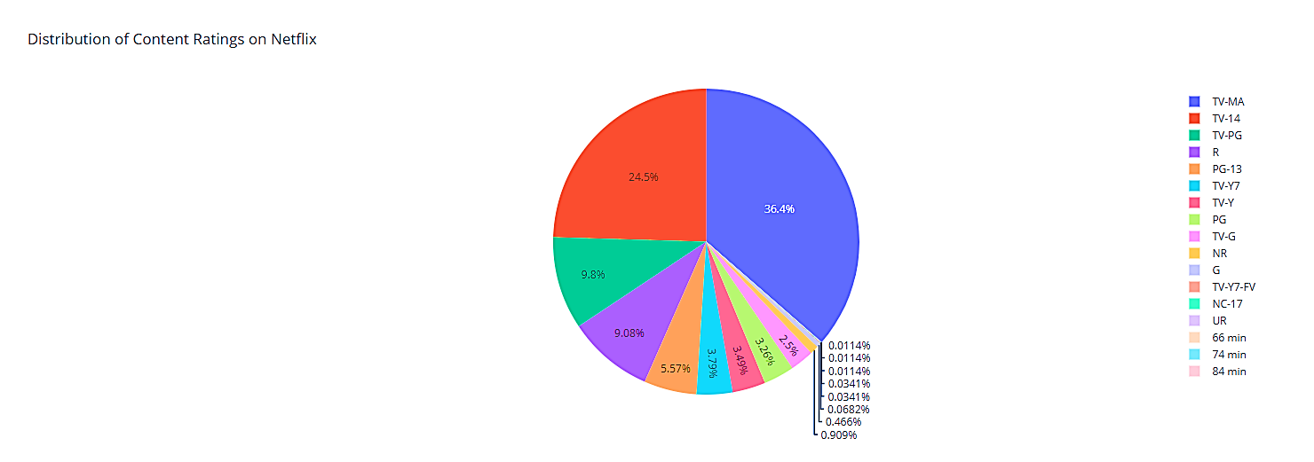
Distribution of Content Ratings
Process:
Grouped shows by their rating and plotted using Plotly pie chart.
Code:
x = df.groupby(['rating']).size().reset_index(name='counts')
px.pie(x, values='counts', names='rating', title='Distribution of Content Ratings’)
Insight:
Majority of Netflix titles are rated TV-MA, followed by TV-14 and PG.
Indicates a focus on mature audiences.

Slide 7
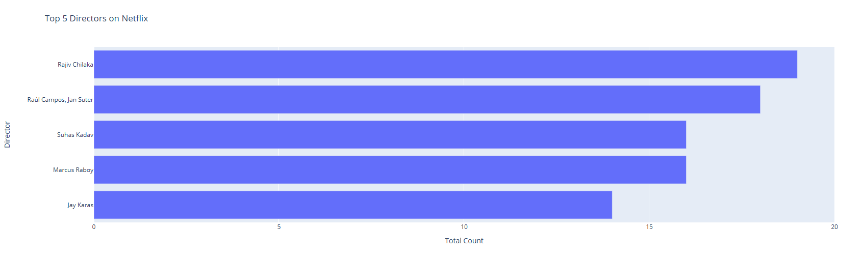
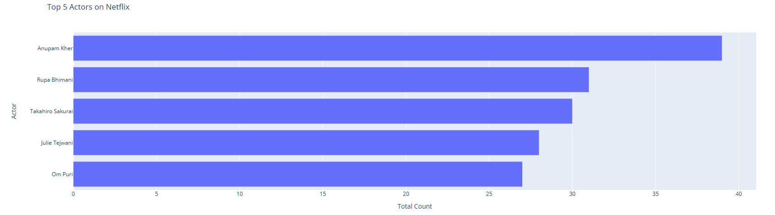
Top Directors & Actors
Directors:
Split director column into individual names.
Counted occurrences and ranked them.
Extracted Top 5 Directors using bar chart.
Actors:
Split cast column into multiple rows.
Counted appearances.
Extracted Top 5 Actors.
Insight:
Certain directors and actors maintain long-term collaborations with Netflix.

Slide 8
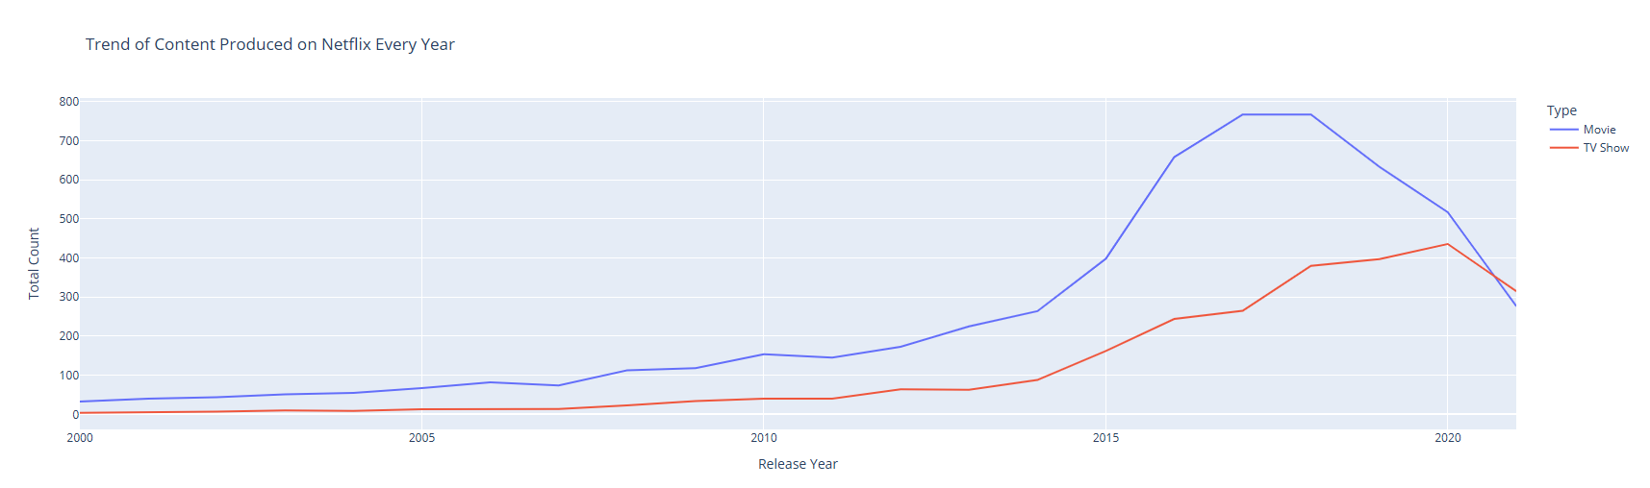
Content Production Over the Years
Process:
Grouped by release_year and type (Movie / TV Show) and plotted trend lines.
Code:
df2 = df.groupby(['release_year','type']).size().reset_index(name='Total Count')
px.line(df2, x='release_year', y='Total Count', color='type’)
Insights:
Explosive growth after 2015 in Netflix content.
Movies outnumber TV shows after 2017.
Reflects Netflix’s shift toward original movie production.

Slide 9
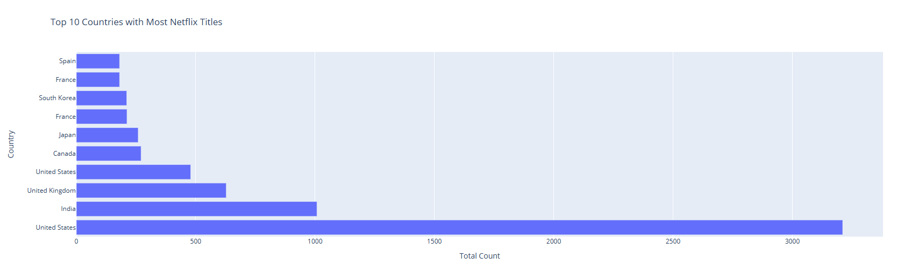
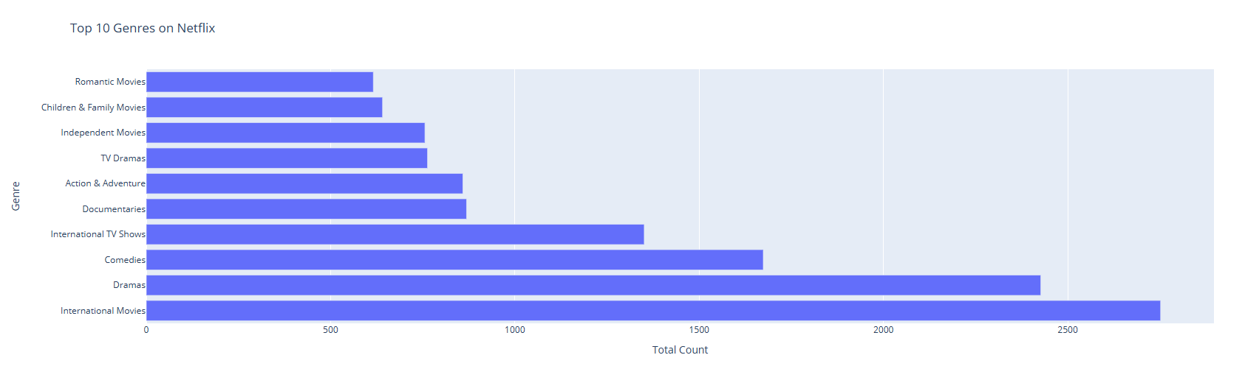
Genre & Country Insights
Genres:
Split listed_in column and counted frequencies.
Top 10 Genres:
  Dramas
  Comedies
  Documentaries
  Action & Adventure
  International Movies
Countries:
Split country column and counted entries.
Top 5: USA, India, UK, Japan, Canada.
Insight:
Netflix maintains a strong global footprint with emphasis on regional storytelling.

Slide 10
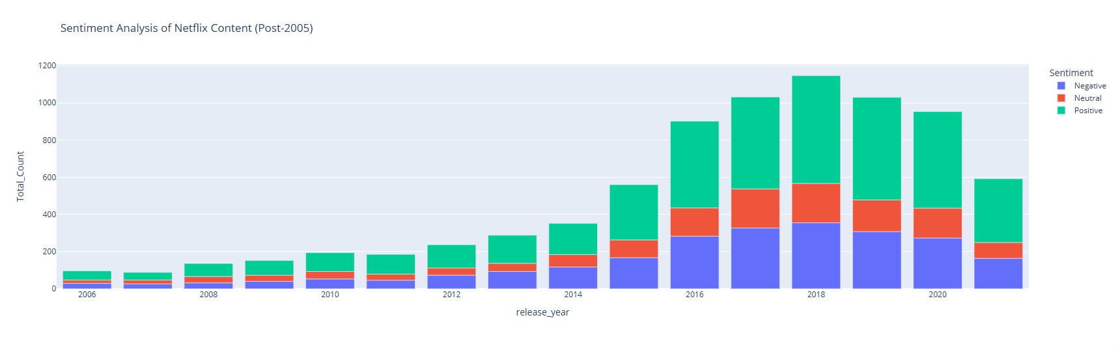
Sentiment Analysis
Process:
Used TextBlob to evaluate the polarity of description text.
Logic:
Polarity > 0 → Positive
Polarity = 0 → Neutral
Polarity < 0 → Negative
Result:
Majority of content has Positive or Neutral sentiment.
Indicates Netflix uses engaging, optimistic descriptions to attract viewers.

Slide 11
Key Findings, Challenges & Learnings
Key Findings:
✅ TV-MA dominates Netflix content.
✅ USA, India, UK lead in production.
✅ Dramas, Comedies, and Documentaries are top genres.
✅ Major content growth post-2015.
✅ Descriptions show mostly positive sentiment.
Challenges Faced:
Cleaning multi-valued columns (e.g., cast, country).
Handling missing entries.
Processing large dataset efficiently in Google Cloud.
Learnings:
Deep understanding of EDA, data wrangling, and sentiment analysis.
Improved knowledge of interactive visualization (Plotly).
Experience in turning raw data into insights.
✅ Project Completed Successfully!

Slide 12
CONCLUSION
Netflix’s Movies and TV Shows dataset reveals the platform’s evolution into a global entertainment powerhouse. Through this Exploratory Data Analysis, we observed that:
TV-MA and Drama/Comedy genres dominate Netflix’s catalog.
The United States, India, and the UK lead in content production, highlighting Netflix’s international collaboration network.
A sharp increase in original content was noted after 2015, coinciding with Netflix’s global expansion.
Sentiment analysis shows most content descriptions are positive or neutral, reflecting Netflix’s strategic marketing tone.
Final Thoughts:
This project demonstrates how data analytics can uncover patterns that drive business strategy, audience targeting, and content planning.
Future enhancements could include integrating IMDB ratings, user reviews, and advanced NLP models for deeper insights.
“Data tells stories — and Netflix’s story is one of global creativity and audience connection.”

Slide 13

💻 GitHub: https://github.com/aadutta007/Netflix_Exploratory_Data_Analysis_Project

